Slide 1



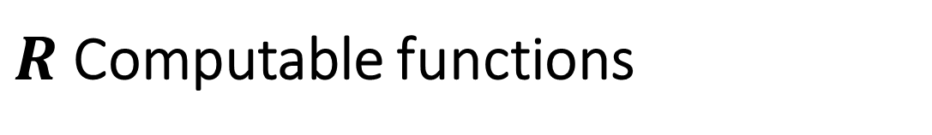













All functions $F:\{0,1\}^{∗}→\{0,1\}$
$R$ Computable functions
$HALT_{2^{2^{n}}}$
$$EXP$$
$HALT$
$$P_{/poly}$$
$HALT_{2^{n}}$
$$BPP$$
Functions with unbounded input lengths: inclusion diagram – not to scale!!
Some classes might “collapse” to one another.
$$P$$
$$BQP$$
?
$2SAT$
U$HALT$
$$NP$$
$$NPC$$
$3SAT$
$FACTORING$

Slide 2

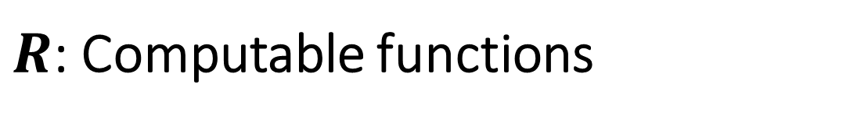
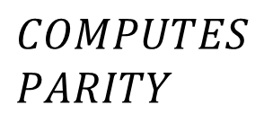

All functions $F:\{0,1\}^{∗}→\{0,1\}$
$HALT$
$F^{∗}$
$HALTONZERO$
$R$: Computable functions
Functions with unbounded input lengths: inclusion diagram – not to scale!!
Some classes might “collapse” to one another.
$$COMPUTES \\ PARITY$$
…

Slide 3




All functions $F:\{0,1\}^{∗}→\{0,1\}$
$R$ Computable functions
$HALT_{2^{2^{n}}}$
$$EXP$$
$HALT$
$$P_{/poly}$$
$HALT_{2^{n}}$
$$P$$
Functions with unbounded input lengths: inclusion diagram – not to scale!!
Some classes might “collapse” to one another.
$MINCUT$
$$NP$$
U$HALT$
$2SAT$
$$NPC$$
$3SAT$
$MAXCUT$

Slide 4



All functions $F:\{0,1\}^{∗}→\{0,1\}$
$R$ Computable functions
$HALT_{2^{2^{n}}}$
$$EXP$$
$HALT$
$HALT_{2^{n}}$
$MAXCUT$
Functions with unbounded input lengths: inclusion diagram – not to scale!!
Some classes might “collapse” to one another.
$$P=NP$$
$$P_{/poly}$$
$MINCUT$
U$HALT$
$2SAT$
$3SAT$

Slide 5


All functions $F:\{0,1\}^{∗}→\{0,1\}$
$R$ Computable functions
$HALT_{2^{2^{n}}}$
$$EXP$$
$HALT$
$$P_{/poly}$$
$HALT_{2^{n}}$
Functions with unbounded input lengths: inclusion diagram – not to scale!!
Some classes might “collapse” to one another.
$$P$$
$MINCUT$
U$HALT$
$2SAT$
$3SAT$
$MAXCUT$

Slide 6




All functions $F:\{0,1\}^{∗}→\{0,1\}$
$R$ Computable functions
$HALT_{2^{2^{n}}}$
$$EXP$$
$HALT$
$$P_{/poly}$$
$HALT_{2^{n}}$
$$P$$
Functions with unbounded input lengths: inclusion diagram – not to scale!!
Some classes might “collapse” to one another.
$MINCUT$
$$NP$$
U$HALT$
$2SAT$
$MAXCUT$
$$NPC$$
$3SAT$

Slide 7

All functions $F:\{0,1\}^{∗}→\{0,1\}$
$R$ Computable functions
$HALT_{2^{2^{n}}}$
$$EXP$$
$HALT$
$$P_{/poly}$$
$HALT_{2^{n}}$
Functions with unbounded input lengths: inclusion diagram – not to scale!!
Some classes might “collapse” to one another.
$$P$$
$MINCUT$
U$HALT$
$2SAT$
$3SAT$
$MAXCUT$

Slide 8
All functions $F:\{0,1\}^{∗}→\{0,1\}$
$R$ Computable functions
$HALT_{2^{2^{n}}}$
$$EXP$$
$HALT$
$$P_{/poly}$$
$HALT_{2^{n}}$
Functions with unbounded input lengths: inclusion diagram – not to scale!!
Some classes might “collapse” to one another.
$$P$$
$MINCUT$
U$HALT$
$2SAT$
$MAXCUT$
$3SAT$

Slide 9
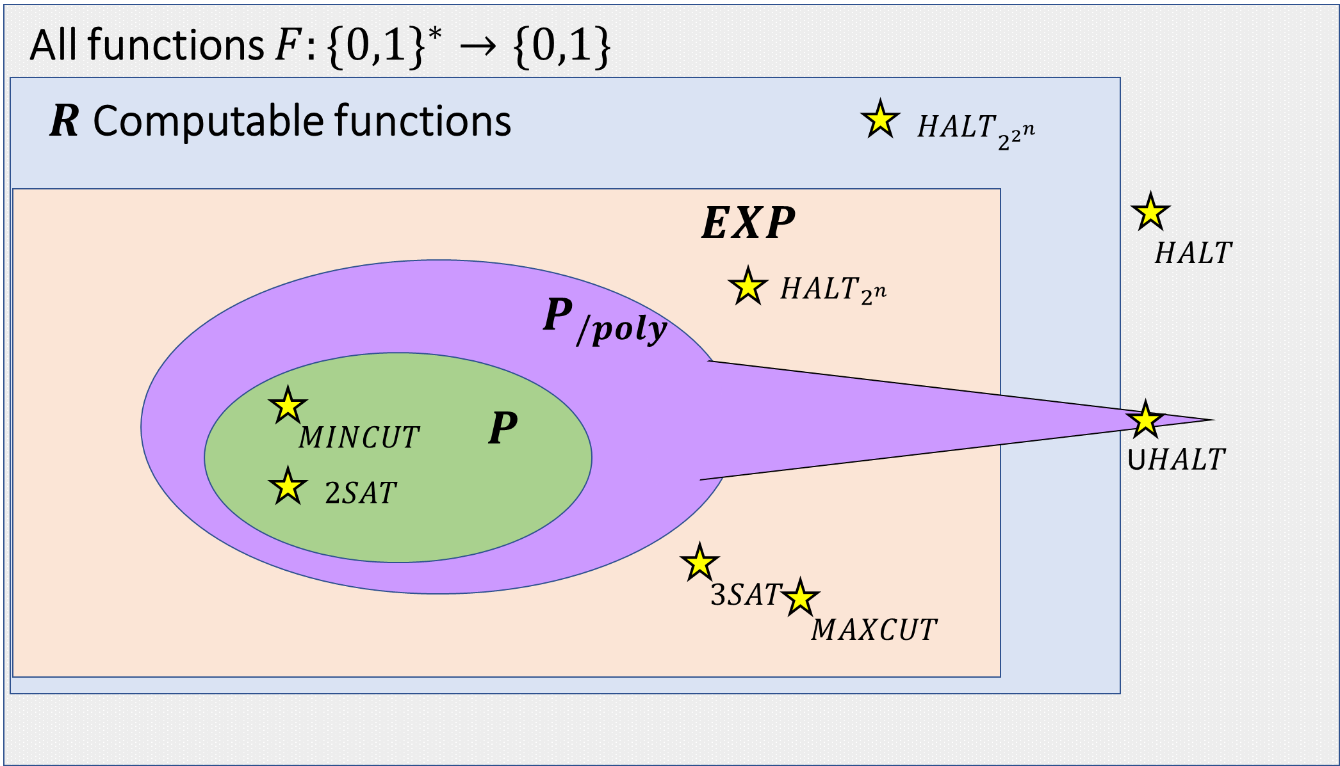
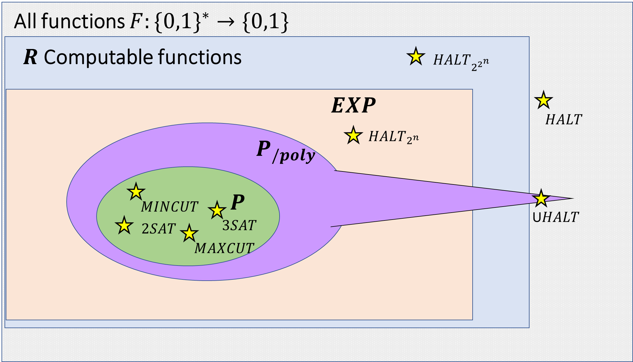
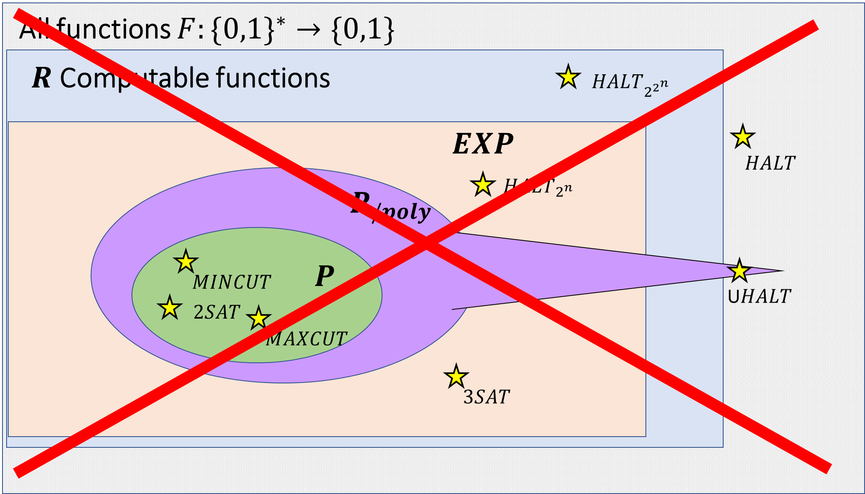
Likely
Possible
Impossible

Slide 10
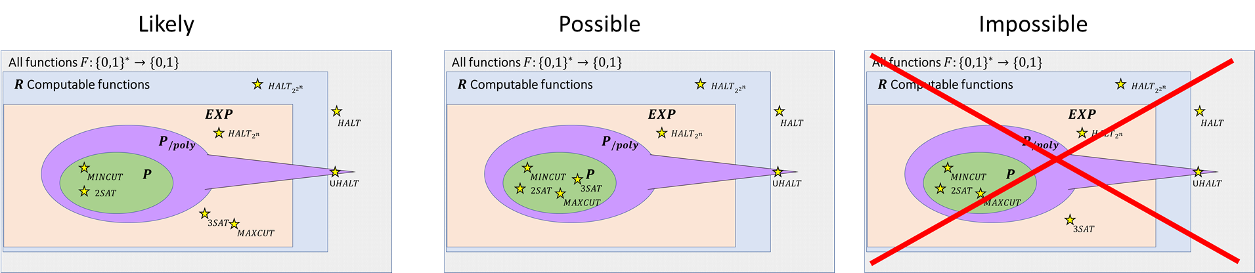

Slide 11
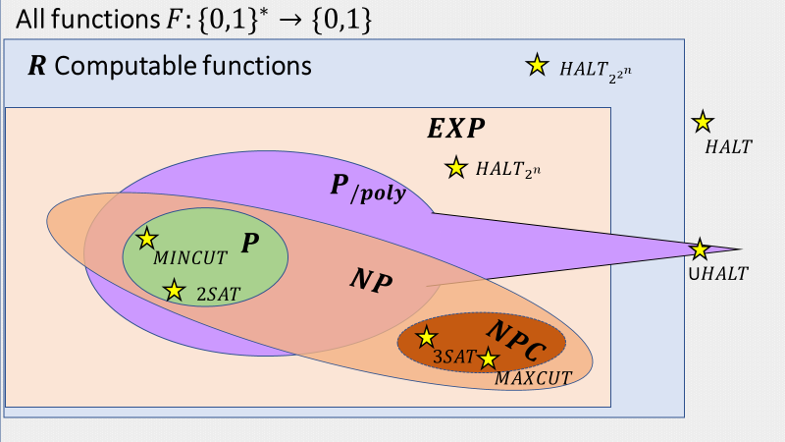
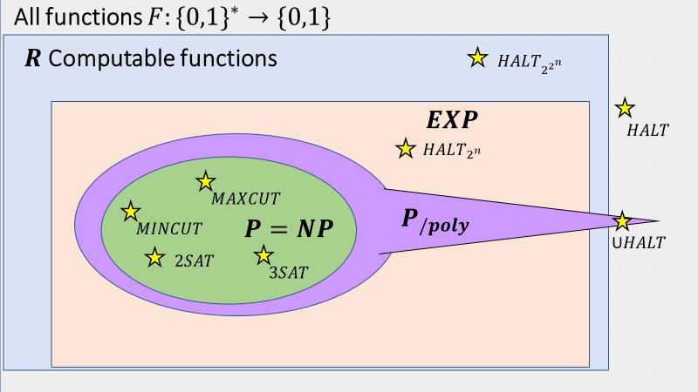
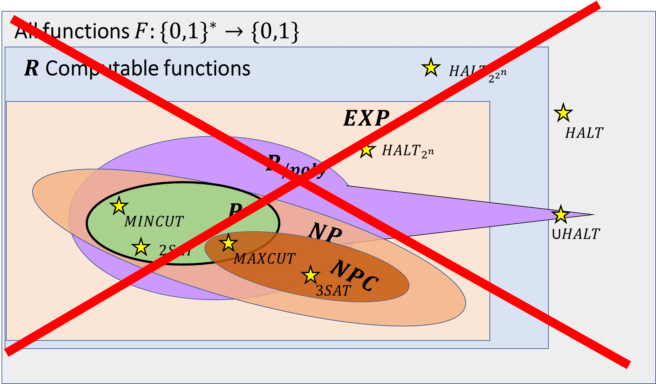
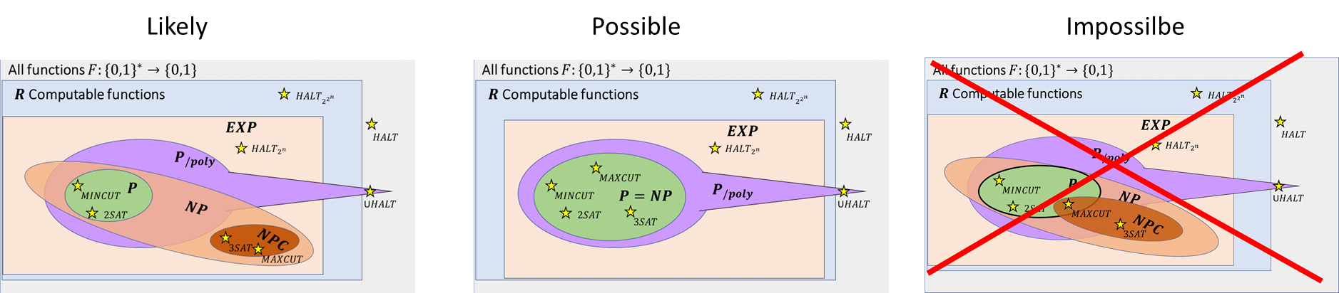
Likely
Possible
Impossilbe

