Slide 1
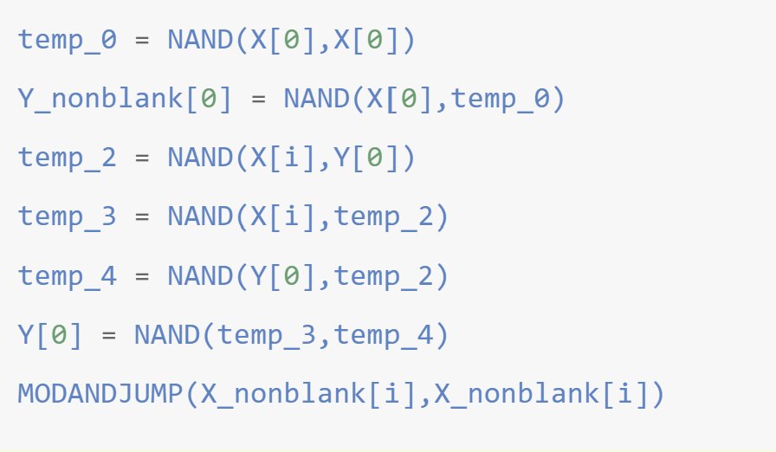

$$\text{▷}$$ | $$0$$ | $$1$$ | $$1$$ | $$0$$ | $$0$$ | $$0$$ | $$1$$ | $$0$$ | $$\text{∅}$$ | $$\text{∅}$$ | $$\text{...}$$
Local State: $s∈[k]$

Slide 2
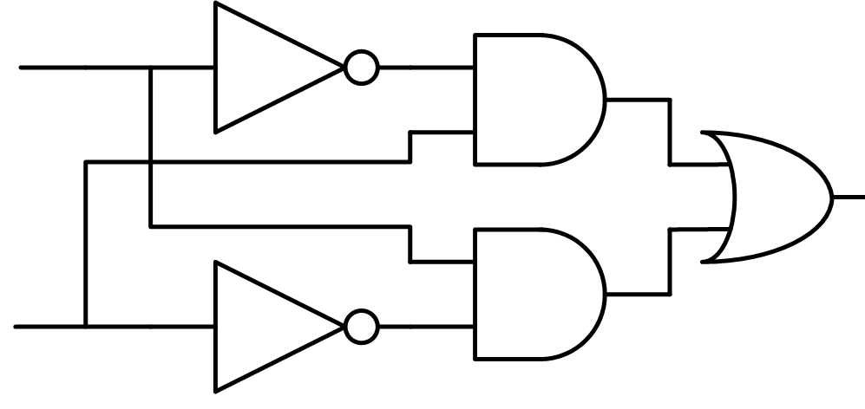
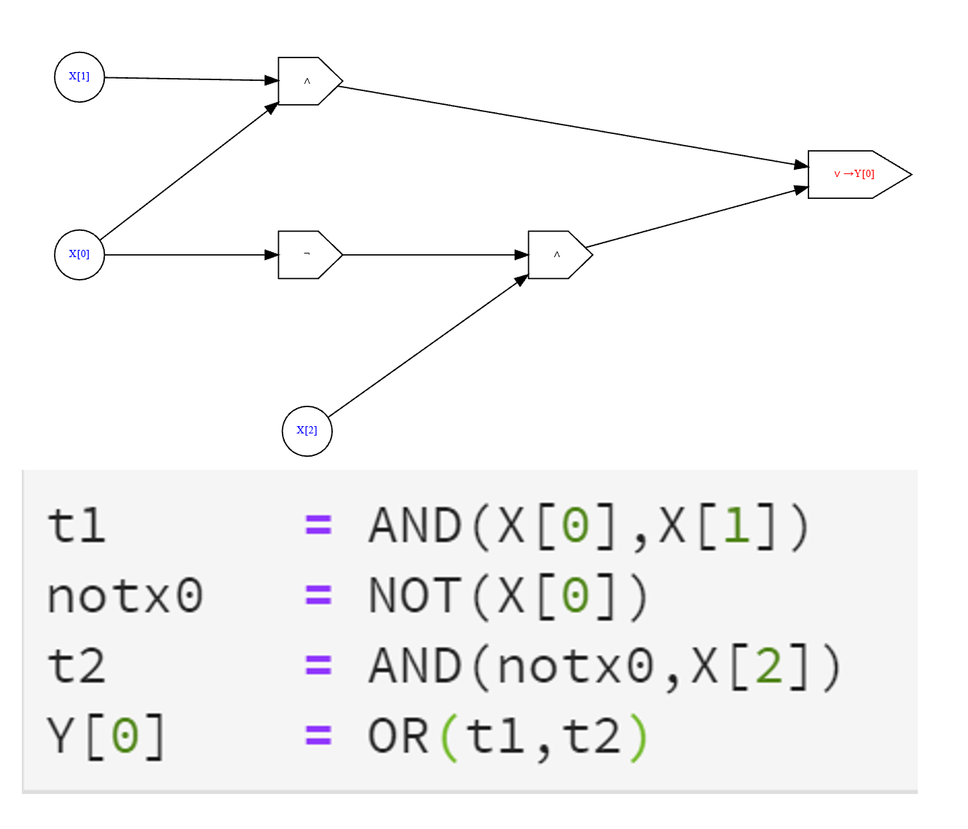
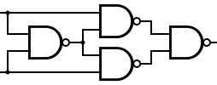
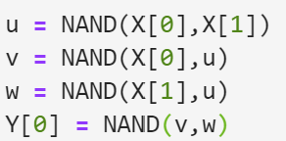
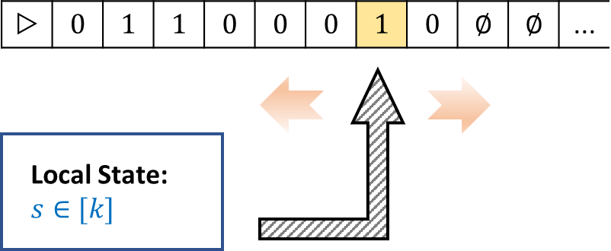
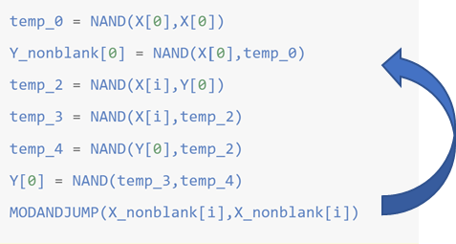
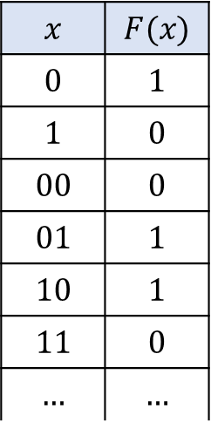


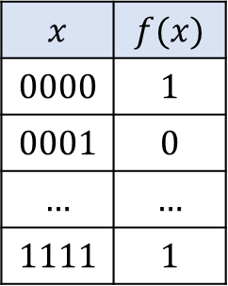
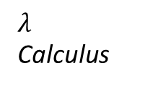
Specification
Implementation
Finite Computation:
$$x$$ | $$f(x)$$
$$0000$$ | $$1$$
$$0001$$ | $$0$$
$$…$$ | $$…$$
$$1111$$ | $$1$$
Previous chapters
$${\left\{0,1\right\}}^{n}$$
$$x$$ | $$F(x)$$
$$0$$ | $$1$$
$$1$$ | $$0$$
$$00$$ | $$0$$
$$01$$ | $$1$$
$$10$$ | $$1$$
$$11$$ | $$0$$
$$…$$ | $$…$$
Turing Machines
NAND-TM Programs
Chapter 6
Unbounded Computation:
From now onwards
$${\left\{0,1\right\}}^{∗}$$
RAM Machines
C/Python/OCaml..
Chapter 7
$λ$ Calculus
…
NAND-RAM
Game of LIfe

