Slide 1
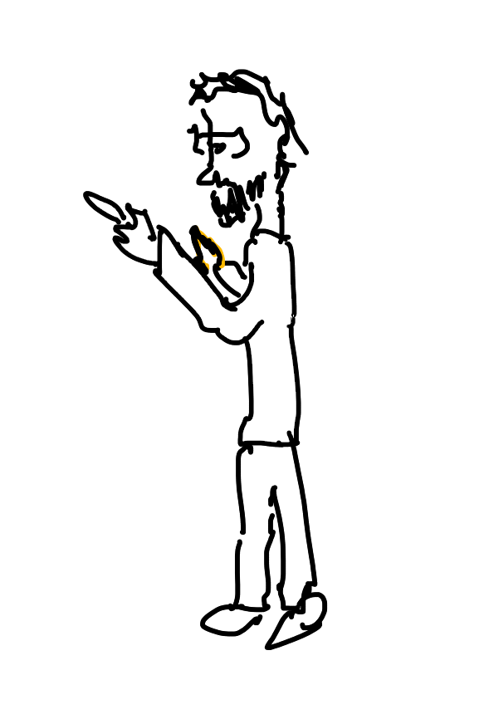
World’s most boring fourth grade class
Day 1
Day 2
Day 3
Today we’ll learn to multiply 1 digit numbers
Today we’ll learn to multiply 2 digit numbers
Today we’ll learn to multiply 3 digit numbers
2 x 5
23 x 57
234 x 576
Day 4
Day 365
Today we’ll learn to multiply 4 digit numbers
Today we’ll learn to multiply 365 digit numbers
…
2345 x 5767
23456767… x 57673432…

