Slide 1


$$T$$
0 1 2 3 4 5 6 7 8 9 10 11 12 13 14 15 16 17 18 19 20 21 22 23….
Atstart
$$\text{1}$$ | $$0$$ | $$0$$ | $$0$$ | $$0$$ | $$0$$ | $$0$$ | $$0$$ | $$0$$ | $$0$$ | $$0$$ | $$0$$ | $$0$$ | $$0$$ | $$0$$ | $$0$$ | $$0$$ | $$0$$ | $$0$$ | $$0$$ | $$0$$ | $$0$$ | $$0$$ | $$0$$ | …
Atend
$$\text{0}$$ | $$0$$ | $$0$$ | $$0$$ | $$0$$ | $$0$$ | $$0$$ | $$0$$ | $$0$$ | $$0$$ | $$0$$ | $$0$$ | $$0$$ | $$0$$ | $$0$$ | $$0$$ | $$0$$ | $$0$$ | $$0$$ | $$0$$ | $$0$$ | $$0$$ | $$1$$ | $$0$$ | …
arrays
Marker
$$\text{0}$$ | $$0$$ | $$0$$ | $$0$$ | $$0$$ | $$0$$ | $$0$$ | $$0$$ | $$0$$ | $$0$$ | $$0$$ | $$0$$ | $$1$$ | $$0$$ | $$0$$ | $$0$$ | $$0$$ | $$0$$ | $$0$$ | $$0$$ | $$0$$ | $$0$$ | $$0$$ | $$0$$ | …
Spam
$$\text{1}$$ | $$0$$ | $$1$$ | $$1$$ | $$0$$ | $$0$$ | $$0$$ | $$1$$ | $$0$$ | $$1$$ | $$0$$ | $$0$$ | $$1$$ | $$1$$ | $$0$$ | $$1$$ | $$0$$ | $$0$$ | $$0$$ | $$0$$ | $$0$$ | $$0$$ | $$0$$ | $$0$$ | …
Eggs
$$\text{0}$$ | $$1$$ | $$0$$ | $$0$$ | $$0$$ | $$1$$ | $$1$$ | $$0$$ | $$1$$ | $$0$$ | $$1$$ | $$1$$ | $$0$$ | $$1$$ | $$0$$ | $$0$$ | $$0$$ | $$0$$ | $$0$$ | $$0$$ | $$0$$ | $$0$$ | $$0$$ | $$0$$ | …
Ni
$$\text{1}$$ | $$1$$ | $$0$$ | $$0$$ | $$1$$ | $$1$$ | $$0$$ | $$1$$ | $$1$$ | $$1$$ | $$1$$ | $$0$$ | $$0$$ | $$0$$ | $$1$$ | $$0$$ | $$0$$ | $$0$$ | $$0$$ | $$0$$ | $$0$$ | $$0$$ | $$0$$ | $$0$$ | …
foo
$$0$$
$$1$$
$$1$$
$$0$$
$$12$$
scalars
bar
baz
blah
index
i

Slide 2

$$\text{▷}$$ | $$0$$ | $$1$$ | $$0$$ | $$1$$ | $$2$$ | $$0$$ | $$1$$ | ∅ | …

Slide 3
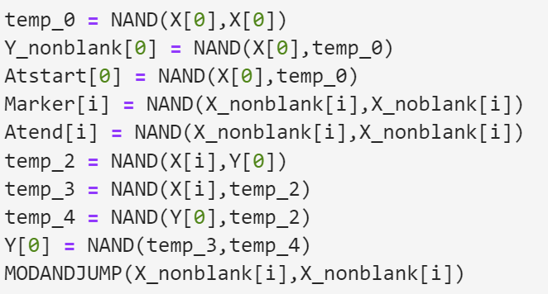
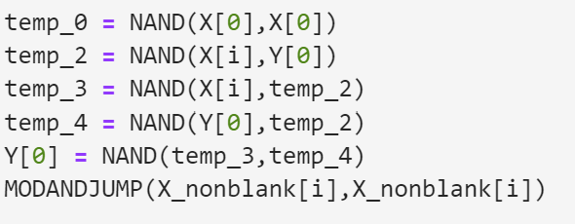
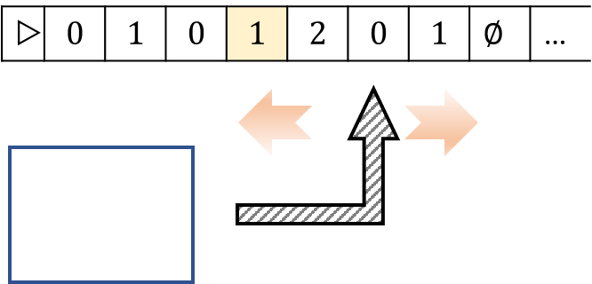
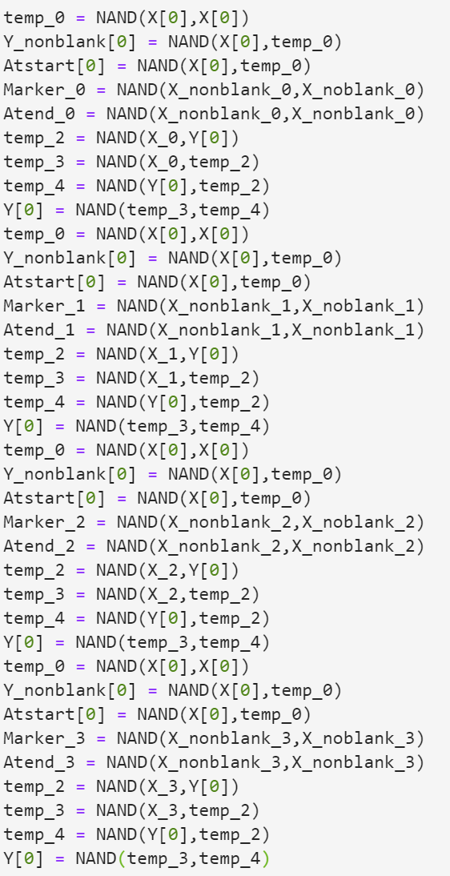
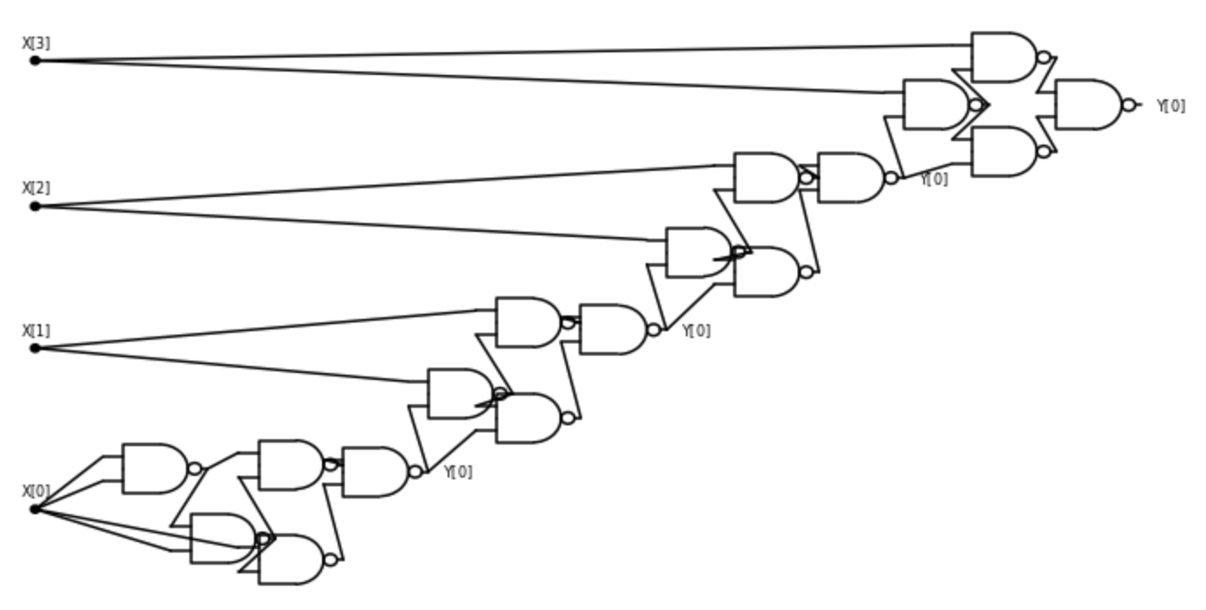
Turing Machine
NAND-TM Program
Oblivious NAND-TM
“Unrolled” NAND-CIRC Program
NAND Circuit

