Slide 1


1st coin
0
1
2nd coin
0
1
0
1
3rd coin
0
1
0
1
0
1
0
1
000 001 010 011 100 101 110 111
$$\left\{ x∈\{0,1\}^{3} \right|x_{0}=0\}$$
$$\left\{ x∈\{0,1\}^{3} \right|x_{1}=1\}$$

Slide 2
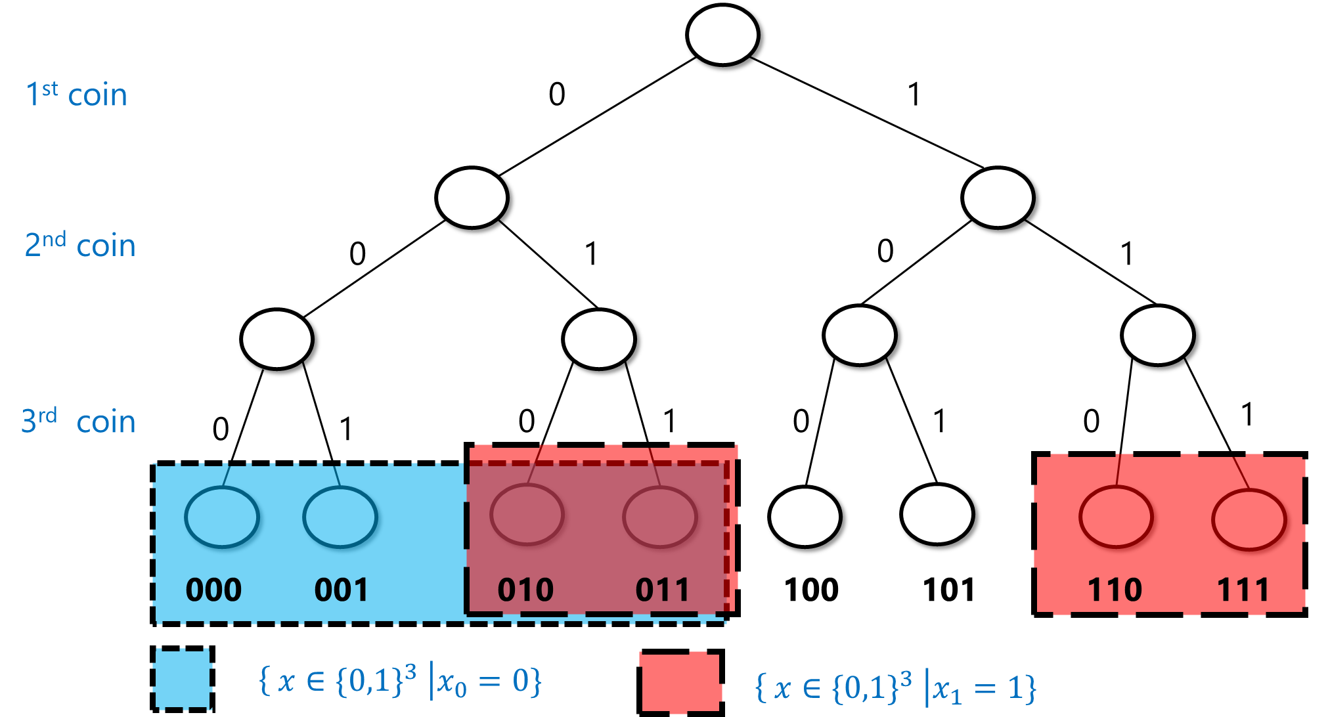

Slide 3
1st coin
0
1
2nd coin
0
1
0
1
3rd coin
0
1
0
1
0
1
0
1
000 001 010 011 100 101 110 111
$$\left\{ x∈\{0,1\}^{3} \right|x_{0}+x_{1}+x_{2}=0 mod 2\}$$

Slide 4
