Slide 1




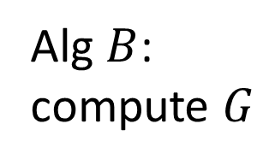

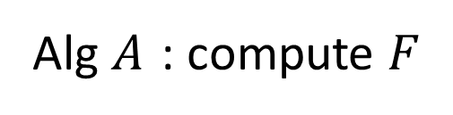


Alg $A$ : compute $F$
Output
Input
Alg $B$: compute $G$
$$R$$
$$y=R(x)$$
$$G\left(R\left(x\right)\right)=F(x)$$
$$x$$
poly time

