Slide 1
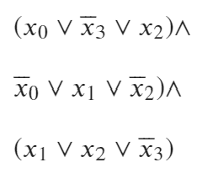


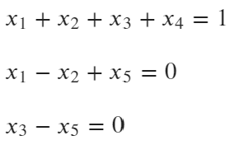
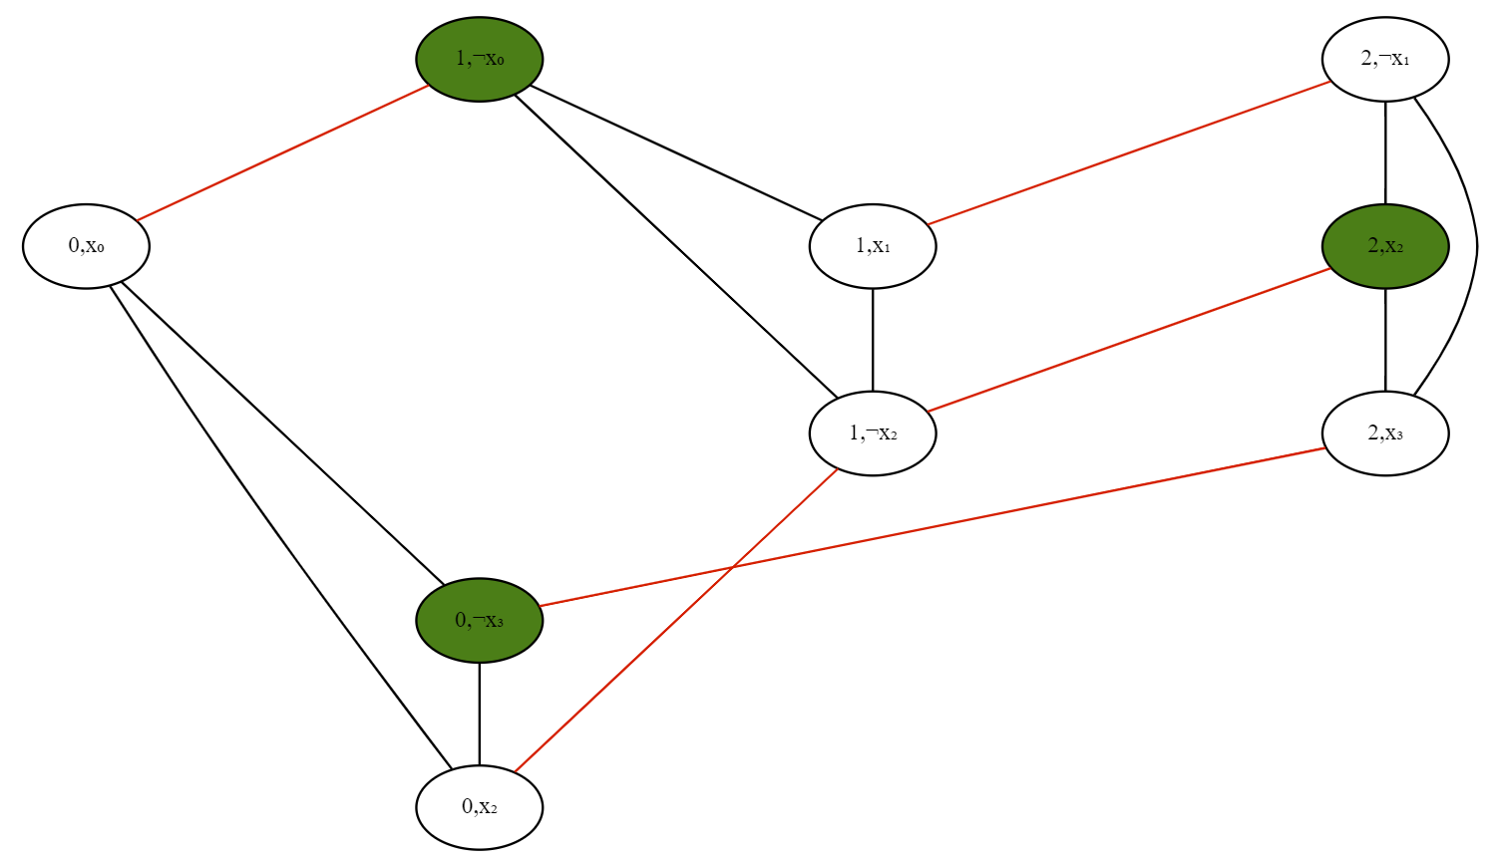
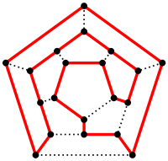
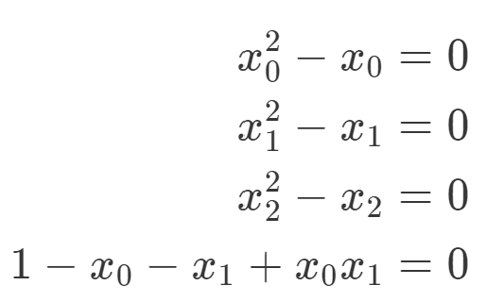
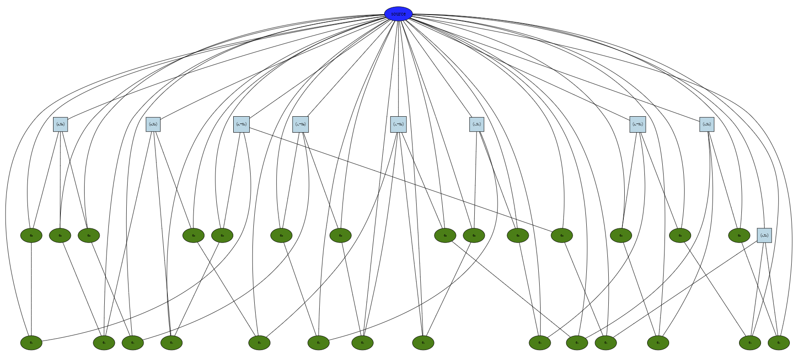





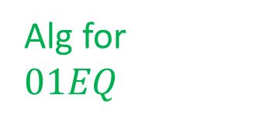




Alg for $3SAT$
$$3SAT$$
Alg for $01EQ$
$01EQ$
$$ISET$$
$$LONGPATH$$
$$QUADEQ$$
$$SUBSETSUM$$
$$MAXCUT$$

Slide 2



