Slide 1
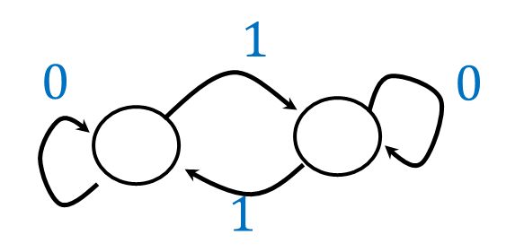
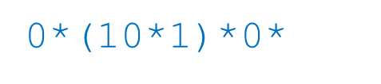
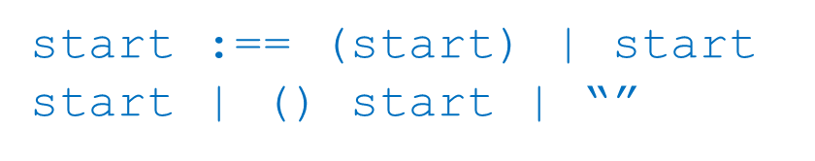
Deterministic Finite Automata
Regular Expressions
Context-Free Grammar

Slide 2




$$1$$
$$0$$
$$0$$
0*(10*1)*0*
$$1$$
start :== (start) | start start | () start | “”

