Slide 1
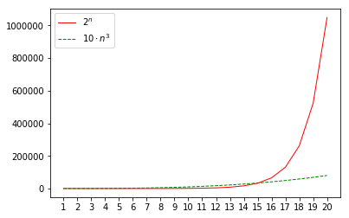
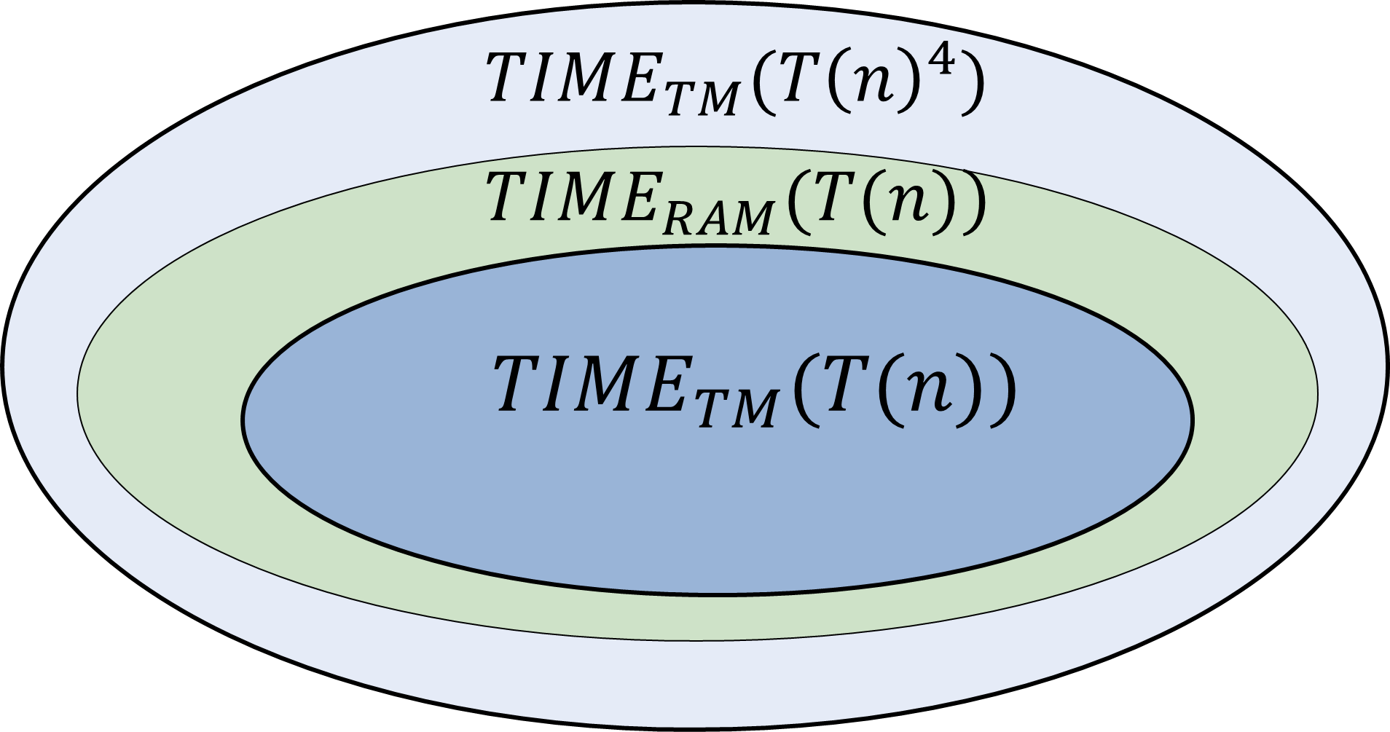
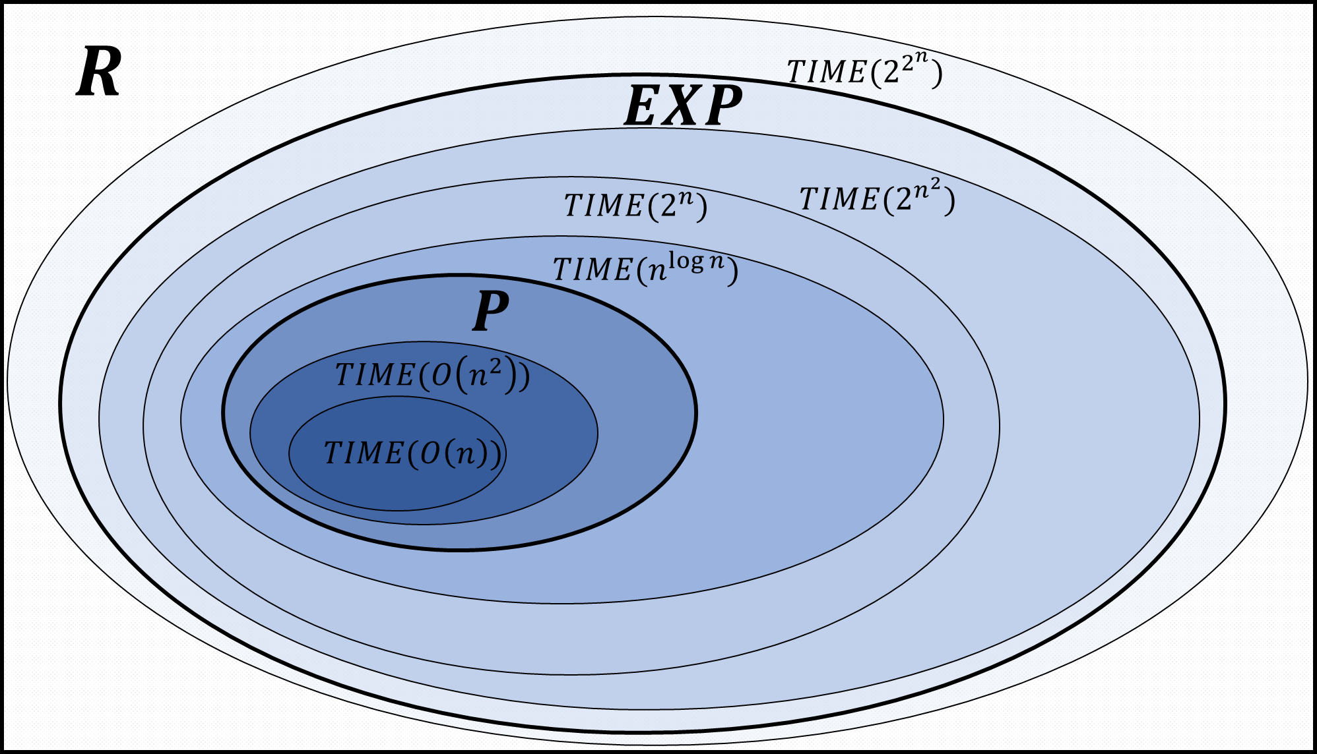
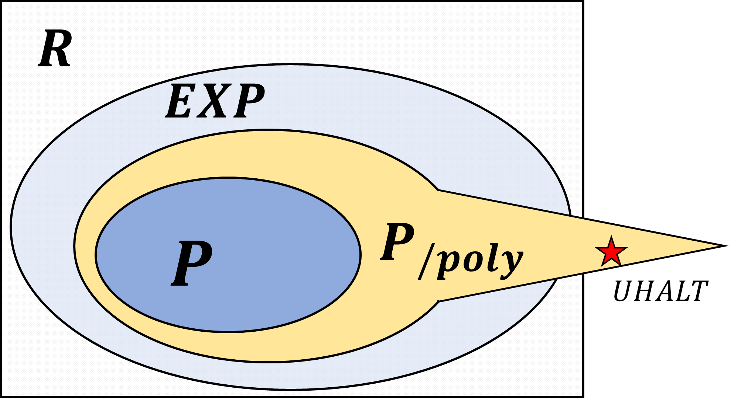

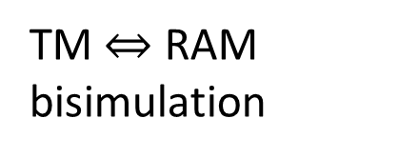
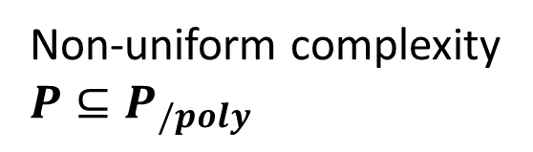
Define running time, $P$ and $EXP$
TM $⇔$ RAM bisimulation
Universal Machine Time Hierarchy Theorem
Non-uniform complexity $P⊆P_{/poly}$

Slide 2









$$R$$
$$TIME(2^{2^{n}})$$
$$EXP$$
$$TIME(2^{n})$$
$$TIME(2^{n^{2}})$$
$$TIME(n^{\log{n}})$$
$$P$$
$$TIME(O\left(n^{2}\right))$$
$$TIME(O\left(n\right))$$

Slide 3




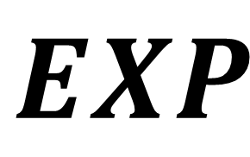












$$EXP$$
$$MAXCUT$$
$$3SAT$$
$$QUADEQ$$
$$LONGPATH$$
$$MINCUT$$
$$2SAT$$
$$P$$
$$LINEQ$$
$$SHORTPATH$$
$$PRIMALITY$$
$$0SUM$$
$$DETERMINANT$$
$$NASH$$
$$FACTORING$$
$$PERMANENT$$

Slide 4



$$TIME_{TM}(T{\left(n\right)}^{4})$$
$$TIME_{RAM}(T(n))$$
$$TIME_{TM}(T(n))$$

Slide 5
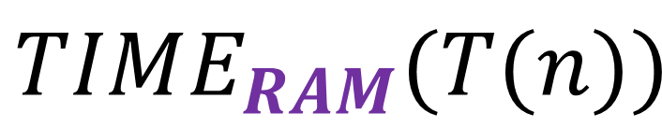
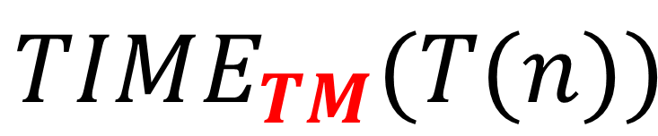
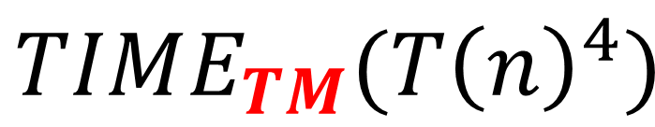
$$TIME_{TM}(T{\left(n\right)}^{4})$$
$$TIME_{RAM}(T(n))$$
$$TIME_{TM}(T(n))$$

Slide 6



$$TIME_{RAM}(T\left(n\right)\log{n})$$
$$HALT_{T}$$
$$TIME_{RAM}(T(n))$$

Slide 7
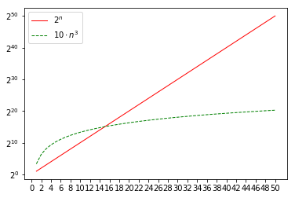


$$TIME_{TM}(2^{n})$$
$$TIME_{TM}(10⋅n^{3})$$

Slide 8





$$R$$
$$EXP$$
$$P_{/poly}$$
$$P$$
$$UHALT$$

Slide 9


$$R$$
$$P_{/poly}$$
$$EXP$$
$$P$$
$$UHALT$$

Slide 10
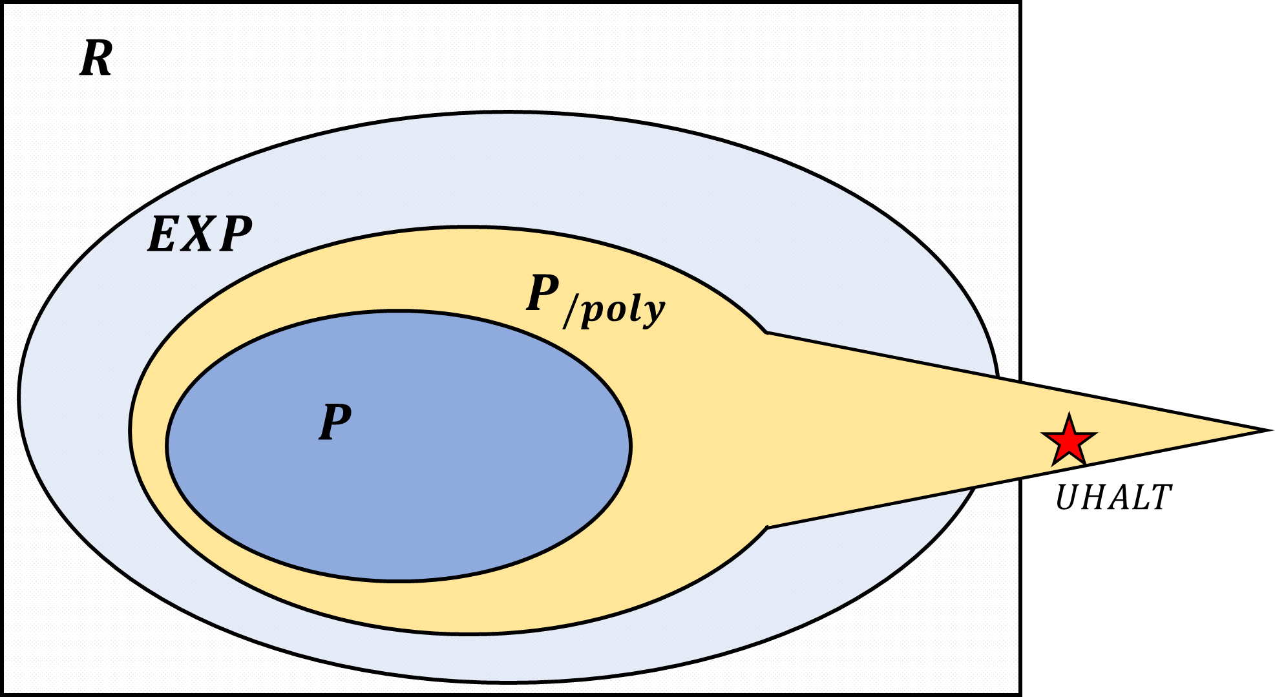
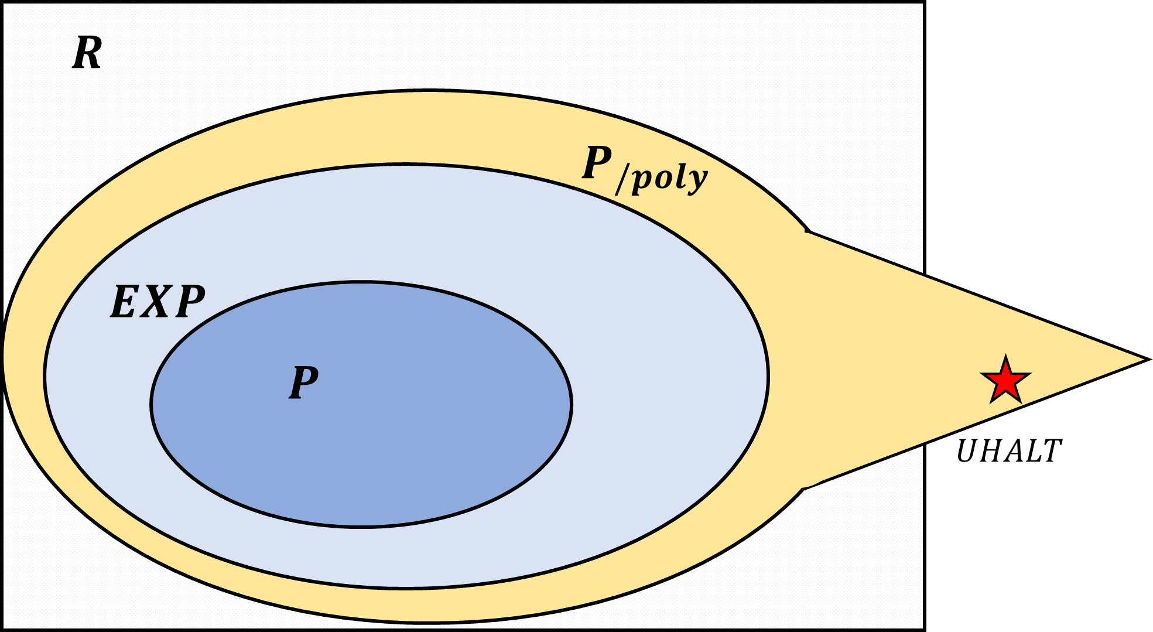
Likely:
Possible:

Slide 11

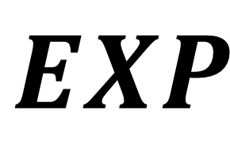


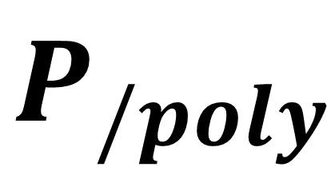
$$R$$
$$EXP$$
$$P_{/poly}$$
$$P$$
$$UHALT$$

