Slide 1




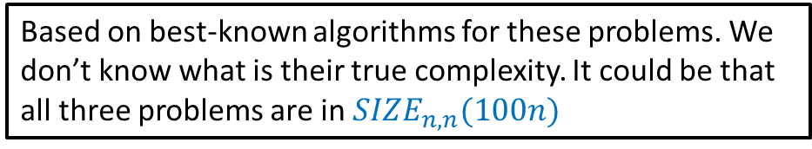


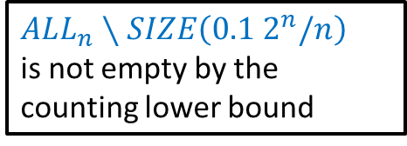

Equality follows from universality of NAND circuits
$ALL_{n}∖SIZE\left(0.1 2^{n}/n\right)$ is not empty by the counting lower bound
$ALL_{n,n}=\left\{ f \right|f:\{0,1\}^{n}→\{0,1\}^{n} \}=SIZE_{n,n}( 10⋅2^{n}$)
$SIZE_{n,n}( 0.1⋅ 2^{n}/n$)
Not empty by the size hierarchy theorem
$SIZE_{n,n}( 2^{0.1 n}$)
$FACT_{n}$?
$SIZE_{n,n}( n^{3}$)
$SIZE_{n,n}( 100n$)
$MULT_{n}$?
$$ADD_{n}$$
Based on best-known algorithms for these problems. We don’t know what is their true complexity. It could be that all three problems are in $SIZE_{n,n}(100n)$

