Slide 1
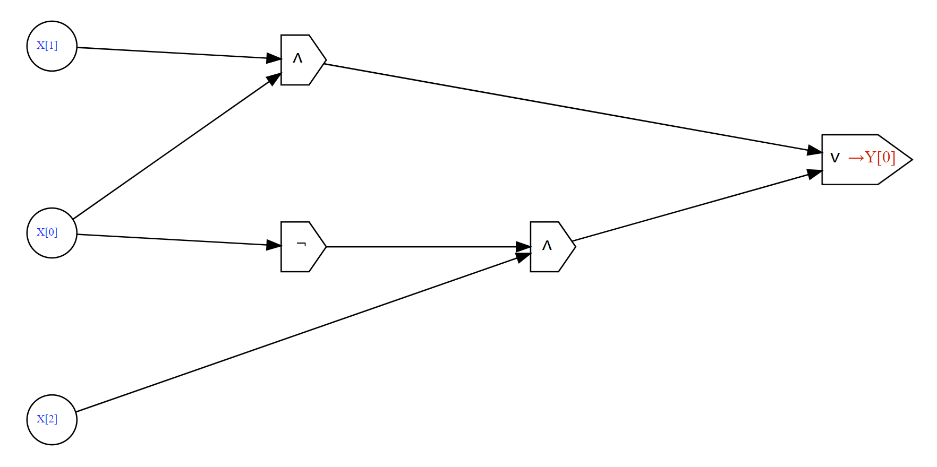
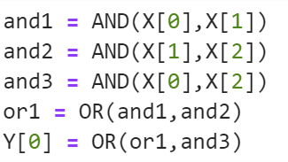
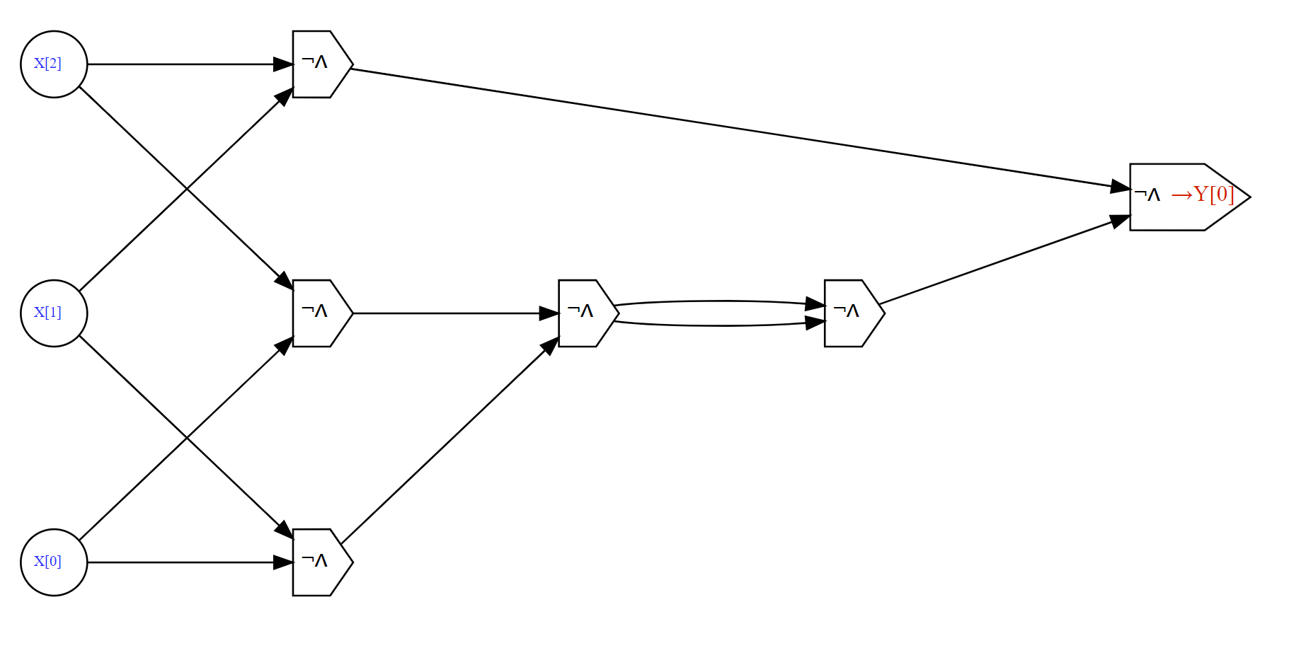
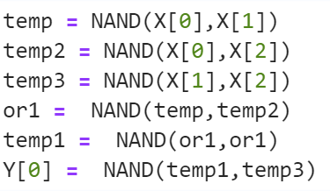

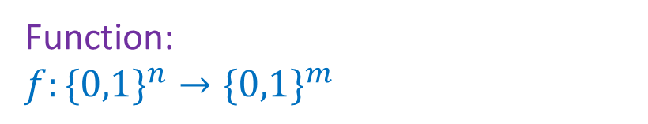

“What” (specification)
“How” (implementation)
Function: $f:\{0,1\}^{n}→\{0,1\}^{m}$
Algorithm/Program/Circuit:
Boolean or NAND circuit $C$, AON-CIRC or NAND-CIRC program $P$
Input | Output
000 | 0
001 | 0
010 | 0
011 | 1
100 | 0
101 | 1
110 | 1
111 | 1
Example:
$MAJ:\{0,1\}^{3}→\{0,1\}$

Slide 2
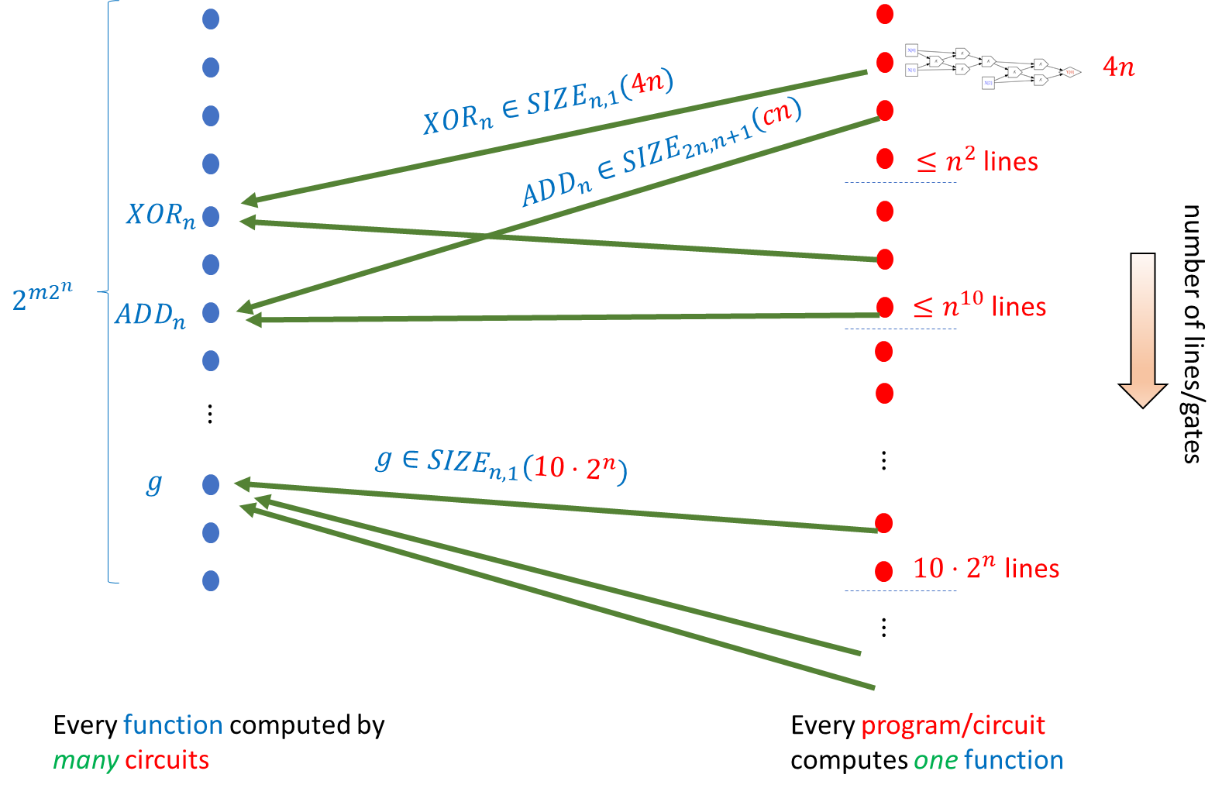



“What” (specification)
“How” (implementation)
Algorithm/Program/Circuit:
Function: $f:\{0,1\}^{n}→\{0,1\}^{m}$
Boolean or NAND circuit $C$, AON-CIRC or NAND-CIRC program $P$
$2^{O\left(s log s\right)}$ circuits of size $≤s$

Slide 3
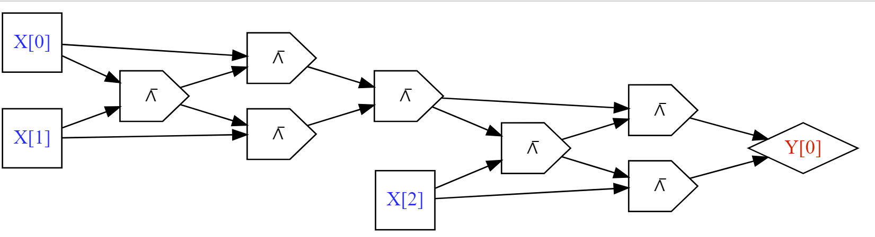


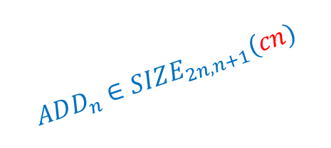







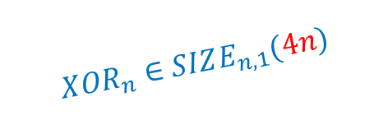
$$4n$$
$$XOR_{n}∈SIZE_{n,1}(4n)$$
$$ADD_{n}∈SIZE_{2n,n+1}(cn)$$
$≤n^{2}$ lines
$$XOR_{n}$$
$$2^{{m2}^{n}}$$
$$ADD_{n}$$
$≤n^{10}$ lines
number of lines/gates
$$⋮$$
$$g∈SIZE_{n,1}(10⋅2^{n})$$
$$⋮$$
$$g$$
$10⋅2^{n}$ lines
$$⋮$$
Every function computed by many circuits
Every program/circuit computes one function

Slide 4



Functions $f:\{0,1\}^{n}→\{0,1\}$
Programs/Circuits $n$ inputs $1$ output
$$4n$$
$$XOR_{n}∈SIZE_{n,1}(4n)$$
$≤n^{2}$ lines
$$XOR_{n}$$
$$2^{2^{n}}$$
$≤n^{10}$ lines
number of lines/gates
$$⋮$$
$$g∈SIZE_{n,1}(10⋅2^{n})$$
$$⋮$$
$$g$$
$10⋅2^{n}$ lines
$$⋮$$
Every function computed by many circuits
Every program/circuit computes one function

