Slide 1
Intro CS
Intro CS II
Operating Systems
Discrete Mathematics
Introduction to TCS
Linear Algebra
Probability
Machine Learning
Calculus

Slide 2
Intro CS
Operating Systems
Intro CS II
Discrete Mathematics
Machine Learning
Introduction to TCS
Linear Algebra
Calculus
Probability

Slide 3
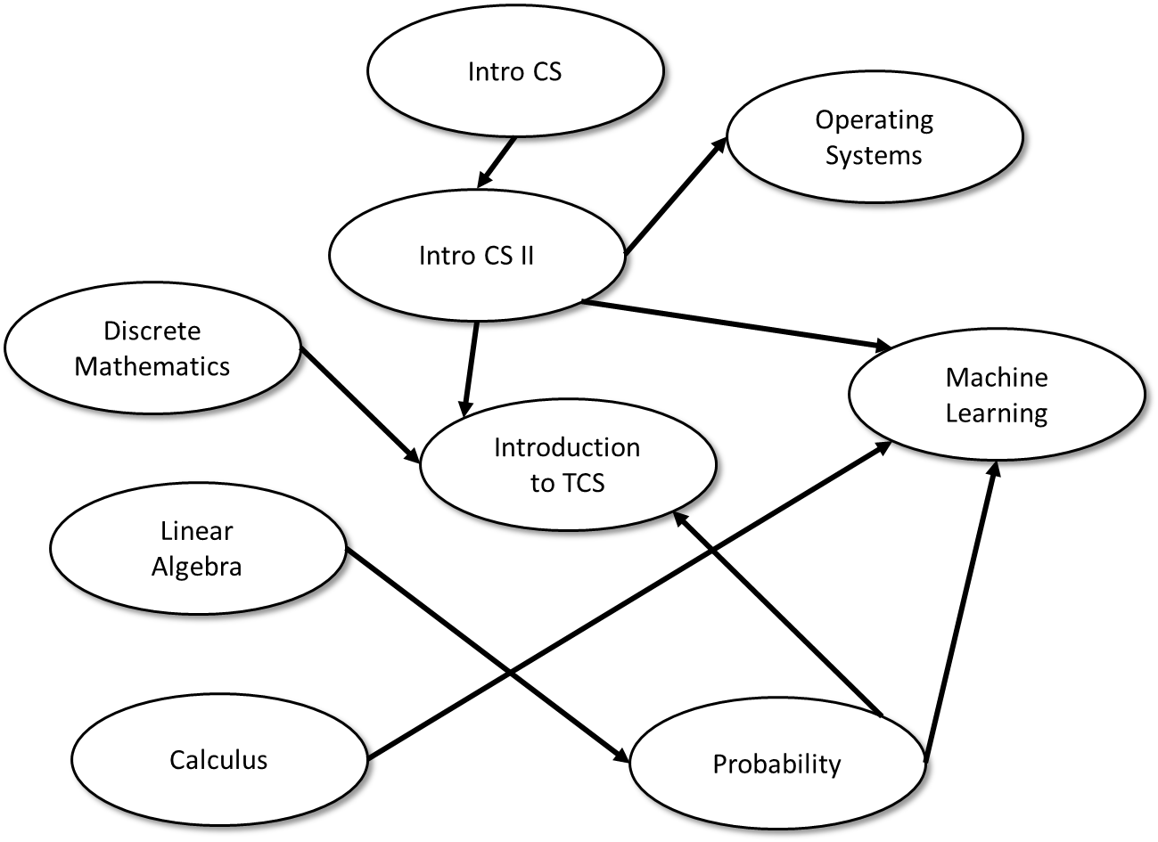
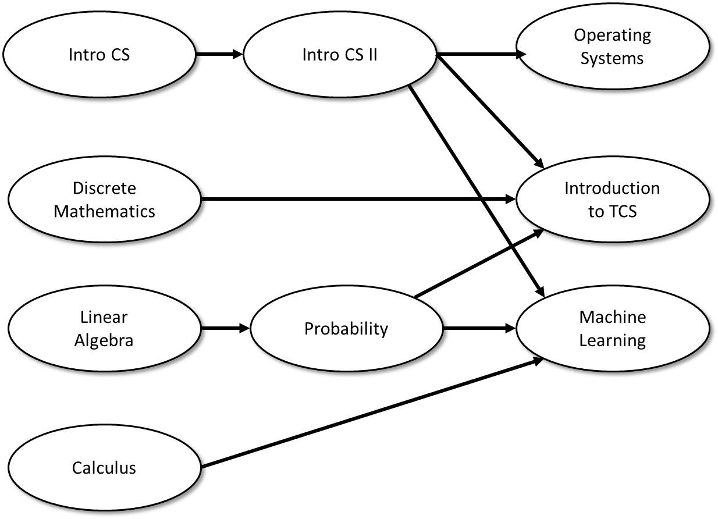
Layer 0
Layer 1
Layer 2

Slide 4
0
0
0
1
2
1
0
0
1
2
1
2

