Slide 1



Alphabet: $Σ ⊇\{\text{▷}\text{,}0, 1,\text{∅}\}$
Head position: $i∈ℕ$
$$\text{▷}$$ | $$0$$ | $$1$$ | $$0$$ | $$3$$ | $$0$$ | $$0$$ | $$2$$ | $$3$$ | $$1$$ | $$0$$ | $$2$$ | $$1$$ | $$2$$ | $$0$$ | $$1$$ | ∅ | ∅ | ∅ | ∅ | ∅ | ∅ | ∅ | ∅ | …
Local State: $s∈[k]$
Rules / transition function: $M:\left[k\right]×Σ→\left[k\right]×Σ×\{L,R,S, H\}$
If read $0$ and state is $17$ then change state to 29, write $1$, and move left.
If read ∅ and state is $23$ then change state to 15, write $2$, and move right.
If read $\text{▷}$ and state is $8$ then change state to 12, write $\text{▷}$, and halt.
...

Slide 2



$$\text{▷}$$ | $$17$$ | $$234$$ | $$4378$$ | $$2$$ | $$0$$ | 23432 | 324 | 87 | 2 | 7 | ∅ | ∅ | ∅ | …
Local Registers:
reg_1: $123$
reg_2: $45$
reg_j := MEMORY[reg_i]
…
MEMORY[reg_l] := rej_k
reg_t: $893$
reg_k := reg_j OP reg_l

Slide 3
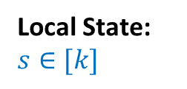
Head position: $i∈ℕ$
$$\text{▷}$$ | $$σ_{0}$$ | $$σ_{1}$$ | $$σ_{2}$$ | $$σ_{3}$$ | $$σ_{4}$$ | $$σ_{5}$$ | $$σ_{6}$$ | $$σ_{7}$$ | $$σ_{8}$$ | $$σ_{9}$$ | $$σ_{10}$$ | $$σ_{11}$$ | $$σ_{12}$$ | $$σ_{13}$$ | $$σ_{14}$$ | ∅ | ∅ | ∅ | ∅ | ∅ | ∅ | ∅ | ∅ | …
Turing machine
Local State: $s∈[k]$
String over alphabet $Σ×(\left\{⋅\right\}∪\left[k\right])$ encoding configuration:
$\text{▷}$,$⋅$ | $$σ_{0},⋅$$ | $$σ_{1},⋅$$ | $$σ_{2},⋅$$ | $$σ_{3},⋅$$ | $$σ_{4},⋅$$ | $$σ_{5},⋅$$ | $$σ_{6},⋅$$ | $$σ_{7},⋅$$ | $$σ_{8},⋅$$ | $$σ_{9},⋅$$ | $$σ_{10},⋅$$ | $$σ_{11},s$$ | $$σ_{12},⋅$$ | $$σ_{13},⋅$$ | $$σ_{14},⋅$$
Configuration in the next step:
$\text{▷}$,$⋅$ | $$σ_{0},⋅$$ | $$σ_{1},⋅$$ | $$σ_{2},⋅$$ | $$σ_{3},⋅$$ | $$σ_{4},⋅$$ | $$σ_{5},⋅$$ | $$σ_{6},⋅$$ | $$σ_{7},⋅$$ | $$σ_{8},⋅$$ | $$σ_{9},⋅$$ | $$σ_{10},⋅$$ | $$τ,⋅$$ | $$σ_{12},t$$ | $$σ_{13},⋅$$ | $$σ_{14},⋅$$

Slide 4

0 1 2 3 4 5 6 7 8 9 10 11 12 13 14 15 16 17 18 19 20 21 22 23….
Spam
$$\text{1}$$ | $$0$$ | $$1$$ | $$1$$ | $$0$$ | $$0$$ | $$0$$ | $$1$$ | $$0$$ | $$1$$ | $$0$$ | $$0$$ | $$1$$ | $$1$$ | $$0$$ | $$1$$ | $$0$$ | $$0$$ | $$0$$ | $$0$$ | $$0$$ | $$0$$ | $$0$$ | $$0$$ | …
arrays
Eggs
$$\text{0}$$ | $$1$$ | $$0$$ | $$0$$ | $$0$$ | $$1$$ | $$1$$ | $$0$$ | $$1$$ | $$0$$ | $$1$$ | $$1$$ | $$0$$ | $$1$$ | $$0$$ | $$0$$ | $$0$$ | $$0$$ | $$0$$ | $$0$$ | $$0$$ | $$0$$ | $$0$$ | $$0$$ | …
Ni
$$\text{1}$$ | $$1$$ | $$0$$ | $$0$$ | $$1$$ | $$1$$ | $$0$$ | $$1$$ | $$1$$ | $$1$$ | $$1$$ | $$0$$ | $$0$$ | $$0$$ | $$1$$ | $$0$$ | $$0$$ | $$0$$ | $$0$$ | $$0$$ | $$0$$ | $$0$$ | $$0$$ | $$0$$ | …
foo
$$0$$
$$1$$
$$1$$
$$0$$
$$12$$
scalars
bar
baz
blah
index
i

Slide 5
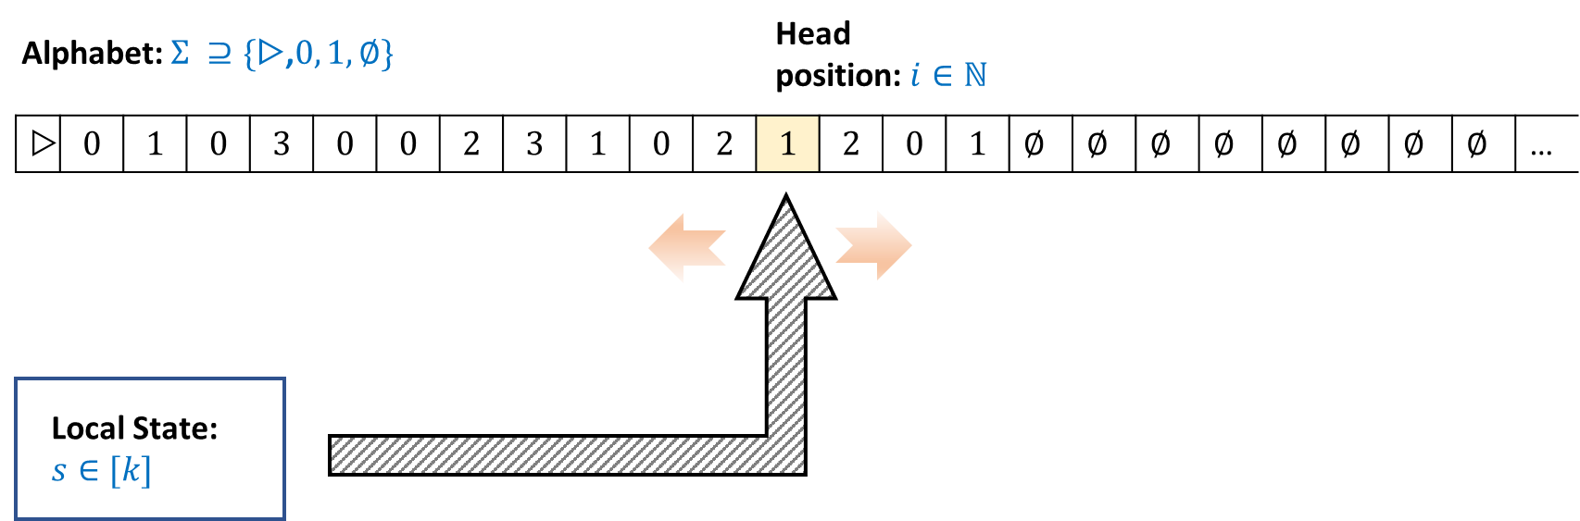
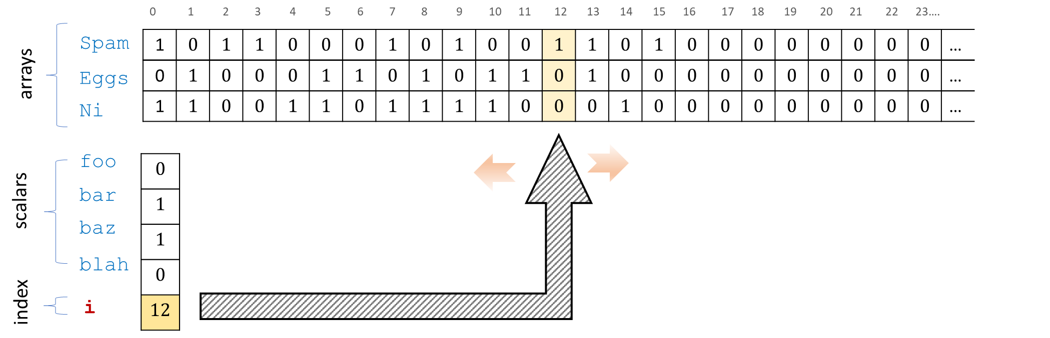
Turing Machine
NAND-TM Program

