Slide 1
Internal loops
Load Foo to i
Indexed access: Foo[Bar]
2-dim arrays
Integer arrays

Slide 2

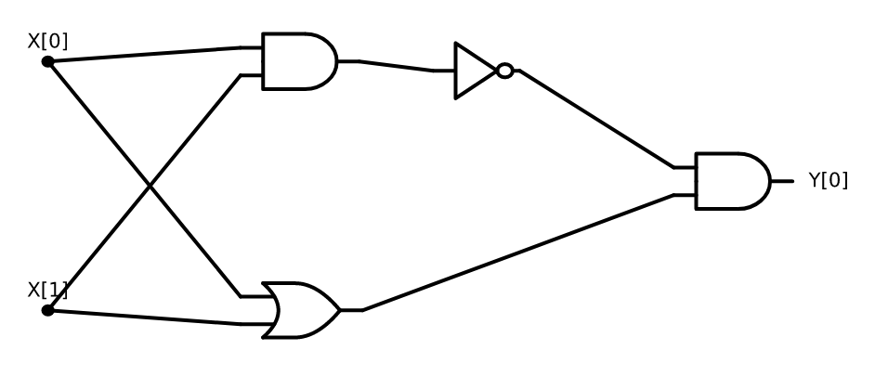
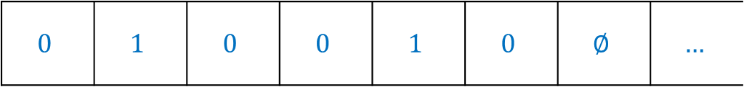
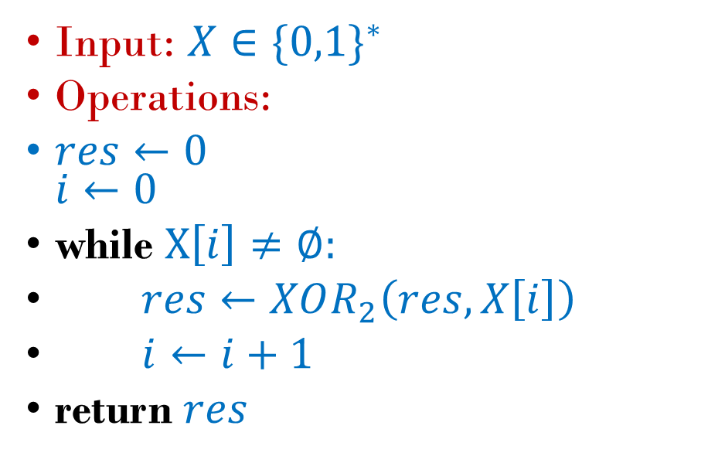
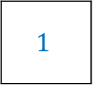
Input: $X∈\{0,1\}^{∗}$
Operations:
$res←0$ $i←0$
while $X\left[i\right]≠∅:$
$res←XOR_{2}\left(res,X\left[i\right]\right)$
$i←i+1$
return $res$
$$0$$ | $$1$$ | $$0$$ | $$0$$ | $$1$$ | $$0$$ | $$∅$$ | $$…$$
$$1$$
Unbounded memory / arrays.
Unbounded memory / arrays.
Finite state / local variables.
Addressing mechanism / indexing
Finite logic
Looping, halting
Finite state / local variables.
Addressing mechanism / indexing
Unbounded memory / arrays.
Finite state / local variables.
Addressing mechanism / indexing
Finite logic
Looping, halting

Slide 3
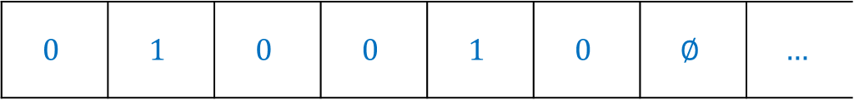
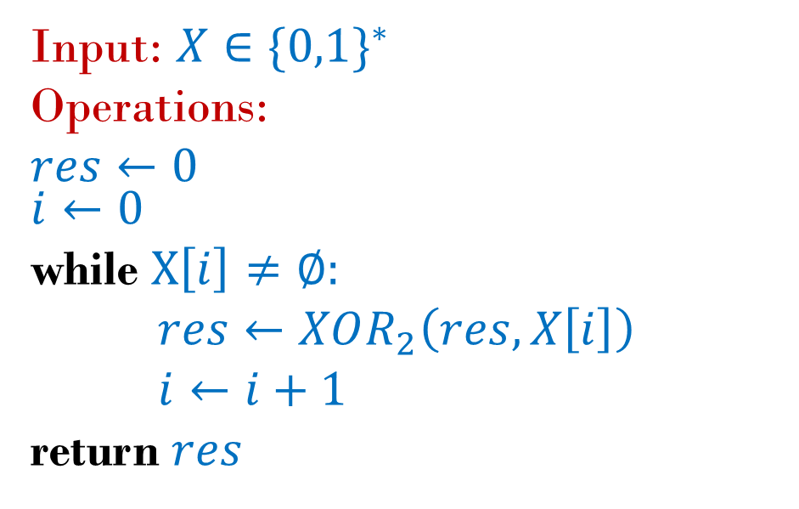
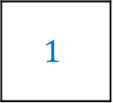
Input: $X∈\{0,1\}^{∗}$
Operations:
$res←0$ $i←0$
while $X\left[i\right]≠∅:$
$res←XOR_{2}\left(res,X\left[i\right]\right)$
$i←i+1$
return $res$
$$0$$ | $$1$$ | $$0$$ | $$0$$ | $$1$$ | $$0$$ | $$∅$$ | $$…$$
$$1$$
Unbounded memory / arrays.
Finite logic
Finite state / local variables.
Looping, halting
Addressing mechanism / indexing

Slide 4
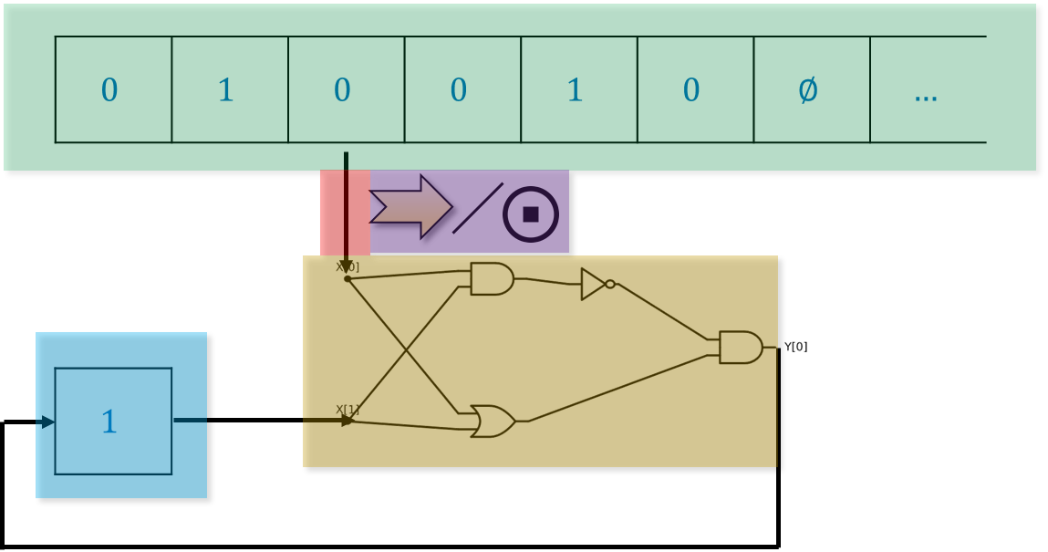
Input: $X∈\{0,1\}^{∗}$
Operations:
$res←0$ $i←0$
while $X\left[i\right]≠∅:$
$res←XOR_{2}\left(res,X\left[i\right]\right)$
$i←i+1$
return $res$
Unbounded memory / arrays.
Finite state / local variables.
Addressing mechanism / indexing
Finite logic
Looping, halting

Slide 5
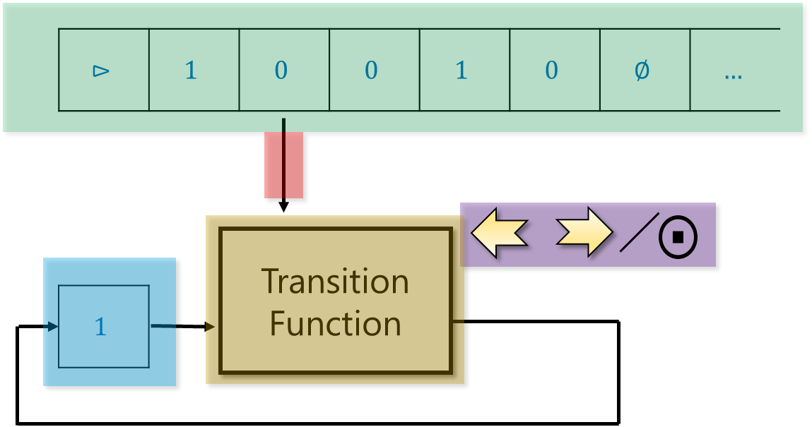
Unbounded tape.
Transition function
Finite state.
Halt/move decision
Head position

