Slide 1
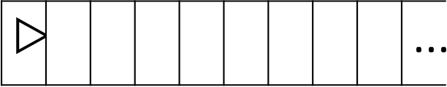

$$\text{▷}$$ |  |  |  |  |  | $$\text{...}$$
$$\text{▷}$$ |  |  |  |  |  |  |  |  | $$\text{...}$$

Slide 2





$$M$$
$$U\left(M,x\right)=M(x)$$
$$x$$
$$\text{▷}0100110110110110110110110110110101110$$
$$110011011011111101101$$
$$U$$

Slide 3

$$M$$
$$x$$
$$\text{▷}0100110110110110110110110110110101110$$
$$110011011011111101101$$
$$U$$

Slide 4
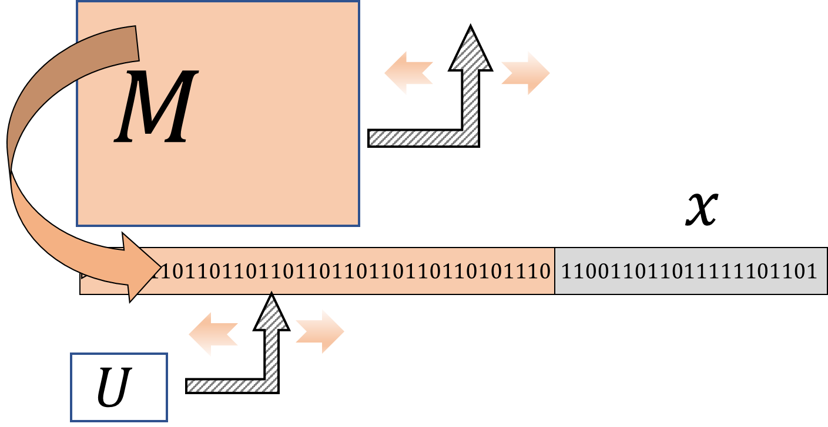
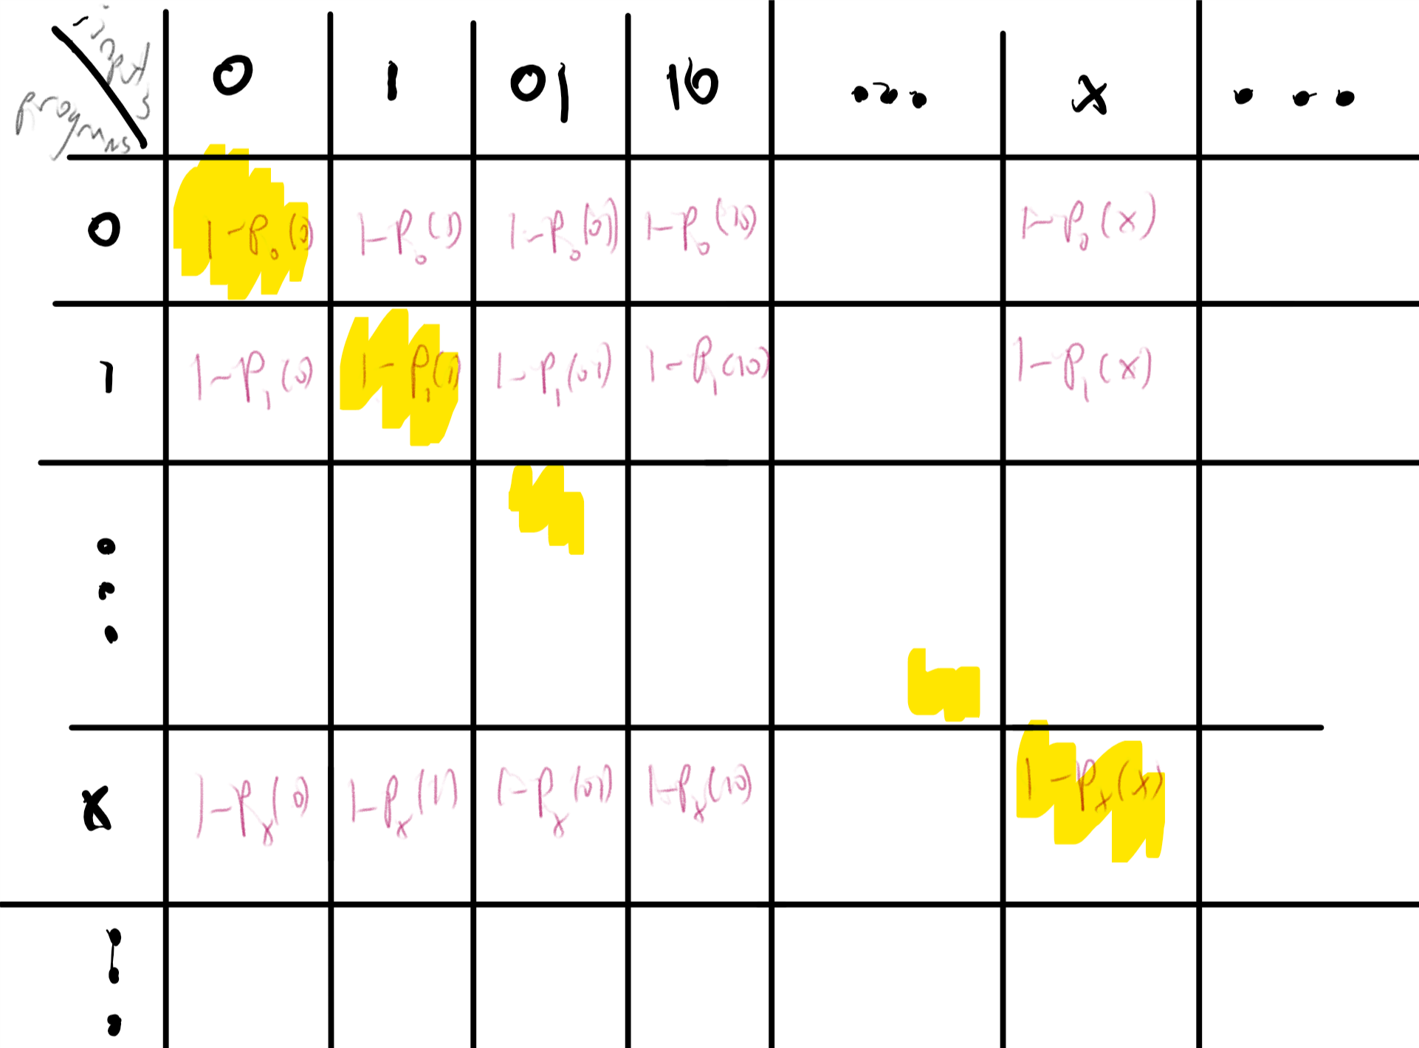
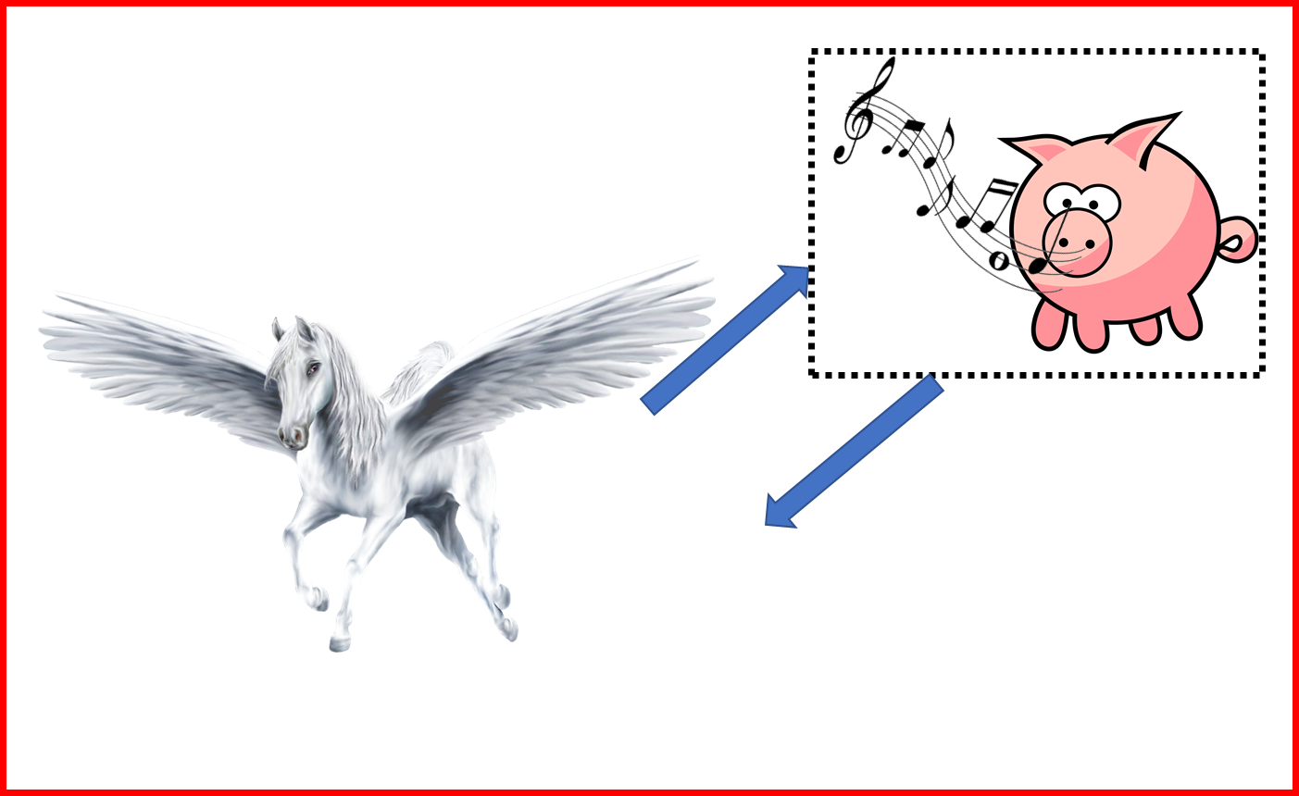
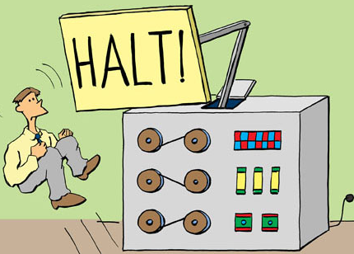

Universal Turing Machine
Uncomputable function
The Halting Problem
Reductions
…
$$HALTONZERO$$
Rice’s Theorem

Slide 5


