Slide 1

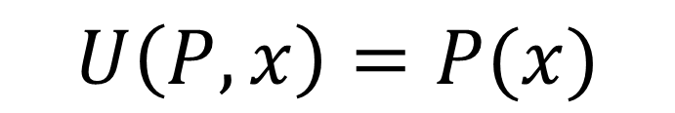




$$P$$
$$010011011011011011010$$
$$U$$
$$U\left(P,x\right)=P(x)$$
$$x$$
$$11101101$$

Slide 2
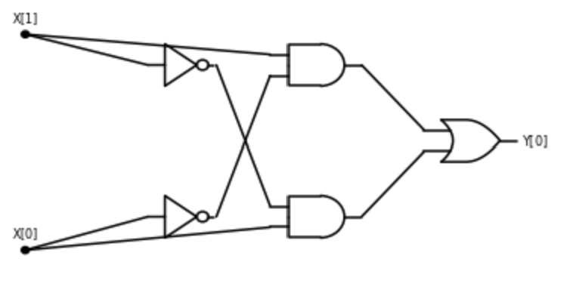

$$010011011011011011010$$

Slide 3


$$010011011011011011010$$
$$U$$
$$x$$
$$11101101$$

Slide 4




$$U$$
$$010011011011011011010$$
$$x$$
$$11101101$$

Slide 5




$$\#$$
$$≤$$
$$\#$$
$$010011011011011011010$$

