Slide 1
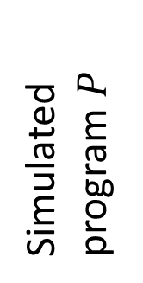

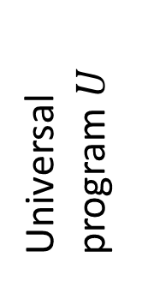



block $0$
block $1$
block $2$
$$⋯$$
Universal program $U$
Vars
3 | 2 | 12 | 14 | 71 |  | 15 | 8 |  | 92 | 28 |  | 6 | 18 |  | 53 | 28 |  | 58 | 45
Foo
3 | 14 | 15 | 92 | 6 | 53 | 58
Simulated program $P$
Bar
2 | 71 | 8 | 28 | 18 | 28 | 45
blah
12

Slide 2
