Slide 1
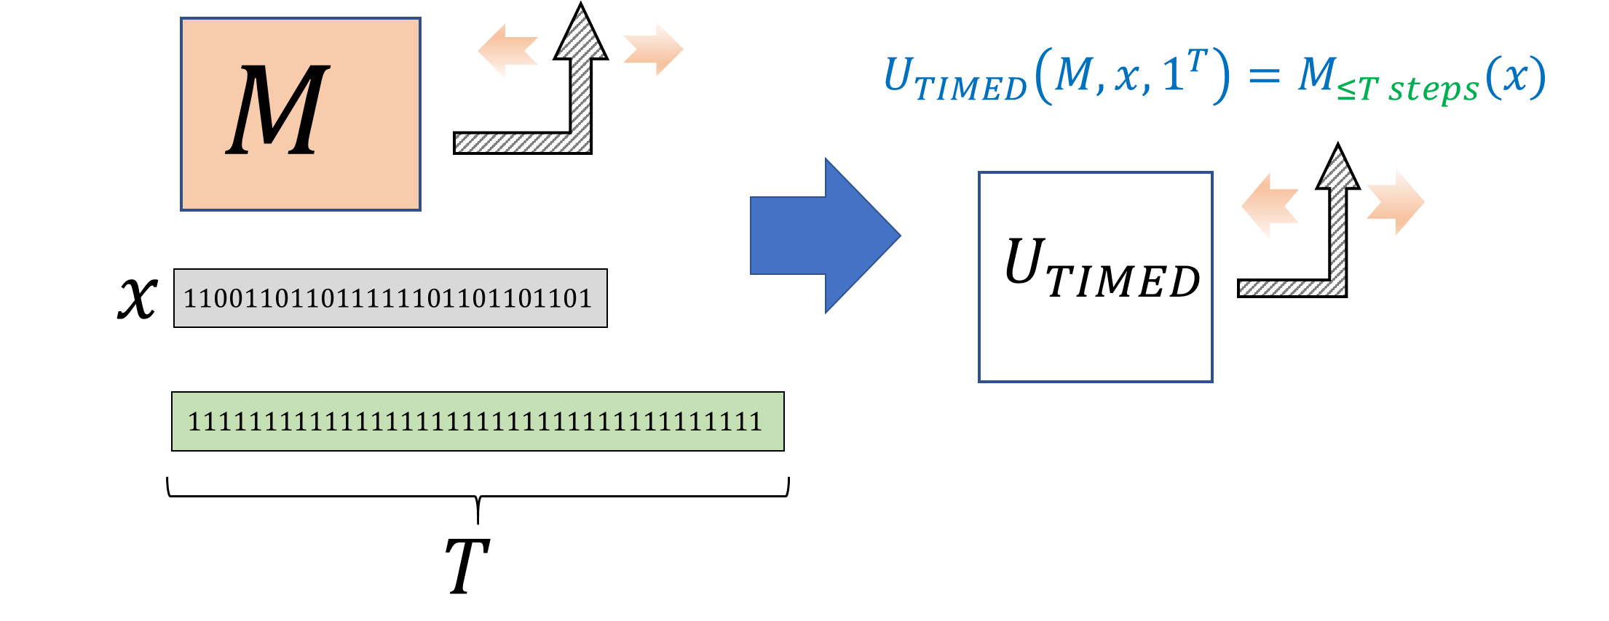

Slide 2
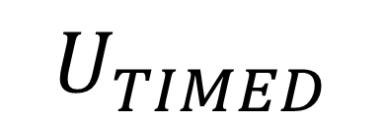




$$M$$
$$U_{TIMED}\left(M,x,1^{T}\right)=M_{≤T steps}(x)$$
$$U_{TIMED}$$
$$x$$
$$110011011011111101101101101$$
$$11111111111111111111111111111111111111$$
$$T$$

Slide 3





$$M$$
$$C$$
$$n$$
$$111111111111111111111111111$$
$$n$$
$$11111111111111111111111111111111111111$$
$$UNROLL\left(M,1^{n},1^{T}\right)=C$$
$$T$$
$$C\left(x\right)=M_{≤T steps}(x)$$

Slide 4
