Slide 1
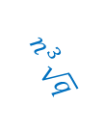

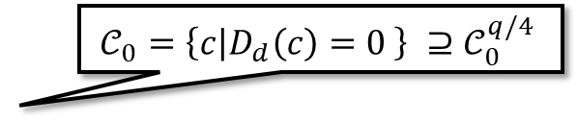

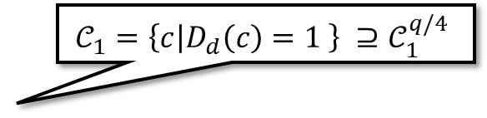



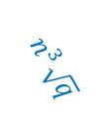


Ciphertext space ( ${\left\{0,1\right\}}^{n}$)
$$𝒞_{0}=\left\{c | D_{d}\left(c\right)=0 \right\} ⊇𝒞_{0}^{q/4}$$
$$𝒞_{1}=\left\{c | D_{d}\left(c\right)=1 \right\} ⊇𝒞_{1}^{q/4}$$
$$q/4$$
Noise level
$$q/4$$
$$n^{3}\sqrt{q}$$
$$n^{3}\sqrt{q}$$
$$\sqrt{q}$$
$$\sqrt{q}$$
$$Supp\left(E_{e}\left(0\right)\right)⊆𝒞_{0}^{\sqrt{q}}$$
$$Supp\left(E_{e}\left(1\right)\right)⊆𝒞_{1}^{\sqrt{q}}$$
Encryptions of 0
Encryptions of 1
$$∈𝒞_{0}^{\sqrt{q}}∧ ∈𝒞_{1}^{\sqrt{q}} ⇒ =ENAND_{e}\left( , \right)∈𝒞_{1}^{n^{3}\sqrt{q}}$$

