Slide 1

Offline Coins and $BPP⊆P_{/poly}$

Slide 2








Def: $F∈BPP$ if there’s poly-time $A$ such that for every input $x$,
$$\underset{r∈\{0,1\}^{m}}{Pr}\left[A\left(x;r\right)=F\left(x\right)\right]≥\frac{2}{3}$$
Randomness $\{0,1\}^{m}$
$$r$$
$$x$$
$$A\left(x;r\right)=F(x)$$
$$x′$$
$$A\left(x;r\right)≠F(x)$$
Inputs: $x∈\{0,1\}^{n}$

Slide 3
Def: $F∈BPP$ if there’s poly-time $A$ such that for every input $x$,
at least 2/3rd of $r$’s in $\{0,1\}^{m}$ satisfy $A\left(x;r\right)=F(x)$
Randomness $\{0,1\}^{m}$
$$r$$
$$x$$
$$A\left(x;r\right)=F(x)$$
$$x′$$
$$A\left(x;r\right)≠F(x)$$
Inputs: $x∈\{0,1\}^{n}$

Slide 4
Def: $F∈offlineBPP$ if there’s poly-time $A$ s.t. at least 2/3rd of $r$’s in $\{0,1\}^{m}$
satisfy for every $x∈\{0,1\}^{n}$ that $A\left(x;r\right)=F(x)$
Randomness $\{0,1\}^{m}$
$$r$$
$$x$$
$$A\left(x;r\right)=F(x)$$
$$x′$$
$$A\left(x;r\right)≠F(x)$$
Inputs: $x∈\{0,1\}^{n}$

Slide 5



Thm: $offlineBPP=BPP$
Pf: Use amplification: If $F∈BPP$ then $∃A$ s.t. for every $x∈\{0,1\}^{n}$
$$\underset{r∈\{0,1\}^{m}}{Pr}\left[A\left(x;r\right)=F\left(x\right)\right]≥1−0.1×2^{−n}$$
In other words # $≤2^{n}×0.1×2^{m−n}=0.1×2^{m}$
Randomness $\{0,1\}^{m}$
Inputs: $x∈\{0,1\}^{n}$
Less than $0.1×2^{m}$ rows can have one or more

Slide 6









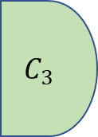
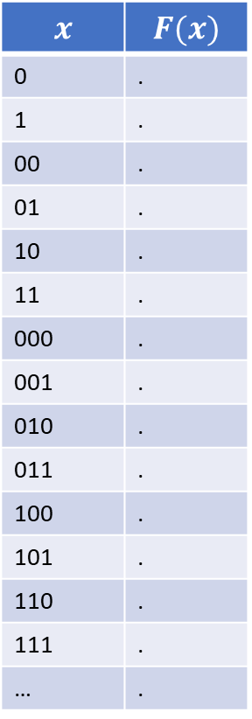

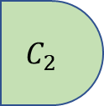
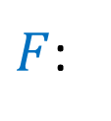

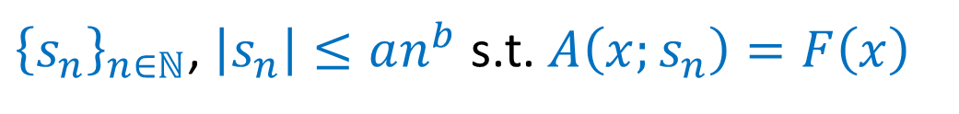
Corollary: $BPP⊆P_{/poly}$
Reminder: $F∈P_{/poly}$ if for every $n∈ℕ$, $F_{n}$ has $poly(n)$ size circuit
Equivalently: $F∈P_{/poly}$ if there is poly $A$
$F$:
${\left\{s_{n}\right\}}_{n∈ℕ}$, $\left|s_{n}\right|≤an^{b}$ s.t. $A\left(x;s_{n}\right)=F\left(x\right)$
$$x$$ | $$F(x)$$
0 | .
1 | .
00 | .
01 | .
10 | .
11 | .
000 | .
001 | .
010 | .
011 | .
100 | .
101 | .
110 | .
111 | .
… | .
$$F_{1}$$
$$C_{1}$$
$$s_{1}$$
for all $x∈\{0,1\}^{n}$
$$F_{2}$$
$$C_{2}$$
$$s_{2}$$
$$C_{3}$$
$$F_{3}$$
$$s_{3}$$
$$\left|C_{n}\right|≤an^{b}$$

Slide 7


Corollary: $BPP⊆P_{/poly}$
Randomness $\{0,1\}^{m}$
Inputs: $x∈\{0,1\}^{n}$
For every $n∈ℕ$, “advice string” is $r_{n}∈\{0,1\}^{m}$ s.t. $A\left(x;r_{n}\right)=F\left(x\right)$ for all $x∈\{0,1\}^{n}$
Equivalently: For every $n∈ℕ$, circuit $C_{n}$ computes map $x↦A(x;r_{n})$

Slide 8
State of BPP

Slide 9




What we know:
$$EXP$$
$$P_{/poly}$$
$$BPP$$
$$P$$
$P⊆BPP⊆EXP$ , $BPP⊆P_{/poly}$ , $P ⊊EXP$ , $P_{/poly} ⊈EXP$

Slide 10





Possibility 1: Randomness gives no extra power: $BPP=P$
$$EXP$$
$$P_{/poly}$$
$$=$$
$$P$$
$$BPP$$
In this case: $P=BPP⊊EXP,P_{/poly}$ , $P_{/poly} ⊈EXP$

Slide 11
What we know:
$$EXP$$
$$P_{/poly}$$
$$BPP$$
$$P$$
$P⊆BPP⊆EXP$ , $BPP⊆P_{/poly}$ , $P ⊊EXP$ , $P_{/poly} ⊈EXP$

Slide 12





Possibility 2: Randomness is a “silver bullet” : $BPP=EXP$
$$P_{/poly}$$
$$BPP$$
$$=$$
$$EXP$$
$$P$$
In this case: $P⊊BPP=EXP$, $EXP⊊P_{/poly}$

Slide 13
BPP and NP

Slide 14





What about $NP$?
$$EXP$$
$$P_{/poly}$$
$$NP$$
$$BPP$$
$$P$$
$$NPC$$
$P⊆BPP⊆EXP$ , $BPP⊆P_{/poly}$ , $P ⊊EXP$ , $P_{/poly} ⊈EXP$
$P⊆NP⊆EXP$ , If NPC problem in $P/BPP/P_{/poly}$ then $NP⊆P/BPP/P_{/poly}$

Slide 15






What we believe
$$EXP$$
$$NP$$
$$P_{/poly}$$
$$BPP$$
$$P=BPP$$
$$NPC$$
$P=BPP⊊NP⊊EXP$
NP complete problems outside $P=BPP$ and even outside $P_{/poly}$

Slide 16
Sipser Gacs Theorem

Slide 17






Sipser Gacs Thm: If $P=NP$ then $BPP=P$
Proof idea: First amplify like crazy: $\operatorname{Pr}\left[ A\left(x;r\right)=F\left(x\right)\right]≥1−2^{−n}≥1 −\frac{1}{1000m}$
$$A\left(x;r\right)=0$$
$$A\left(x;r\right)=1$$
$$F\left(x\right)=0$$
$$F\left(x\right)=1$$
$$S_{x}=\left\{r\right|F\left(x;r\right)=1 \}$$
CLAIM: $F\left(x\right)=1$ iff there are “few” shifts $s_{1},…,s_{k}$ s.t. $\{0,1\}^{m}=∪\left(S_{x}+s_{i}\right)$

Slide 18








Sipser Gacs Thm: If $P=NP$ then $BPP=P$
$\operatorname{Pr}\left[ A\left(x;r\right)=F\left(x\right)\right]≥1−2^{−n}≥1 −\frac{1}{10k}$
$$S_{x}$$
$$S_{x}+s$$
$$S_{x}$$
$$S_{x}+s$$
$$s=$$
$$F\left(x\right)=1$$
$$F\left(x\right)=0$$
CLAIM: $F\left(x\right)=1$ iff there are “few” shifts $s_{1},…,s_{k}$ s.t. $\{0,1\}^{m}=∪\left(S_{x}+s_{i}\right)$

Slide 19





Sipser Gacs Thm: If $P=NP$ then $BPP=P$
$\operatorname{Pr}\left[ A\left(x;r\right)=F\left(x\right)\right]≥1−2^{−n}≥1 −\frac{1}{10k}$
$$S_{x}$$
$$S_{x}+s$$
$$∪$$
$$∪$$
$$S_{x}$$
$$S_{x}+s$$
$$s=$$
$$F\left(x\right)=1$$
$$F\left(x\right)=0$$
CLAIM: $F\left(x\right)=1$ iff there exist shifts $s_{1},…,s_{k}$ s.t. for every $z∈\{0,1\}^{m}$ there exists $i∈\{1..k\}$ s.t. $A\left(x;z+s\right)=1$
CLAIM: $F\left(x\right)=1$ iff there are “few” shifts $s_{1},…,s_{k}$ s.t. $\{0,1\}^{m}=∪\left(S_{x}+s_{i}\right)$

Slide 20
Pseudorandom Generators

Slide 21
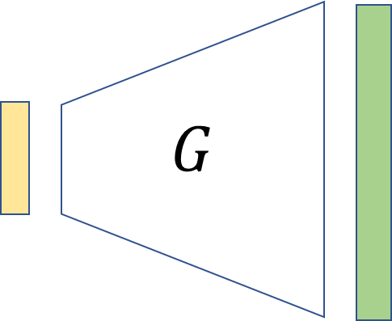


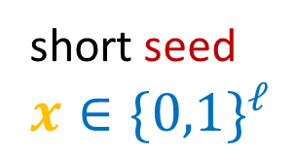

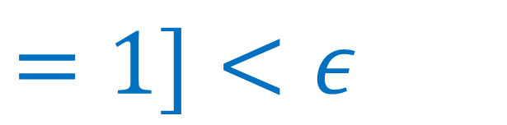

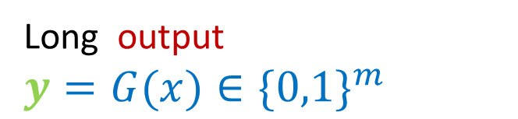

short seed $x∈\{0,1\}^{ℓ}$
$$G$$
Long output $y=G(x)∈\{0,1\}^{m}$
$G:\{0,1\}^{ℓ}→\{0,1\}^{m}$ is $(T,ε)$ pseudorandom generator if for every $C$ of size $≤T$
$$Pr⁡[$$
$=1]−{ }\operatorname{Pr}{[}$
$=1]<ε$
$$C$$
$$C$$

Slide 22


PRG in practice
random.randint(1,100)
seed
Unpredictable data
$$G$$
new seed
output
seed
Back to HTML

Slide 24

$\operatorname{Pr}\left[ A\left(x;r\right)=F\left(x\right)\right]≥1−2^{−n}≥1 −\frac{1}{10k}$
$$S_{x}$$
$$S_{x}+s$$
$$S_{x}$$
$$S_{x}+s$$
$$F\left(x\right)=0$$
$$F\left(x\right)=1$$
$$s=$$
CLAIM: $F\left(x\right)=1$ iff there are “few” shifts $s_{1},…,s_{k}$ s.t. $\{0,1\}^{m}=∪\left(S_{x}+s_{i}\right)$

