Slide 1
CS 121 Recap
Review lecture: Tuesday December 11 3:30pm-5pm Science Center Hall C
Deadline reminders:
Coding assignment: December 6th (no late days*)
Homework 10: December 7th (can use late days if you have them)
Q: Are you planning to ask me a question at AMA session?
a. Yes b. No
c. I’m not sure

Slide 2
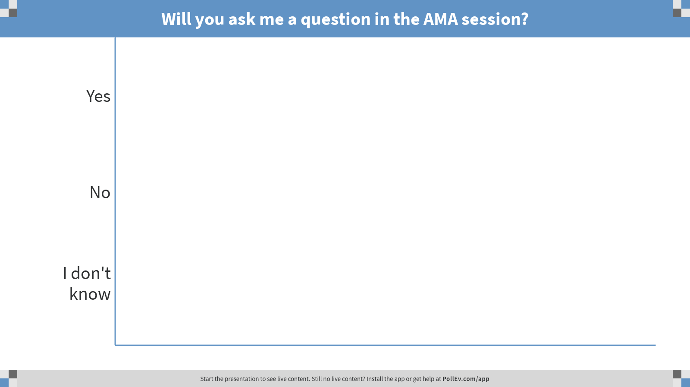
Notes:
Poll Title: Will you ask me a question in the AMA session? https://www.polleverywhere.com/multiple_choice_polls/igm8xMwivCyHyDB

Slide 3
“In the 1920’s, an engineer’s “half life of knowledge” … was 35 years. In the 1960’s, it was a decade. Now it’s five years at most, and, for a software engineer, less than three. ”
Tad Friend, The New Yorker, Nov 20, 2017

Slide 4
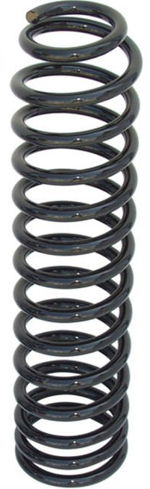
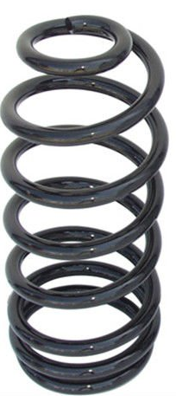
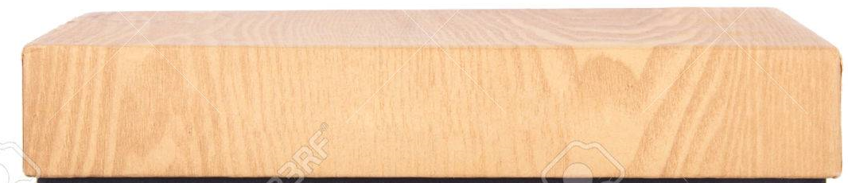







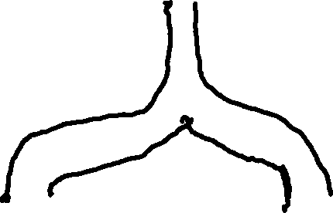

$$y_{}$$
“An Investigation of the Laws of Thought”, George Boole, 1854
$$x_{0}$$
$$x_{1}$$

Slide 8
0 | 1 | 0 | 0 | 1 | 1 | 1 | 1 | 0 | 0 | 1 | 0 | 1 | 0 | 1 | 1 | 1 | 0 | 0 | 1 | 0 | 1 | 0 | 0 | 0 | 1 | 1 | 0 | 1 | 1 | 0 | 0 | 0 | 1 | 1 | 0 | 1 | 1 | 0 | 0 | 1 | 0 | 1 | 0 | 1 | 0 | 0 | 1 | 1
0 | 1 | 0 | 0 | 1 | 1 | 1 | 1 | 0 | 0 | 1 | 0 | 1 | 0 | 1 | 1 | 1 | 0 | 0 | 1 | 0 | 1 | 0 | 0 | 0 | 1 | 1 | 0 | 1 | 1 | 0 | 0 | 0 | 1 | 1 | 0 | 1 | 1 | 0 | 0 | 1 | 0 | 1 | 0 | 1 | 0 | 0 | 1 | 1

Slide 9
0 | 1 | 0 | 0 | 1 | 1 | 1 | 1 | 0 | 0 | 1 | 0 | 1 | 0 | 1 | 1 | 1 | 0 | 0 | 1 | 0 | 1 | 0 | 0 | 0 | 1 | 1 | 0 | 1 | 1 | 0 | 0 | 0 | 1 | 1 | 0 | 1 | 1 | 0 | 0 | 1 | 0 | 1 | 0 | 1 | 0 | 0 | 1 | 1

Slide 10
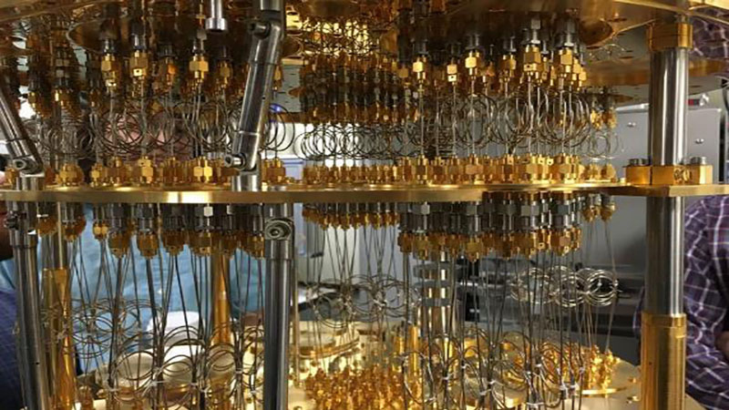
0 | 1 | 0 | 0 | 1 | 1 | 1 | 1 | 0 | 0 | 1 | 0 | 1 | 0 | 1 | 1 | 1 | 0 | 0 | 1 | 0 | 1 | 0 | 0 | 0 | 1 | 1 | 0 | 1 | 1 | 0 | 0 | 0 | 1 | 1 | 0 | 1 | 1 | 0 | 0 | 1 | 0 | 1 | 0 | 1 | 0 | 0 | 1 | 1

Slide 11
Major Lessons

Slide 12
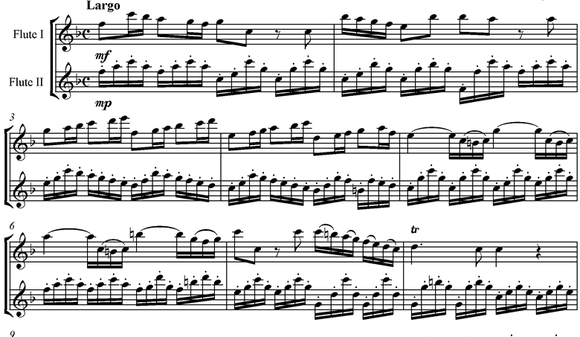
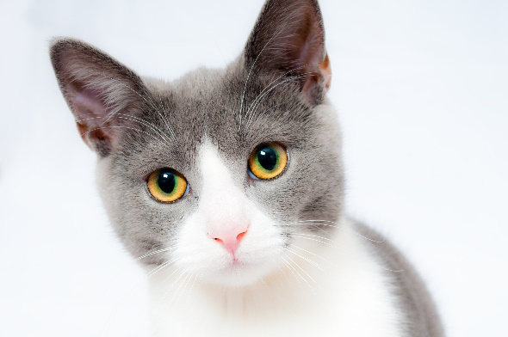

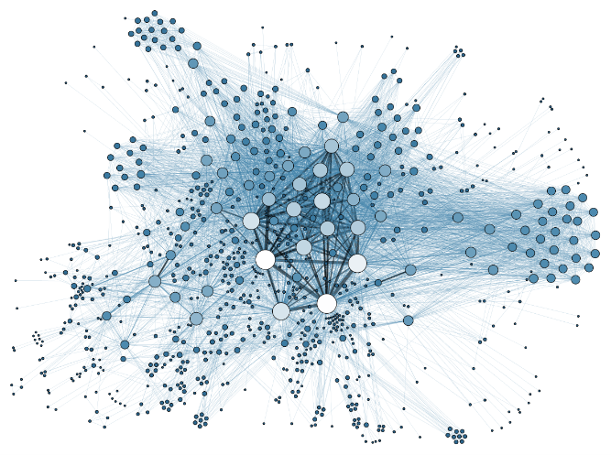
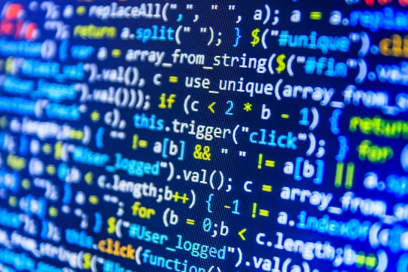
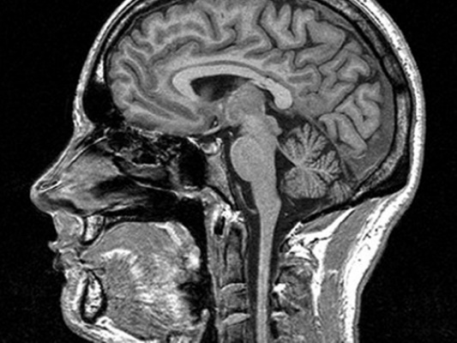
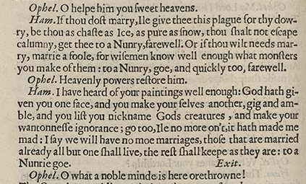
1) Everything is a string

Slide 13

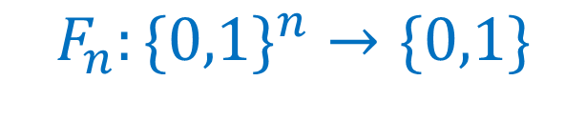
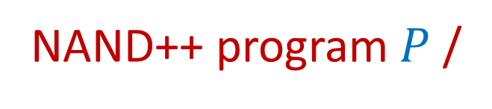
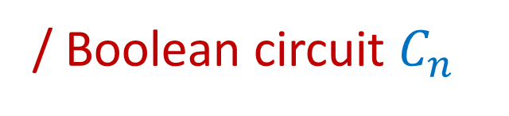
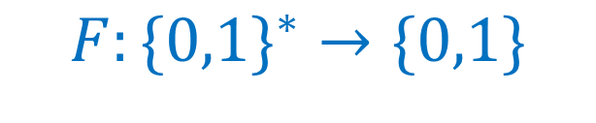
2) Distinguish Computational Task from Algorithm to solve it.
finite/ fixed input:
NAND program $P_{n}$
$$F_{n}:\{0,1\}^{n}→\{0,1\}$$
/ Boolean circuit $C_{n}$
NAND++ program $P$ /
Infinite/ unbounded input:
$$F:\{0,1\}^{∗}→\{0,1\}$$
NAND<< program /
Turing machine / λ calculus / etc. etc.

Slide 14
3) A program is a string …
and can be input to other programs.
EVAL functions for NAND, NAND++, etc..
Counting lower bound for NAND programs / circuits.
Uncomputability of Halting
Godel’s Incompleteness Theorem
Time hierarchy theorem
NP completeness

Slide 15

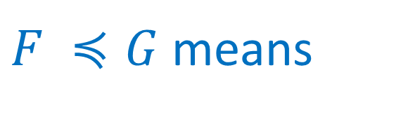
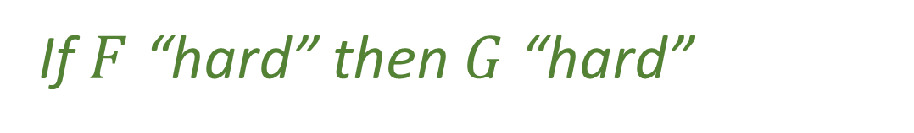
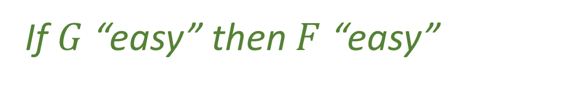
4) Reductions can be used to show a problem is easy…
…but also that it’s hard.
Can solve $F$ using a “$G$ solver”
$F ≼G$ means
If $G$ “easy” then $F$ “easy”
If $F$ “hard” then $G$ “hard”
Uncomputability, NP completeness

Slide 16
5) Can define inherent complexity of a task
Define computational model: finite, infinite, randomized, quantum, ….
Define resource measure: lines, time, memory, coins, quantum steps,…
Complexity($F$) = # resources used by “best” program P computing $F$.
Ask questions: Can we trade resource X for Y? At what cost?
Example: Can replace randomness with time at exponential cost. Can we do better?

Slide 17



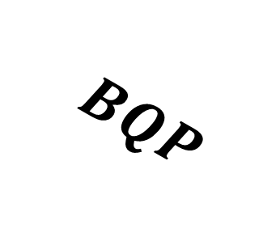


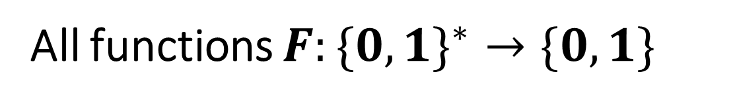









All functions $F:\{0,1\}^{∗}→\{0,1\}$
Computable functions
$HALT_{2^{2^{n}}}$
$$EXP$$
$HALT$
$$P_{/poly}$$
$HALT_{2^{n}}$
$$BPP$$
Functions with unbounded input lengths: inclusion diagram – not to scale!!
Some classes might “collapse” to one another.
$$P$$
$$BQP$$
?
$2SAT$
U$HALT$
$$NP$$
$$NPC$$
$3SAT$
$FACTORING$

Slide 18
Significant Topics

Slide 19
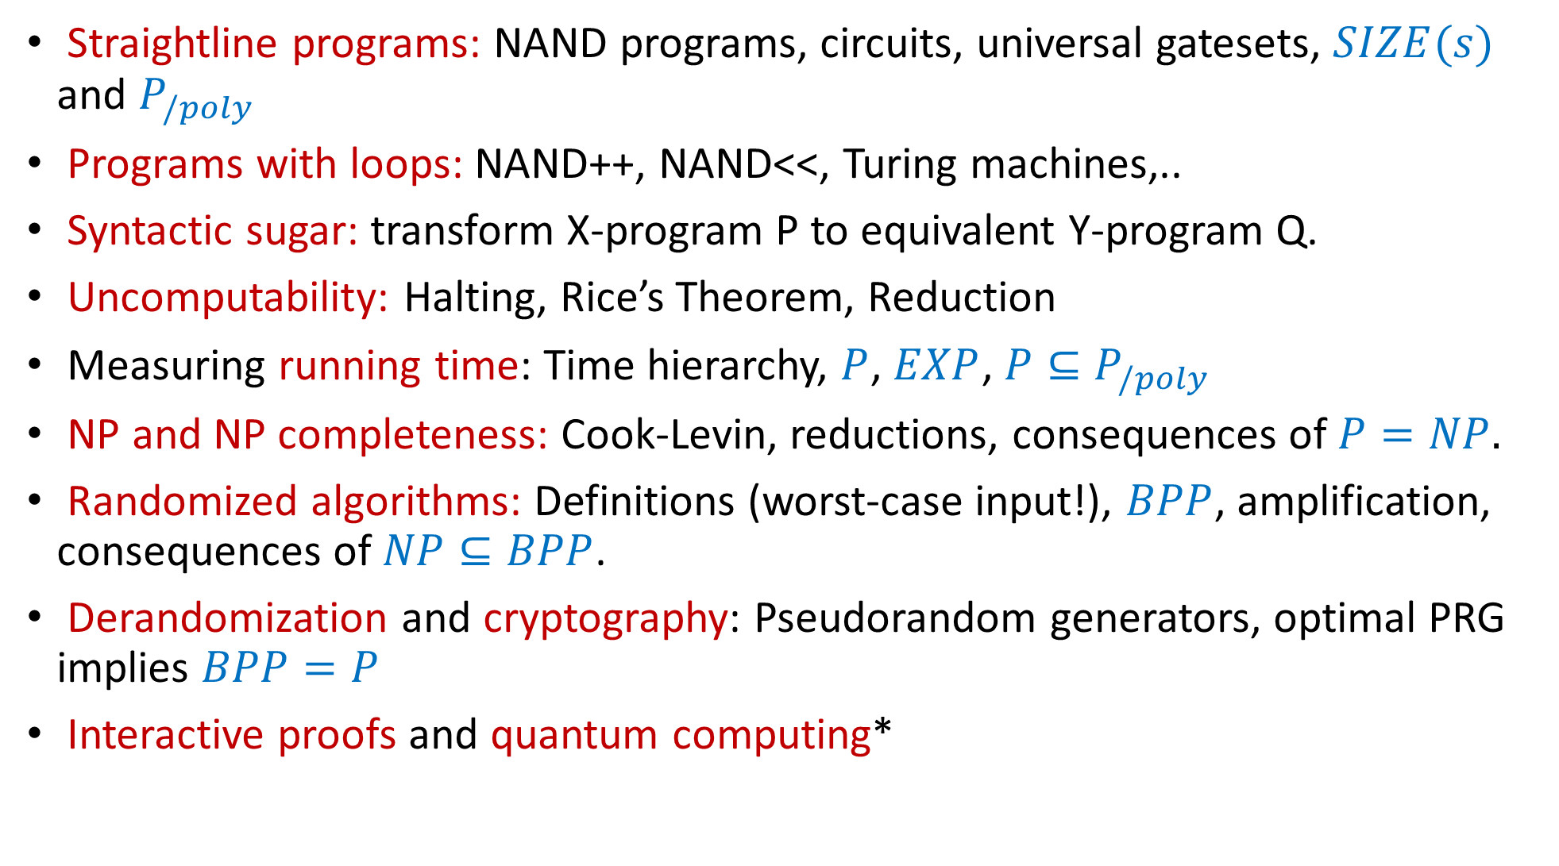
Straightline programs: NAND programs, circuits, universal gatesets, $SIZE(s)$ and $P_{/poly}$
Programs with loops: NAND++, NAND<<, Turing machines,..
Syntactic sugar: transform X-program P to equivalent Y-program Q.
Uncomputability: Halting, Rice’s Theorem, Reduction
Measuring running time: Time hierarchy, $P$, $EXP$, $P⊆P_{/poly}$
NP and NP completeness: Cook-Levin, reductions, consequences of $P=NP.$
Randomized algorithms: Definitions (worst-case input!), $BPP$, amplification, consequences of $NP⊆BPP$.
Derandomization and cryptography: Pseudorandom generators, optimal PRG implies $BPP=P$
Interactive proofs and quantum computing*

Slide 20
What we didn’t see
(and where to see it.)

Slide 21
input
output
Algorithm

Slide 22


Data
Decisions

Slide 23
input
output
Algorithm
Who supplies the input?
And what do we do with the output?
Incentives, mechanism design (CS 13x, 23x)
Privacy , Fairness (Vadhan CS20x, CS126, Dwork-Minow CSxxx)
Cryptography (CS 127/227, MIT 6.857, MIT 6.875 )
Average case complexity, learning, generalization (CS 181, 281)

Slide 24
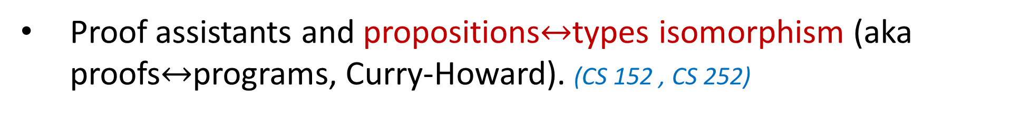
Proofs
More proofs – interactive, PCPs, ZKs, SNARKs (CS 127, CS 221)
Proof assistants and propositions$↔$types isomorphism (aka proofs$↔$programs, Curry-Howard). (CS 152 , CS 252)
Formal verification. (CS 252)
Axiomatic proof systems, more Godel. (PHIL 144)

Slide 25
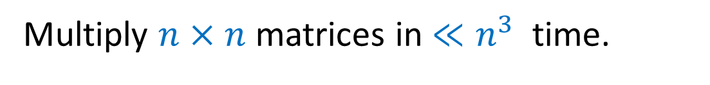
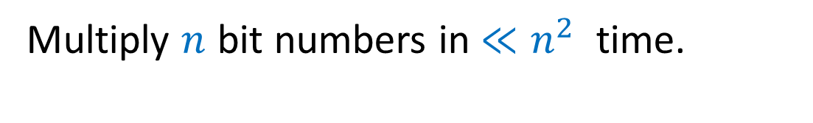
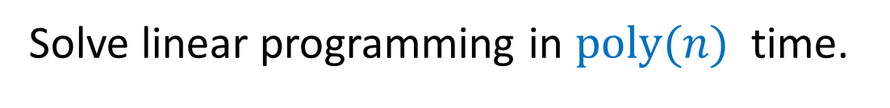
Surprising algorithms and data structures
Multiply $n$ bit numbers in $≪n^{2}$ time.
Multiply $n×n$ matrices in $≪n^{3}$ time.
Solve linear programming in $poly(n)$ time.
Answer query “$i∈S$?” in $O(1)$ time. (dictionaries, hash tables)
Answer query “$dist\left(u,v\right)<k$?” in $≪n$ time. (distance oracles, nearest neighbors)
CS 124, CS 224, CS 222, CS 223, MIT 6.854

Slide 26
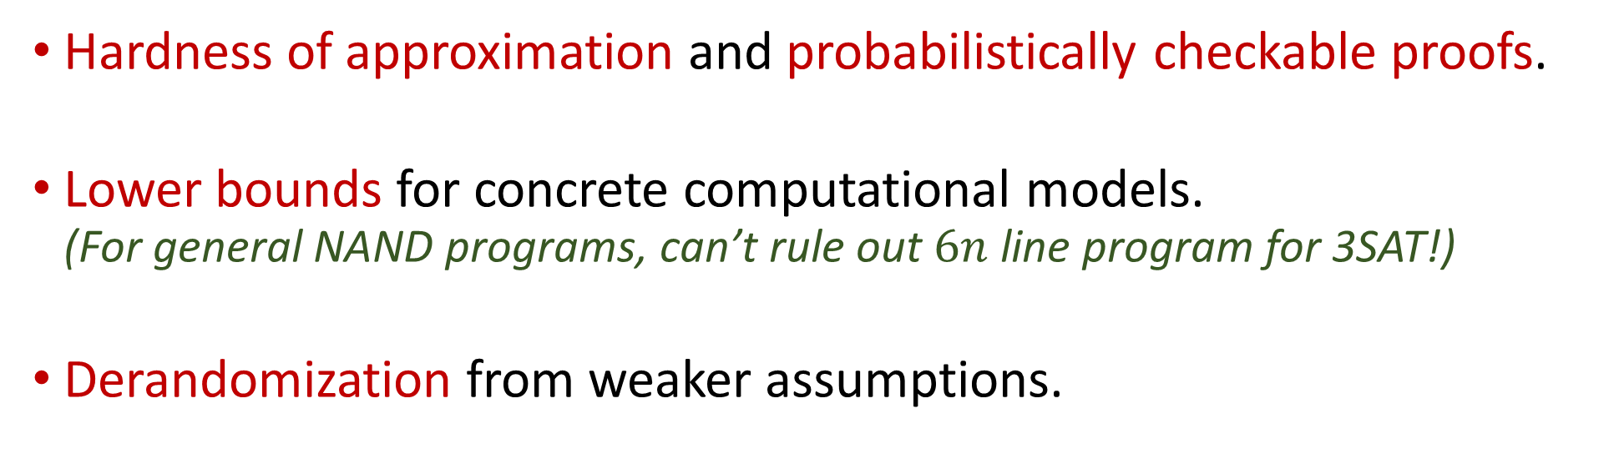
More on computational complexity
Hardness of approximation and probabilistically checkable proofs.
Lower bounds for concrete computational models. (For general NAND programs, can’t rule out $6n$ line program for 3SAT!)
Derandomization from weaker assumptions.
CS 221 , MIT 6.841

Slide 27
Information Theory / Entropy
Shannon capacity
KL div. VC dim.
Communication Complexity
Error correcting codes
Machine Learning
Data structures lower bounds
CS 229r (Sudan)
CS 18x/28x
CS 224/226

Slide 28
CS 124/224/223/222/226 CS 127/227
AM 106, 107, 121
Mathematics
CS 229cr (Luh)
(other) Computer Science
Statistics
CS 229r (Sudan)
Logic
Randomness
CS 20x (Vadhan) CS126 Dwork-Minow
Engineering
Communication Complexity
Property
testing
Theoretical Computer Science
Theoretical
Computer
Science
Learning Theory
Theoretical
Computer Science
Verification
Social
Science
Crypto
Distributed
PHIL 144
Algorithmic Game Theory
Lower
bounds
Philosophy
Quantum Computing
Biology
Economics
Physics
CS 229br (Valiant)
CS 13x, 23x
MIT 2.111, 6.443
Machine Learning
Pseudorandomness
Machine Learning
Pseudorandomness
Machine Learning
Pseudorandomness
Cryptography
Cryptography
Core TCS
Cryptography
Core TCS
Core TCS
Coding
Theory
Coding
Theory
Coding
Theory
Quantum Computing
Quantum Computing
Sublinear Algorithms
Quantum Computing
Interactive Computation
Sublinear Algorithms
Interactive Computation
Sublinear Algorithms
Interactive Computation

Slide 29
Thanks!
Brian Sapozhnikov
Albert Chalom, Alexis Ross, Charles O'Mara, Daniel Chen, David Li , Jambay Kinley, Jane Ahn, John Shen, Josh Seides, Laura Pierson, Pranay Tankala,Raymond Lin, Theresa Nguyen, Wanqian Yang, William Fu.
Hikari Sorensen (extension)
Eric Lu (Patel Fellow)
Alec Sun (121.5)
YOU!

Slide 30

Ask Me Anything

