Slide 1
Interactive & Zero-Knowledge Proofs
Thanks to Salil Vadhan

Slide 2
Announcements
Homework 10 out today – very long but optional and good final prep.
BF coding assignment

Slide 3
Prescriptive vs Descriptive Models
Natural and Social Sciences: Descriptive models – atoms, markets, cells, ..
Engineering: Prescriptive models – motors, bridges,..
Computer Science: both
Turing Machine was descriptive: model computation by a person
Evolved to prescriptive models: programming languages.
Proof models in Godel’s Theorem are descriptive: rule out “math proofs”
Evolved to prescriptive models: formally verifiable proofs.

Slide 4
Won’t see today: Curry-Howard Isomorphism
When you compile a program, compiler proves a theorem.
int x
char *s = “hello”
x = func(s)
Thm: Every time func is called with a string, the output is an int.
Richer type systems $⇒$ more sophisticated theorems.
types = statements/propositions
programs = proofs

Slide 5
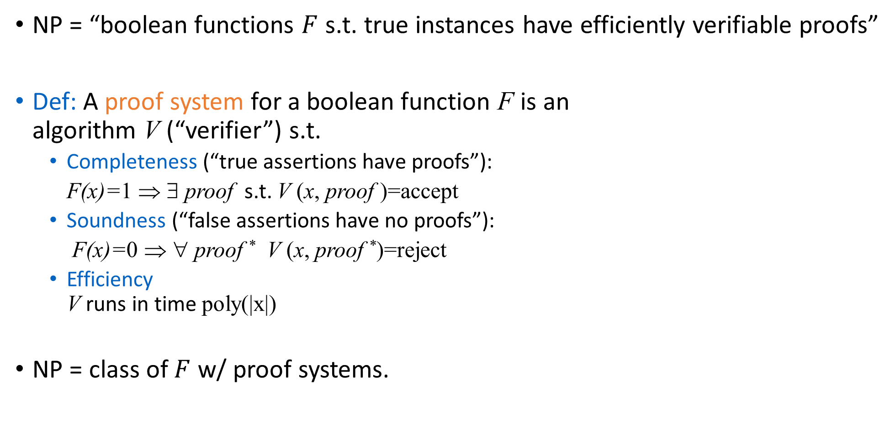
Proofs & Complexity Theory
NP = “boolean functions $F$ s.t. true instances have efficiently verifiable proofs”
Def: A proof system for a boolean function F is an algorithm V (“verifier”) s.t.
Completeness (“true assertions have proofs”):
F(x)=1 ⇒ ∃ proof s.t. V (x, proof )=accept
Soundness (“false assertions have no proofs”):
F(x)=0 ⇒ ∀ proof * V (x, proof *)=reject
Efficiency V runs in time poly(|x|)
NP = class of $F$ w/ proof systems.
Notes:
Connection with last week: last week many different verifiers...
Efficiency important to make proofs meaningful

Slide 6
Today: Two New Ingredients
Randomization: verifier can “toss coins”
Augment TM with extra tape of random bits
Allow verifier to err with small probability
Interaction: replace static proof with dynamic, all-powerful prover
Will “interact” with verifier and try to “convince” it that assertion is true.

Slide 7
What can we gain?
More general notion of “efficiently verifiable proofs”
Greater efficiency in verification
verifier may not have to “read” entire proof
Properties impossible in NP pfs (“zero knowledge”)
Cryptographic protocols.
Connection to approximability of NP-complete problems.
E.g. Approximate size of largest clique in a graph within 1%.
Notes:
Item 1: more assertions may have such proofs.
Item 2: e.g. verifier may only have to read a few bits
Item 4: say what zero-knowledge is
Item 5: crypto was motivation of GMR, hardness of approx more unsuspected.

Slide 8
Interactive Proofs
Common Input x
Random coins_{V}
Random coins_{P}
m₁
Prover
computationally unbounded
m₂
Verifier polynomial
time
m₃
m_{k}
accept
Parties are functions (x, coins, m₁,…,m_{i-1})m_{i}
m_{i} ∈∑*∪ {accept, reject, halt}
Notes:
metnion that accept, reject, halt end computation
there are other ways to formalize this (interactive TM’s), but this is more model-independent

Slide 9
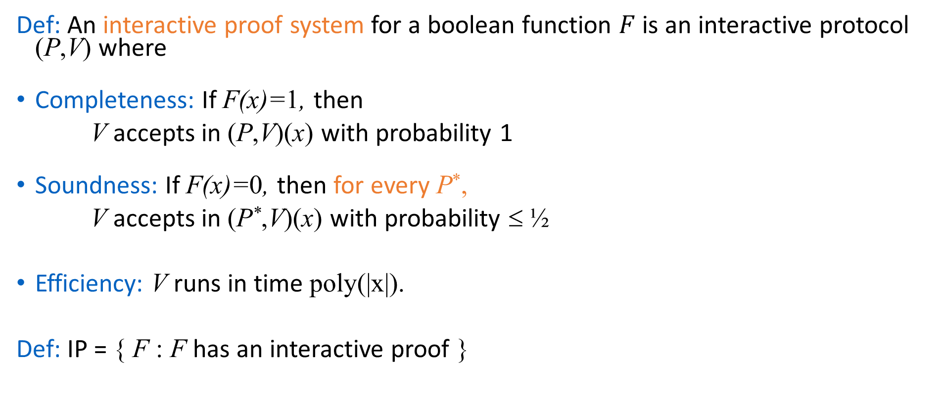
Interactive Proofs
Def: An interactive proof system for a boolean function $F$is an interactive protocol (P,V) where
Completeness: If F(x)=1, then
V accepts in (P,V)(x) with probability 1
Soundness: If F(x)=0, then for every P*,
V accepts in (P*,V)(x) with probability ≤ ½
Efficiency: V runs in time poly(|x|).
Def: IP = { F : F has an interactive proof }

Slide 10
Comments on Definition
Probabilities taken only over coin tosses, not over input.
Can reduce error probability (in soundness) to 2⁻¹⁰⁰⁰ with 1000 repetitions.
Interactive proofs generalize classical proofs: NP⊆IP.
Is IP bigger?

Slide 11
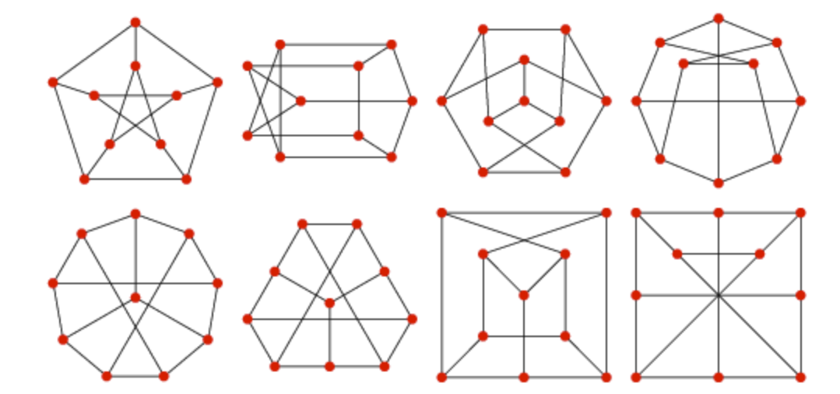
GRAPH ISOMORPHISM
When are two graphs the “same” upto relabelling?
Graph G with vertices {1,...,n} can be specified by (sorted) list of edges E={(i₁, j₁), (i₂, j₂),...,(i_{m}, j_{m})}
Def: For π : {1,...,n}→ {1,...,n} permutation (bijection), π(G) = graph on {1,...,n} w/ edge set
E′={(π(i), π(j)) : (i, j)∈E}
Def: G is isomorphic to H (written G≅H) if ∃ π s.t. π(G)= H
Notes:
explain defn of pi(G_0)
How to prove that two graphs are nonisomorphic???

Slide 12
GRAPH ISOMORPHISM Example 1
Are these graphs isomorphic? (Yes or No)
1
1
5
2
5
2
4
3
4
3

Slide 13
GRAPH ISOMORPHISM Example 1
Are these graphs isomorphic?
YES
1
1
5
2
5
2
4
3
4
3

Slide 14
GRAPH ISOMORPHISM Example 2
What about these graphs?
1
1
2
3
2
3
4
5
4
5
6
6

Slide 15
GRAPH ISOMORPHISM Example 2
What about these graphs?
NO
1
degree 4
1
2
3
2
3
4
5
4
5
6
6

Slide 16
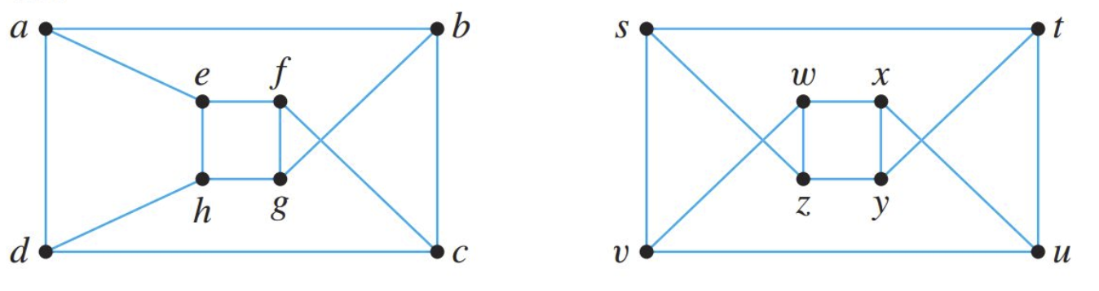

GRAPH ISOMORPHISM Example 3
And these? (Yes or No)
Has 5 cycle
Bipartite

Slide 17
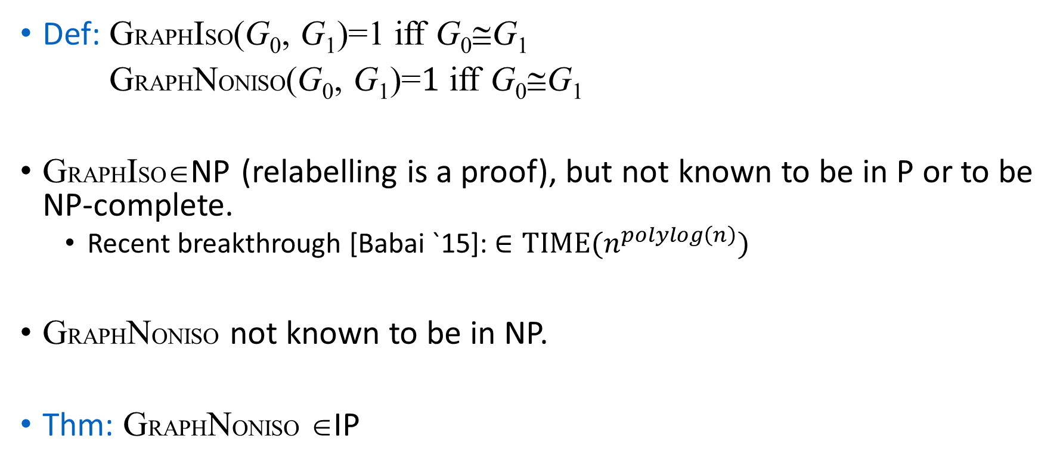
GRAPH NONISOMORPHISM
Def: GRAPHISO(G₀, G₁)=1 iff G₀≅G₁
GRAPHNONISO(G₀, G₁)=$1$ iff G₀≅G₁
GRAPHISO∈NP (relabelling is a proof), but not known to be in P or to be NP-complete.
Recent breakthrough [Babai `15]: $∈\text{TIME}(n^{polylog\left(n\right)})$
GRAPHNONISO not known to be in NP.
Thm: GRAPHNONISO ∈IP
Notes:
explain defn of pi(G_0)
How to prove that two graphs are nonisomorphic???

Slide 18
Proof System for GRAPHNONISO
Prover
Verifier
1.
2.
3.
Notes:
WLOG G_0 and G_1 have the same vertex set V (Verifier can check this, and reject otherwise).

Slide 19
Analysis of GRAPHNONISO Pf Sys.
Completeness: If G₀≅G₁, then
H is isomorphic to exactly one of G₀,G₁ (namely G_{coin}).
⇒ Prover always guesses correctly
⇒ Verifier accepts w.p.1
Soundness: If G₀≅G₁, then
Every graph H isomorphic to G₀ is also isomorphic to G₁ & vice-versa. (+ distributions under random π are same)
⇒ H gives prover no information about coin.
⇒ Prover guesses correctly w.p. ≤ 1/2 no matter what strategy it follows.
Notes:
Additional comments:
- very efficient (constant # rounds)
- seemingly essential use of private coins
- [GS] (hard exercise) : GNI has (constant-round) public-coin proof system

Slide 20
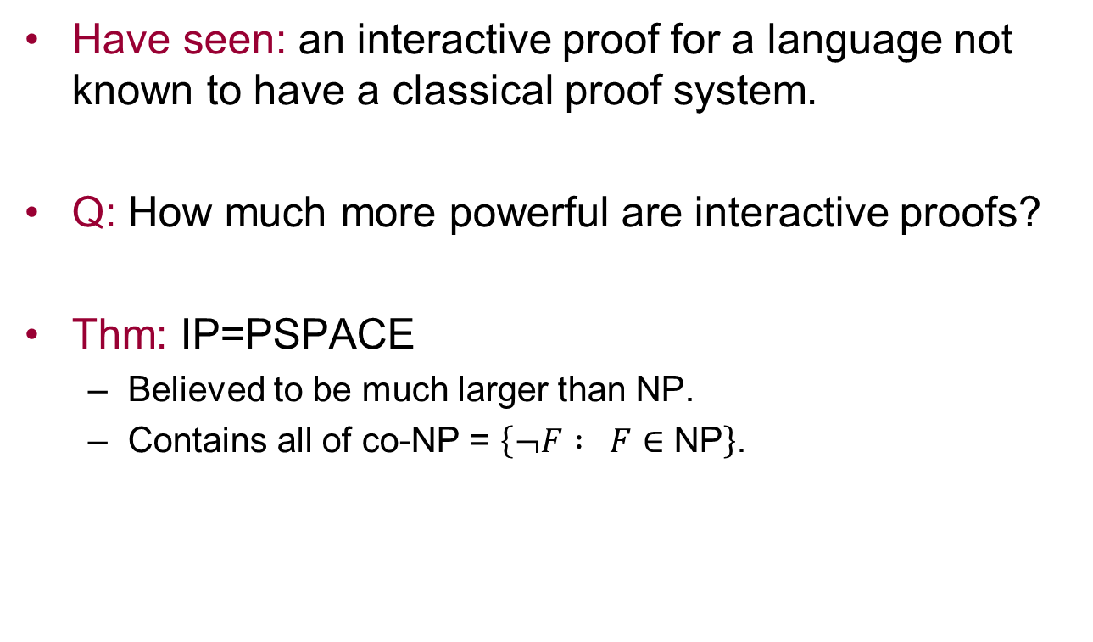
The Power of Interaction
Have seen: an interactive proof for a language not known to have a classical proof system.
Q: How much more powerful are interactive proofs?
Thm: IP=PSPACE
Believed to be much larger than NP.
Contains all of co-NP = $\left\{¬F : F∈\text{NP}\right\}$.

Slide 21
Zero Knowledge Proofs
[Goldwasser-Micali-Rackoff’82]

Slide 22
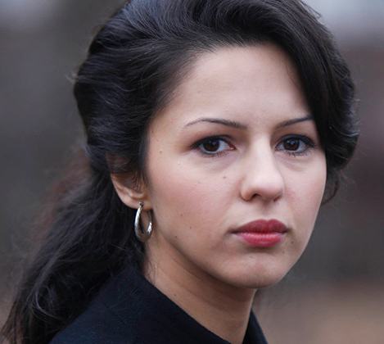
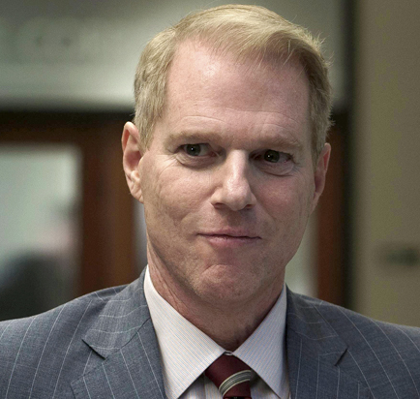
123359087852340237583427239 has a prime factor ending in 7.
Really? Show me the prime factors.
I won’t reveal anything about them, but I can still prove to you this is true

Slide 23
What does one learn from a proof?
The validity of the assertion being proven (by defn).
Anything else?
Classical (NP) proofs: Upon receiving a proof of statement x, one gains the ability to prove x to others.
Interactive proofs: Can be “zero knowledge”, i.e. reveal nothing other than the validity of the assertion being proven.
⇒ verifier does not gain ability to prove same assertion to others!

Slide 24
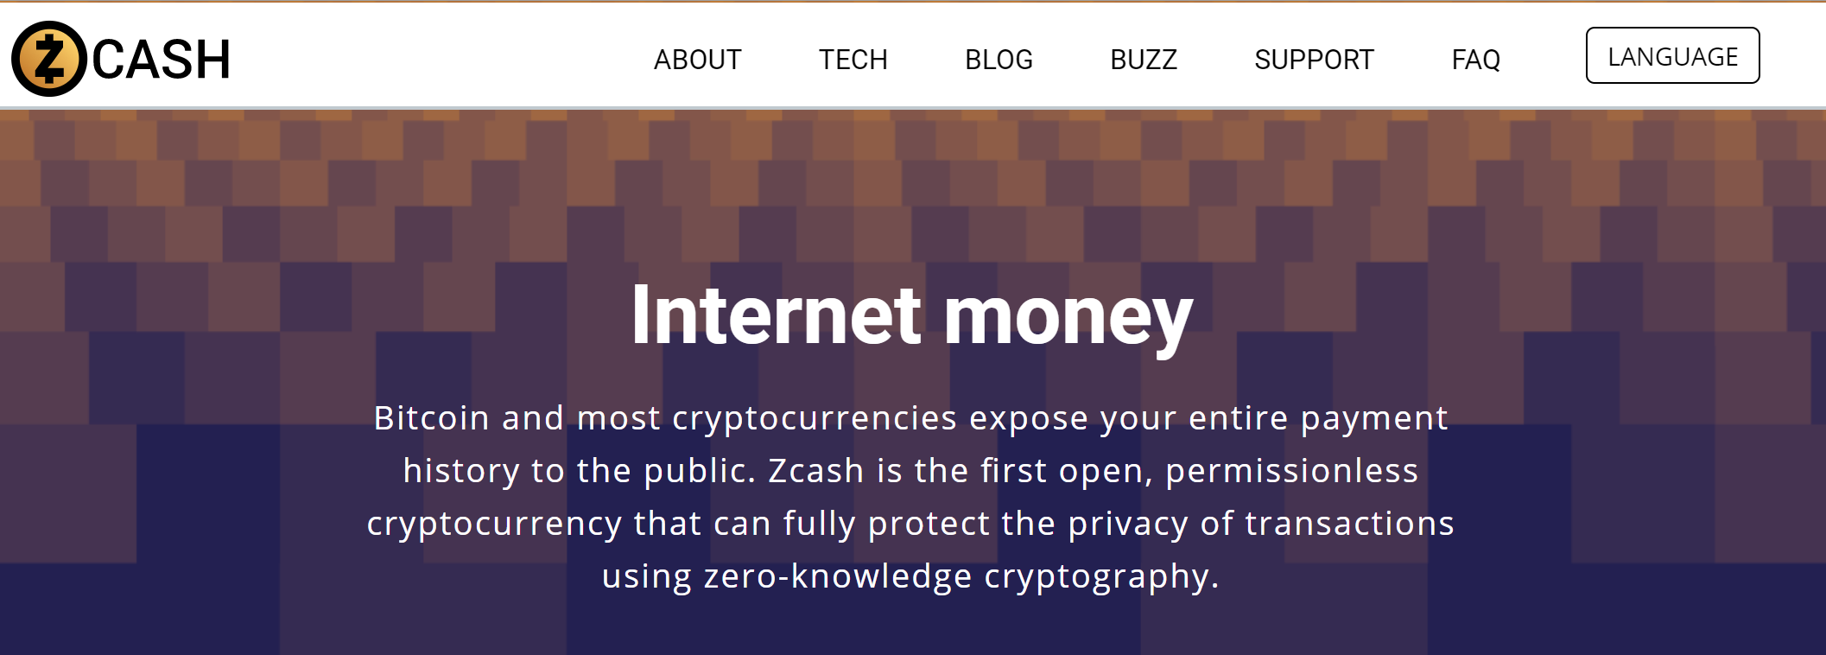
An Application
http://z.cash

Slide 25
Z-Cash Idea
The public ledger (in all cryptocurrencies):
List of valid cash notes
List of “nullifiers” specifying which notes have been spent
Maintained & immutable using distributed “blockchain” protocol
Achieving privacy
Keep commitments/encryptions to notes and nullifiers in ledger.
When Alice spends a note, she proves in zero knowledge that:
She owns such a note in the ledger
And its nullifier is not in the ledger
An NP Statement!

Slide 26
Another Application: Identification
Alice wants to securely identity herself to Bob.
Traditional “password” solutions: Bob learns Alice’s password & can later impersonate her.
public directory
Using zero-knowledge (ZK) proofs:
G
Alice publishes a graph G s.t. only she knows a 3-coloring.
ZK property ⇒ Bob (or an eavesdropper) cannot later impersonate Alice.
Alice
ZK proof that
G is 3-colorable.
Bob

Slide 27
Nuclear Disarmament
Currently: limits on deployed (strategic) nuclear weapons.
Future treaties: reduce total number
"Going forward, we’ll continue to seek discussions with Russia on a step we have never taken before -- reducing not only our strategic nuclear warheads, but also tactical weapons and warheads in reserve."
President Barack Obama, March 2012
…requires verified warhead dismantlement.
Verification is necessary (“trust but verify” , “Доверяй, но проверяй”):
Prevent cheating: e.g. keeping high quality fissile material, dismantling fake or obsolete warheads, etc..
Cheating could seriously affect balance of power between countries.
Not just political but also a technical challenge:
How do you verify a warhead offered for dismantlement is authentic, without revealing its design?

Slide 28
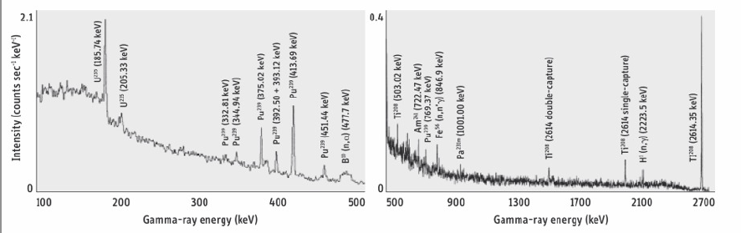
How do you verify a warhead offered for dismantlement is authentic, without revealing its design?
Gamma radiation spectrum from a Soviet warhead measured in 1989
We did not think that any design information could be obtained from this spectrum, but we were wrong. One could not infer the design from the spectrum but weapon designers could compare the spectrum with the spectra from known designs.
Frank von Hippel

Slide 29
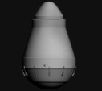
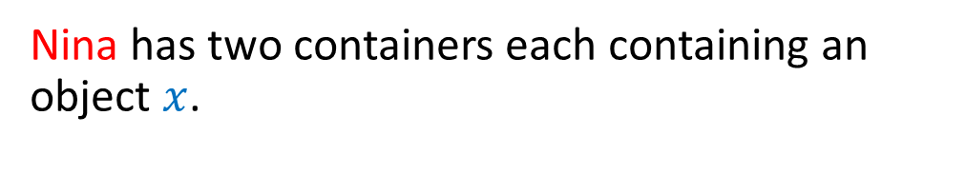
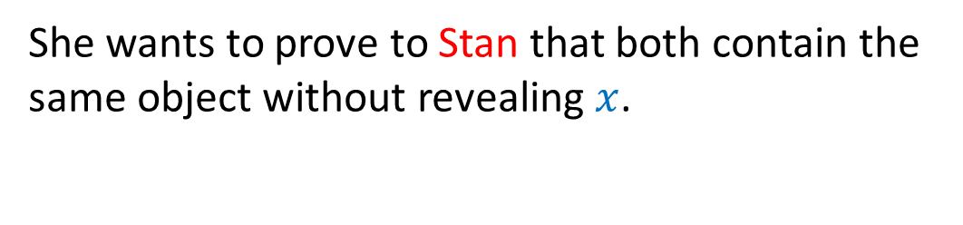
Zero Knowledge for nuclear verification [Glaser-Barak-Goldston’12]
Nina has two containers each containing an object $x$.
She wants to prove to Stan that both contain the same object without revealing $x$.

Slide 30
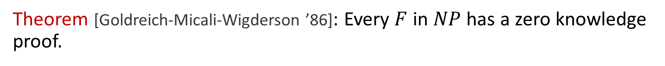
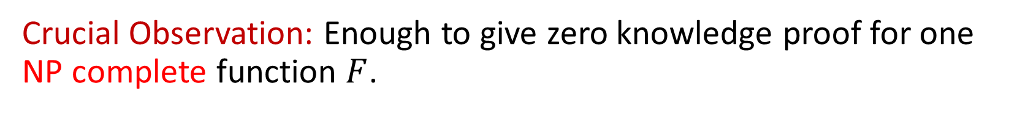
GMW Theorem
Theorem [Goldreich-Micali-Wigderson ’86]: Every $F$ in $NP$ has a zero knowledge proof.
“Everything you can prove, you can prove in zero knowledge”
Example NP statement: “The ciphertexts $c_{0},…,c_{m}$ encrypt a ledger in which I own 1 bitcoin”
Crucial Observation: Enough to give zero knowledge proof for one NP complete function $F$.

Slide 31
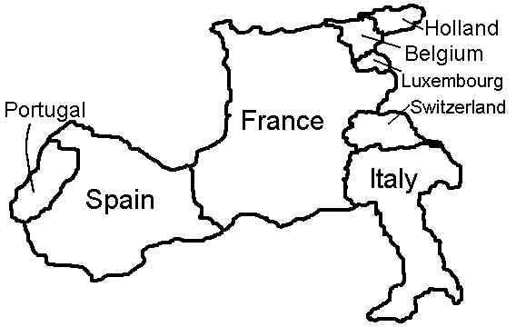
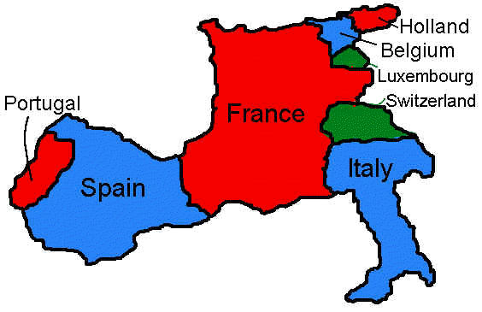
MAP 3-COLORING
Given: a map M Decide: can it be colored w/3 colors s.t. no two adjacent countries have the same color?
Formally: 3-COL(M)=1 iff M is 3-colorable.
Fact: 3-COL is NP-complete.
http://www.ctl.ua.edu/math103/

Slide 32
GRAPH 3-COLORING
Given: a graph G Decide: can it be colored w/3 colors s.t. no two adjacent vertices have the same color?
Formally: 3-COL(G)=1 iff G is 3-colorable.
Fact: 3-COL is NP-complete.

Slide 33
GRAPH 3-COLORING
Notes:
explain defn of pi(G_0)
How to prove that two graphs are nonisomorphic???

Slide 34
GRAPH 3-COLORING
a 3-colorable graph
Notes:
explain defn of pi(G_0)
How to prove that two graphs are nonisomorphic???

Slide 35
GRAPH 3-COLORING
a 3-colorable graph
a non-3-colorable graph
Notes:
explain defn of pi(G_0)
How to prove that two graphs are nonisomorphic???

Slide 36
Claim: the following graph is 3-colorable

Slide 37
3-COL Proof System
3-coloring
C of V
Prover
graph G
Verifier
1. Choose random
permutation π of
{R,G,B}. Let C′= π(C).
“commit” to coloring C′
2. Choose random
edge (x,y).
(x,y)
“reveal” C′(x), C′(y)
3. Accept if
C′(x)≠C′(y)
Notes:
WLOG G_0 and G_1 have the same vertex set V (Verifier can check this, and reject otherwise).

Slide 38
Analysis of “Physical” 3-COL Proof Sys.
Completeness:
If C is a proper 3-coloring, so is C′ .
⇒ For every edge (x,y), C′(x)≠C′(y)
⇒ Verifier accepts w.p. 1.
Soundness:
Prover committed to some C′ after step 1.
⇒ Since G is not 3-colorable, then for some edge (x,y), C′(x)=C′(y)
⇒ Verifier accepts w.p. ≤ 1-1/m, where m = # edges
(repeat m times to get error prob. to (1-1/m)^{m} < 1/2.)

Slide 39
Analysis of “Physical” 3-COL Proof Sys. (cont.)
Zero Knowledge:
All verifier sees are commitments & colors on one edge.
Commitments reveal nothing (in physical implementation).
Colors on one edge = random pair of distinct colors.
Verifier can generate random pair of distinct colors on its own, without prover.
⇒ zero knowledge!

Slide 40
“Digital” Implementation?
Need way to “commit” to coloring C′ s.t.
Binds prover to C′, i.e. cannot later change its mind about colors of any vertices.
Yet reveals nothing to verifier.
Impossible? NO
Key observation: only need it to “reveal nothing” to a polynomial-time algorithm.
Cryptography provides such commitments.

Slide 41
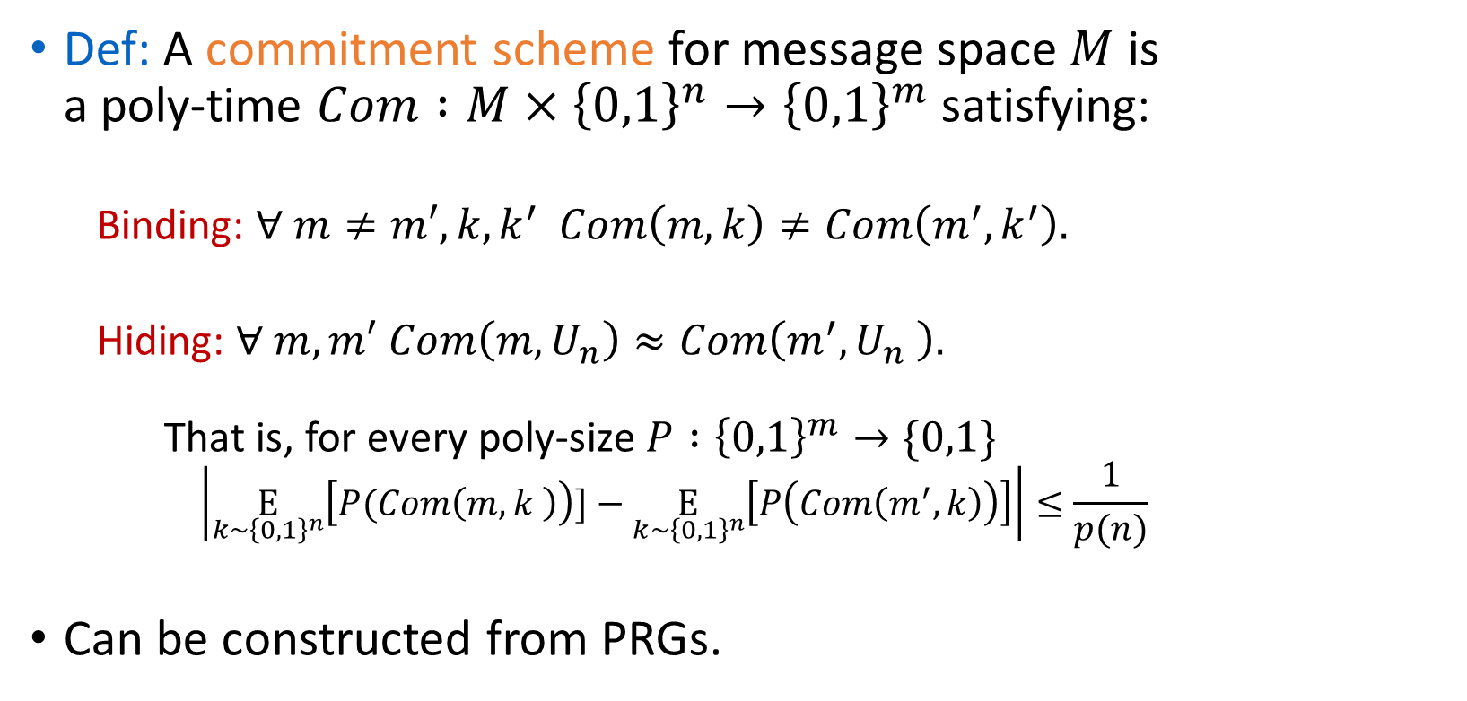
Commitment Schemes
Def: A commitment scheme for message space $M$ is a poly-time $Com :M×{\left\{0,1\right\}}^{n}→{\left\{0,1\right\}}^{m}$ satisfying:
Binding: $∀ m≠m′,k,k^{′}$ $Com\left(m,k\right)≠Com\left(m^{′},k^{′}\right).$
Hiding: $∀ m,m′$ $Com\left(m,U_{n}\right)≈Com\left(m^{′},U_{n} \right).$ That is, for every poly-size $P :{\left\{0,1\right\}}^{m}→\{0,1\}$
$$\left|\underset{k∼{\left\{0,1\right\}}^{n}}{E}\left[P(Com\left(m,k \right)\right)]−\underset{k∼{\left\{0,1\right\}}^{n}}{E}\left[P\left(Com\left(m^{′},k\right)\right)\right]\right|≤\frac{1}{p(n)}$$
Can be constructed from PRGs.

Slide 42
Zero Knowledge for all of NP
GMW Thm: If ∃ commitment scheme, then every function in NP has a zero-knowledge proof.
Proof Sketch: 3-COL is NP-complete ⇒ can reduce any NP problem to it.
Positive use of NP-completeness!
Can give a zero-knowledge proof of any mathematical theorem in time poly(|proof|)!

Slide 43
Defining Zero Knowledge
How to formalize “Verifier learns nothing”?
Simulation Paradigm (informally):
Require: anything that can computed in poly-time by interacting with prover can also be computed in poly-time without interacting with prover.
That is, for every poly-time verifier V*, there exists a poly-time simulator S s.t.
[output of S(x)] ≈ [output of V* after interacting w/ P on x].

Slide 44
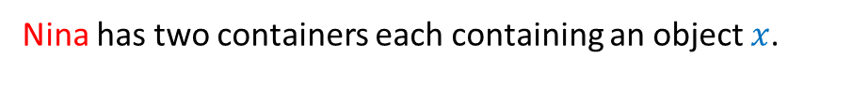
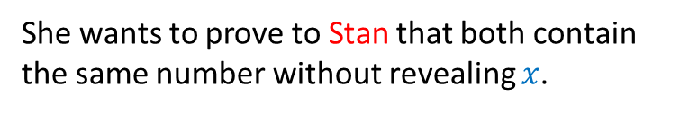
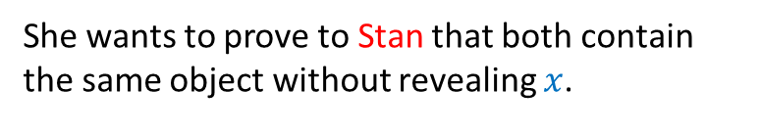
Zero Knowledge for nuclear verification
Actual setting:
Nina has two containers each containing an object $x$.
She wants to prove to Stan that both contain the same object without revealing $x$.
Cartoon/Abstraction:
Nina has two cups each containing $x∈[0,n)$ marbles.
She wants to prove to Stan that both contain the same number without revealing $x$.

Slide 45

Our Protocol - Cartoon
Nina has two cups each containing $x∈[0,n)$ marbles.
She wants to prove to Stan that both contain the same number without revealing $x$.
Nina prepares two additional cups each containing $n−x$ marbles.
Stan decides whether to flip the order of the cups or not.
They pour each original cup into the corresponding new cup.

Slide 46
Our Protocol - Cartoon
Nina has two cups each containing $x∈[0,n)$ marbles.
She wants to prove to Stan that both contain the same number without revealing $x$.
Nina prepares two additional cups each containing $n−x$ marbles.
Stan decides whether to flip the order of the cups or not.
They pour each original cup into the corresponding new cup.

Slide 47
Our Protocol - Cartoon
Nina has two cups each containing $x∈[0,n)$ marbles.
She wants to prove to Stan that both contain the same number without revealing $x$.
Nina prepares two additional cups each containing $n−x$ marbles.
Stan decides whether to flip the order of the cups or not.
They pour each original cup into the corresponding new cup.

Slide 48
Our Protocol - Cartoon
Nina has two cups each containing $x∈[0,n)$ marbles.
She wants to prove to Stan that both contain the same number without revealing $x$.
Nina prepares two additional cups each containing $n−x$ marbles.
Stan decides whether to flip the order of the cups or not.
They pour each original cup into the corresponding new cup.
Stan looks inside the new cups and verify they each contain $n$ marbles.
Zero Knowledge: Stan only learns the upper bound $n$ and not the secret $x$
Soundness: If two cups contain different number of marbles, with probability ½ so will the new cups after they are poured into them.

Slide 49
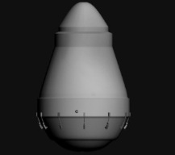
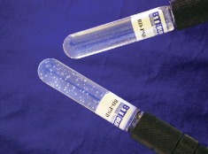
From Cartoon to Implementation
Place weapon in container at random orientation.
Shoot neutrons at weapon.
Measure number $x$neutrons emerging on other side using “bubble detector”
Number is a function of materials, design and characterizes the weapon*
Inspected party (Nina) prepares in advance pair of detectors each pre-initialized to $n−x$ bubbles**

Slide 50
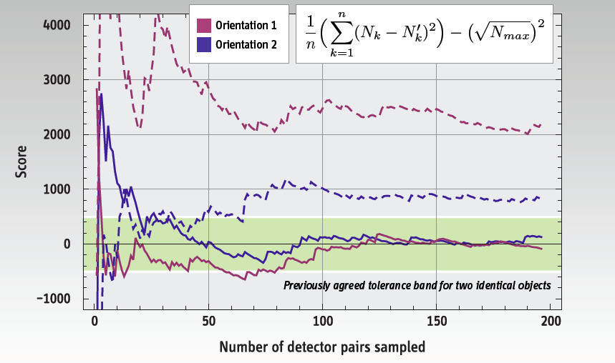
Some Simulation Results
Don’t use actual warheads…
…use “British Test Object”
Taking about 50 measurements may suffice for 99.9% accuracy.

Slide 51
For more on these topics
“Interactive and Zero-Knowledge Proofs.” Lecture Notes from Park City Math Institute Graduate Summer School 2000. http://people.seas.harvard.edu/~salil/research/pcmi-abs.html
Sipser Sec. 10.4
Oded Goldreich. Probabilistic Proof Systems: A Primer. http://www.wisdom.weizmann.ac.il/~oded/pps-primer.html
Courses: CS 127/227, 221.

Slide 53
C
H
B
D
G
O
M
K
L
E
A
J
N
I
F

Slide 54
C
H
B
D
G
O
M
K
L
E
A
J
N
I
F

Slide 55
C
H
B
D
G
O
M
K
L
E
A
J
N
I
F

Slide 56
C
H
B
D
G
O
M
K
L
E
A
J
N
I
F

Slide 57
C
H
B
D
G
O
M
K
L
E
A
J
N
I
F

Slide 58
C
H
B
D
G
O
M
K
L
E
A
J
N
I
F

