Slide 1

Balloon Shooter
Authors:
Tzabar Nasich
Boaz Descalo

Slide 2
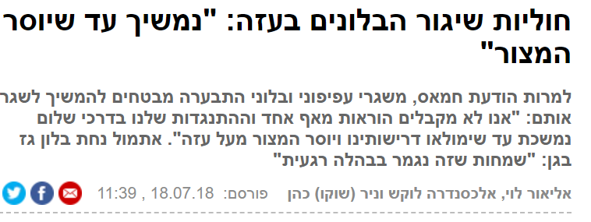
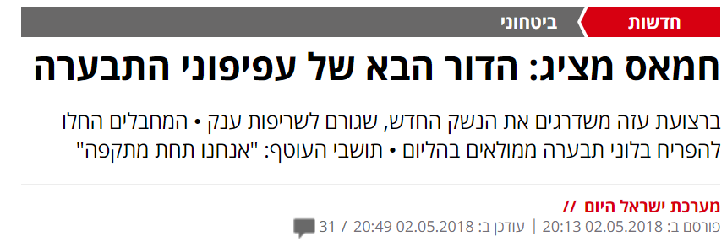

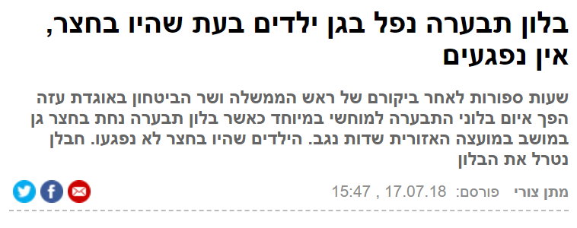
Problem description

Slide 3
Solution Description
Present a demo for a camera based Laser system which can detect and shoot a Laser energy on the Balloon
The demo is based on Intel’s RealSense camera and Intels Arduino 101 board which are controlling the servo engines that are connected to the laser pointer

