Slide 1
Natural Language Processing in 2004
Bob Carpenter
Alias-i, Inc.

Slide 2
What’s Natural Language Processing?
Depends on your point of view
Psychology: Understand human language processing
  How do we learn language?
  How do we understand language?
  How do we produce language?
  How is language tied to thought?
Engineering: Build systems to process language
  Build dialogue-based call centers
  Build information retrieval engines
  Build question-answering systems
  Design general algorithms for a range of applications

Slide 3
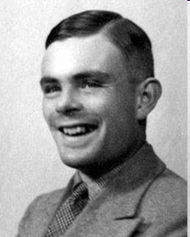
NLP is Turing Test Hard
“Computer Machinery & Intelligence.” 1950. Alan Turing.
The Big Question
    I propose to consider the question, 'Can machines think?'
The Imitation Game
    The new form of the problem can be described' in terms of a game
    which we call the 'imitation game'. It is played with three people, a
    man (A), a woman (B), and an interrogator (C) who may be of either sex.
    The interrogator stays in a room apart from the other two. The object of the
    game for the interrogator is to determine which of the other two is the man and
    which is the woman. He knows them by labels X and Y, and at the end of the
    game he says either 'X is A and Y is B' or 'X is B and Y is A'.
Turing’s Test
    We now ask the question, 'What will happen when a machine takes the part of
    A in this game?' Will the interrogator decide wrongly as often when the game is
    played like this as he does when the game is played between a man and a
    woman? These questions replace our original, 'Can machines think?'
Alan Turing

Slide 4

Brief History of NLP
1950s: Machine Translation
  Abandoned due to lack of computing resources
1960s: Despair
  Problem considered impossible philosophically (Quine)
  Problem considered impossible linguistically (Chomsky)
1970s: Dawn of Artificial Intelligence
  “Full” dialog systems (eg. SHRDLU)
  Symbolic processing in LISP
  Early theories of semantics; first big systems (eg. LUNAR)
  First information retrieval systems
W.V.O. Quine

Slide 5
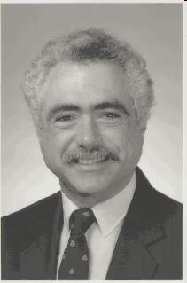
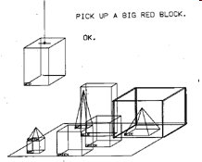
1970s Example: SHRDLU
Terry Winograd. 1971.
MIT Ph.D. Thesis.
Person: PICK UP A BIG RED BLOCK.
Computer: OK. (does it)
Person: GRASP THE PYRAMID.
Computer: I DON'T UNDERSTAND WHICH
PYRAMID YOU MEAN.
Person: FIND A BLOCK WHICH IS TALLER
THAN THE ONE YOU ARE HOLDING
AND PUT IT INTO THE BOX.
Computer: BY "IT", I ASSUME YOU MEAN THE BLOCK WHICH IS TALLER THAN THE ONE I AM HOLDING.
Computer: OK. (does it)
Person: WHAT DOES THE BOX CONTAIN?
Computer: THE BLUE PYRAMID AND THE BLUE BLOCK.
Person: WHAT IS THE PYRAMID SUPPORTED BY?
Computer: THE BOX.
Person: HOW MANY BLOCKS ARE NOT
IN THE BOX?
Computer: FOUR OF THEM.
Person: IS AT LEAST ONE OF THEM
NARROWER THAN THE ONE WHICH
I TOLD YOU TO PICK UP?
Computer: YES, THE RED CUBE.
Terry Winograd
This is one of the only dialogs it knows.
SHRDLU is too stupid
to make mistakes.
Beautiful “Demo-ware”

Slide 6
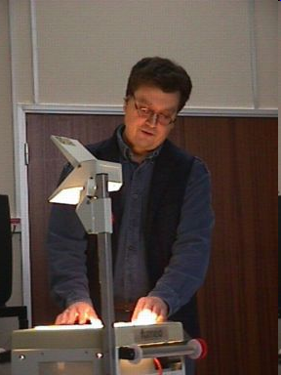
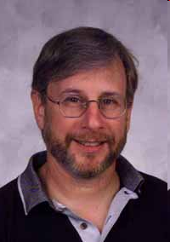
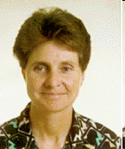
History of NLP (2)
1980s: Rationalism
  Focus on syntactic and semantic grammars and discourse
  Logical frameworks for grammar (LFG, GPSG) and for knowledge (KL-ONE, CYC, etc.)
  Everything hand-built
  Couldn’t scale; wasn’t robust
Ron Brachman (KL-ONE)
Joan Bresnan (LFG)
Gerald Gazdar (GPSG)

Slide 7
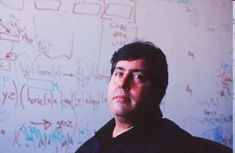
1980s Example: CYC
CYC’s way of saying “every animal has a mother”
      (forAll ?A
      (implies
      (isa ?A Animal)
      (thereExists ?M
      (and
      (mother ?A ?M)
      (isa ?M FemaleAnimal)))))
Couldn’t make all the world’s knowledge consistent
Maintenance is a huge nightmare
But it still exists and is getting popular again due to the “Semantic Web” in general and WordNet in NLP
Check out the latest at opencyc.org
Doug Lenat

Slide 8
History of NLP (3)
1990s and 2000s: Empiricism
  Focus on simpler problems like part-of-speech tagging and simplified parsing (e.g. Penn TreeBank)
  Focus on full coverage (earlier known as “robustness”)
  Focus on Empirical Evaluation
  Still symbolic!
  Examples in the rest of the talk
The Future?
  Applications?
  Still waiting for our Galileo (not even Newton, much less Einstein)

Slide 9
Current Paradigm
1. Express a “problem”
  Computer science sense of well-defined task
  Analyses must be reproducible in order to test systems
  This is the first linguistic consideration
  Examples:
    Assign parts of speech from a given set (noun, verb, adjective, etc.) to each word in a given text.
    Find all names of people in a specified text.
    Translate a given paragraph of text from Arabic to English
    Summarize 100 documents drawn from a dozen newspapers
    Segment a broadcast news show into topics
    Find spelling errors in email messages
    Predict most likely pronunciation for a sequence of characters

Slide 10
Current Paradigm (2)
Generate Gold Standard
  Human annotated training & test data
    Most precious commodity in the field
  Tested for inter-annotator agreement
    Do two annotators provide the same annotation?
    Typically measured with kappa statistic
      (P-E)/(1-E)
      P: Proportion of cases for which annotators agree
      E: Expected proportion of agreements
        [assuming random selection according to distribution]
  Difficult for non-deterministic generation tasks
    Eg. Summarization, translation, dialog, speech synthesis
    System output typically ranked on an absolute or relative scale
    Agreement requires ranking comparison statistics and correlations
  Free in other cases, such as language modeling, where test data is just text.

Slide 11
Current Paradigm (3)
3. Build a System
  Divide Training Data into Training and Tuning sets
  Build a system and train it on training data
  Tune it on tuning data
4. Evaluate the System
  Test on fresh test data
  Optional: Go to a conference to discuss approaches and results

Slide 12

Example Heuristic System: EngCG
EngCG is the most accurate English part-of-speech tagger: 99+% accurate
Try it online: http://www.lingsoft.fi/cgi-bin/engcg
Lexicon plus 4000 or so rules with a 700,000 word hand-annotated development corpus
Several person-years of skilled labor to compile the rule set
Example output:
    The_DET
    free_A
    cat_N
    prowls_Vpres
    in_PREP
    the_DET
    woods_Npl
    .
Atro Voutilainen

Slide 13
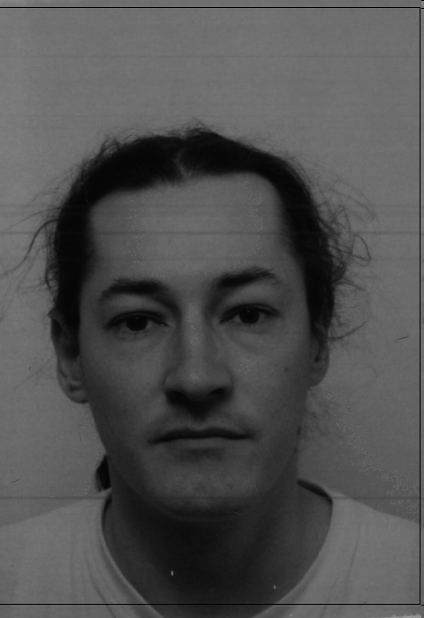
Example Heuristic System: EngCG (2)
Consider example input “to Miss Sloan”
Lexically, from the dictionary, the system starts with:
      "<to>"
      "to" PREP
      "to" INFMARK
      "<*miss>"
      "miss" <*> <SVO> <SV> V INF
      "miss" <*> <Title> N NOM SG
      "<*sloan>"
      "sloan" <*> <Proper> N NOM SG
Grammatically, “Miss” could be an infinitive or a noun here (and “to” an infinitive marker or a preposition, respectively). However:
    “miss” is written in the upper case, which is untypical for verbs
    the word is followed by a proper noun, an extremely typical context for the titular noun “miss”
Timo Järvinen

Slide 14
Example Heuristic System (EngCG 3)
Lexical Context: “to[PREP,INFMARK] Miss[V,N] Sloan[N]”
Rules work by narrowing or transforming non-determinism
The following rule can be proposed:
      SELECT ("miss" <*> N NOM SG)
      (1C (<*> NOM))
      (NOT 1 PRON) ;
This rule selects the nominative singular reading of the noun “miss” written in the upper case (<*>) if the following word in a non-pronoun nominative written in the upper case (i.e. also abbreviations are accepted).
A run against the test corpus shows that the rule makes 80 correct predictions and no mispredictions.
This suggests that the collocational hypothesis was a good one, and the rule should be included in the grammar.
http://www.ling.helsinki.fi/~avoutila/cg/doc/

Slide 15
“Machine Learning” Approaches
“Learning” is typically of parameters in a statistical model.
Often not probabilistic
  E.g. Vector-based information retrieval; support-vector machines
Statistical analysis is rare
  E.g. Hypothesis testing, posterior parameter distribution analysis, etc.
Usually lots of data and not much known problem structure (weak priors in Bayesian sense)
Types of Machine Learning Systems
  Classification: Assign input to category
  Transduction: Assign categories to sequence of inputs
  Structure Assignment: Determine relations

Slide 16
Simple Information Retrieval
Problem: Given a query and set of documents, classify each document as relevant or irrelevant to the query.
  Query and document are both sequences of characters
  May have some structure, which can also be used
Effectiveness Measures (against gold standard)
  Precision
    # correctly classfied as relevant / # classified as relevant
    = True Positives / (True Positives + False Positives)
  Recall
    # correctly classified as relevant / # actually relevant
    = True Positives / (True Positives + False Negatives)
  F-measure
    (Precision + Recall) / 2*Precision*Recall

Slide 17
TREC 2004 Ad Hoc Genomics Track
Documents = Medline Abstracts
    PMID- 15225994
    DP - 2004 Jun
    TI - Factors influencing resistance of UV-irradiated DNA to the restriction
    endonuclease cleavage.
    AD - Institute of Biophysics, Academy of Sciences of the Czech Republic,
    Kralovopolska 135, CZ-612 65 Brno, Czech Republic.
    LA - eng
    PL - England
    SO - Int J Biol Macromol 2004 Jun;34(3):213-22.
    FAU - Kejnovsky, Eduard
    FAU - Kypr, Jaroslav
    AB - DNA molecules of pUC19, pBR322 and PhiX174 were irradiated by various
    doses of UV light and the irradiated molecules were cleaved by about two
    dozen type II restrictases. The irradiation generally blocked the cleavage
    in a dose-dependent way. In accordance with previous studies, the (A +
    T)-richness and the (PyPy) dimer content of the restriction site belongs
    among the factors that on average, cause an increase in the resistance of
    UV damaged DNA to the restrictase cleavage. However, we observed strong
    effects of UV irradiation even with (G + C)-rich and (PyPy)-poor sites. In
    addition, sequences flanking the restriction site influenced the
    protection in some cases (e.g. HindIII), but not in others (e.g. SalI),
    whereas neoschizomer couples SmaI and AvaI, or SacI and Ecl136II, cleaved
    the UV-irradiated DNA similarly. Hence the intrastrand thymine dimers
    located in the recognition site are not the only photoproduct blocking the
    restrictases. UV irradiation of the …

Slide 18
TREC (cont.)
Queries = Ad Hoc “Topics”
    <TOPIC>
    <ID>51</ID>
    <TITLE>pBR322 used as a gene vector</TITLE>
    <NEED>Find information about base sequences and restriction maps in plasmids that are used as gene vectors.</NEED>
    <CONTEXT>The researcher would like to manipulate the plasmid by removing a particular gene and needs the original base sequence or restriction map information of the plasmid.</CONTEXT>
    </TOPIC>
Task: Given 4.5 million documents (9 GB raw text) and 50 query topics, return 1000 ranked results per query
(I used Apache’s Jakarta Lucene for the indexing (it’s free), and it took about 5 hours; returning 50,000 results took about 12 minutes, all on my home PC. Scores are out in August or September before this year’s TREC conference.)

Slide 19
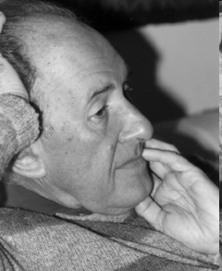
Vector-Based Information Retrieval
“Standard” Solution (Salton’s SMART; Jakarta Lucene)
  Tokenize documents by dividing characters into “words”
    Simple way to do this is at spaces or on punctuation characters
  Represent a query or document as a word vector
    Dimensions are words; values are frequencies
    E.g. “John showed the plumber the sink.”
      John:1 showed:1 the:2 plumber:1 sink:1
  Compare query word vectory Q with document word vector D
    Angle between document and query
    Roughly speaking, a normalized proportion of shared words
    Cosine(Q,D)
    = SUM_{word} Q(word) * D(word) / length(Q) / length(D)
    Q(word) is word count in query Q; D(word) is count in document D
    length(V) = SQRT( SUM_{word} V(word) * V(word) )
  Return ordered results based on score
  Documents above some threshold are classified as relevant
  Fiddling weights is a cottage industry
Gerard Salton

Slide 20
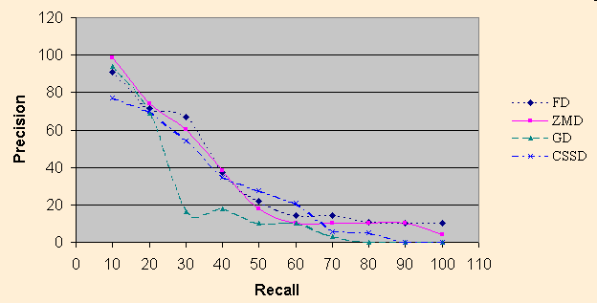
Trading Precision for Recall
Higher Threshold = Lower Recall & Higher Precision
Plot of values is called a “Received Operating Curve”

Slide 21
Other Applications of Vector Model
Spam Filtering
  Documents: collection of spam; collection of non-spam
  Query: new email
  (I don’t know if anyone’s doing this this way; more on spam later)
Call Routing
  Problem: Send customer to right department based on query
  Documents: transcriptions of conversations for a call center location
  Queries: Speech rec of customer utterances
  See my and Jennifer Chu-Carroll’s Computational Linguistics article
  One of few NLP dialog systems actually deployed
  Also used for automatic answering of customer support questions (e.g. AOL Germany was using this approach)

Slide 22
Applications of Vector Model (cont.)
Word “Similarity”
  Problem: Car~driver, beans~toast, duck~fly, etc.
  Documents: Words found near a given word
  Queries: Word
  See latent-semantic indexing approach (Susan Dumais, et al.)
Coreference
  45 different “John Smith”s in 2 years of Wall St. Journal
  E.g. Chairman of General Motors; boyfriend of Pocohantas
  Documents: Words found near a given mention of “John Smith”
  Queries: Words found near new entity
  Word sense disambiguation problem very similar
  See Baldwin and Bagga’s paper

Slide 23
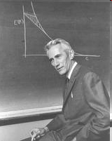
The Noisy Channel Model
Shannon. 1948. A mathematical theory of communication. Bell System Technical Journal.
Seminal work in information theory
  Entropy: H(p) = SUM_{x} p(x) * log₂ p(x)
  Cross Entropy: H(p,q) = SUM_{x} p(x) * log₂ q(x)
  Cross-entropy of model vs. reality determines compression
  Best general compressors (PPM) are character-based language models; fastest are string models (Zip class), but 20% bigger on human language texts
Originally intended to model transmission of digital signals on phone lines and measure channel capacity.
Claude Shannon

Slide 24
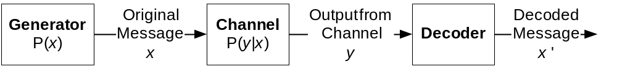
Noisy Channel Model (cont.)
E.g. x, x’ are sequence of words; y is seq of typed characters, possibly with typos, misspellings, etc.
Generator generates a message x according to P(x)
Message passes through a “noisy channel” according to P(y|x): probability of output signal given input message
Decoder reconstructs original message via Bayesian Inversion:
  ARGMAX_{x’} P(x’|y) [Decoding Problem]
  = ARGMAX_{x’} P(x’,y) / P(y) [Definition of Conditional Probability]
  = ARGMAX_{x’} P(x’,y) [Denominator is Constant]
  = ARGMAX_{x’} P(x’) * P(y|x’) [Definition of Joint Probability]

Slide 25
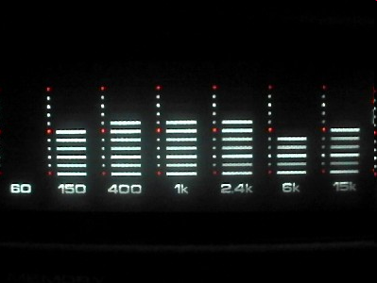
Speech Recognition
Almost all systems follow the Noisy Channel Model
Message: Sequence of Words
Signal: Sequence of Acoustic Spectra
  10ms Spectral Samples over 13 bins
  Like a stereo sound level meters measured 100 times/second
  Some Normalization
Decoding Problem:
  ARGMAX_{x’} P(words|sounds)
  = ARGMAX_{x’} P(words,sounds) / P(sounds)
  = ARGMAX_{x’} P(words,sounds)
  = ARGMAX_{x’} P(words) * P(sounds|words)
Language Model: P(words) = P(w₁,…,w_{N})
Acoustic Model: P(sounds|words) = P(s₁,…,s_{M}|w₁,…,w_{N})
Stereo Level Meter

Slide 26
Spelling Correction
Application of Noisy Channel Model
Problem: Find most likely word given spelling
  ARGMAX_{Word} P(Word|Spelling)
  = ARGMAX_{Word} P(Spelling|Word) * P(Word)
Example:
  “the” = ARGMAX_{Word} P(Word| “hte”)
  because P(“the”) * P(“hte”| “the”) > P(“hte”) * P(“hte”| “hte”)
Best model of P(Spelling|Word) is a mixture of:
  Typing “mistake” model
    Based on common typing mistakes (keys near each other)
    substitution, deletion, insertion, transposition
  Spelling “mistake” model
    English ‘f’ likely for ‘ph’, ‘i’ for ‘e’, etc.

Slide 27

Transliteration & Gene Homology
Transliteration like spelling with two different languages
Best models are paired transducers:
  P(pronuncation | spelling in language 1)
  P(spelling in language 2 | pronunciation)
  Languages may not even share character sets
  Pronunciations tend to be in IPA: International Phonetic Alphabet
  Sounds only in one language may need to be mapped to find spellings or pronunciations
  Applied to Arabic, Japanese, Chinese, etc.
  See Kevin Knight’s papers
Can also be used to find abbreviations
Very similar to gene similarity and alignment
  Spelling Model replaced by mutation model
  Works over protein sequences
Kevin Knight

Slide 28
Chinese Tokens & Arabic Vowels
Chinese is written without spaces between tokens
  “Noise” in coding is removal of spaces:
    Characters + Dividers → Characters
  Decoder finds most likely original dividers:
    Characters→ Characters + Dividers
    ARGMAX_{Vowels} P(Characters | Characters+Dividers)
    * P(Characters+Dividers)
    = ARGMAX_{Vowels} P(Characters+Dividers)
Arabic is written without vowels
  “Noise”/Coding is removal of vowels
    Consonants + Vowels ➔ Consonants
  Decode most likely original sequence:
    Consonants → Consonants + Vowels
    ARGMAX_{Vowels} P(Consonants|Consonants+Vowels)
    * P(Consonants+Vowels)
    = ARGMAX_{Vowels} P(Consonants+Vowels)

Slide 29
N-gram Language Models
P(word₁,…,word_{N})
= P(word₁) [Chain Rule]
* P(word₂ | word₁)
* P(word₃ | word₂, word₁)
* …
* P(word_{N} | word_{N-1}, word_{N-2}, …, word₁)
N-gram approximation = N-1 words of context:
P(word_{K} | word_{K-1}, word_{K-2}, …, word₁)
~ P(word_{K} | word_{K-1}, word_{K-2}, …, word_{K-N+1})
E.g. trigrams: P(word_{K} | word_{K-1}, word_{K-2}, …, word₁)
~ P(word_{K} | word_{K-1}, word_{K-2})
For commercial speech recognizers, usually bigrams (2-grams).
For research recognizers, the sky’s the limit (> 10 grams)

Slide 30
Smoothing Models
Maximum Likelihood Model
  P_{ML}(word | word-1, word-2)
  = Count(word-2, word-1, word) / Count(word-2, word-1)
  Count(words) = # of times sequence appeared in training data
Problem: If Count(words) is 0, then estimate for word is 0, and estimate for whole sequence is 0.
  If Count(words) = 0 in denominator, choose shorter context
But real likelihood is greater than 0, even if not seen in training data.
Solution: Smoothe maximum likelihood model

Slide 31
Linear Interpolation
“Backoff” via Linear Interpolation:
P’(w | w₁,…,w_{K})
= lambda(w₁,…,w_{K}) * P_{ML}(w | w₁,…,w_{K})
+ (1-lambda(w₁,…,w_{K})) * P’(w | w₁,…,w_{K-1})
P’(w) = lambda() * P_{ML}(w) + (1-lambda() * U)
U = uniform estimate = 1/possible # outcomes
Witten-Bell Linear Interpolation
lambda(words)
= count(words)
/ ( count(words) + K * numOutcomes(words) )
K is a constant that is typically tuned (usually ~ 4.0)

Slide 32
Character Unigram Language Model
May be familiar from Huffman coding
Assume 256 Latin1 characters; uniform U = 1/256
“abracadabra” counts a:5 b:2 c:1 d:1 r:2
P’(a) = lambda() * P_{ML}(a)
+ (1-lambda() * U)
= (11/31 * 5/11) + (1-11/31)*1/256 ~ 1/6 + 1/750
P_{ML}(a) = count(a) / count() = 5/11
lambda() = count() / (count() + 4 * outcomes())
= 11 / (11 + 4*5) = 11/31
P’(z) = (1-lambda()) * U = 11/31 * 1/256 ~ 1/750

Slide 33
Compression with Language Models
Shannon connected coding and compression
Arithmetic Coders code a symbol using
log₂ P(symbol|previous symbols) bits
[details are too complex for this talk; basis for JPG]
Arithmetic Coding codes below the bit level
A stream can be compressed by dynamically predicting likelihood of next symbol given previous symbols
Built language model based on previous symbols
Using a character-based n-gram language model for English using Witten-Bell smoothing, the result is about 2.0 bits/character.
Best compression is using unbounded length contexts.
See my open-source Java implementation: www.colloquial.com/ArithmeticCoding/
Best model for English text is around 1.75 bits/character; it involves a word model and punctuation model and has only been tested on a limited corpus (Brown corpus) [Brown et al. (IBM) Comp Ling paper]

Slide 34
Classification by Language Model
The usual Bayesian inversion:
  ARGMAX_{Category} P(Category | Words)
  = ARGMAX_{Category} P(Words|Category) * P(Category)
Prior Category Distribution
  P(Category)
Language Model per Category
  P(Words|Category) = P_{Category}(Words)
Spam Filtering
  P(SPAM) is proportion of input that’s spam
  P_{SPAM}(Words) is spam language model (E.g. P(Viagra) high)
  P_{NONSPAM}(Words) is good email model (E.g. P(HMM) high)
Author/Genre/Topic Identification
Language Identification

Slide 35
Hybrid Language Model Applications
Very often used for rescoring with generation
Generation
  Step 1: Select topics to include with clauses, etc.
  Step 2: Search with language model for best presentation
Machine Translation
  Step 1: Symbolic translation system generates several alternatives
  Step 2: One with highest langauge model score is selected
  See Kevin Knight’s papers

Slide 36
Information Retrieval via Language Models
Each document generates a language model P_{Doc}
  Smoothing is critical and can be against background corpus
Given a query Q consisting of words w₁,…,w_{N}
Calculate ARGMAX_{Doc} P_{Doc}(Q)
Beats simple vector model because it handles dependencies; not just simple bag of words
Often vector model is used to restrict collection to a subset before rescoring with language models
Provides way to incorporate prior probability of documents in a sensible way
Does not directly model relevance
See Zhai and Lafferty’s paper (Carnegie Mellon)

Slide 37
HMM Tagging Models
A tagging model attempts to classify each input token
A very simple model is based on a Hidden Markov Model
  Tags are the “hidden structure” here
Reduce Conditional to Joint and invert as before:
  ARGMAX_{Tags} P(Tags|Words)
  = ARGMAX P(Tags) * P(Words|Tags)
Use bigram model for Tags [Markov assumption]
Use smoothed one-word-at-a-time word approximation:
  P(w₁,…,w_{N} | t₁, …, t_{N}) ~ PRODUCT_{1<=k<=N} P(w_{k} | t_{k})
  P(w|t) = lambda(t) * P_{ML}(w) + (1-lambda(t)) UniformEstimate
Measured by Precision and Recall and F score
  Evaluations often include partial credit (reader beware)

Slide 38
Penn TreeBank Part-of-Speech Tags
Example sentence with tags:
    Battle-tested/JJ Japanese/JJ industrial/JJ managers/NNS
    here/RB always/RB buck/VBP up/RP nervous/JJ newcomers/NNS
    with/IN the/DT tale/NN of/IN the/DT first/JJ of/IN
    their/PP$ countrymen/NNS to/TO
    visit/VB Mexico/NNP ,/, a/DT boatload/NN
    of/IN samurai/FW warriors/NNS blown/VBN
    ashore/RB 375/CD years/NNS ago/RB ./.
    Tokenization of “battle-tested” is tricky here
Description of Tags
  JJ: adjective, RB: adverb, NNS: plural noun, DT: determiner, VBP: verb, IN: preposition, PP$: possessive, NNP: proper noun, VBN: participail verb, CD: numberal
Annotators disagree on 3% of the cases
  Arguably this is because the tagset is ambiguous – bad linguistics, not impossible problem
Best Treebank Systems are 97% accurate (about as good as humans)

Slide 39
Pronunciation & Spelling Models
Phonemes: sounds of a language (42 or so in English)
Graphemes: letters of a language (26 in English)
Many-to-many relation
  e→ [] [Silent ‘e’]
  e → IY [Long ‘e’]
  t+h → TH [TH is one phoneme] o+u+g+h → OO [“through”]
  x → K+S
Languages vary wildly in pronunciation entropy (ambiguity)
  English is highly irregular; Spanish is much more regular
Pronunciation model
  P(Phonemes|Graphemes)
  Each grapheme (letter) is transduced as 0, 1, or 2 phonemes
  “ough”→ OO via o→[OO], u→ [], g→[], h→[]
  Can also map multiple symbols
Spelling Model just reverses pronunciation model
See Alan Black and Kevin Lenzo’s papers

Slide 40
Named Entity Extraction
CoNLL = Conference on Natural Language Learning
Tagging names of people, locations and organizations
  Wolff B-PER
  , O
  currently O
  a O
  journalist O
  in O
  Argentina B-LOC
  , O
  played O
  with O
  Del B-PER
  Bosque I-PER
  in O
O is out of name, B-PER is begin person name, I-PER continues person name, etc.
“Wolff” is person, “Argentina” location and “Del Bosque” a person

Slide 41
Entity Detection Accuracy
Message Understanding Conference (MUC) Partial Credit
  ½ score for wrong boundaries, right tag
  ½ score for right bounaries, wrong tag
English Newswire: People, Location, Organization
  97% precision/recall with partial credit
  90% with exact scoring
English Biomedical Literature: Gene
  85% with partial credit; 70% without
English Biomedical Literature: Precise Genomics
  GENIA corpus (U. Tokyo): 42 categories including proteins, DNA, RNA (families, groups, substructures), chemicals, cells, organisms, etc.
  80% with partial credit
  60% with exact scoring
See our LingPipe open-source software: www.aliasi.com/lingpipe

Slide 42
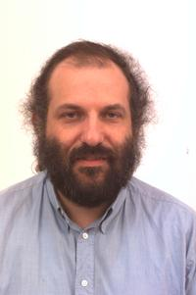
CoNLL Phrase Chunks (+POS, +Entity)
Find Noun Phrase, Verb Phrase and PP chunks:
    U.N. NNP I-NP I-ORG
    official NN I-NP O
    Ekeus NNP I-NP I-PER
    heads VBZ I-VP O
    for IN I-PP O
    Baghdad NNP I-NP I-LOC
    . . O O
First column contains tokens
Second column contains part of speech tags
Third column contains phrase chunk tags
Fourth column contains entity chunk tags
Shallow parsing as “chunking” originated by Ken Church
Ken Church

Slide 43
2003 BioCreative Evaluation
Find gene names in text
Simple one category problem
Training data in form
    @@98823379047 Varicella-zoster/NEWGENE virus/NEWGENE (/NEWGENE VZV/NEWGENE )/NEWGENE glycoprotein/NEWGENE gI/NEWGENE is/OUT a/OUT type/NEWGENE 1/NEWGENE transmembrane/NEWGENE glycoprotein/NEWGENE which/OUT is/OUT one/OUT component/OUT of/OUT the/OUT heterodimeric/OUT gE/NEWGENE :/OUT gI/NEWGENE Fc/NEWGENE receptor/NEWGENE complex/OUT ./OUT
In reality, we spend a lot of time munging oddball data formats.
And like this example, there are lots of errors in the training data.
And it’s not even clear what’s a “gene” in reality. Only 75% kappa inter-annotator agreement on this task.

Slide 44
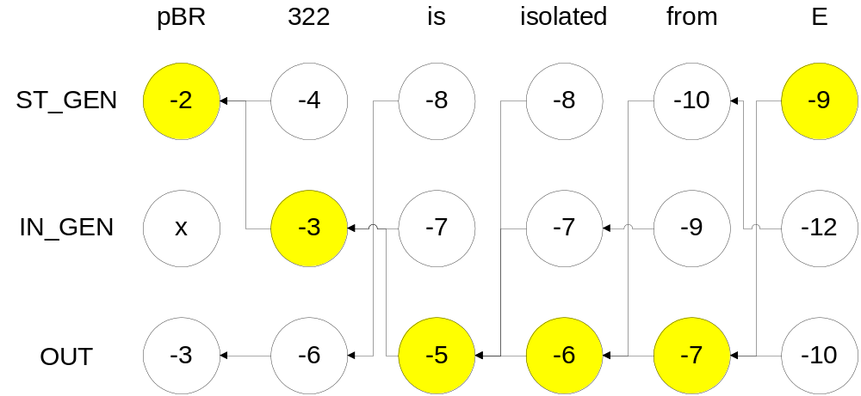
Viterbi Lattice-Based Decoding
Work left-to-right through input tokens
Node represents best analysis ending in tag (Viterbi = best path)
Back pointer is to history; when done, backtrace outputs best path
Score is sum of token joint log estimates:
  log P(token|tag) + log P(tag|tag-1)

Slide 45
Sample N-best Output
First 7 outputs for “Prices rose sharply today”
Rank. Log Prob : Tag/Token(s)
0. -35.612683136497516 : NNS/prices VBD/rose RB/sharply NN/today
1. -37.035496392922575 : NNS/prices VBD/rose RB/sharply NNP/today
2. -40.439580756197934 : NNS/prices VBP/rose RB/sharply NN/today
3. -41.86239401262299 : NNS/prices VBP/rose RB/sharply NNP/today
4. -43.45450487625557 : NN/prices VBD/rose RB/sharply NN/today
5. -44.87731813268063 : NN/prices VBD/rose RB/sharply NNP/today
6. -45.70597331609037 : NNS/prices NN/rose RB/sharply NN/today
Likelihood for given subsequence with tags is sum of all estimates for sequences containing that subsequence
  E.g. P(VBD/rose RB/sharply) is the sum of probabilities of 0, 1, 4, 5, …

Slide 46
Forward/Backward Algorithm: Confidence
Viterbi stores best-path score at node
Assume all paths complete; sum of all outgoing arcs 1.0
Forward stores sum of all paths to node from start
  Total probability that node is part of answer
  Normalized so all paths complete; all outgoing paths sum to 1.0
Backward stores sum of all paths from node to end
  Also total probability that node is part of answer
  Also normalized in same way
Given a path P, its total likelihood is product of:
  Forward score to start of path (likelihood of getting to start)
  Backward score from end of path (likelihood of finishing from end = 1.0)
  Score of arcs along the path itself
  This provides confidence of output, e.g. that “John Smith” is a person in “Does that John Smith live in Washington?” or that “c-Jun” is a gene in “MEKK1-mediated c-Jun activation”

Slide 47
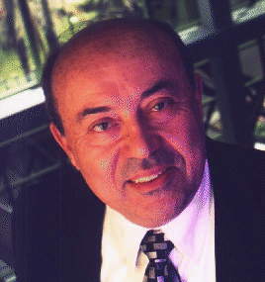
Viterbi Decoding (cont.)
Basic decoder has asymptotic complexity O(n*m²) where n is the number of input symbols and m is the number of tags.
Quadratic in tags because each slot must consider each previous slot
Memory can be reduced to the number of tags if backpointers are not needed
Keeping n-best at nodes increases time and
memory requirements by n
More history requires more states
  Bigrams, states = tags
  Trigrams, states = pairs of tags
Pruning removes states
  Remove relatively low-scoring paths
Andrew J. Viterbi

Slide 48
Common Tagging Model Features
More features usually means better systems if features’ contributions can be estimated
Previous/Following Tokens
Previous/Following Tags
Token character substrings (esp for biomedical terms)
Token prefixes or suffixes (for inflection)
Membership of token in dictionary or gazetteer
Shape of token (capitalized, mixed case, alphanumeric, numeric, all caps, etc.)
Long range tokens (trigger model = token appears before)
Vectors of previous tokens (latent semantic indexing)
Part-of-speech assignment
Dependent elements (who did what to whom)

Slide 49
Adaptation and Corpus Analysis
Can retrain based on output of a run
  Known as “adaptation” of a model
  Common for language models in speech dictation systems
  Amounts to “semi-supervised learning”
    Original training corpus is supervised
    New data is just adapted by training on high-confidence analyses
Can look at whole corpus of inputs
  If a phrase is labeled as a person somewhere, it can be labeled elsewhere – context may cause inconsistencies in labeling
  Can find common abbreviations in text and know they don’t end sentences when followed by periods

Slide 50
Who did What to Whom?
Previous examples involved so-called “shallow” analyses
Syntax is really about who did what to whom (when, why, how, etc.)
Often represented via dependency relations between lexical items; sometimes structured

Slide 51


CoNLL 2004: Relation Extraction
Task defned/run by Catalan Polytechnic (UPC)
Goal is to extract PropBank-style relations (Palmer, Jurafsky et al., LDC)
[_{A0} He ] [_{AM-MOD} would ] [_{AM-NEG} n't ] [_{V} accept ]
[_{A1} anything of value ] from
[_{A2} those he was writing about ] .
V: verb
A0: acceptor
A1: thing accepted
A2: accepted-from
A3: attribute
AM-MOD: modal
AM-NEG: negation
These are semantic roles, not syntactic roles:
  ~ Anything of value would not be accepted by him from those
  he was writing about.
Xavier Carreras
Lluís Màrquez

Slide 52
ConLL 2004 Task & Corpus Format
The DT B-NP (S* O - (A0* (A0*
$ $ I-NP * O - * *
1.4 CD I-NP * O - * *
billion CD I-NP * O - * *
robot NN I-NP * O - * *
spacecraft NN I-NP * O - *A0) *A0)
faces VBZ B-VP * O face (V*V) *
a DT B-NP * O - (A1* *
six-year JJ I-NP * O - * *
journey NN I-NP * O - * *
to TO B-VP (S* O - * *
explore VB I-VP * O explore * (V*V)
Jupiter NNP B-NP * B-LOC - * (A1*
and CC O * O - * *
its PRP$ B-NP * O - * *
16 CD I-NP * O - * *
known JJ I-NP * O - * *
moons NNS I-NP *S) O - *A1) *A1)
. . O *S) O - * *

Slide 53
CoNLL Performance
Evaluation on exact precision/recall of binary relations
10 Groups Participated
  All adopted tagging-based (shallow) models
  The task itself is not shallow so each verb required a separate run plus heuristic balancing
  Best System from Johns Hopkins
    72.5% Precision, 66.5% recall (69.5 F)
  Systems 2, 3, 4 have F-scores of 66.5%, 66.0% & 65%
  12 total entries
Is English too Easy?
  Lots of information from word order & locality
    Adjectives next to their nouns
    Subjects precede verbs
  Not much information from agreement (case, gender, etc.)

Slide 54
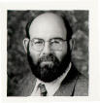
Parsing Models
General approach to who-did-what-to-whom problem
Penn TreeBank is now standard for several languages:
  ( (S (NP-SBJ-1 Jones)
  (VP followed
  (NP him)
  (PP-DIR into
  (NP the front room))
  ,
  (S-ADV (NP-SBJ *-1)
  (VP closing
  (NP the door)
  (PP behind
  (NP him)))))
  .))
Jones followed x; Jones closed the door behind y
Doesn’t resolve pronouns
Mitch Marcus

Slide 55
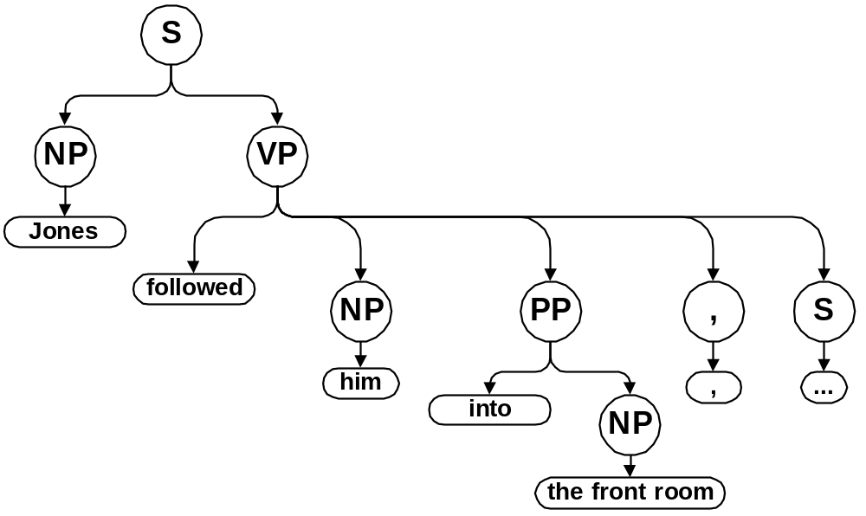
“Standard” Parse Tree Notation

Slide 56

Context Free Grammars
Phrase Structure Rules
  S → NP VP
  NP → Det N
  N → N PP
  N → N N
  PP → P NP
  VP → IV VP → TV NP VP → DV NP NP
Lexical Entries
  N → book, cow, course, …
  P → in, on, with, …
  Det → the, every, …
  IV → ran, hid, …
  TV → likes, hit, …
  DV → gave, showed
Noam Chomsky

Slide 57
Context-Free Derivations
S → NP VP → Det N VP → the N VP → the kid VP → the kid IV → the kid ran
Penn TreeBank bracketing notation (Lisp-like)
  (S (NP (Det the)
  (N kid))
  (VP (IV ran)))
Theorem: A sequence has a derivation if and only if it has a parse tree

Slide 58
Ambiguity
Part-of-speech Tagging has lexical category ambiguity
  E.g. “report” may be a noun or a verb, etc.
Parsing has structural attachment ambiguity
  English linguistics professor
    [N [N English]
    [N [N linguistics]
    [N professor]]]
      linguistics professor who is English
    [N [N [N English]
    [N linguistics]]
    [N professor]]
      professor of English linguistics
  Put the block in the box on the table.
    Put [the block in the box] [on the table]
    Put [the block] [in the box on the table]
Structural ambiguity compounds lexical ambiguity

Slide 59
Bracketing and Catalan Numbers
How bad can ambiguity be?
Noun Compound Grammar: N → N N
  A sequence of nouns has every possible bracketing
  Total is known as the Catalan Numbers
    Catalan(n) = SUM_{1 <= k <= n} Catalan(k) * Catalan(n-k)
      Number of analyses of left half * Number of analyses of right half for every split point
    Catalan(1) = 1
  Catalan(n) = (2n)! / (n+1)! / n!
  As n → infinity, Catalan(n) –> (4^{N} / N^{2/3})

Slide 60
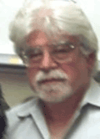
Can Humans Parse Natural Language?
Usually not
  We make mistakes on complex parsing structures
  We can’t parse without world knowledge and lexical knowledge
    Need to know what we’re talking about
    Need to know the words used
Garden Path Sentences
    While she hunted the deer ran into the woods.
    The woman who whistles tunes pianos.
  Confusing without context, sometimes even with
  Early semantic/pragmatic feedback in syntactic discrimination
Center Embedding
  Leads to “stack overflow”
    The mouse ran.
    The mouse the cat chased ran.
    The mouse the cat the dog bit chased ran.
    The mouse the cat the dog the person petted bit chased ran
Problem is ambiguity and eager decision making
  We can only keep a few analyses in memory at a time
Thomas Bever

Slide 61
CKY Parsing Algorithm
Every CFG has an equivalent grammar with only binary branching rules (can even preserve semantics)
Cubic algorithm (see 3 loops)
Input: w[1], …, w[n]
Cats(left,right) = set of categories found for w[left],…,w[right]
  For pos = 1 to n
  if C → w[pos] add C to Cats(pos,pos)
  For span = 1 to n
  For left = 1 to n-span
  For mid = left to left+span
  if C → C1 C2 & C2 in Cats(left,mid) & C3 in Cats(mid,left+span)
  add C to Cats(left,left+span)
Only makes decision; need to store pointers to children for parse tree
Can store all children and still be cubic: packed parse forest
Unpacking may lead to exponentially many analyses
Example of “dynamic programming” algorithm (as was tagging); keep record (“memo”) of best sub-analyses and combine into super-analysis

Slide 62
CKY Parsing example
John will show Mary the book.
Lexical insertion step
  Only showing some ambiguity; realistic grammars have more
  John:NP will:N,AUX show:N,V Mary:NP the:det book:N,V
2 spans
  John will: NP will show:NP,VP show Mary: NP,VP the book:NP
3 spans
  John will show: S will show Mary:VP Mary the book:NP
4 spans
  John will show Mary: S show Mary the book:VP
5 spans
  will show Mary the book:VP
6 spans
  John will show Mary the book: S

Slide 63
Probabilistic Context-Free Grammars
Top-down model:
  Probability distribution over rules with given left-hand-side
    Includes pure phrase structure rules and lexical rules
  SUM_{Cs} P(C→Cs | C) = 1.0
Total probability is sum of each rule
  Context-free: Each rewriting is independent
  Can’t distinguish noun compound structure
    ((English linguistics) professor) vs. (English (linguistics professor))
    Both use rules N→ N N twice and same three lexical entries
    Lexicalization helps with this problem immensely
Decoding
  CKY algorithm, but store best analysis for each category
  Still cubic to find best parse

Slide 64
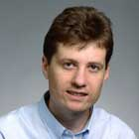
Collins’s Parser
# of Distinct CFG Rules in Penn Treebank: 14,000 in 50,000 sentences
Michael Collins (now at MIT) 1998 UPenn PhD Thesis
Generative model of tree probabilities: P(Tree)
Parses WSJ with ~90% constituent precision/recall
  Best performance for single parser
  Not a full who-did-what-to-whom problem, though
  Dependencies 50%-95% accurate depending on type)
Similar to GPSG + Categirla Grammar (aka HPSG) model
  Subcat frames: adjuncts / complements distinguished
  Generalized Coordination
  Unbounded Dependencies via slash percolation
  Punctuation model
  Distance metric codes word order (canonical & not)
Probabilities conditioned top-down but with lexical information
12,000 word vocabulary (>= 5 occs in treebank)
  backs off to a word’s tag
  approximates unknown words from words with < 5 instances
Michael Collins

Slide 65
Collins’s Statistical Model (Simplified)
Choose Start Symbol, Head Tag, & Head Word
  P(RootCat, HeadTag, HeadWord)
Project Daughter and Left/Right Subcat Frames
  P(DaughterCat | MotherCat, HeadTag, HeadWord)
  P(SubCat | MotherCat, DtrCat, HeadTag, HeadWord)
Attach Modifier (Comp/Adjunct & Left/Right)
  P(ModifierCat, ModiferTag, ModifierWord
  | SubCat, . . MotherCat, DaughterCat,
  HeadTag, HeadWord, Distance)

Slide 66
Collins Parser Derivation Example
(John (gave Mary Fido yesterday))
Generate Sentential head
  root=S head tag=TV word=met P_{Start}(S,TV,gave)
Generate Daughter & Subcat
  Head daughter = VP P_{Dtr}(S,VP,TV,gave)
  Left subcat = [NP] P_{LeftSub}([NP],S,VP,TV,gave)
  Right subcat = [] P_{RightSub}([],S,VP,TV,gave)
Generate Attachments
  Attach left NP P_{attachL}(NP,[NP],arg,S,VP,TV,gave,distance=0)
Continue, expanding VP’s daughter and subcat
  Generate Head = TV P(TV,VP,TV,gave)
  Generate left subcat P([],TV,TV,gave)
  Generate right subcat P([NP,NP],TV,TV,gave)
Generate Attachments
  Attach First NP P(NP,[NP,NP],arg,TV,TV,gave,distance=0)
  Attach Second NP P(NP,[NP],arg,TV,TV,gave,distance=1)
  Attach Modifier Adv P(Adv,[],adjunct,TV,TV,gave,distance=2)
Continue expanding NPs and Advs and TV, eventually linking lexicon

Slide 67
Implementing Collins’s Parser
Collins’ wide coverage linguistic grammar generates millions of readings for real 20-word sentences
But Collins’ parser runs faster than real time on unseen sentences of length > 40.
How?
Beam Search Reduces time to Linear
  Only store a hypothesis if it is at least 1/10,000th as good as the best analysis for a given span
  Beam allows tradeoff of accuracy (search error) and speed
Tighter estimates with more features and more complex grammars ran faster and more accurately

Slide 68
Roles In NLP Research
Linguists
  Deciding on the structure of the problems
  Developing annotation guides and a gold standard
  Developing features and structure for models
Computer Scientists
  Algorithms & Data Structures
  Engineering Applications
  Toolkits and Frameworks
Statisticians
  Machine Learning Frameworks
  Hypothesis Testing
  Model Structuring
  Model Inference
Psychologists
  Insight about way people process language
  Psychological Models
  Is language like chess, or do we have to process it the same way as people do?
Best researchers know a lot about all of these topics!!!

Slide 69
References
Best General NLP Text
  Jurafsky and Martin. Speech and Language Processing.
Best Statistical NLP Text
  Manning and Schuetze. Foundations of Statistical Natural Language Processing.
Best Speech Text
  Jelinek. Statistical Methods for Speech Recognition.
Best Information Retrieval Text
  Witten, Moffat & Bell. Managing Gigabytes.

