Slide 1

LAB: Evaluating the Microscope
LAB: Microscope and the Letter “e”
Questions:
What claim or thesis is represented by this assignment?
What data supports the claim?
What do you think the data suggests? (Warrants)
Notes:
Biological Significance
Findings / Observations
Analyze Data / Results
40X Magnification
100X Magnification
400X Magnification
Personal Reflection:
002
003

Slide 2

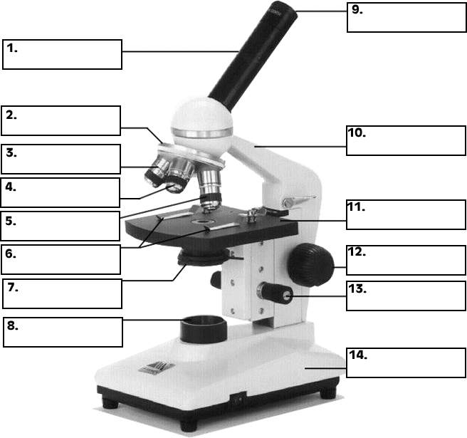
Week 01 Wednesday Goal: By the end of the lesson, students will be able to … identify the parts of the microscope, their functions, and identify the microscopes advantages and limits.
Daily Starter:
Explain what you think the following analogy means:
telescope : astronomy :: microscope : biology.

Slide 3


Table of Contents: Be sure to match your table of contents so that we all work together as a class.
Pg. | Left Side Items |  | Pg. | Right Side Items
BI | Inheritance & Variation |  | BI | Inheritance and Variation
000 | Mother Earth |  | 001 | Characteristics of Life
002 | Lab: Evaluating the Microscope |  | 003 | Lab: Microscope & the Letter “e”

Slide 4
Evidence That You Have Successfully Completed This Lesson
Checkpoints
You can identify all the parts of the microscope and their functions.
You can identify the effect that magnification has on the image.
You can analyze the advantages & disadvantages of the microscope.

Slide 5

Check
point 1
You can identify all the parts of the microscope and their functions.
Complete Notebook
Eyepiece
Stage Clips
Diaphragm
Body Tube
Stage
Arm
Nosepiece
Coarse Adjust
Low Objective
Fine Adjust
Mid Objective
Lamp
High Objective
Base

Slide 6
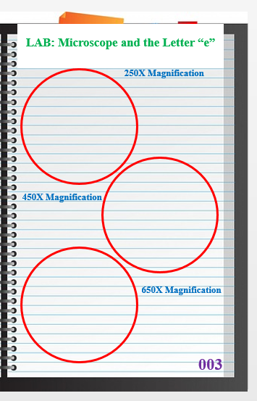
Check
point 2
You can identify the effect that magnification has on the image.

Slide 7
Check
point 2
You can identify the effect that magnification has on the image.

Slide 8

Personal Reflection (Revisit the Goal)
How well were you able to …
identify the parts of the microscope, their functions, and identify the microscopes advantages and limits?
In your personal reflection space …
Rate your learning using a letter grade from A to F.
Summarize what you have learned.

Slide 9
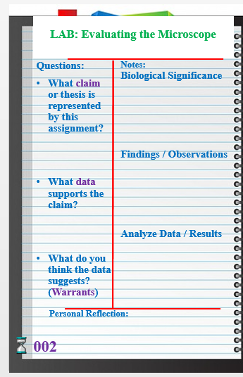
Checkpoint 3: Understanding Check Homework
Good Job!
You can analyze the advantages & disadvantages of the microscope.

Slide 10
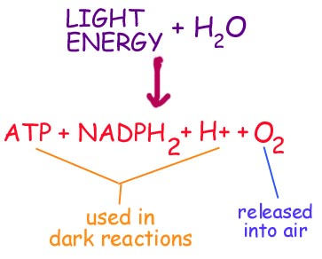
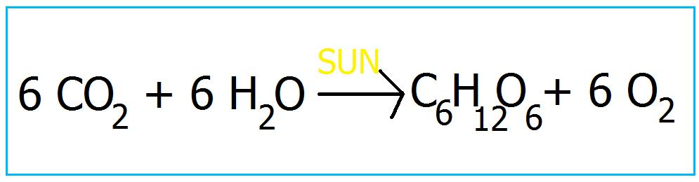
Mitochondria
Due
Friday

Slide 11
LAB: Geological Timeline
LAB: Homologous Structures
Questions:
What claim or thesis is represented by this assignment?
What data is available to support the claim?
What do you think the data suggests? (Warrants)
Are there any main patterns / changes?
Notes:
Biological Significance
Findings / Observations
Analyze Data / Results
Patterns of Change
Questions:
What claim or thesis is represented by this assignment?
What data is available to support the claim?
What do you think the data suggests? (Warrants)
Are there any main patterns / changes?
Notes:
Biological Significance
Findings / Observations
Analyze Data / Results
Patterns of Change
Personal Reflection:
Personal Reflection:
116
117

