Slide 1
Practical Verification of System-Software Components
Written in Standard C

Slide 2
Goals (in context of existing verifiers)
Only some parts of the systems are critical -> Aim to prove the correctness of critical components of systems, not entire systems.
A lot of modern tools are interactive (developer iteratively provides instructions to the verifier for correctness proof), therefore it can take several person-years for reasonably sized code -> Enable developers to prove the correctness of correct code in one go.
Other verifiers rely on programmer to annotate code with formal comments that describe the logic (pre-/post-conditions) -> Reduce annotation burden.
To reduce annotation burden some would forgo C language and choose other better suited language for annotation. That leads to need to learn new language -> Not require system programmers to learn verification-specific languages.

Slide 3
Spectrum
Interactive verification: a lot of interaction with theorem provers to write proofs as detailed sequence of steps, separately from code.
Semi-automated verifiers: inserting logic annotation in code. The annotations provide pre-/post-conditions and proof hints (invariants).
Automated verification: highest possible degree of proof automation: complete elimination. But significant restrictions in expressivity (only some properties can be verified).

Slide 4
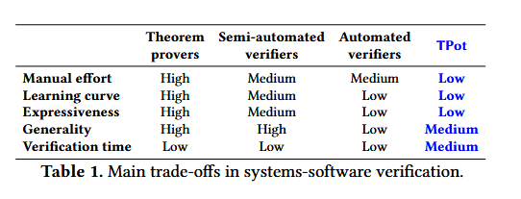
TPot: A New Point in the Design Space
much less manual effort than existing approaches
trades lots of expressiveness and some generality for a flatter learning curve
more expressive and general than automated verifiers

Slide 5
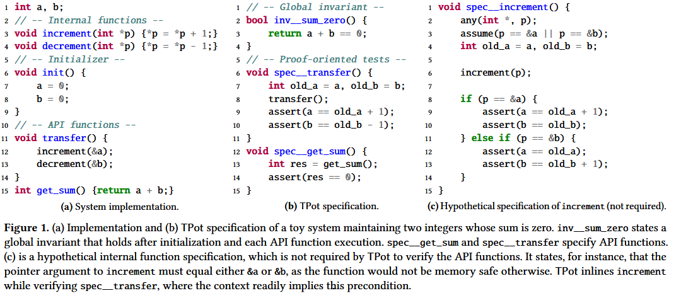
Example

Slide 6
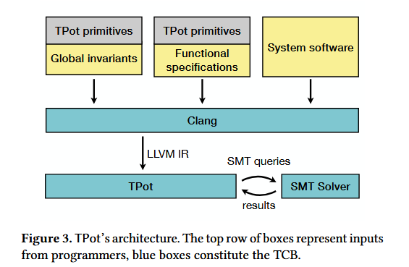
TPot architecture

Slide 7
Design goals
specification language should be familiar to developers without verification expertise
Developers should not have to write intermediate specifications for the purposes of verification
the specification language must enable the right combination of expressiveness and automated reasoning

Slide 8
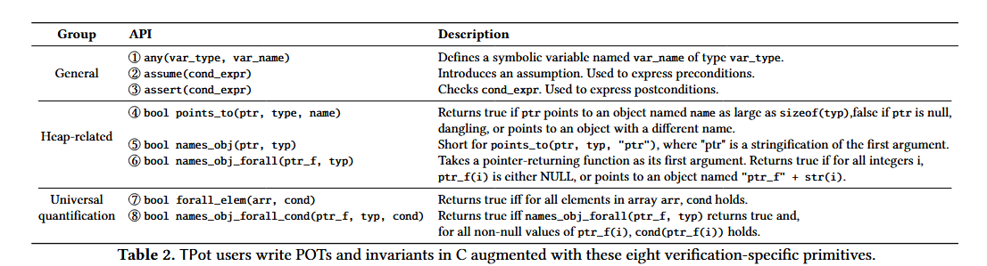
Language overview

Slide 9
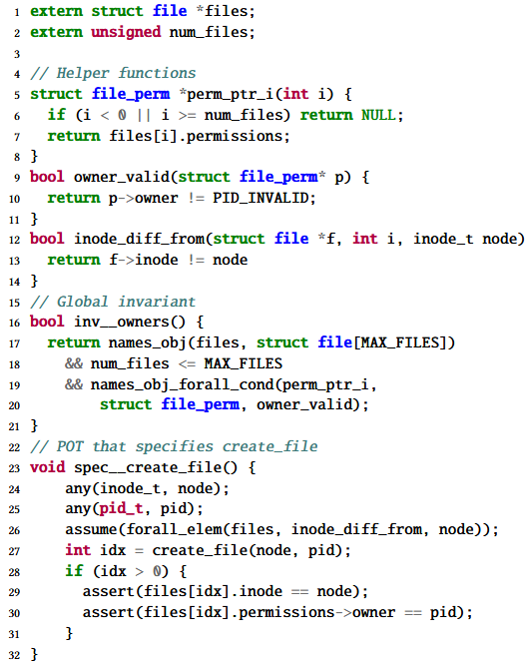
Global invariants

Slide 10
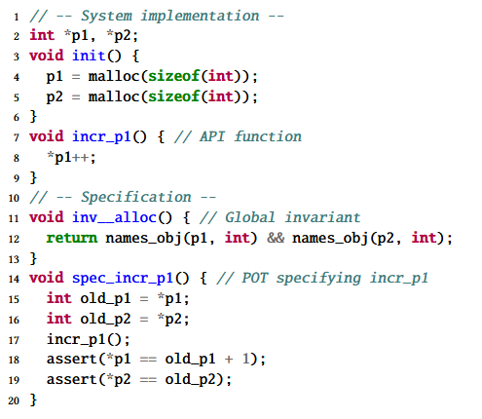
Naming

Slide 11
Universal quantification.

Slide 12
Loop invariants
Loop invariants. TPot also supports loop invariants to keep verification tractable when the implementation includes loops whose bounds are dynamically determined, or too large to be unrolled within an acceptable amount of time. By default, TPot will unroll all loops during symbolic execution and does not require loops to be annotated.

Slide 13
Custom Byte Memory Model
TPot’s memory model builds on top of KLEE’s, which represents objects using SMT arrays of bytes accessed at bounds-checked indices. Tpot extends it with a symbolic heap representation supporting lazily materialized objects, symbolic base addresses, and symbolic object sizes. Like KLEE, TPot does not distinguish between pointers and data, and uses SMT queries to resolve addresses and objects.

Slide 14
TPot’s SMT Encoding
Eliminating quantifiers.
Converting pointer values, heap addresses, and object sizes to integers.
Query simplification.
Read after write.
Constant offsets.

Slide 15
Evaluation
TPot can verify diverse systems components without requiring their code to be modified to suit TPot. TPot proves the absence of low-level bugs and achieves the same functional correctness guarantees as the baselines, though without the same level of abstraction or compositionality.
Compared to the baseline verifiers, the annotation overhead TPot incurs is consistently less, with reductions ranging up to more than 3×. This is an underestimate of the true benefit that TPot offers practitioners in terms of reduction in effort, and thus increase in productivity.
The amount of time it takes to verify system components using TPot is compatible with modern CI pipelines. The practitioner therefore gets to trade verification time for a reduction in annotation overhead.

Slide 16
Conclusion
incurs less manual effort than existing semi-automated verifiers;
is friendly for ordinary programmers;
is not limited to specific types of applications;
does not require adapting systems code for verification.

