Slide 1

MEDICAL MISSIONARY
TWO GAME MODES

Slide 2

MODE 1: During the colonial era, medical missionaries like Leader Stirling changed Tanzanian medicine and culture. Historian Michael Jennings describes this as “healing bodies, saving souls” – first, replacing traditional medicine with biomedicine, and second, converting communities to Christianity.

Slide 3
MODE 2: One report says that traditional healers are “promoting positive health behavior” and act as “a good referral point to [the] modern health care system” (Abdullahi).

Slide 4
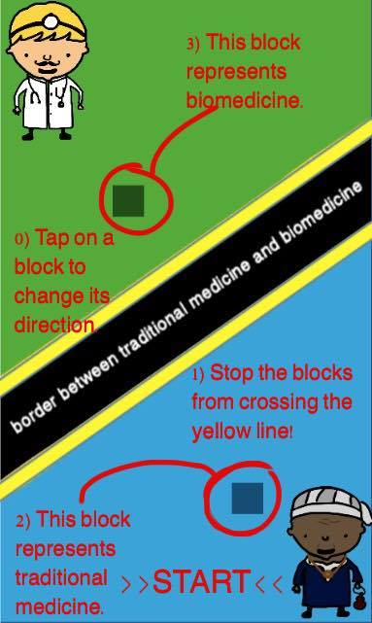
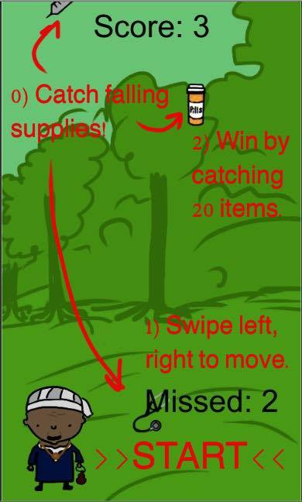

Slide 5
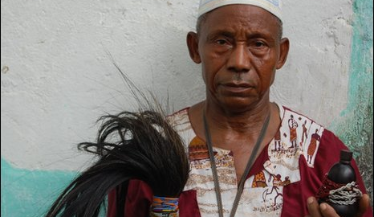
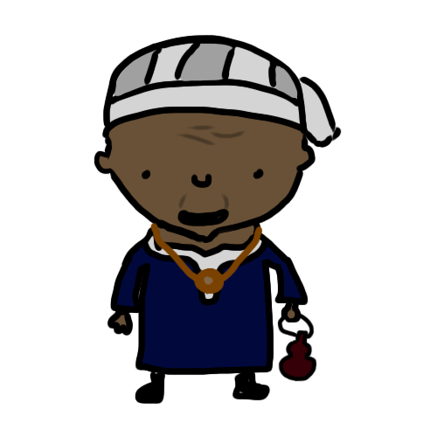
SOME FACTS.
“[M]ore than 50% of…traditional healers...referred patients at least once to modern health cfacilities for further treatment” (Osowole et al. 2005).
Also, “non-Western medicine can provide important links between disease and behavior as well as effective treatment not found in Western medicine” (Ratzan 2000).
When completely unregulated, traditional medicine has the potential to be abused by self-proclaimed, illegitimate healers (Abdullahi).
“For millions of people in rural areas, native healers remain [the primary] health providers” (Abdullahi).

Slide 6
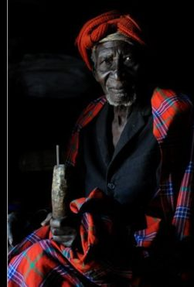
“The herbalists…sometimes use Western medicines such as paracetamol for pain control and X-rays to diagnose breaks” (BBC “In pictures: Tanzania’s traditional healers”).
http://www.bbc.com/news/world-africa-22263057

Slide 7
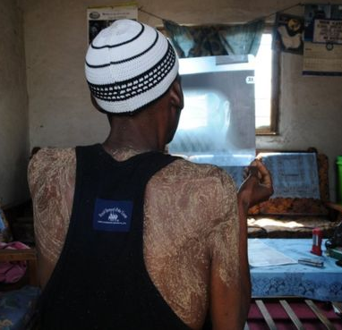
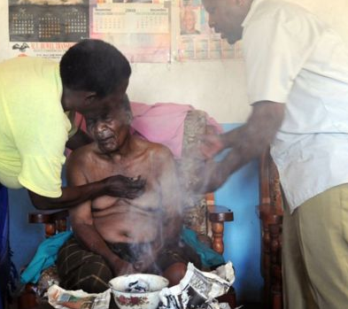
BELIEF:
“There is a widely-held belief among the Wahehe people of southern Tanzania that sickness is caused by supernatural forces” (BBC).

Slide 8
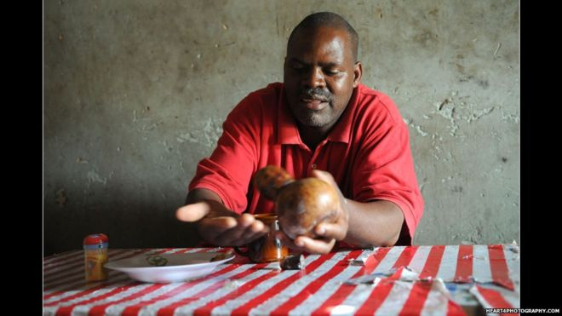
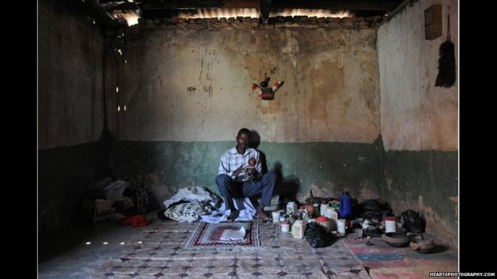
“Most of those who come to me have already been to hospital," says the young healer above. "They have not managed to get a solution for their problems. Injections and medicine that were applied have not shown any effect, it only soothes, but it does not treat. If I treat them successfully they tell their friends. I do not have any advertising,” he says.
(BBC)

Slide 9
