Slide 1
Comparing newspapers in their perspective on the economic implications of automation and globalization
Bobae Kang
Computational Content Analysis (Winter ‘17)
The University of Chicago

Slide 2
Motivation
Rise of the “right-wing populism” in 2016
Brexit in June
Election of Trump in November
The economic plight of working class
The role of news media

Slide 3
Research Question
Do newspapers with different audience tell different stories concerning the economic implications of automation/artificial intelligence/robot and globalization/immigration/international trade?
Two of the major challenges concerning national economy and job market

Slide 4
Data
2 major UK newspapers X 2 categories
Articles published in 2016 with 6 search terms
Maximum 500 articles for each term
Daily Mail (Conservative, non-elite)
The Guardian (Liberal, elite)
Category 0 (artificial intelligence, automation, robot)
Category 1 (globalization, international trade, immigration)

Slide 5
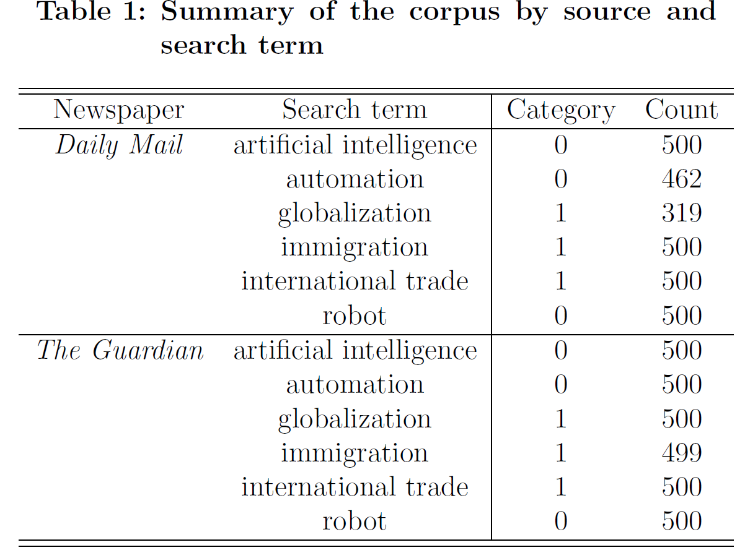
Data

Slide 6
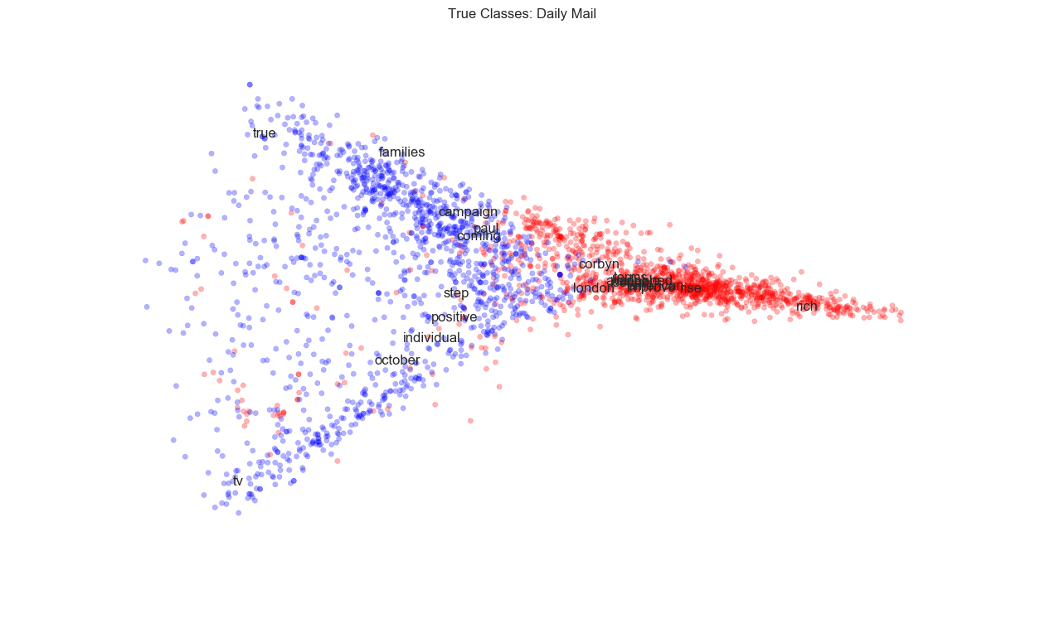
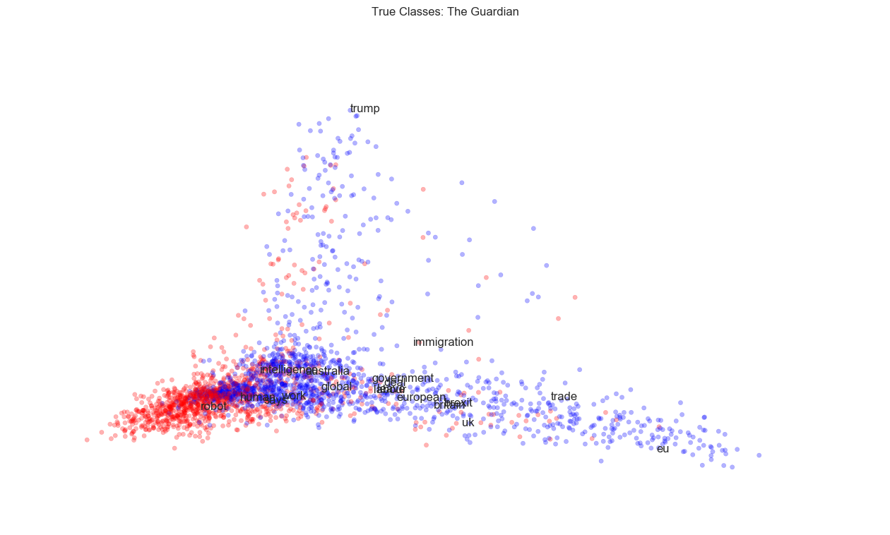
Data
2 groups of word vectors separated by category in each corpus
Red: Category 0
Blue: Category 1

Slide 7
Method
LDA Topic Modeling
Investigating each sub-corpus (i.e. newspaper-category pair) via topics (distributions of words across documents)
Vector Semantics
Investigating specific terms and their meaning via examining how they relate to other terms

Slide 8
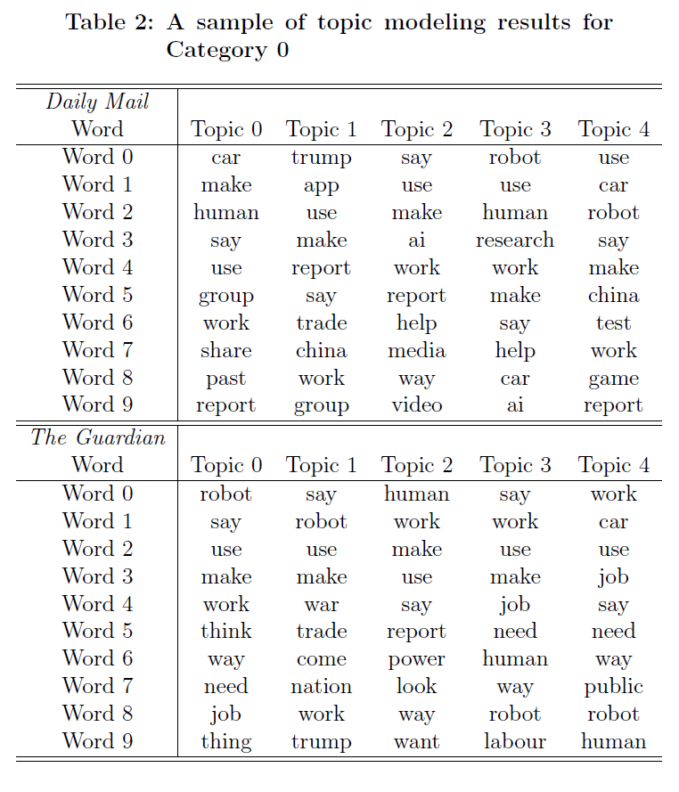
Results: Topic modeling
Topics: Category 0
Little noticeable difference
Both newspapers mostly covering similar set of events in the given category

Slide 9

Results: Topic modeling
Topics: Category 1
Little noticeable difference
Both newspapers mostly covering similar set of events in the given category

Slide 10
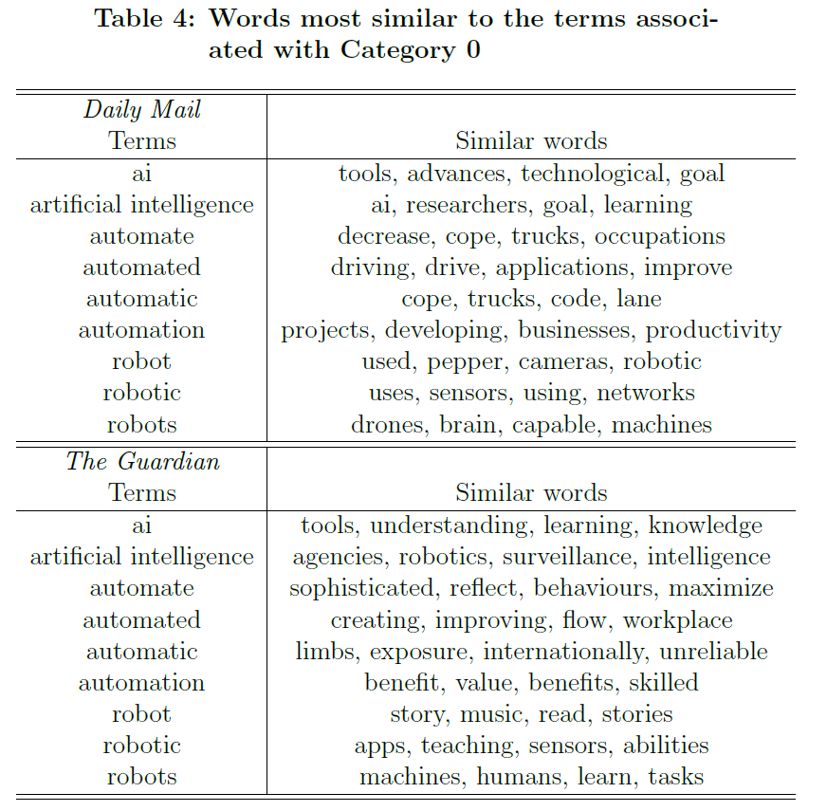
Results: Vector Semantics
Cosine similarity: Category 0
Daily Mail articles relate automation-related terms to truck/driving
Guardian articles perhaps more skeptical of AI and automation (‘surveillance’, ‘unreliable’)

Slide 11
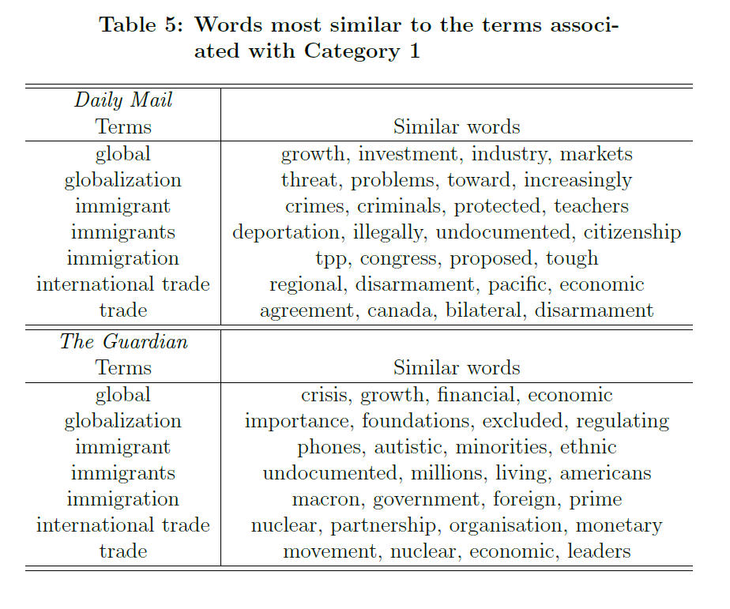
Results: Vector Semantics
Cosine similarity: Category 1
Daily Mail articles perhaps more negative towards globalization (‘threat’, ‘problems’) and immigrants (‘crimes’, ‘criminals’)

Slide 12
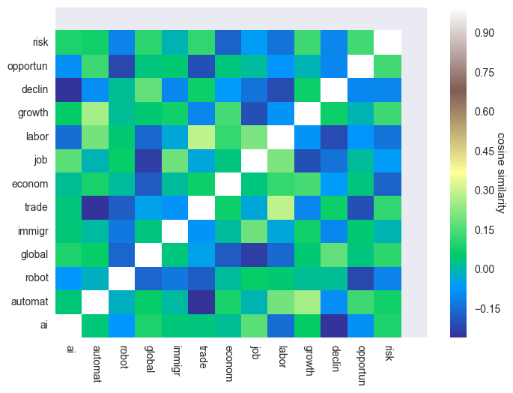
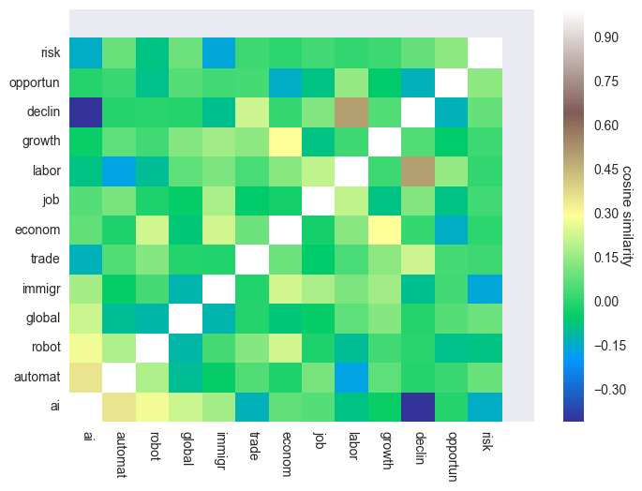
Results: Vector Semantics
Daily Mail The Guardian
Cosine similarity heatmap
Overall, examined words are dissimilar or neutral to each other in Daily Mail
Overall, examined words are similar or neutral to each other in The Guardian
‘labor’ and ‘declin’ dissimilar in Daily Mail but similar in The Guardian
‘economy’ and ‘growth’ neutral in Daily Mail but similar in The Guardian

Slide 13
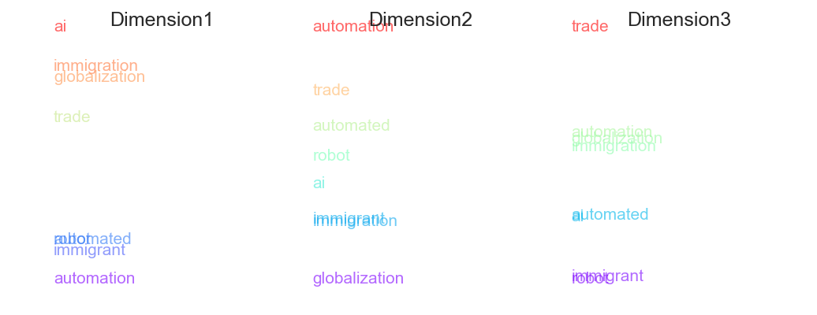
Results: Vector Semantics
Projecting Daily Mail word embeddings on three dimensions
On relative scale, ai is most positive, automation most negative
On relative scale, automation is most business, globalization most labor
On relative scale, trade is most economic, robot/immigrant most social

Slide 14
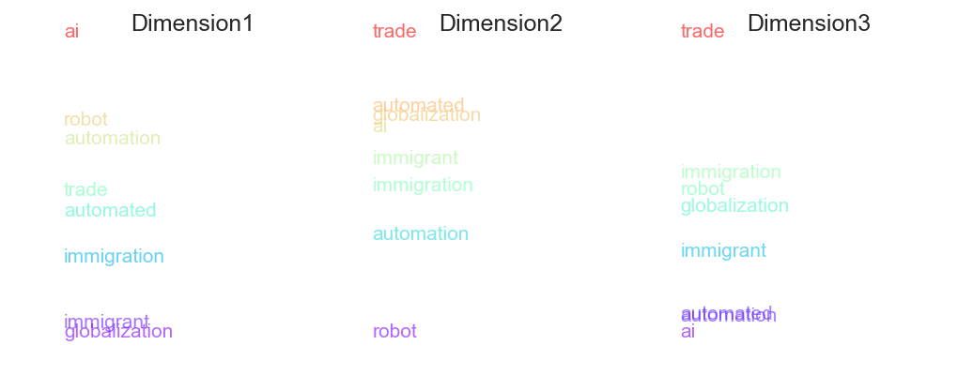
Results: Vector Semantics
Projecting Guardian word embeddings on three dimensions
On relative scale, ai is most positive, globalization most negative
On relative scale, trade is most business, robot most labor
On relative scale, trade is most economic, ai most social

Slide 15
Summary
No clear evidence concerning which newspaper is more positive/negative toward which category
Daily Mail seems to be more critical toward immigrant-related words (e.g. relating immigrant to crimes). Immigration more as a social problem than economic problem?
The Guardian appears to relate Category 0 terms to labor-workplace issues while Daily Mail do not.
Limitations:
Choice of search terms
Choice of terms to define dimensions for projection
Difficulty of interpretation

