Slide 1

Caerleon Skills Tracker: Teacher User Guide
Adding, editing and reviewing curriculum mapping
For teachers and subject leads
Use this guide when recording curriculum work, maintaining framework references and checking subject coverage.
Caerleon Skills Tracker
01

Slide 2
GUIDE OVERVIEW
What this guide covers
Three practical workflows for keeping curriculum mapping clear, current and useful.
Add Curriculum
Edit Curriculum
View Subject Health
✓
Create a curriculum entry
✓
Browse by subject and year group
✓
Review mapped schemes
✓
Add Literacy, Numeracy and DCF links
✓
Find the scheme or activity
✓
Check skills and theme coverage
✓
Record theme evidence where relevant
✓
Amend details or references
✓
Spot gaps quickly
✓
Save the mapping
✓
Save changes
✓
Open items needing improvement
Caerleon Skills Tracker
02

Slide 3
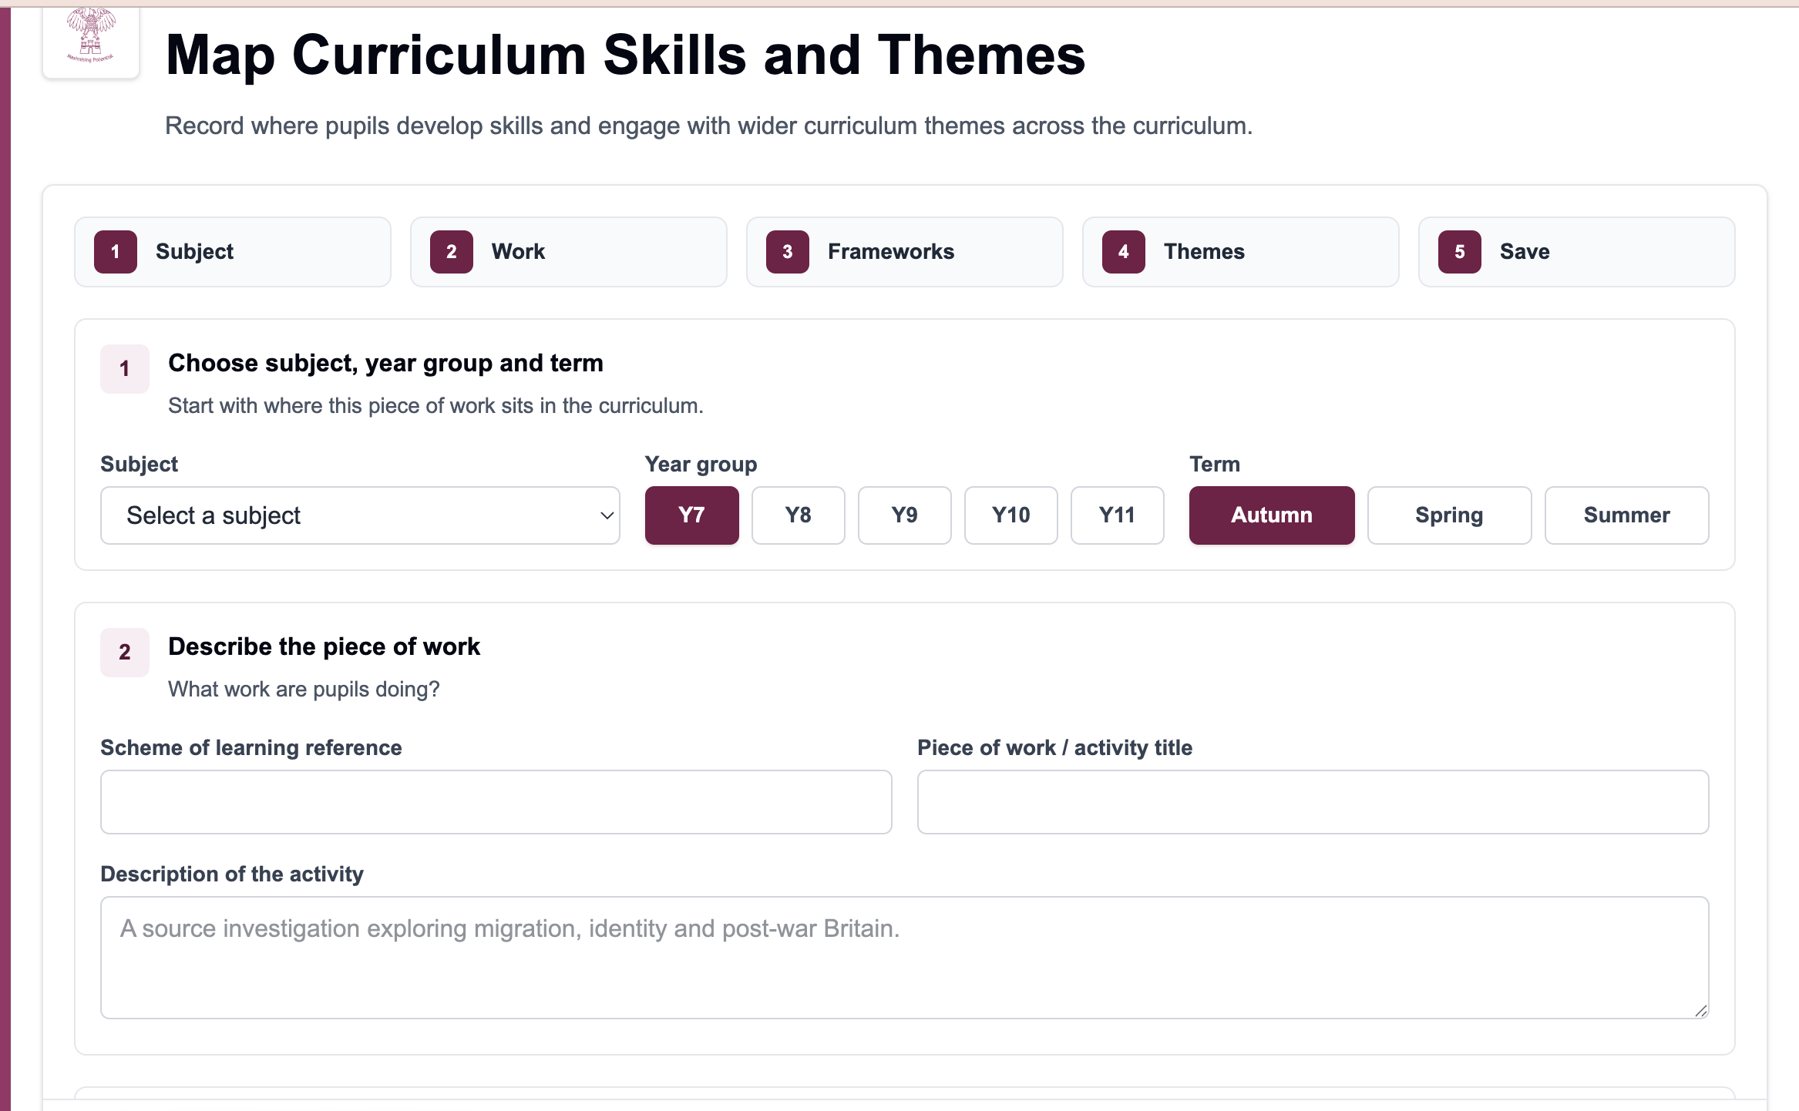
ADD CURRICULUM ENTRY
What the Add Curriculum page is for
Use it to make a visible record of curriculum work and the skills it develops.
1
Record the piece of work
Choose subject, year group, term and the activity or scheme reference.
2
Map the frameworks
Add the Literacy, Numeracy or DCF references that genuinely apply.
3
Save useful evidence
Add optional theme evidence and notes, then save for curriculum visibility.
- Keep entries specific enough to review later
- Map evidence that is actually taught or practised
Caerleon Skills Tracker
03

Slide 4
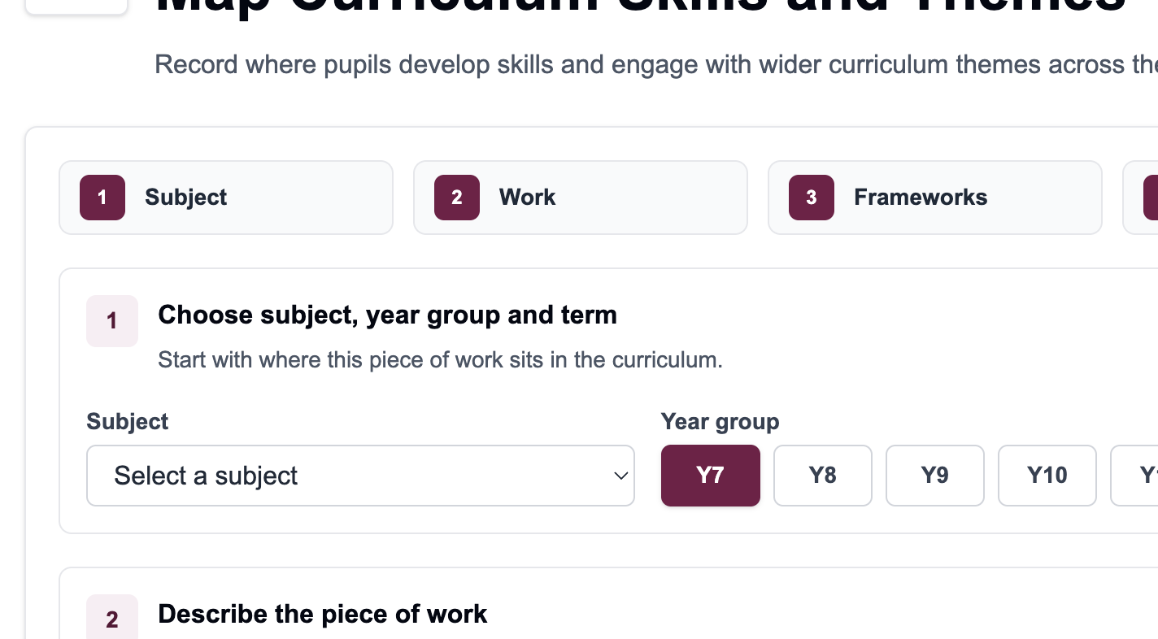
ADD CURRICULUM ENTRY
Step 1 and 2 - Curriculum details
Start by describing where the work sits in the curriculum.
Choose the subject, year group and term.
Use scheme references such as 7.1 or CT7.3.
Give the activity a clear title.
Keep descriptions concise but meaningful.
Caerleon Skills Tracker
04

Slide 5
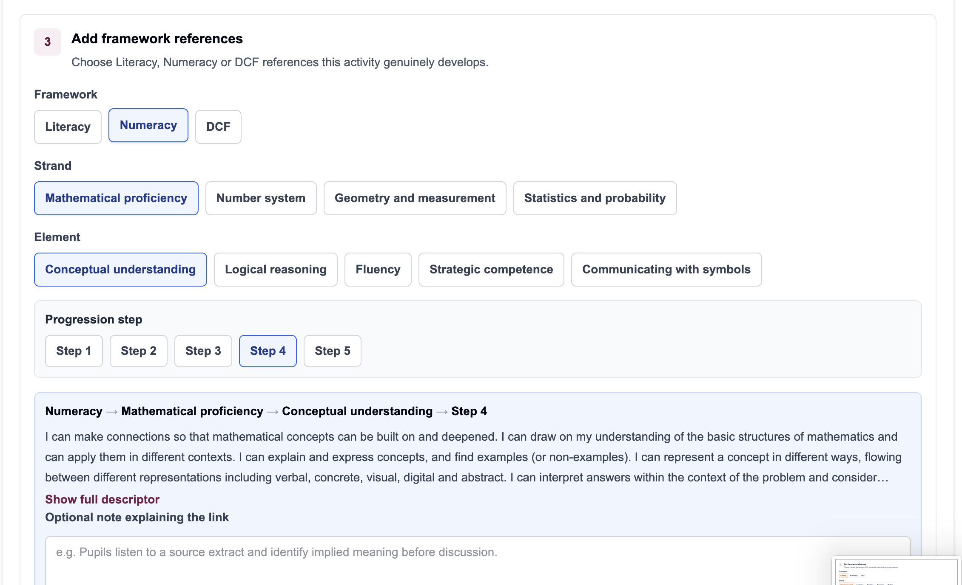
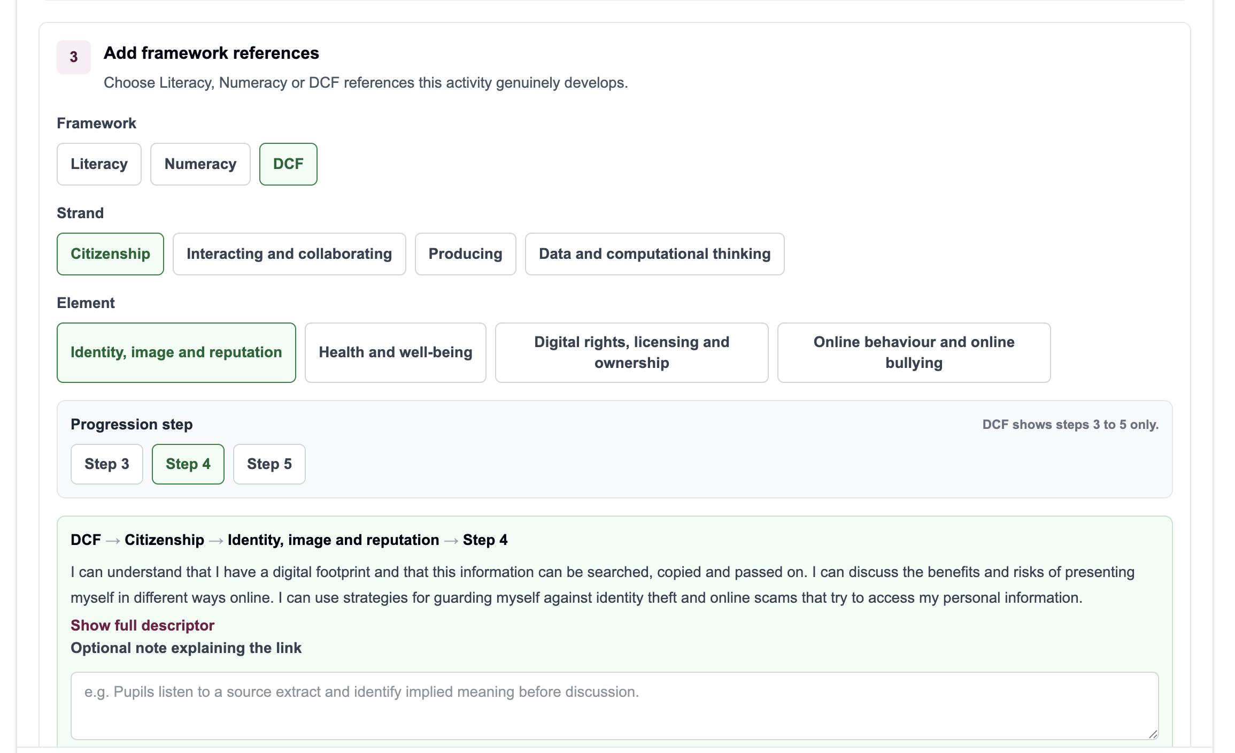
ADD CURRICULUM ENTRY
Step 3 - Add framework references
Select the framework, strand and element that match the work being taught.
Select framework
Select element
Check descriptor
Add reference
Progression step usually defaults sensibly. Check it before adding the reference.
Caerleon Skills Tracker
05

Slide 6
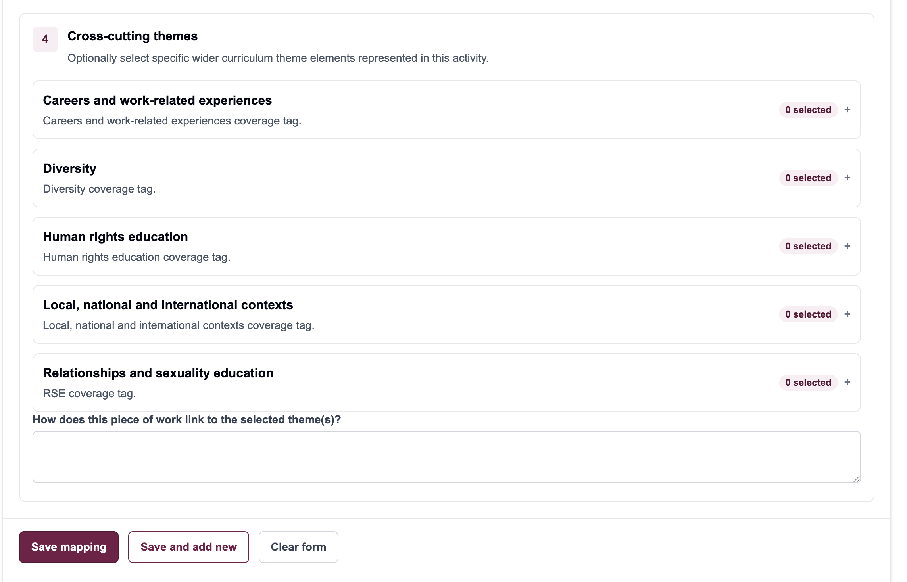
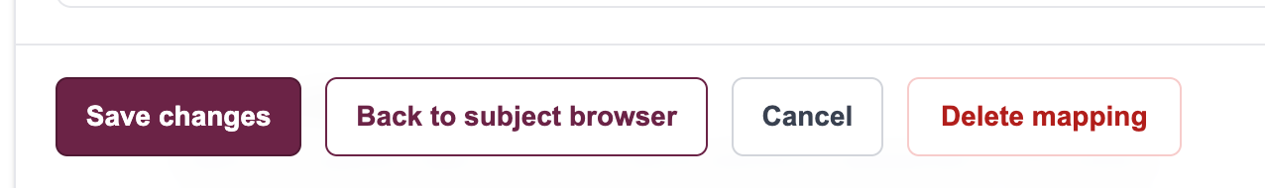
ADD CURRICULUM ENTRY
Step 4 and 5 - Themes and save
Cross-cutting theme elements are optional on skills entries, but they help explain wider curriculum evidence.
Expand a theme, then tick only the elements that are genuinely covered.
- Add notes if they help explain the judgement
- Review skills and theme choices before saving
- Use Save mapping to finish the entry
Caerleon Skills Tracker
06

Slide 7
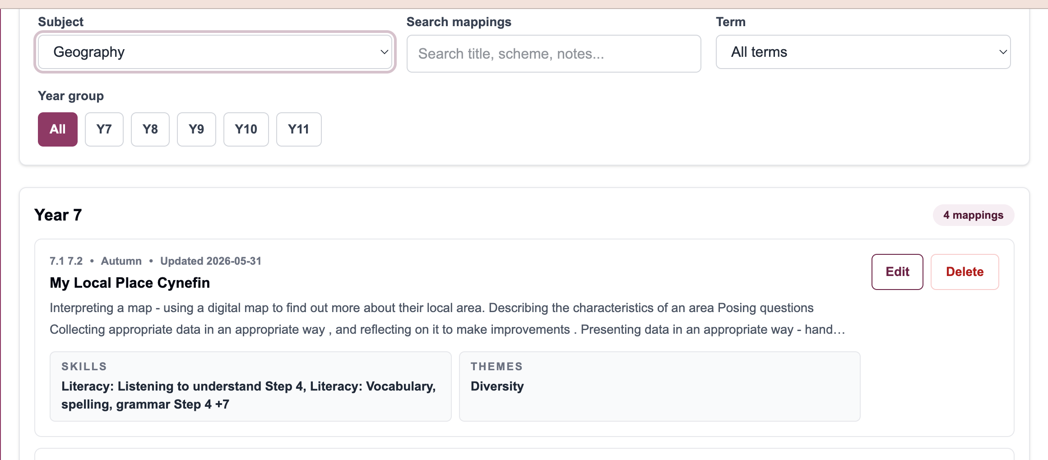
EDIT CURRICULUM ENTRY
When to use Edit Curriculum
Use edit mode to improve existing mappings rather than creating duplicates.
- Correct mistakes in curriculum details
- Add missing skills evidence
- Remove references that do not really apply
- Add or amend theme evidence
- Update descriptions or scheme references
Good rule: edit the existing entry when the scheme already exists.
Caerleon Skills Tracker
07

Slide 8
EDIT CURRICULUM ENTRY
Browse by subject
Start with the subject, then find the year group and scheme or activity card.
1. Select your subject.
2. Use year group and term filters if needed.
3. Find the scheme/reference.
4. Open the mapping to edit.
Caerleon Skills Tracker
08

Slide 9
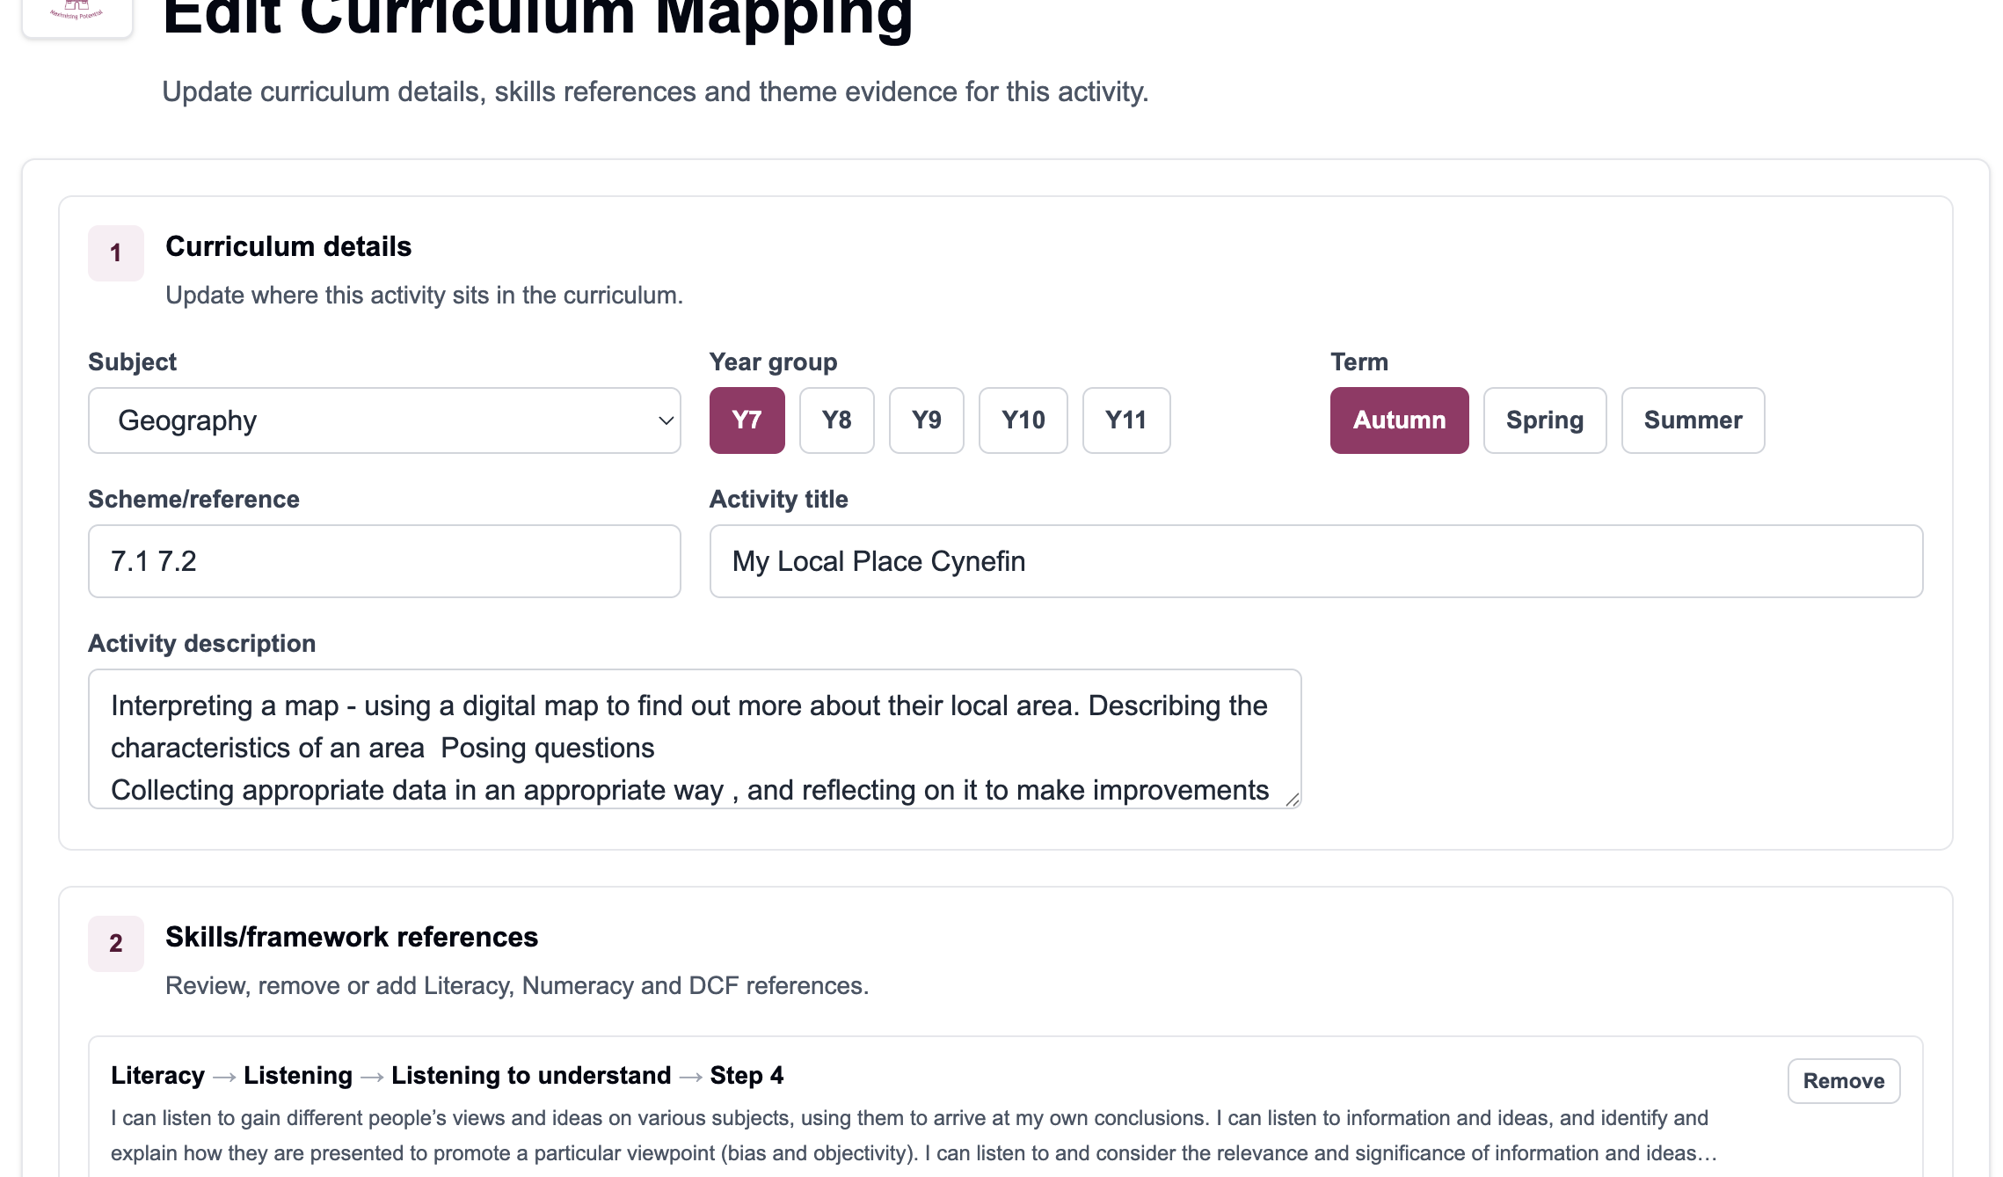
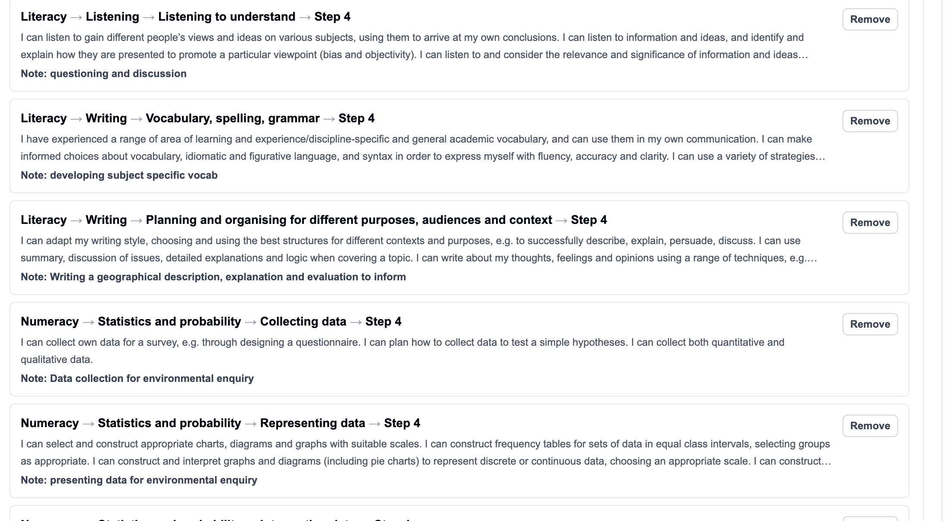
EDIT CURRICULUM ENTRY
Editing a mapping
Review the curriculum details and the linked framework references before saving.
- Update curriculum details
- Add or remove framework references
- Amend theme elements and notes
Save changes when the mapping is accurate.
Caerleon Skills Tracker
09

Slide 10
EDIT CURRICULUM ENTRY
Good editing practice
Keep the tracker useful by making each mapping specific and evidence-led.
- Avoid duplicate mappings for the same scheme or activity
- Use one entry per meaningful curriculum item
- Add only genuine skills evidence
- Use notes to explain judgement where needed
- Save after checking selected references
If a mapping needs major reworking, edit it carefully rather than starting again.
Only use Delete mapping when the entry should no longer exist.
Caerleon Skills Tracker
10

Slide 11
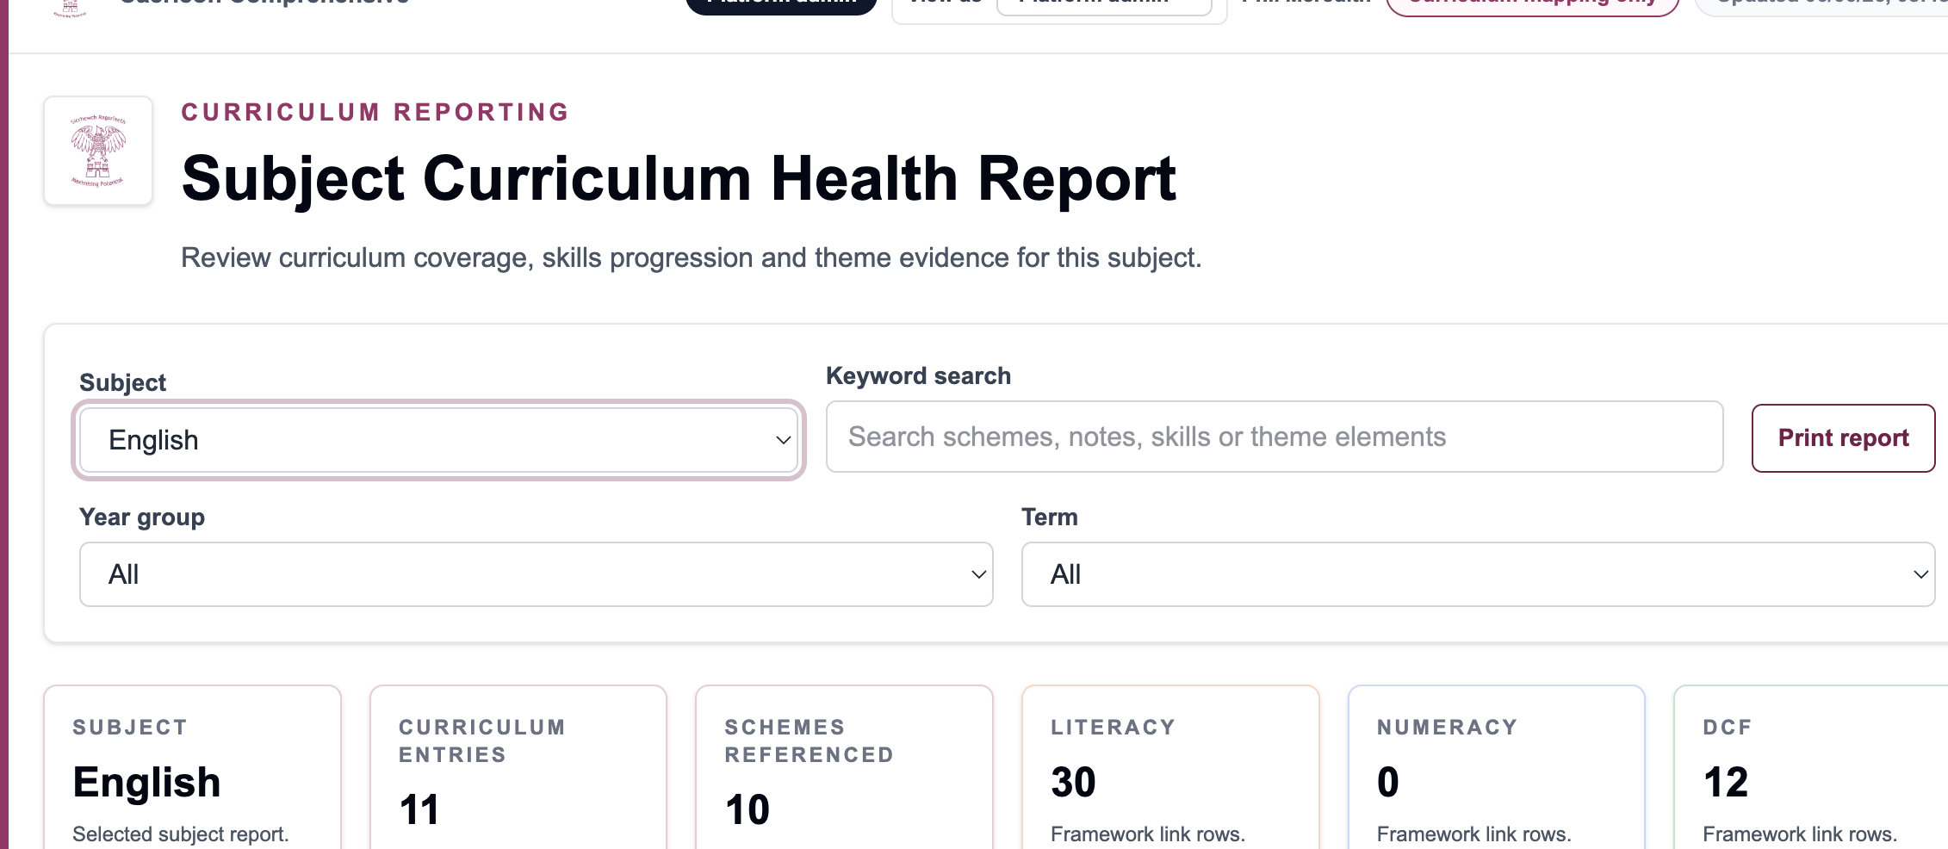
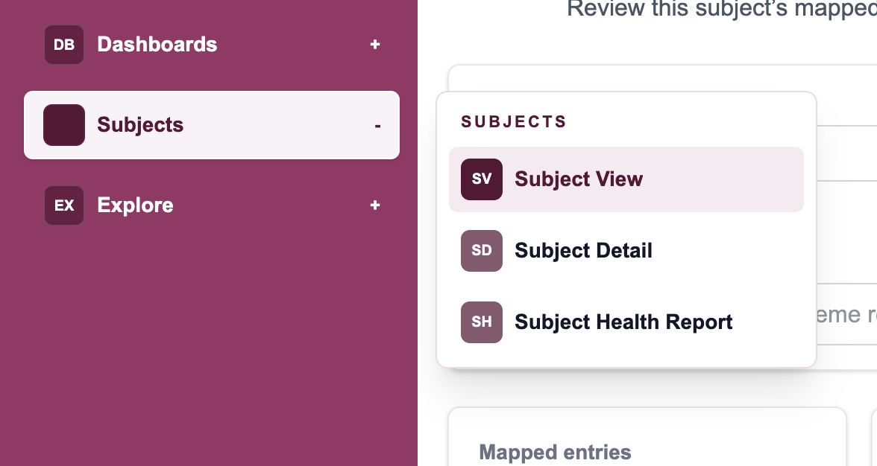
VIEW SUBJECT HEALTH
Subject Health overview
Subject leads can use this page to review curriculum coverage and identify useful next actions.
- Open Subject Health from the Subjects menu
- Select the subject and filters
- Review mapped schemes and framework coverage
- Use the report to spot gaps before improvement planning
Caerleon Skills Tracker
11

Slide 12
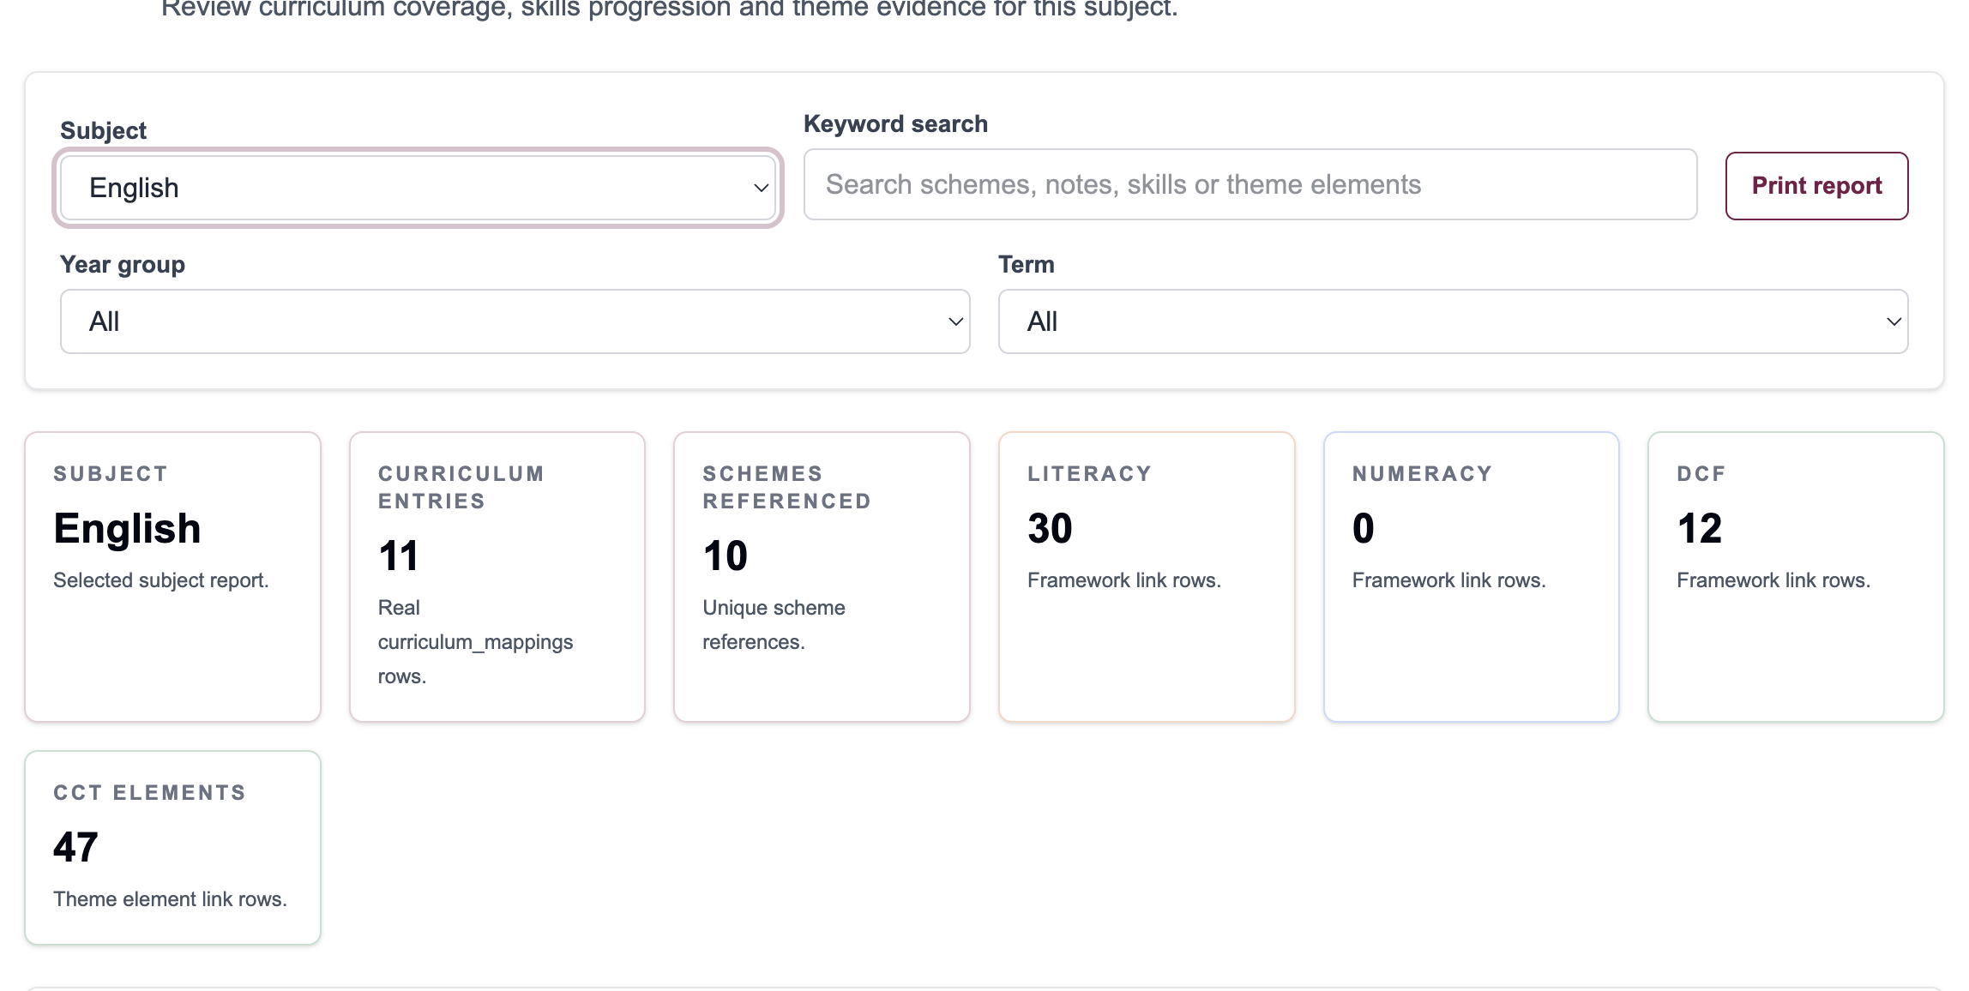
VIEW SUBJECT HEALTH
Reading the Subject Curriculum Journey
The report helps you see what is mapped and where coverage is thin.
Curriculum entries show how much mapped evidence exists.
Framework cards summarise Literacy, Numeracy and DCF rows.
Use the filter area to focus the report by year group or term.
Open mappings for improvement where coverage needs strengthening.
Caerleon Skills Tracker
12

Slide 13
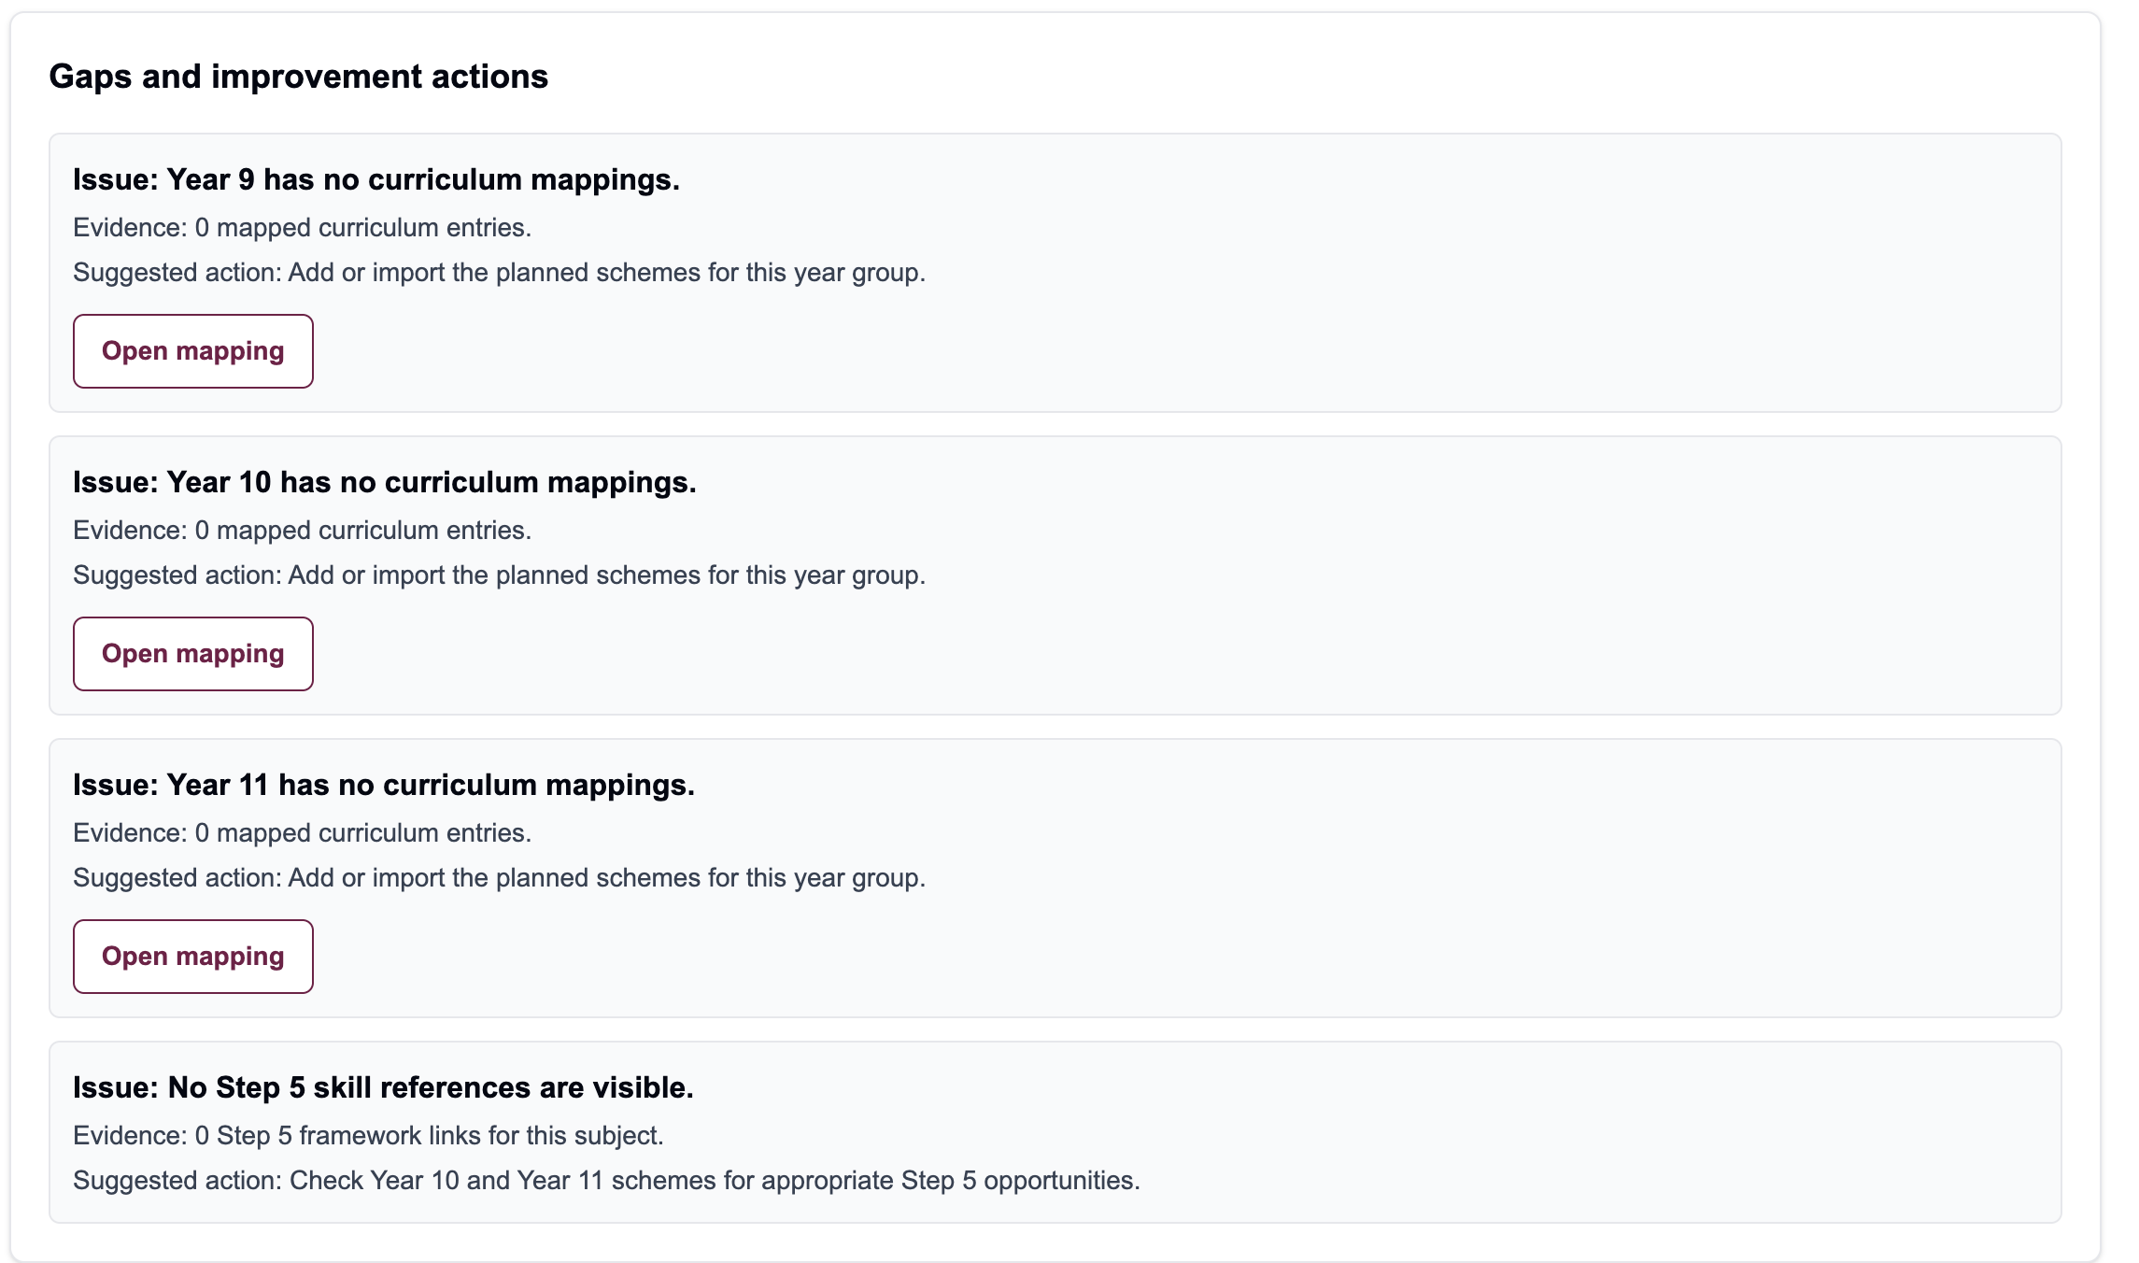
VIEW SUBJECT HEALTH
Spotting gaps and improvement actions
Use the report to turn curriculum coverage into practical follow-up work.
- Year groups with no mappings
- Schemes with no DCF evidence
- Schemes with no theme evidence
- Over-reliance on one framework
- Missing Step 5 challenge where it would be appropriate
Best use: agree one or two high-value actions, then update the relevant mappings.
Caerleon Skills Tracker
13

Slide 14
QUICK REFERENCE
Final checklist
Use this as a quick reminder when adding, editing or reviewing curriculum mappings.
Add Curriculum
Edit Curriculum
Subject Health
✓
Choose subject/year/term
✓
Browse by subject
✓
Select subject
✓
Add scheme and activity details
✓
Find the scheme
✓
Review mapped schemes
✓
Add skills
✓
Open edit
✓
Check gaps
✓
Add themes if relevant
✓
Check references
✓
Open items needing work
✓
Save
✓
Save changes
✓
Agree next action
Caerleon Skills Tracker
14

