Slide 1
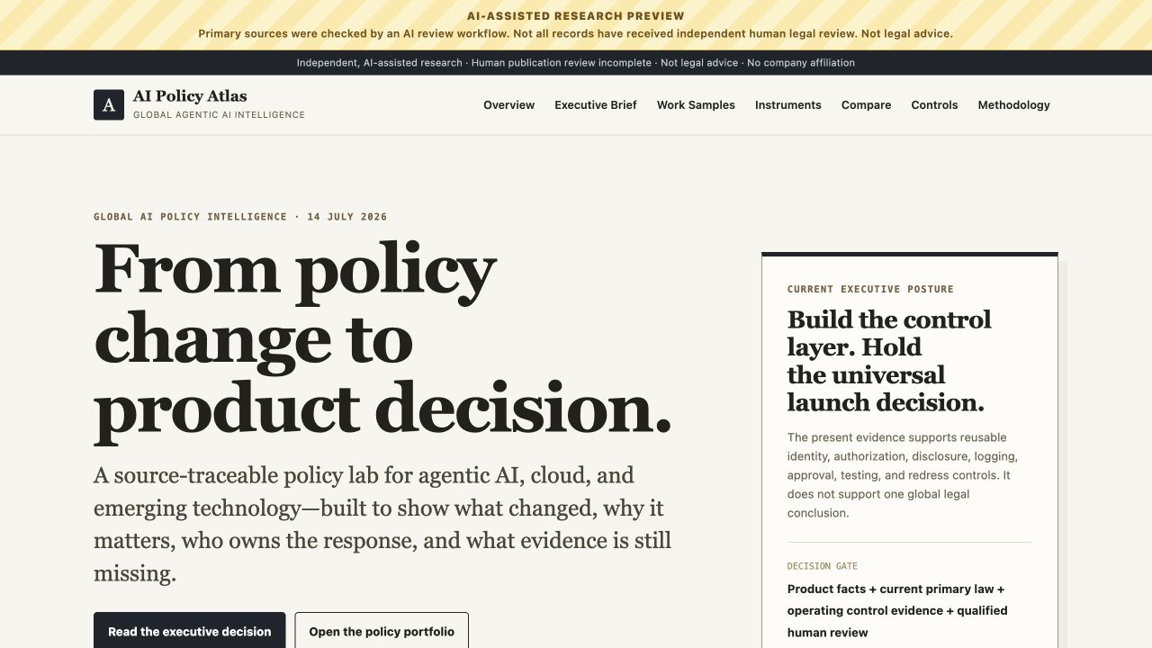
EXECUTIVE BRIEFING · 14 JULY 2026
POLICY → PRODUCT → EVIDENCE
Global AI policy: preserve launch options
Decision for leadership
Fund the shared control layer and a 30-day cross-functional review rhythm. Hold universal launch approval until product-market evidence is complete.
Independent portfolio work sample · not legal advice · no company affiliation
A source-traceable work sample
Official-source monitoring, market implications, control mapping, and explicit evidence gates.
1

Slide 2
Policy is accelerating capacity—and accountability
The executive tension
Infrastructure policy can widen capacity and commercial routes while standards and governance raise expectations for identity, disclosure, human accountability, and redress. Treat both as one operating problem.
CAPACITY + MARKET ACCESS
Faster buildout and proposed EU cloud expansion can widen supply, partnerships, and public-sector routes.
ACCOUNTABILITY + TRUST
Agent identity, authorization, disclosure, and redress are becoming policy and standards questions.
US · expedited qualifying data-center permitting
EU · CADA capacity, sustainability, sovereignty
NIST · secure identity, authorization, interoperability
EU + IMDA · transparency and bounded agency
Official sources: White House EO 14318; European Commission CADA proposal; NIST AI Agent Standards Initiative; European Commission Article 50 code; IMDA Model AI Governance Framework for Agentic AI. Checked 14 Jul 2026.
2

Slide 3
Market duties differ; the control baseline travels
Current official signals should change sequencing, ownership, and evidence—not be flattened into one global legal conclusion.
MARKET | VERIFIED SIGNAL | BUSINESS MEANING | 30-DAY MOVE
EU | Article 50 transparency from 2 Aug 2026; high-risk dates moved later. | Sequence disclosure work now; a delay is not a general pause. | Inventory covered surfaces; test disclosure and output marking.
US | BIS compute licensing guidance; NIST agent standards initiative. | Customer eligibility and agent protocols become product constraints. | Screen ultimate parent and end use; prepare identity + security evidence.
SINGAPORE | Agentic-AI governance framework plus sandbox insights. | Voluntary guidance is an assurance path, not binding law. | Crosswalk controls; select a low-risk sandbox use case.
KOREA | AI Basic Act and Enforcement Decree in force since 22 Jan 2026. | APAC launch planning needs market-specific classification. | Nominate a Korean-source owner; validate the use-case class.
Official sources: Council of the EU + European Commission (EU); BIS + NIST (US); IMDA (Singapore); MSIT (Republic of Korea). Facts checked 14 Jul 2026; implications are analysis.
3

Slide 4
Four controls preserve product options
The shared layer should reduce rework without pretending that one configuration satisfies every law, sector, or market.
01 IDENTITY + AUTHORIZATION
Short-lived credentials, deny-by-default scopes, and tool allowlists protect cloud-remediation agents and developer APIs.
02 ACTION EVIDENCE
Immutable logs, named decision owners, and rollback proof make assurance usable by security, legal, and enterprise buyers.
03 DISCLOSURE + PROVENANCE
First-interaction notices, output marking, and content metadata protect support, gaming, and social product surfaces.
04 HUMAN CONTROL + REDRESS
Approval thresholds, a kill switch, and an appeal path bound autonomy without discarding useful automation.
Analysis synthesized from the project Business Implications Matrix and scoped policy corpus. External signals: NIST agent standards; EU Article 50; IMDA agentic-AI framework. This control baseline is not a legal conclusion.
4

Slide 5
Thirty days to turn monitoring into decisions
Run one shared evidence cycle; issue product- and market-specific decisions at the end.
DAYS 0–7
DAYS 8–20
DAYS 21–30
Scope & own
• Product-market inventory • Named legal + policy owners • Dated re-verification triggers
Test & evidence
• Disclosure + redress UX • Identity, scopes, logs, rollback • Export + ownership screen
Decide & engage
• Market launch memo • Cross-functional evidence review • Standards or sandbox pack
Operating model synthesized from the project Intelligence Brief and Policy Radar. Monitoring inputs: official NIST, BIS, EU, IMDA, and MSIT sources cited in slides 2–3; reviewed 14 Jul 2026.
5

Slide 6
Approve shared controls. Hold universal launch.
APPROVE NOW
Shared control layer
Identity, authorization, logs, disclosure, approval gates, testing, and redress.
Operating rhythm
A 30-day review with named owners, dated triggers, and non-confidential evidence for standards or sandbox engagement.
REQUIRE BEFORE EACH LAUNCH
Decision evidence
Product facts, current primary law, and proof that the selected controls operate as intended.
Market judgment
Qualified human review and an explicit product-market launch memo. No score or sparse corpus substitutes for that judgment.
One architecture can preserve options. One legal conclusion cannot travel.
Recommendation is analytical work product based on the scoped portfolio evidence; it is not legal advice, a launch authorization, or a statement of company policy. Independent work sample; no company affiliation.
6

