Slide 1
Evaluation Methods: Part 1 Randomized Experiment
American Society of Criminology
November 14, 2023

Slide 2
Diagram of a Randomized Experiment
Randomization
Treatment Group
Control Group
Complier
Non-Complier
Complier
Non-Complier

Slide 3
Diagram of a Randomized Experiment
Randomization
Treatment Group
Control Group
Complier
Non-Complier
Complier
Non-Complier
Gets intervention they’re supposed to get
Fails to get their intended intervention
Does not get any intervention, as intended
Gets intervention on their own outside the study

Slide 4
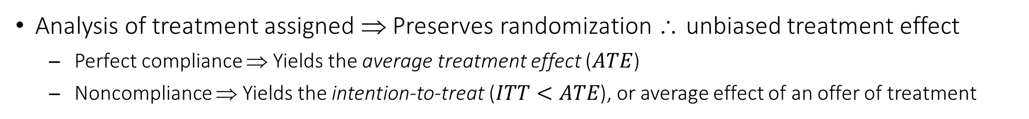
Intention-to-Treat Analysis
Randomization
Treatment Group
Control Group
Complier
Non-Complier
Complier
Non-Complier
Analysis of treatment assigned ⇒ Preserves randomization ∴ unbiased treatment effect
Perfect compliance ⇒ Yields the average treatment effect ($ATE$)
Noncompliance ⇒ Yields the intention-to-treat ($ITT<ATE$), or average effect of an offer of treatment

Slide 5
Per-Protocol Analysis
Randomization
Treatment Group
Control Group
Complier
Non-Complier
Complier
Non-Complier
Retains just the subset of each group that complies with their assigned treatment
Introduces endogenous sample selection ∴ biased treatment effect estimate

Slide 6
As-Treated Analysis
Randomization
Treatment Group
Control Group
Complier
Non-Complier
Complier
Non-Complier
Classifies units by treatment delivered rather than treatment assigned
Introduces endogenous treatment assignment∴ biased treatment effect estimate

Slide 7
Instrumental Variable Analysis
Randomization
Treatment Group
Control Group
Complier
Non-Complier
Complier
Non-Complier
Uses treatment assigned to instrument for treatment delivered in a two-stage analysis
Two-sided noncompliance ⇒ Yields the local average treatment effect (LATE), applicable to the compliers
One-sided noncompliance ⇒ LATE is equivalent to the average treatment effect on the treated (ATT)

Slide 8
Experimental Design
Impact of Supported Work on Earnings

Slide 9
Supported Work: Datafile
supported-work.csv
Variable | Description
id | Respondent ID
exp | = 1 if Experimental
stratum | Study Stratum
site | Study Site
pre.unemp | Unemployment Rate
pre.age | Pretest: Age
pre.male | Pretest: = 1 if Male
pre.race | Pretest: Race/Eth
pre.marr | Pretest: Marital Status
pre.educ | Pretest: Education
pre.empl | Pretest: = 1 if Employed
Variable | Description
pre.active | Pretest: Activity Last 4 Wks
pre.illeg | Pretest: Total Illegal Income
pre.months | Pretest: Prior Total Months
pre.hours | Pretest: Prior Total Hours
pre.earned | Pretest: Prior Total Earnings
trt.months | Program: Total Months
trt.hours | Program: Total Hours
trt.earned | Program: Total Earnings
out.months | Posttest: Total Months
out.hours | Posttest: Total Hours
out.earned | Posttest: Total Earnings

Slide 10
National Supported Work Demonstration
Job readiness program for hard-to-employ individuals (MDRC, 1980)
https://www.icpsr.umich.edu/web/ICPSR/studies/7865
Supported Work ⇒ Randomized offer of subsidized employment for up to 12 months, followed by search assistance to facilitate the transition into unsubsidized employment
Former AFDC recipients, formerly drug addicted, formerly incarcerated, high school non-completers
See applications in criminology by Uggen (2000) and Nguyen et al. (2023)
Outcome ⇒ Total earnings reported at the 27th month, which is the sum of earnings from months 19 to 27 (out.earned)
Treatment ⇒ Randomly assigned treatment (exp) and treatment take-up (trt.months)
QUESTION: Did the Supported Work program boost unsubsidized earnings?

Slide 11
Supported Work: Load Packages
library(drgee)
library(effectsize)
library(ivreg)
library(lmtest)
library(modelsummary)
library(ritest)
library(sandwich)
library(scales)
library(tidyverse)
These must already have been installed before they can be loaded, and this can be done using install.packages(). That command only needs to be run a single time (and updated from time to time), but library() must be run prior to every session that you wish to use a particular package.
Be sure to also set the default working directory using setwd() to specify the path to the data folder (PC users should note the use of forward slashes):
setwd("C:/projectfolder/datafolder")

Slide 12
Supported Work: Read in the Data
nsw <- read_csv("supported-work.csv")
names(nsw)
## [1] "id" "exp" "stratum" "site" "pre.unemp" "pre.age"
## [7] "pre.male" "pre.race" "pre.marr" "pre.educ" "pre.empl" "pre.activ"
## [13] "pre.illeg" "pre.months" "pre.hours" "pre.earned" "trt.months" "trt.hours"
## [19] "trt.earned" "out.months" "out.hours" "out.earned"
table(nsw$exp)
## contr exper
## 3339 3190
table(nsw$exp[nsw$out.earned != "NA"])
## contr exper
## 1515 1510
names() provides column headers of the specified data frame. The df$var convention references a specific variable from any data frame.
Subsetting brackets are a way to reference specific rows or columns in the specified object. Here, we are requesting a table of exp where out.earned is non-missing (denoted NA in R).

Slide 13
Using R for Data Visualization
ggplot() ⇒ Input data frame and basic aesthetic mapping
ggplot(data = df, mapping = aes(x = xvar, y = yvar))
Aesthetics passed to ggplot() are applied to every layer, and can include other options related to line color (color), fill color (fill), size (size), and shape (shape)
Layer on geometric objects (geoms) and other features using the plus sign
geom_bar (bar graph), geom_histogram (histogram), geom_density (kernel density plot), geom_line (time series plot), geom_point (point scatterplot), geom_jitter (jittered scatterplot), geom_smooth (line of best fit), etc.
Each layer has its own set of options that give us full control over the graph

Slide 14
Using R for Data Visualization
Use ggsave() to save a graph as a JPEG or PDF
ggsave("Fig.jpg", width = #, height = #, units = units)
The filename can have extension .jpg or .pdf, among others
width and height are in the specified units ("in" [default], "cm")
For Powerpoint slides, I use the options width = 13, height = 7.3
This will save the graph to the working directory, which we can override using another invocation of the setwd() command, or else manually specify the file path and name
Once saved, it is a simple matter to copy the file and paste it into a Powerpoint presentation or Word document

Slide 15
Supported Work: Distribution of Outcome Earnings
ggplot(nsw, aes(x = out.earned, fill = as.factor(exp), color = as.factor(exp))) +
geom_histogram(aes(y = after_stat(density)), binwidth = 1000, alpha = 0.2, position = "identity") +
labs(x = "Total Earnings", y = "Density", title = "Distribution of Earnings, by Treatment Assignment") +
scale_fill_hue(name = "Treatment Group", labels = c("Control", "Experimental")) +
scale_color_hue(name = "Treatment Group", labels = c("Control", "Experimental")) +
theme_gray(base_size = 15) +
theme(legend.position = c(0.8, 0.8)) +
scale_x_continuous(label = dollar_format())
This program plots histograms of outcome earnings (out.earned) by treatment group (exp). This histograms will be overlaid on top of each other with different colors. When specifying features by another variable, like fill color and line color, it is often a good idea to use as.factor() to ensure the specified variable is treated as a categorical or “factor” variable. It is not technically necessary here, since exp is already a character variable and will be factor coded by default.

Slide 16
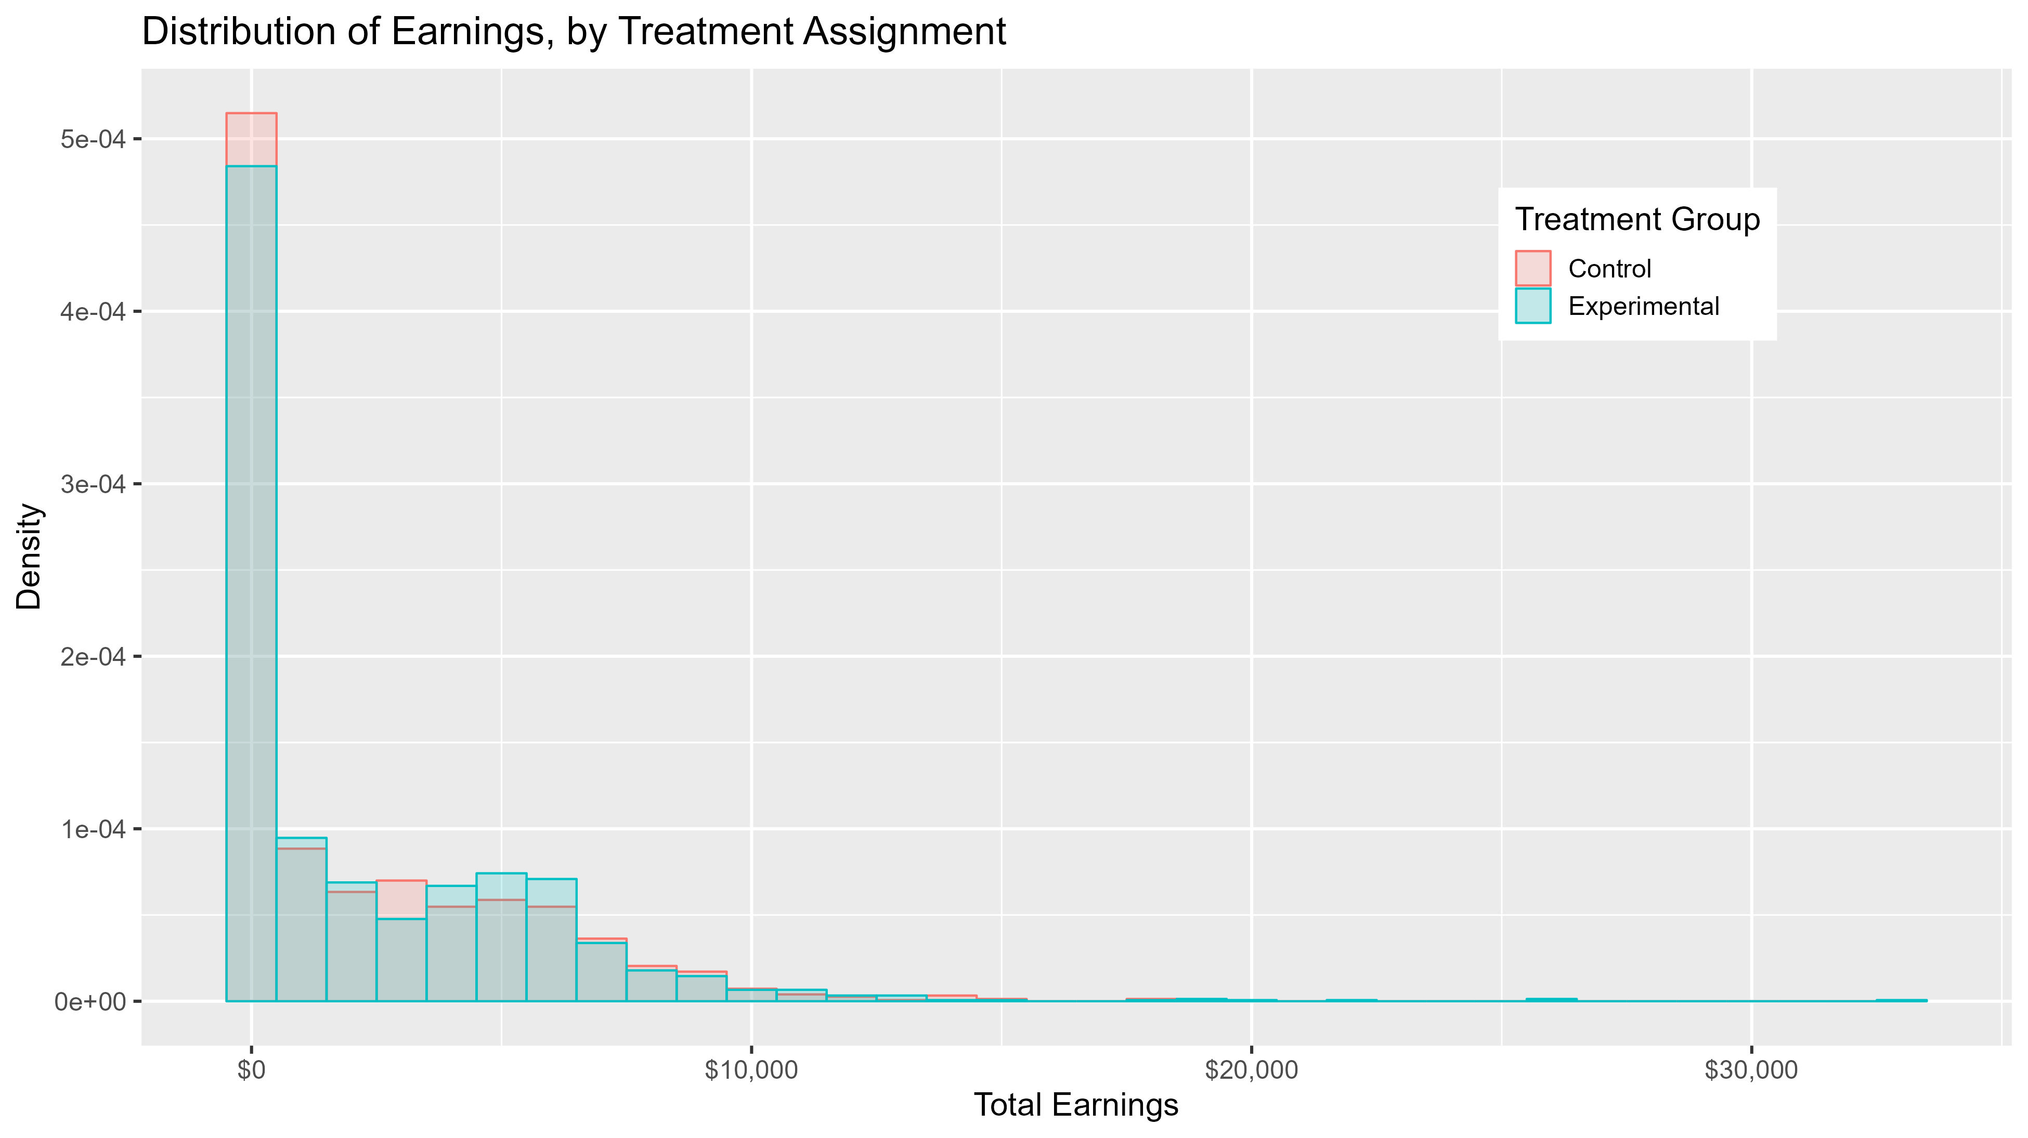
ggplot(nsw, aes(x = out.earned, fill = as.factor(exp), color = as.factor(exp))) + geom_histogram(aes(y = after_stat(density)), binwidth = 1000, alpha = 0.2, position = "identity") + labs(x = "Total Earnings", y = "Density", title = "Distribution of Earnings, by Treatment Assignment") + scale_fill_hue(name = "Treatment Group", labels = c("Control", "Experimental")) + scale_color_hue(name = "Treatment Group", labels = c("Control", "Experimental")) + theme_gray(base_size = 15) + theme(legend.position = c(0.8, 0.8)) + scale_x_continuous(label = dollar_format())

Slide 17
Notice there is higher density around $0 for the control group, and higher density around $5,000 for the experimental group.
Also notice earnings are highly skewed. In most applications, outliers are not necessarily a problem, unless there is also sparsity (which we have here). We would probably want to consider some kind of sensitivity analysis that transforms earnings, for example, a Poisson regression (see the appendix).

Slide 18
Supported Work: Distribution of Cumulative Earnings
ggplot(subset(nsw, out.earned <= 12000), aes(x = out.earned, color = exp)) +
stat_ecdf(geom = "step", pad = F, linewidth = 1) +
labs(x = "Total Earnings", y = "Empirical CDF", title = "Cumulative Distribution of Earnings, by Treatment Assignment") +
scale_color_hue(name = "Treatment Group", labels = c("Control", "Experimental")) +
theme_gray(base_size = 15) +
theme(legend.position = c(0.8, 0.2)) +
scale_x_continuous(label = dollar_format()) +
ylim(c(0.4, 1.0))
With this program, we will plot the cumulative earnings distributions by treatment group. When there is a lot of overlap, earnings differences can be easier to see in cumulative distributions as opposed to histograms. The subset() function removes outliers above $12,000.

Slide 19
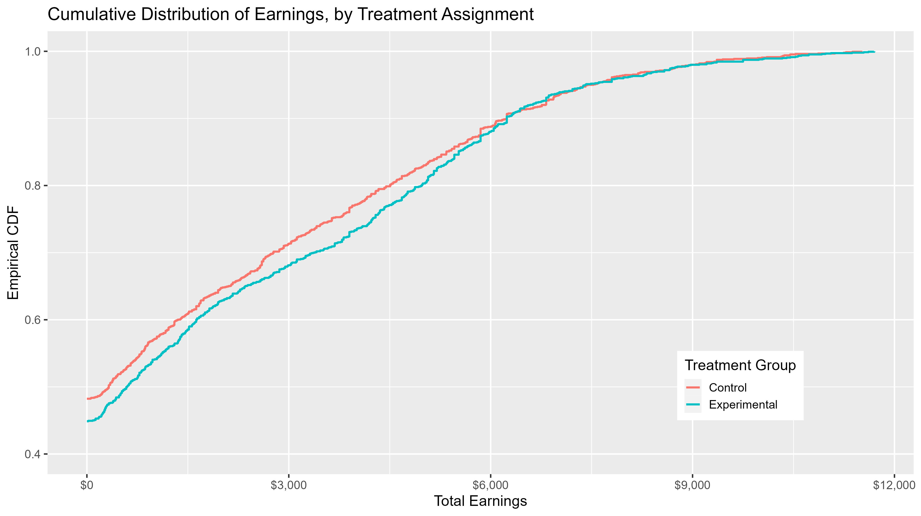
The fact the CDF for the control group (red line) is higher than the experimental group (blue line) indicates that total earnings are generally lower for the control group, at least up to $6,000. In this kind of graph, just remember that higher = lower!

Slide 20
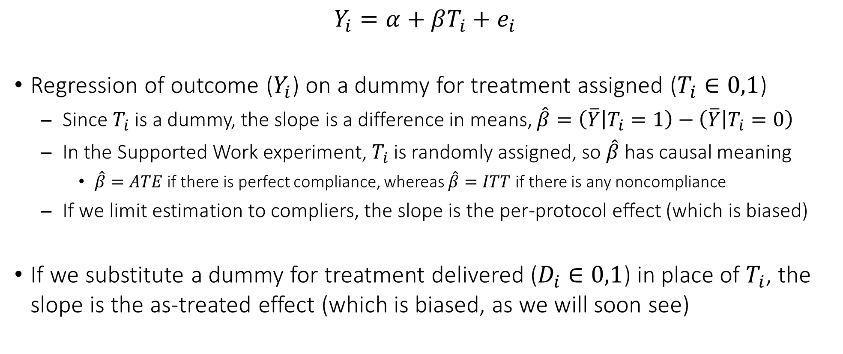
Regression Estimation of Treatment Effects
$$Y_{i}=α+βT_{i}+e_{i}$$
Regression of outcome ($Y_{i}$) on a dummy for treatment assigned ($T_{i}∈0,1$)
Since $T_{i}$ is a dummy, the slope is a difference in means, $\hat{β}=\left(\overline{Y} | T_{i}=1\right)−\left(\overline{Y} | T_{i}=0\right)$
In the Supported Work experiment, $T_{i}$ is randomly assigned, so $\hat{β}$ has causal meaning
$\hat{β}=ATE$ if there is perfect compliance, whereas $\hat{β}=ITT$ if there is any noncompliance
If we limit estimation to compliers, the slope is the per-protocol effect (which is biased)
If we substitute a dummy for treatment delivered ($D_{i}∈0,1$) in place of $T_{i}$, the slope is the as-treated effect (which is biased, as we will soon see)

Slide 21
Using R to Estimate a Linear Regression Model
obj <- lm(formula = yvar ~ tvar, weights = wgt, data = df, subset = rule)
yvar is the outcome variable, and tvar is the treatment group dummy
If we wish to estimate an intercept-only model, we would specify yvar ~ 1, but with covariates, the intercept is otherwise assumed
If there are other right-hand-side variables, they are linked with plus signs, yvar ~ tvar + xvar
The weights option yields the weighted least squares estimator, and takes any kind of weight (e.g., normed sampling weight)
The subset option takes any Boolean expression
If we prefer, the maximum likelihood estimator is available using the glm() command with the default family = gaussian option

Slide 22
Using R to Estimate a Linear Regression Model
When we store the lm() results as an object, the default is to provide analytical standard errors and confidence intervals
summary(obj) will tabulate results and confint(obj) will….you guessed it
tidy(obj, conf.int = T) and glance(obj) from the broom package
More complex standard errors use the lmtest and sandwich packages
coeftest(obj, vcov = vcovHC(obj, type = "type"))
Default type is HC3 (MacKinnon and White, 1985), compared to HC1 default in Stata (White, 1980)
coeftest(obj, vcov = vcovCL(obj, cluster = df$clustvar))
coeftest(obj, vcov = vcovBS(obj, R = #, seed = #))
Case resampling is the default, but we can request residual resampling or the wild bootstrap

Slide 23

Supported Work: Intention-to-Treat Analysis
fit.itt <- lm(out.earned ~ exp, data = nsw)
coeftest(fit.itt, vcov = vcovHC(fit.itt))
## t test of coefficients:
##
## Estimate Std. Error t value Pr(>|t|)
## (Intercept) 2095.149 75.581 27.7205 < 2e-16 ***
## expexper 223.928 112.714 1.9867 0.04705 *
## ---
## Signif. codes: 0 ‘***’ 0.001 ‘**’ 0.01 ‘*’ 0.05 ‘.’ 0.1 ‘ ’ 1
$$Y_{i}=α+βT_{i}+e_{i}$$
This regression model preserves the randomization, and yields the causal effect of an offer of treatment. In this case, it is the causal effect of being assigned to the Supported Work intervention. Individuals in Supported Work (irrespective of whether they took up the work offer) earn $ITT=\$224$ more than their peers not in Supported Work.

Slide 24
Supported Work: Identify Complier Status
nsw <- nsw %>% mutate(trt.worked = if_else(trt.months > 0, 1, 0),
complier = case_when(exp == "exper" & trt.months > 0 ~ 1,
exp == "contr" & trt.months == 0 ~ 1,
TRUE ~ 0))
nsw %>% filter(trt.worked != "NA") %>%
group_by(exp) %>% summarize(n = n(),
pwork = mean(trt.worked, na.rm = T),
pcomp = mean(complier, na.rm = T))
## # A tibble: 2 × 4
## exp n pwork pcomp
## <chr> <int> <dbl> <dbl>
## 1 contr 2929 0.629 0.371
## 2 exper 2875 0.943 0.943
if_else() creates a new variable from a simple expression, whereas case_when() creates a new variable from a more complex set of expressions. Note that TRUE is identical to “all else.” We want two new variables: trt.worked identifies units who worked during the intervention period (irrespective of what their assigned treatment was), and complier identifies units that complied with their assigned treatment.

Slide 25
Supported Work: Per-Protocol Analysis
fit.per <- lm(out.earned ~ exp, data = nsw, subset = complier == 1)
coeftest(fit.per, vcov = vcovHC(fit.per))
## t test of coefficients:
##
## Estimate Std. Error t value Pr(>|t|)
## (Intercept) 717.528 72.794 9.8569 < 2.2e-16 ***
## expexper 1700.350 115.148 14.7666 < 2.2e-16 ***
## ---
## Signif. codes: 0 ‘***’ 0.001 ‘**’ 0.01 ‘*’ 0.05 ‘.’ 0.1 ‘ ’ 1
The model is the same as before, but the sample is subset to include only those who complied with their treatment assignment—units assigned to Supported Work who actually worked during the treatment period, and units assigned to the control group who did not work. Workers who complied earn $1,700 more than non-workers who complied.

Slide 26

Supported Work: As-Treated Analysis
fit.trt <- lm(out.earned ~ trt.worked, data = nsw)
coeftest(fit.trt, vcov = vcovHC(fit.trt))
## t test of coefficients:
##
## Estimate Std. Error t value Pr(>|t|)
## (Intercept) 708.604 66.484 10.658 < 2.2e-16 ***
## trt.worked 1909.143 95.438 20.004 < 2.2e-16 ***
## ---
## Signif. codes: 0 ‘***’ 0.001 ‘**’ 0.01 ‘*’ 0.05 ‘.’ 0.1 ‘ ’ 1
$$Y_{i}=α+βD_{i}+e_{i}$$
This is a model of the treatment delivered, or treatment take-up, irrespective of what group individuals were assigned to. Individuals who were employed at all during the intervention period earn $1,909 more than their peers who were not employed at all during the intervention period.

Slide 27
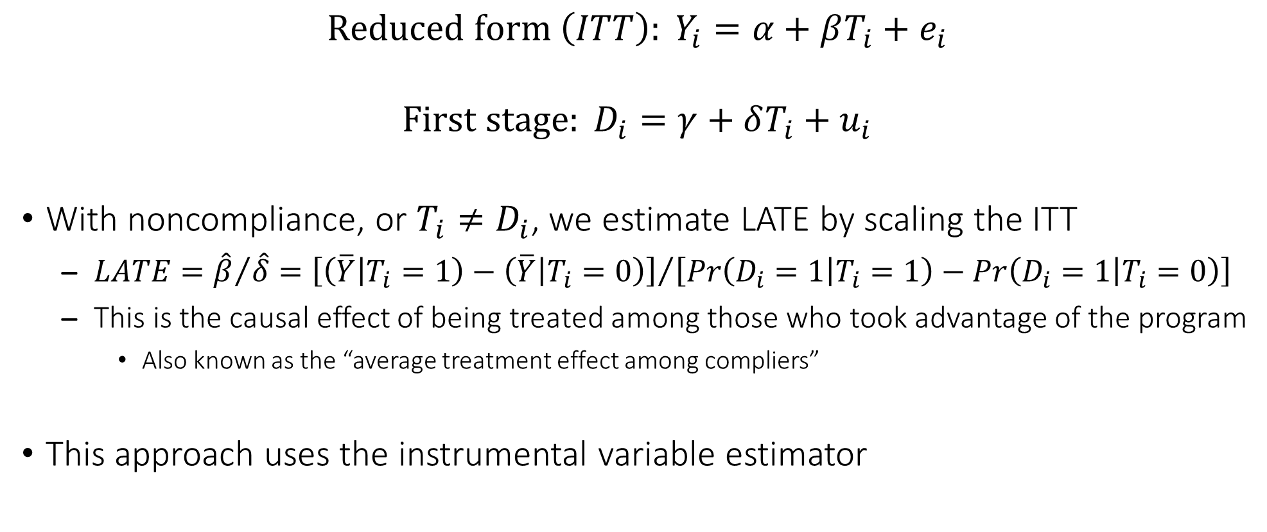
Regression Estimation of Local Average Treatment Effect
$$Reduced form \left(ITT\right): Y_{i}=α+βT_{i}+e_{i}$$
$$First stage: D_{i}=γ+δT_{i}+u_{i}$$
With noncompliance, or $T_{i}≠D_{i}$, we estimate LATE by scaling the ITT
$LATE={\hat{β}}/{\hat{δ}}={\left[\left(\overline{Y} | T_{i}=1\right)−\left(\overline{Y} | T_{i}=0\right)\right]}/{\left[Pr\left(D_{i}=1 | T_{i}=1\right)−Pr\left(D_{i}=1 | T_{i}=0\right)\right]}$
This is the causal effect of being treated among those who took advantage of the program
Also known as the “average treatment effect among compliers”
This approach uses the instrumental variable estimator

Slide 28
Using R to Estimate an Instrumental Variable Model
ivreg(formula = yvar ~ 1 | dvar | tvar, data = df)
yvar is the outcome variable, dvar is the endogenous treatment variable (treatment delivered), and tvar is the instrumental variable (treatment assigned)
yvar ~ 1 indicates there are no control variables (1 just represents the constant), but controls can be added using yvar ~ xvar | dvar | tvar (1 need not be listed, in that case)
If the pipes (|) are excluded, the model reduces to ordinary least squares
This is actually an as-treated analysis, but one where the treatment delivered is instrumented by the treatment assigned
Robust standard errors can be obtained in the usual way from the lmtest and sandwich packages

Slide 29

Supported Work: Instrumental Variable Analysis
fit.ive <- ivreg(out.earned ~ 1 | trt.worked | exp, data = nsw)
coeftest(fit.ive, vcov = vcovHC(fit.ive))
## t test of coefficients:
##
## Estimate Std. Error t value Pr(>|t|)
## (Intercept) 1638.42 270.18 6.0643 1.495e-09 ***
## trt.worked 717.32 348.97 2.0555 0.03992 *
## ---
## Signif. codes: 0 ‘***’ 0.001 ‘**’ 0.01 ‘*’ 0.05 ‘.’ 0.1 ‘ ’ 1
$$Y_{i}=α+βT_{i}+e_{i}$$
$$D_{i}=γ+δT_{i}+u_{i}$$
This model scales the intention-to-treat ($\hat{β}$) by the difference in treatment take-up between the treatment and control groups ($\hat{δ}$). The estimate indicates individuals who were employed because they were given an unsubsidized work opportunity earn $LATE=\$717$ more than peers who were not employed because they were not given a work opportunity.
R and Stata produce slightly different standard errors here, in part because R makes a small-sample correction. You can reproduce Stata if you specify type = "HC0".

Slide 30
Supported Work: Report All Estimates
modelsummary(list("ITT" = fit.itt, "PP" = fit.per, "AT" = fit.trt, "LATE" = fit.ive), vcov = vcovHC, gof_map = c("nobs"), estimate = "{estimate}{stars}", fmt = 1)
##
## | | ITT | PP | AT | LATE |
## |:------------|----------:|----------:|----------:|----------:|
## | (Intercept) | 2095.1*** | 717.5*** | 708.6*** | 1638.4*** |
## | | (75.6) | (72.8) | (66.5) | (270.2) |
## | expexper | 223.9* | 1700.3*** | | |
## | | (112.7) | (115.1) | | |
## | trt.worked | | | 1909.1*** | 717.3* |
## | | | | (95.4) | (349.0) |
## |:------------|----------:|----------:|----------:|----------:|
## | Num.Obs. | 3025 | 1940 | 2934 | 2934 |
The only valid estimates here are ITT and LATE. The per-protocol and as-treated estimates are not valid treatment effects.

Slide 31
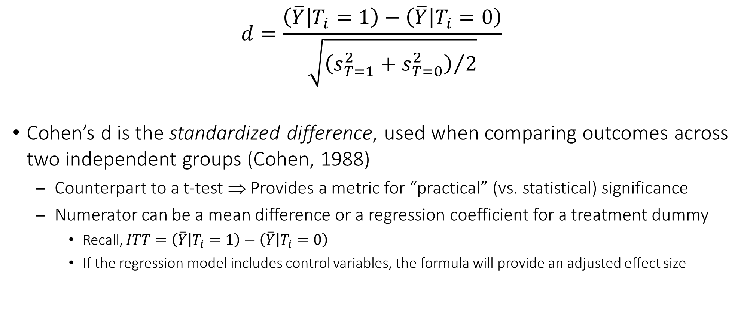
Digression on Effect Sizes
$$d=\frac{\left(\overline{Y} | T_{i}=1\right)−\left(\overline{Y} | T_{i}=0\right)}{\sqrt{{\left(s_{T=1}^{2}+s_{T=0}^{2}\right)}/2}}$$
Cohen’s d is the standardized difference, used when comparing outcomes across two independent groups (Cohen, 1988)
Counterpart to a t-test ⇒ Provides a metric for “practical” (vs. statistical) significance
Numerator can be a mean difference or a regression coefficient for a treatment dummy
Recall, $ITT=\left(\overline{Y} | T_{i}=1\right)−\left(\overline{Y} | T_{i}=0\right)$
If the regression model includes control variables, the formula will provide an adjusted effect size

Slide 32
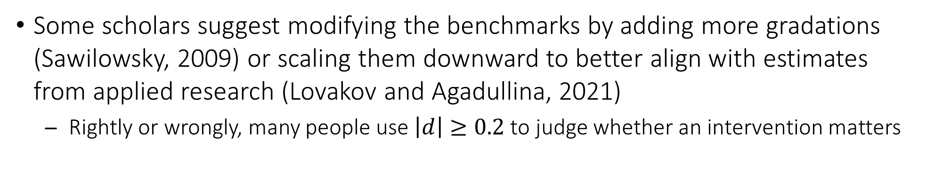
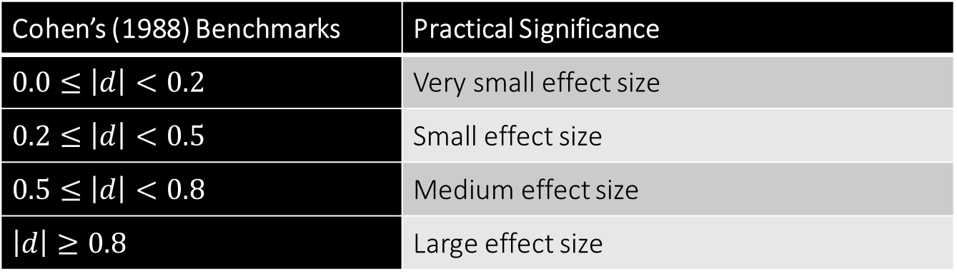
Digression on Effect Sizes
Cohen’s (1988) Benchmarks | Practical Significance
$$0.0≤\left|d\right|<0.2$$ | Very small effect size
$$0.2≤\left|d\right|<0.5$$ | Small effect size
$$0.5≤\left|d\right|<0.8$$ | Medium effect size
$$\left|d\right|≥0.8$$ | Large effect size
Some scholars suggest modifying the benchmarks by adding more gradations (Sawilowsky, 2009) or scaling them downward to better align with estimates from applied research (Lovakov and Agadullina, 2021)
Rightly or wrongly, many people use $\left|d\right|≥0.2$ to judge whether an intervention matters

Slide 33

Supported Work: Effect Size for the ITT
d <- cohens_d(out.earned ~ exp, pooled_sd = F, data = nsw)
d
## Cohen's d | 95% CI
## --------------------------
## -0.07 | [-0.14, 0.00]
##
## - Estimated using un-pooled SD.
interpret_cohens_d(d$Cohens_d, rules = "cohen1988")
## [1] "very small"
## (Rules: cohen1988)
The effectsize package automates calculation of Cohen’s d. Just note that the sign is switched from what it should be, because of the order in which groups are entered. The estimate for our data is $d=0.07$, which would be regarded as a very small effect, even though statistically significant.
interpret_cohens_d() will apply Cohen’s (1988) benchmarks, or else alternative benchmarks specified via the rules option.

Slide 34

Supported Work: Effect Size for the LATE
d$Cohens_d
## [1] -0.07227347
coef(fit.itt)
## (Intercept) expexper
## 2095.1492 223.9285
coef(fit.ive)
## (Intercept) trt.worked
## 1638.422 717.318
d$Cohens_d * (coef(fit.ive)[2] / coef(fit.itt)[2])
## trt.worked
## -0.2315162
Because cohens_d() only takes lm()-type objects, we cannot use it to directly calculate an effect size for the LATE from ivreg(). However, we can trick the program into giving us the LATE effect size by noting the following about Cohen’s d:
$$d_{ITT}=\frac{ITT}{SD}⇝d_{LATE}=d_{ITT}\frac{LATE}{ITT}$$
We merely need to substitute a different numerator. We can use coef() with subsetting brackets to extract the ITT and LATE from their respective model results. Notice we an effect size for the LATE ($d=0.23$) that exceeds the threshold for a small effect size.

Slide 35
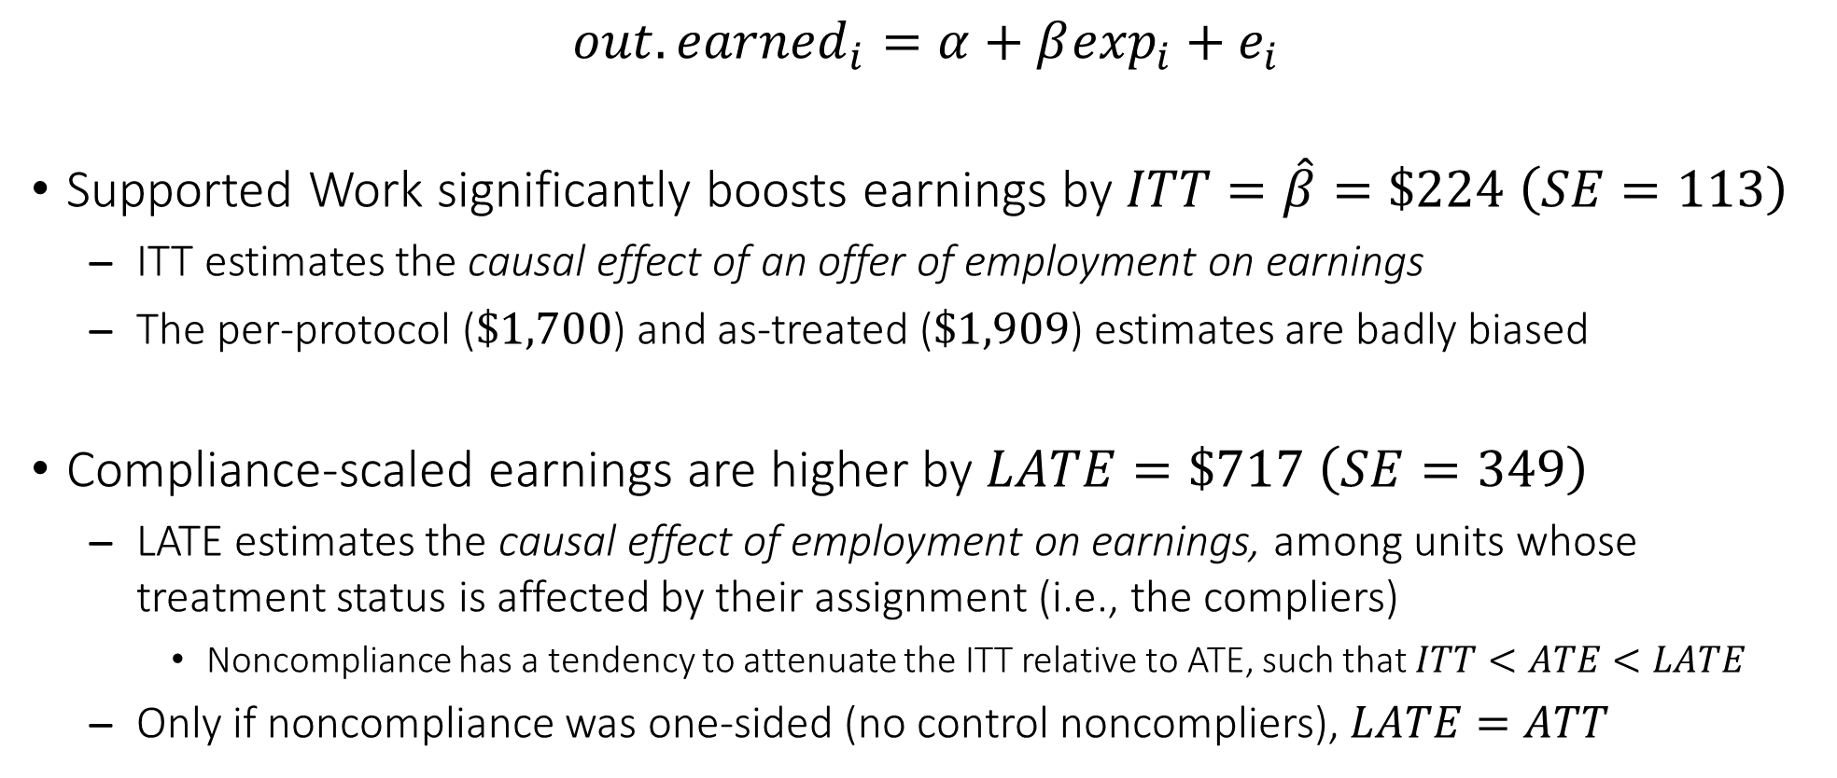
Summary Findings about the Supported Work Program
$${out.earned}_{i}=α+β\exp_{i}+e_{i}$$
Supported Work significantly boosts earnings by $ITT=\hat{β}=\$224 \left(SE=113\right)$
ITT estimates the causal effect of an offer of employment on earnings
The per-protocol ($\$1,700$) and as-treated ($\$1,909$) estimates are badly biased
Compliance-scaled earnings are higher by $LATE=\$717 \left(SE=349\right)$
LATE estimates the causal effect of employment on earnings, among units whose treatment status is affected by their assignment (i.e., the compliers)
Noncompliance has a tendency to attenuate the ITT relative to ATE, such that $ITT<ATE<LATE$
Only if noncompliance was one-sided (no control noncompliers), $LATE=ATT$

Slide 36
Some Advanced Methods with Experimental Data
Randomization inference ⇒ Obtain an exact p-value for the ITT estimate that adjusts for variation arising from randomization itself
Regression adjustment ⇒ Adjust for pretest covariates semi-parametrically rather than as control variables in a standard regression model
Reweighting estimator ⇒ Adjust for missing outcome data from study dropout (post-random assignment), incorporating pretest covariates

Slide 37
Randomization Inference
Standard tests of statistical significance are rooted in sampling error and the asymptotic behavior of estimators (e.g., central limit theorem)
The p-value assumes an underlying distribution of infinite estimates, and the sample estimate represents a hypothetical random draw from this distribution
In an RCT, variation arises from randomization, not from sampling
The p-value should be computed based on variation in hypothetical experimental group assignment, not based on a hypothetical draw from a sampling distribution
Imagine re-randomizing units to the experimental and control groups over and over, computing the ITT each time, and then plotting the full distribution of the “placebo ITTs”
The exact p-value for the original ITT can be obtained, without any asymptotic assumptions

Slide 38
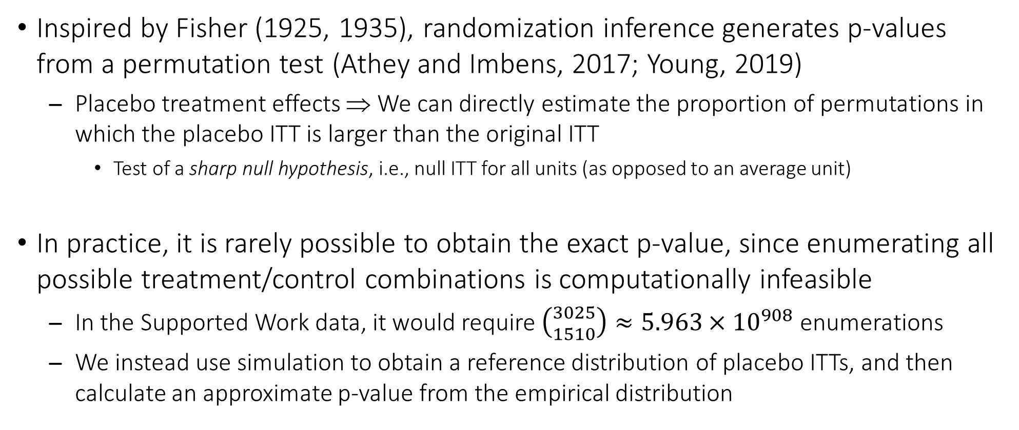
Randomization Inference
Inspired by Fisher (1925, 1935), randomization inference generates p-values from a permutation test (Athey and Imbens, 2017; Young, 2019)
Placebo treatment effects ⇒ We can directly estimate the proportion of permutations in which the placebo ITT is larger than the original ITT
Test of a sharp null hypothesis, i.e., null ITT for all units (as opposed to an average unit)
In practice, it is rarely possible to obtain the exact p-value, since enumerating all possible treatment/control combinations is computationally infeasible
In the Supported Work data, it would require $\left({3025 \atop 1510}\right)≈5.963×{10}^{908}$ enumerations
We instead use simulation to obtain a reference distribution of placebo ITTs, and then calculate an approximate p-value from the empirical distribution

Slide 39
Using R for Randomization Inference
ritest(object = obj, resampvar = "tvarcoef", reps = #, seed = #)
obj is the name of an lm() object containing the original ITT
tvarcoef refers to the name of the coefficient for the treatment variable as shown in the regression output (not the name of the variable)
reps is the number of repetitions or reassignments
seed is the seed for the random number generator to ensure results are reproducible
Small samples, simple random assignment, and well-behaved outcomes require as few as 1,000 repetitions, but large samples, complex random assignment (e.g., cluster randomization), or skewed outcomes may require many more

Slide 40
Supported Work: Randomization Inference
ri <- ritest(fit.itt, "expexper", reps = 1000, seed = 20231114)
ri
## Call: lm(formula = out.earned ~ exp, data = nsw)
## Res. var(s): expexper
## H0: expexper=0
## Num. reps: 1000
## ─────────────────────────────────────────────────────────────────────────
## T(obs) c n p=c/n SE(p) CI 2.5% CI 97.5%
## 223.9 46 1000 0.046 0.0109 0.02807 0.06393
## ─────────────────────────────────────────────────────────────────────────
## Note: Confidence interval is with respect to p=c/n.
## Note: c = #{|T| >= |T(obs)|}
The key output is the column headed by p=c/n, and is the two-sided proportion of placebo treatment effects that exceed the original ITT estimate (see the note to the table).
A nice feature of ritest() is we get a confidence interval for the p-value. We would like for the interval to exclude 0.05, which does not apply here.

Slide 41
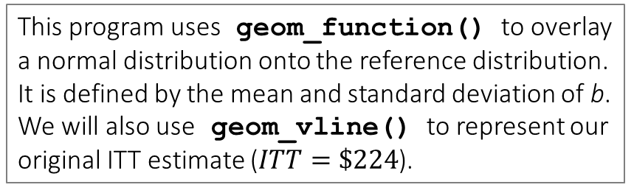
Supported Work: Graph of Placebo ITTs
ri.coef <- data.frame(b = ri$betas)
ggplot(ri.coef, aes(x = b)) +
geom_histogram(aes(y = after_stat(density)), binwidth = 20) +
geom_function(fun = dnorm, args = list(mean = mean(ri.coef$b), sd = sd(ri.coef$b)), color = "blue", linetype = "dashed", linewidth = 1.2) +
geom_vline(xintercept = coef(fit.itt)[2], linetype = "dashed") +
labs(x = "Impact of Supported Work on Earnings", y = "Density", title = "Distribution of Intention-to-Treat Coefficients") +
theme_gray(base_size = 15) +
scale_x_continuous(label = dollar_format())
Here we produce a histogram of all 1,000 placebo ITTs, to visualize the reference distribution and original ITT estimate.
This program uses geom_function() to overlay a normal distribution onto the reference distribution. It is defined by the mean and standard deviation of b. We will also use geom_vline() to represent our original ITT estimate ($ITT=\$224$).

Slide 42
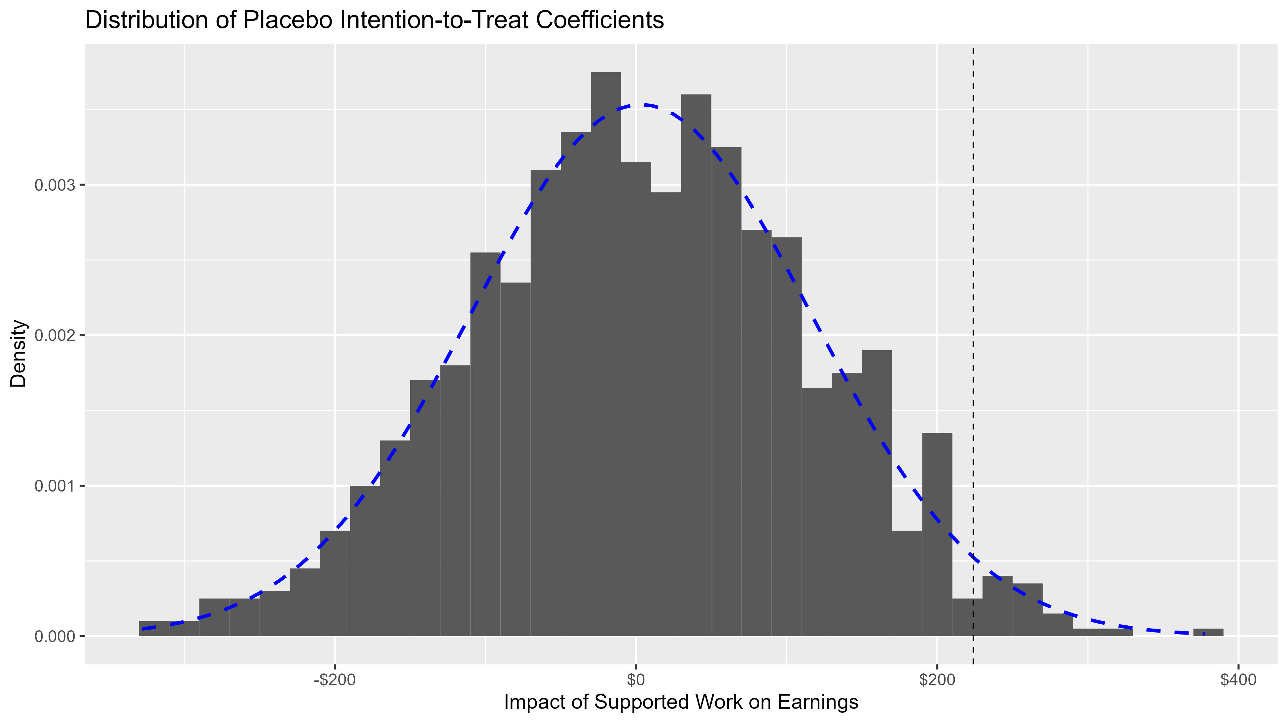
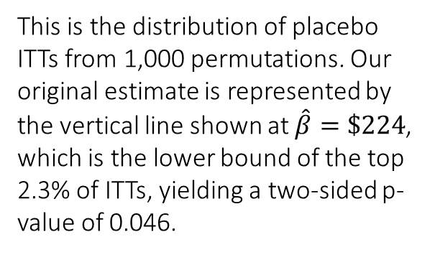
This is the distribution of placebo ITTs from 1,000 permutations. Our original estimate is represented by the vertical line shown at $\hat{β}=\$224$, which is the lower bound of the top 2.3% of ITTs, yielding a two-sided p-value of 0.046.

Slide 43
Summary of Randomization Inference
The asymptotic p-value is 0.047, and the p-value obtained from randomization inference is 0.046, which gives us confidence in the original result
With RCTs, it is becoming standard practice to use randomization inference to obtain p-values, at least to accompany asymptotic p-values
A p-value takes into account uncertainty, and in an RCT, the chief source of uncertainty stems from the random assignment, not from the sampling process
Someone assigned to the treatment group could have instead been assigned to the control group
Many RCTs use convenience samples anyway, rather than representative samples, which at any rate calls into question the sampling assumptions underlying asymptotic p-values
With enough computing power, we could estimate an exact p-value, but with even modestly-sized samples, simulations are required

Slide 44
Regression Adjustment
We think of regression adjustment as just including pretest covariates as control variables in a regression model, but regression adjustment has new meaning in the context of treatment effect estimation
Contrast of the average of group-specific predicted outcomes
Imagine estimating separate regression models for the treatment and control groups, and using the coefficients to obtain outcomes for all subjects under both treatment regimes
For units in the treatment group, they have (1) a prediction based on their treatment-group-specific regression model as well as (2) an extrapolation based on a control-group-specific regression model
The estimate of the treatment effect for each unit is then just the difference between their predicted and extrapolated outcomes

Slide 45
Using R for Regression Adjustment
drgee(oformula = yvar ~ xvarlist, exposure = "tvar", estimation.method = "type", data = df)
xvarlist provides the covariate names, xvar1 + xvar2 + ⋅ ⋅ ⋅ + xvarK
oformula is the outcome model specification, excluding tvar
The estimation.method option takes "o" (outcome model only), "e" (exposure model only), or "dr" (doubly robust)
We will use the outcome model only, since we are not specifying an exposure model
Robust standard errors are reported
For additional documentation of drgee, see Zetterqvist and Sjölander (2015)

Slide 46
Supported Work: Variable Prep for Balance Tests
nsw <- nsw %>% mutate(pre.worked = if_else(pre.months > 0, 1, 0),
pre.unemp.ln = log(pre.unemp),
pre.illeg.ln = log1p(pre.illeg),
pre.hours.ln = log1p(pre.hours),
pre.earned.ln = log1p(pre.earned))
covars <- cbind(nsw$pre.age, nsw$pre.male, nsw$pre.race, nsw$pre.marr, nsw$pre.educ, nsw$pre.empl, nsw$pre.activ, nsw$pre.unemp.ln, nsw$pre.illeg.ln, nsw$pre.worked, nsw$pre.months, nsw$pre.hours.ln, nsw$pre.earned.ln)
Let’s log the continuous pretest measures. Because hours and earnings have 0s, we will use log1p(), which adds 1 to each value.
cbind() combines the specified columns into a new data frame. We need to separate them from the original data frame because we are going to write a function that loops through each of them to perform a test of balance.

Slide 47
Supported Work: Loop through Balance Tests
bal <- matrix(NA, 13, 4)
rownames(bal) <- c("age", "male", "race", "marr", "educ", "empl", "activ", "unemp", "illeg", "worked", "months", "hours", "earned")
colnames(bal) <- c("F-stat", "df-num", "df-denom", "p-val")
for (i in 1:ncol(covars)) {
est <- lm(as.numeric(as.factor(nsw$exp)) ~ covars[, i])
fstat <- summary(est)$fstatistic
bal[i, 1] <- round(fstat[1], 2)
bal[i, 2] <- round(fstat[2], 0)
bal[i, 3] <- round(fstat[3], 0)
bal[i, 4] <- round(pf(fstat[1], fstat[2], fstat[3], lower.tail = F), 4)
}
We are going to create an empty 13 × 4 matrix, where each row represents a pretest variable. Then one by one, we will regress treatment group (exp) on the pretest variable, store the F-test and degrees of freedom, and then compute the corresponding p-value.

Slide 48
Supported Work: Balance Matrix
bal
## F-stat df-num df-denom p-val
## age 1.53 4 6385 0.1903
## male 0.39 1 6527 0.5341
## race 1.62 2 6406 0.1974
## marr 0.00 2 6480 0.9998
## educ 1.51 2 6462 0.2201
## empl 0.00 1 6389 0.9884
## activ 1.23 4 5776 0.2945
## unemp 1.29 1 6388 0.2561
## illeg 0.53 1 6389 0.4684
## worked 1.31 1 6418 0.2520
## months 0.05 1 6418 0.8186
## hours 0.96 1 6406 0.3285
## earned 0.69 1 6399 0.4074
Here is the resulting balance matrix. A significant F-test is an indication that the treatment and control groups are imbalanced at pretest. There is no indication this is the case, which is good affirmation of success of the randomization.
If we wished to do so, we could add a subset option to lm() inside the loop to restrict the model to individuals with non-missing outcome earnings. Doing so would still not provide any evidence of imbalance between the treatment groups.
Because pre.activ has a lot more non-response (notice the denominator degrees of freedom), we will exclude it from the regression adjustment approach.

Slide 49
Supported Work: ITT with Regression Adjustment
fit.itt.ra <- drgee(oformula = out.earned ~ stratum + pre.age + pre.male + pre.race + pre.marr + pre.educ + pre.empl + pre.unemp.ln + pre.illeg.ln + pre.worked + pre.months + pre.hours.ln + pre.earned.ln, exposure = "exp", estimation.method = "o", data = nsw)
summary(fit.itt.ra)$coefficients
## Estimate Std. Error z value Pr(>|z|)
## expexper 221.4122 112.7082 1.964474 0.04947518
For regression adjustment, we will exclude pre.activ (too many missing values) and include stratum. Because the treatment and control groups are very well balanced, we do not expect a major difference between the adjusted ITT and the unadjusted ITT. Indeed, the adjusted ITT is $221 (compared to $224 for the unadjusted ITT), and statistically significant.

Slide 50
Summary of Regression Adjustment
Regression adjustment proceeds via separate regression functions and averages over the difference in group-specific distributions of the pretest covariates
Each subject has two predicted outcomes, one assuming treated and one untreated
The “counterfactual” outcome is an extrapolation using the coefficients obtained from subjects assigned to the other treatment group
The ITT is estimated non-parametrically, even though the predicted and extrapolated outcomes are obtained parametrically
Regression adjustment can be expanded in very flexible ways
Generalized linear model ⇒ Outcome model other than normal-error model is possible, although only the logit is available in drgee()

Slide 51
Reweighting Estimator for Missing Outcome Data
About 1/2 of the Supported Work sample drops out at the 27-month follow-up
Our solution thus far has been to ignore missing data, but the problem is that units with non-missing outcome data could very well be non-random
Reweighting for survey non-response can preserve generalizability
In surveys, weighting serves the important function of converting sample estimates to quantities representing a population (via normed sampling weights)
Inverse probability weighting (IPW) ⇒ Outcome model is fitted only from units with non-missing data, as before, but more weight is given to some cases than others
Sum of the weights is approximately equal to the original sample size

Slide 52
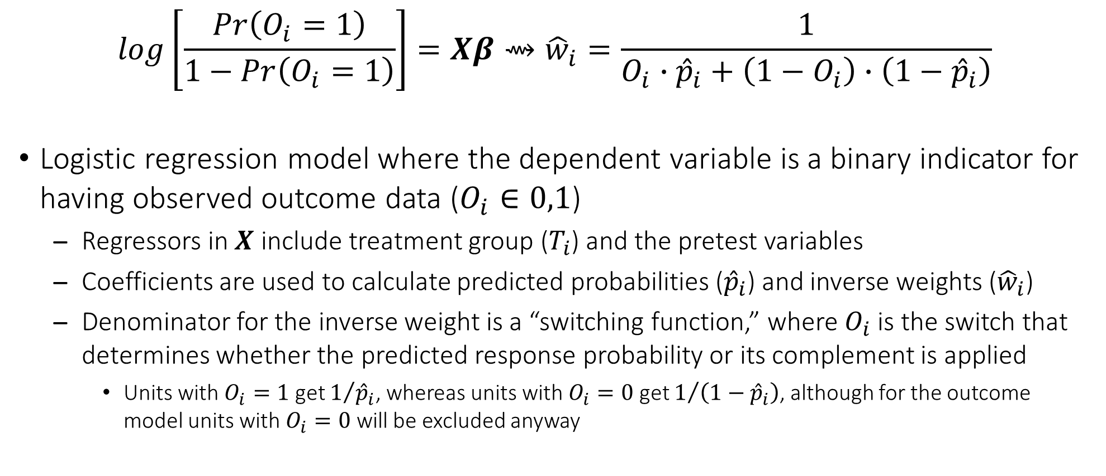
Calculating the Inverse Weights
$$log\left[\frac{Pr\left(O_{i}=1\right)}{1−Pr\left(O_{i}=1\right)}\right]=Xβ⇝{\hat{w}}_{i}=\frac{1}{O_{i}∙{\hat{p}}_{i}+\left(1−O_{i}\right)∙\left(1−{\hat{p}}_{i}\right)}$$
Logistic regression model where the dependent variable is a binary indicator for having observed outcome data ($O_{i}∈0,1$)
Regressors in $X$ include treatment group ($T_{i}$) and the pretest variables
Coefficients are used to calculate predicted probabilities (${\hat{p}}_{i}$) and inverse weights (${\hat{w}}_{i}$)
Denominator for the inverse weight is a “switching function,” where $O_{i}$ is the switch that determines whether the predicted response probability or its complement is applied
Units with $O_{i}=1$ get $1/{{\hat{p}}_{i}}$, whereas units with $O_{i}=0$ get $1/{\left(1−{\hat{p}}_{i}\right)}$, although for the outcome model units with $O_{i}=0$ will be excluded anyway

Slide 53
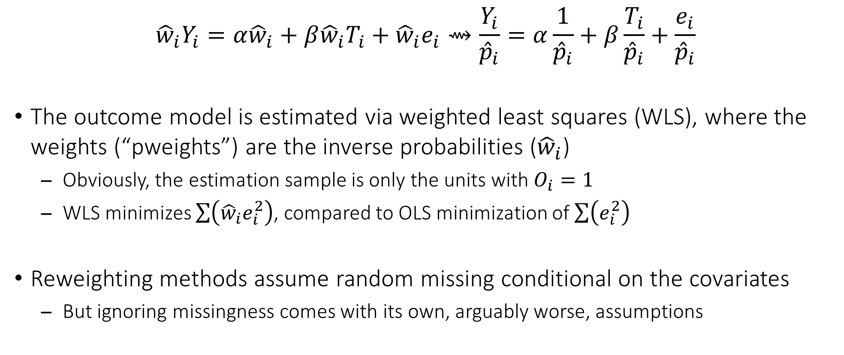
Reweighting the Outcome Model
$${\hat{w}}_{i}Y_{i}=α{\hat{w}}_{i}+β{\hat{w}}_{i}T_{i}+{\hat{w}}_{i}e_{i}⇝\frac{Y_{i}}{{\hat{p}}_{i}}=α\frac{1}{{\hat{p}}_{i}}+β\frac{T_{i}}{{\hat{p}}_{i}}+\frac{e_{i}}{{\hat{p}}_{i}}$$
The outcome model is estimated via weighted least squares (WLS), where the weights (“pweights”) are the inverse probabilities (${\hat{w}}_{i}$)
Obviously, the estimation sample is only the units with $O_{i}=1$
WLS minimizes $\sum{\left({\hat{w}}_{i}e_{i}^{2}\right)}$, compared to OLS minimization of $\sum{\left(e_{i}^{2}\right)}$
Reweighting methods assume random missing conditional on the covariates
But ignoring missingness comes with its own, arguably worse, assumptions

Slide 54
Supported Work: Obtain the Inverse Probability Weights
nsw$insamp <- as.numeric(!is.na(nsw$out.earned))
logit <- glm(insamp ~ exp + stratum + pre.age + pre.male + pre.race + pre.marr + pre.educ + pre.empl + pre.unemp.ln + pre.illeg.ln + pre.worked + pre.months + pre.hours.ln + pre.earned.ln, family = binomial(link = "logit"), data = nsw, na.action = na.exclude)
nsw$phat <- predict(logit, type = "response")
nsw$invprob <- 1 / (nsw$insamp * nsw$phat + (1 - nsw$insamp) * (1 - nsw$phat))
insamp is a dummy for non-missing outcome data.
Predicted probabilities are contained in phat and inverse weights are contained in invprob. To get predictions, we just need to make sure to use the na.action = na.exclude option with glm(), so that when we add the predictions back to the data frame, we do not get an error message telling us the number of rows are incompatible (due to the NAs).

Slide 55
Supported Work: Weighted Least Squares for the ITT
fit.itt.ipw <- lm(out.earned ~ exp, weights = invprob, data = nsw)
coeftest(fit.itt.ipw, vcov = vcovHC(fit.itt.ipw))
## t test of coefficients:
##
## Estimate Std. Error t value Pr(>|t|)
## (Intercept) 2051.302 77.778 26.3738 < 2e-16 ***
## expexper 286.926 119.200 2.4071 0.01614 *
## ---
## Signif. codes: 0 ‘***’ 0.001 ‘**’ 0.01 ‘*’ 0.05 ‘.’ 0.1 ‘ ’ 1
To obtain the weighted least squares estimate of the ITT, we simply specify lm() with the weights option. Notice the resulting estimate of $287 is 28% larger than our original estimate of $224. Recall this reflects the causal effect of an offer of employment on earnings. We underestimated it because of attrition.

Slide 56
Supported Work: Weighted Least Squares for the LATE
fit.ive.ipw <- ivreg(out.earned ~ 1 | trt.worked | exp, weights = invprob, data = nsw)
coeftest(fit.ive.ipw, vcov = vcovHC(fit.ive.ipw))
## t test of coefficients:
##
## Estimate Std. Error t value Pr(>|t|)
## (Intercept) 1483.66 269.49 5.5054 4.016e-08 ***
## trt.worked 901.48 356.29 2.5302 0.01145 *
## ---
## Signif. codes: 0 ‘***’ 0.001 ‘**’ 0.01 ‘*’ 0.05 ‘.’ 0.1 ‘ ’ 1
ivreg() also accepts the weights option. Our refined estimate of the LATE is $905, which is 26% larger than the original estimate of $717. Recall this is the causal effect of employment on earnings among units whose treatment status is affected by their assignment (i.e., the compliers).

Slide 57
Supported Work: OLS and WLS Comparative Estimates
modelsummary(list("ITT" = fit.itt, "ITT-IPW" = fit.itt.ipw, "LATE" = fit.ive, "LATE-IPW" = fit.ive.ipw), vcov = vcovHC, gof_map = c("nobs"), estimate = "{estimate}{stars}", fmt = 1)
##
## | | ITT | ITT-IPW | LATE | LATE-IPW |
## |:------------|----------:|----------:|----------:|----------:|
## | (Intercept) | 2095.1*** | 2051.3*** | 1638.4*** | 1483.7*** |
## | | (75.6) | (77.8) | (270.2) | (269.5) |
## | expexper | 223.9* | 286.9* | | |
## | | (112.7) | (119.2) | | |
## | trt.worked | | | 717.3* | 901.5* |
## | | | | (349.0) | (356.3) |
## |:------------|----------:|----------:|----------:|----------:|
## | Num.Obs. | 3025 | 2899 | 2934 | 2817 |

Slide 58
Summary of the Reweighting Estimator
When units drop out of longitudinal experimental designs, we have the problem of endogenous sample selection, not to mention loss of generalizability
With a sufficiently rich set of pretest covariates, we can model the dropout mechanism and then reweight the outcome model
Retained subjects with a low predicted probability of retention (based on their pretest covariate pattern) are given more weight to represent their peers who dropped out
Reweighting is a very general procedure with even broader usage in treatment effect estimation from non-experimental data
Modern propensity score methods rely less on matching, and more on reweighting
Inverse probability of treatment weighting (IPTW), doubly robust estimation

Slide 59
References
Athey, S., and G. W. Imbens. 2017. The econometrics of randomized experiments. In A. V. Banerjee and E. Duflo (Eds.), Handbook of Economic Field Experiments, Vol. 1 (pp. 73–140). North-Holland: Elsevier.
Cohen, Jacob. (1988). Statistical Power Analysis for the Behavioral Sciences (2nd edition). Hillsdale, NJ: Lawrence Erlbaum Associates.
Fisher, R. A. 1925. Statistical Methods for Research Workers. London: Oliver and Boyd.
Fisher, R. A. 1935. The Design of Experiments. Edinburgh: Oliver and Boyd.
Lovakov, Andrey, and Elena R. Agadullina. 2021. Empirically derived guidelines for effect size interpretation in social psychology. European Journal of Social Psychology 51: 485–504.
MacKinnon, James G., and Halbert White. 1985. Some heteroskedasticity-consistent covariance matrix estimators with improved finite sample properties. Journal of Econometrics 29: 305–325.
Manpower Demonstration Research Corporation [MDRC]. 1980. Summary and Findings of the National Supported Work Demonstration. Cambridge, MA: Ballinger.
Nguyen, Holly, Kyle J. Thomas, and Jennifer J. Tostlebe. (2023). Revisiting the relationship between age, employment, and recidivism. Criminology 61: 449–481.

Slide 60
References
Permutt, Thomas, and J. Richard Hebel. 1989. Simultaneous-equation estimation in a clinical trial of the effect of smoking on birth weight. Biometrics 45: 619–622.
Sawilowsky, Schlomo S. (2009). New effect size rules of thumb. Journal of Applied Statistical Methods 8: 597–599.
Uggen, Christopher. 2000. Work as a turning point in the life course of criminals: A duration model of age, employment, and recidivism. American Sociological Review 65: 529–546.
White, Halbert. 1980. A heteroskedasticity-consistent covariance matrix estimator and a direct test for heteroskedasticity. Econometrica 48: 817–838.
Young, Alwyn. 2019. Channeling Fisher: Randomization tests and the statistical insignificance of seemingly significant experimental results. Quarterly Journal of Economics 134: 557–598.
Zetterqvist, J., and A. Sjölander. 2015. Doubly robust estimation with the R package drgee. Epidemiologic Methods 4: 69–86.

Slide 61
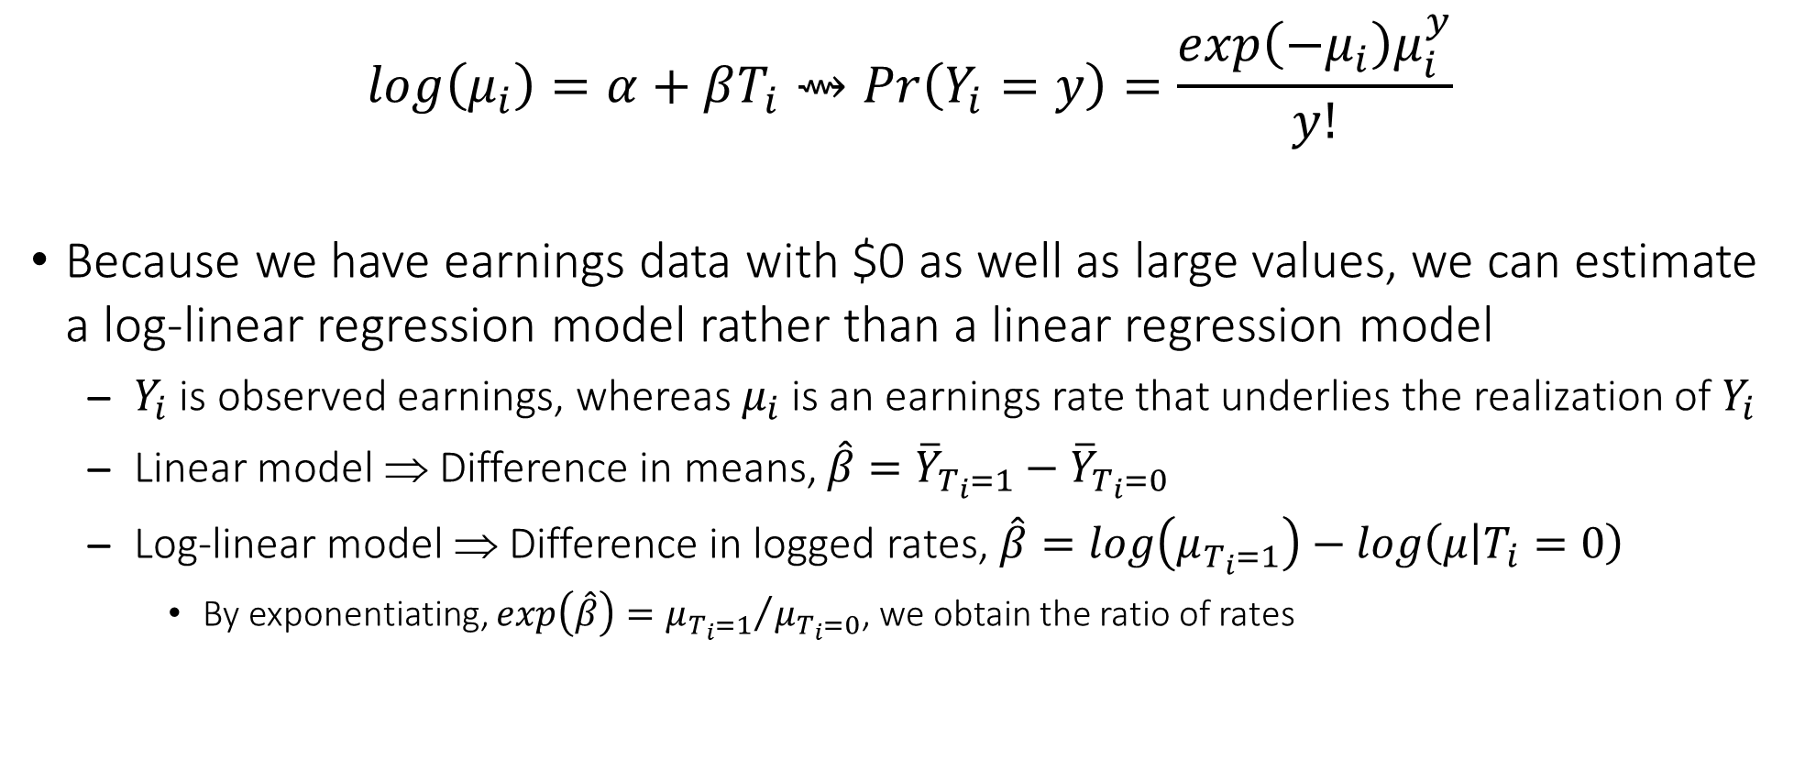
Appendix: Log-Linear Regression Model
$$log\left(μ_{i}\right)=α+βT_{i}⇝Pr\left(Y_{i}=y\right)=\frac{exp\left(−μ_{i}\right)μ_{i}^{y}}{y!}$$
Because we have earnings data with $0 as well as large values, we can estimate a log-linear regression model rather than a linear regression model
$Y_{i}$ is observed earnings, whereas $μ_{i}$ is an earnings rate that underlies the realization of $Y_{i}$
Linear model ⇒ Difference in means, $\hat{β}={\overline{Y}}_{T_{i}=1}−{\overline{Y}}_{T_{i}=0}$
Log-linear model ⇒ Difference in logged rates, $\hat{β}=log\left(μ_{T_{i}=1}\right)−log\left(μ | T_{i}=0\right)$
By exponentiating, $exp\left(\hat{β}\right)={μ_{T_{i}=1}}/{μ_{T_{i}=0}}$, we obtain the ratio of rates

Slide 62
Appendix: Log-Linear Regression Model
The earnings outcome is not a count, but we can still use Poisson, which is appropriate for any non-negative outcome (not just non-negative integers)
Inherently heteroskedastic, since variance is also a function of the mean
Quasi-maximum likelihood estimation (QMLE)
Because of excess 0s and overdispersion, we might be tempted to instead use negative binomial, but don’t do it!
If we’re only interested in ensuring the conditional mean is correctly specified, Poisson QMLE (with robust standard errors) is generally preferred
Negative binomial is a Poisson-gamma mixture, which is poorly motivated in practice

Slide 63

Appendix: Log-Linear Regression Model for the ITT
pois.itt <- glm(out.earned ~ exp, family = "quasipoisson", data = nsw)
coeftest(pois.itt, vcov = vcovHC(pois.itt))
## z test of coefficients:
##
## Estimate Std. Error z value Pr(>|z|)
## (Intercept) 7.647380 0.036074 211.9891 < 2e-16 ***
## expexper 0.101545 0.051004 1.9909 0.04649 *
## ---
## Signif. codes: 0 ‘***’ 0.001 ‘**’ 0.01 ‘*’ 0.05 ‘.’ 0.1 ‘ ’ 1
100 * (exp(coef(pois.itt)[2])-1)
## expexper
## 10.68795
In a log-linear model, the slope $\hat{β}$ is the proportional difference (approximately) in the earnings rate. We can obtain the earnings ratio by exponentiation. This is the ratio of the earnings rate of units in the treatment group to the earnings rate of units in the control group—when we subtract 1 and multiple by 100, we can convert it to a percentage.

Slide 64
Appendix: Log-Linear Regression Model for the LATE
nsw$res.1st <- resid(lm(trt.worked ~ exp, data = nsw, subset = out.earned != "NA", na.action = na.exclude))
pois.ive <- glm(out.earned ~ trt.worked + res.1st, family = "quasipoisson", data = nsw)
coeftest(pois.ive, vcov = vcovBS(pois.ive, R = 250))
## z test of coefficients:
##
## Estimate Std. Error z value Pr(>|z|)
## (Intercept) 6.94560 0.14892 46.6409 < 2.2e-16 ***
## trt.worked 0.81199 0.18144 4.4752 7.635e-06 ***
## res.1st 0.57999 0.16166 3.5878 0.0003335 ***
## ---
## Signif. codes: 0 ‘***’ 0.001 ‘**’ 0.01 ‘*’ 0.05 ‘.’ 0.1 ‘ ’ 1
It is not practical to estimate an IV Poisson model, but we can use a “control function” to trick Poisson into giving us the LATE in log-linear form. We need to compute the residual from the first-stage model (res.1st), and then include it in the second-stage model along with the endogenous treatment variable (trt.worked). We just need to remember to obtain standard errors via the bootstrap, since res.1st is a “generated” regressor.

