Slide 1
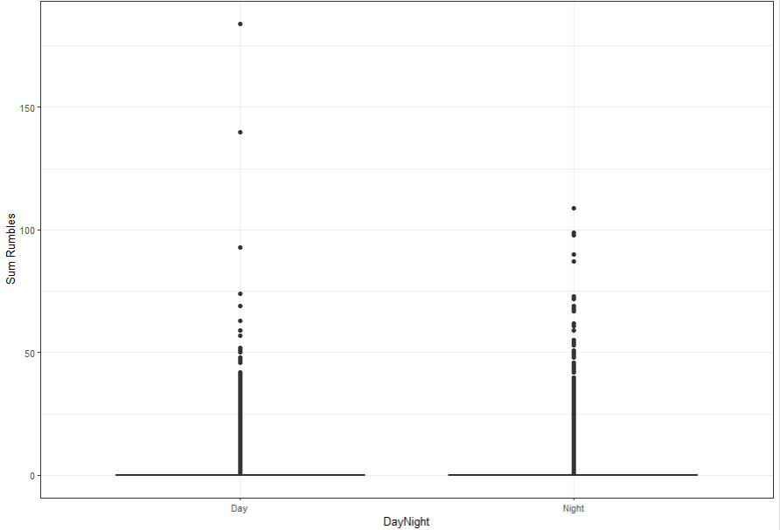
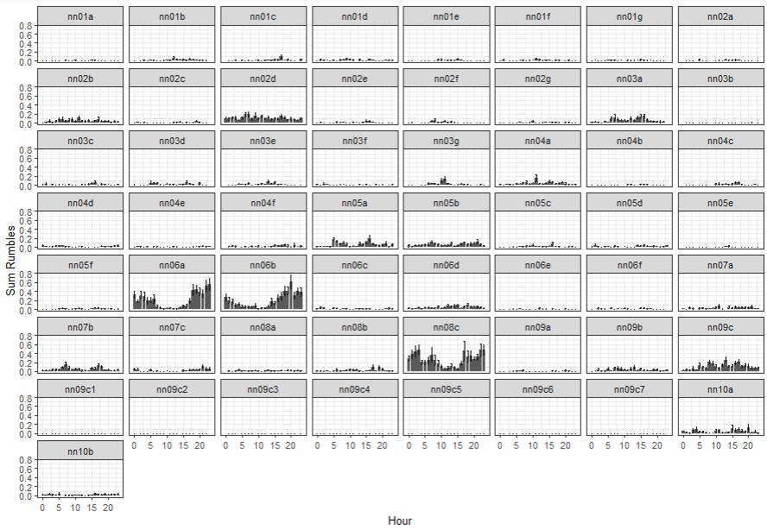
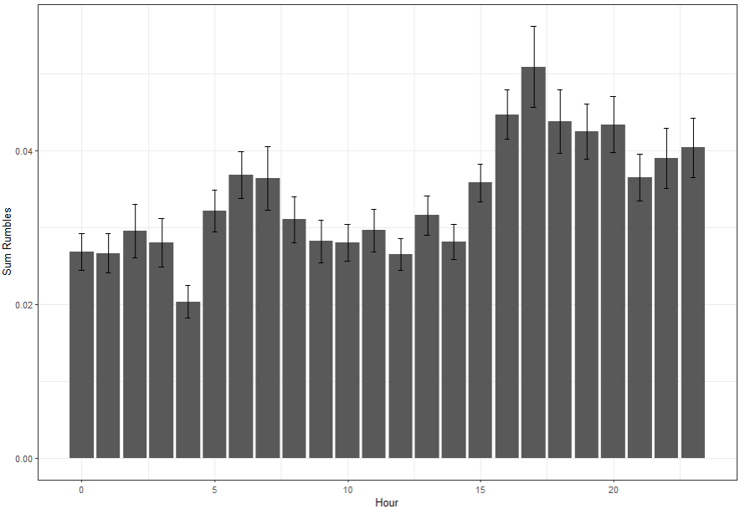
Sound Check (user option not implemented yet)
Excluded (y/n)
All sounds
HOURLY
Site
  from selection tables
Date
  every date from sound check and selection tables
Hour (0-24)
Rand/nonrand (optional)
  From rand .txt file in elpR
  If rand needed, then non-random dates will be filtered out
Sum rumbles
  Includes zero days
  Does not include empty tables
Bad sound excluded
  From sound check file
Deployment #
  User defined
Site details
  User option
  From .txt file
Day/night
  Day = 06:00-18:00
  Night = 18:00-06:00
Week date
  first date of the week
Save table
Random days (user option)
Random
Non-random
Site Details (user provided)
Lat/long
Habitat
Strata
Selection tables
All detections
includes marginals
0+ counts
Non-rumbles
Deployment number
Zero Days
Good sound days only (bad sounds excluded)
Random days only
0 detections at score >0.4.
Empty Tables
- Selection tables with 0 detections at score 0.2

Slide 2
HOURLY
Site
  from selection tables
Date
  every date from sound check and selection tables
Hour (0-24)
Rand/nonrand (optional)
  From rand .txt file in elpR
  If rand needed, then non-random dates will be filtered out
Sum rumbles
  Includes zero days
  Does not include empty tables
Bad sound excluded
  From sound check file
Deployment #
  User defined
Site details
  User option
  From .txt file
Day/night
  Day = 06:00-18:00
  Night = 18:00-06:00
Week date
  first date of the week
Save table
DAILY
Site
Date
Proportion Night Rumbles
  % rumbles per night
Sum Rumbles
Sum night rumbles
Random days only
Site details
Week date
  First date of the week
Month
Year
Week of year
Save table
  Daily
  By strata
Plot rumbles per day/strata

Slide 3
DAILY
Site
Date
Proportion Night Rumbles
  % rumbles per night
Sum Rumbles
Sum night rumbles
Random days only
Deployment #
Site details
Week date
  First date of the week
Month
Year
Save table & plot
WEEKLY
Site
Week date
Month
Year
Site details
Mean daily rumbles
SD daily rumbles
Sum rumbles
Proportion night rumbles
Total days sampled per week
Save table & plot

Slide 4
WEEKLY
Site
Week date
Month
Year
Site details
Mean daily rumbles
SD daily rumbles
Sum rumbles per week
Proportion night rumbles
Total days sampled per week
Save table & plot
MONTHLY
Site
Month
Year
Site details
Mean weekly rumbles per week
SD rumbles per week
Sum rumbles per month
Proportion night rumbles per week
Total days sampled
Save table and plot

Slide 5
Sound Check (user option not implemented yet)
Excluded (y/n)
All sounds
DAILY
Site
Date
Proportion Night Rumbles
  % rumbles per night
Sum Rumbles
Sum night rumbles
Random days only
Deployment #
Site details
Week date
  First date of the week
Month
Year
Save table & plot
HOURLY
Site
  from selection tables
Date
  every date from sound check and selection tables
Hour (0-24)
Rand/nonrand (optional)
  From rand .txt file in elpR
  If rand needed, then non-random dates will be filtered out
Sum rumbles
  Includes zero days
  Does not include empty tables
Bad sound excluded
  From sound check file
Deployment #
  User defined
Site details
  User option
  From .txt file
Day/night
  Day = 06:00-18:00
  Night = 18:00-06:00
Week date
  first date of the week
Save table
Random days (user option)
Random
Non-random
Site Details (user provided)
Lat/long
Habitat
Strata
Selection tables
All detections
includes marginals
0+ counts
Non-rumbles
WEEKLY
Site
Week date
Month
Year
Site details
Mean daily rumbles
SD daily rumbles
Sum rumbles
Proportion night rumbles
Total days sampled per week
Save table & plot
Zero Days
Good sound days only (bad sounds excluded)
Random days only
0 detections at score >0.4.
Empty Tables
- Selection tables with 0 detections at score 0.2

