Slide 1


Slide 2
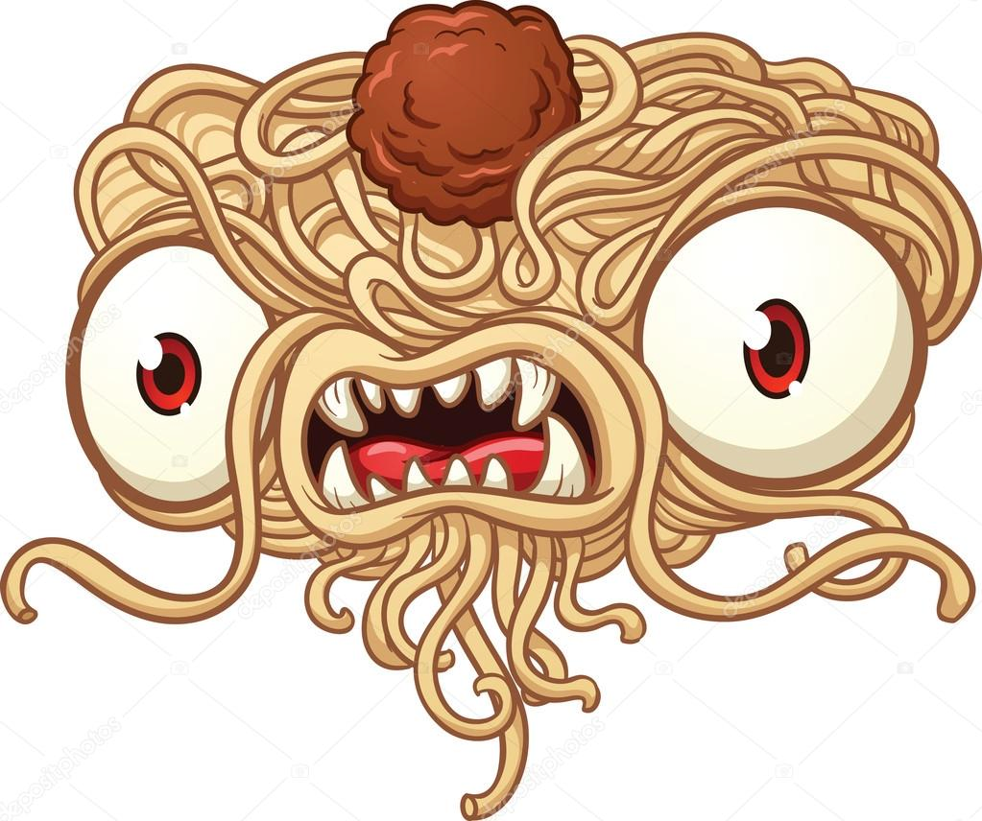

Slide 3
BAD
SPAGHETTI
CODE

Slide 4
BAD
PROGRAMMING

Slide 5
“Mutable,
stateful objects
are the new
spaghetti code.”
- Rich Hickey

Slide 6
“No man can step into the same river twice.”
- Heraclitus

Slide 7
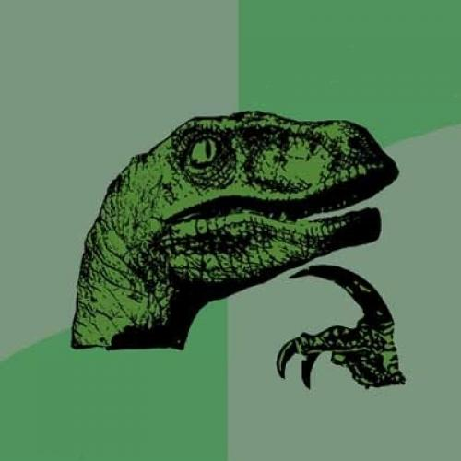

Slide 8
Deepity:
Profound-seeming
but superficial equivocation

Slide 9
BAD
Parasitic
Programming
Languages

Slide 10
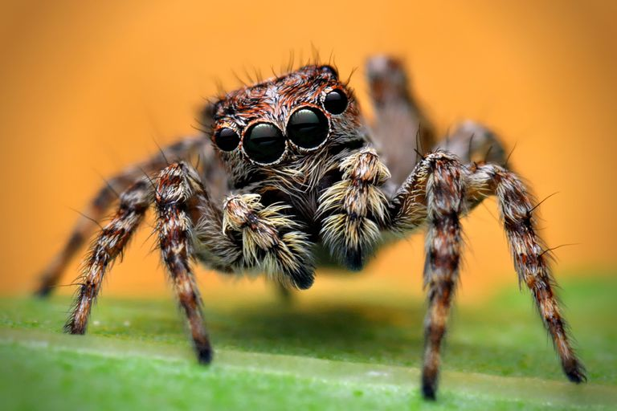

Slide 11
