Slide 1
BrainStation
Capstone Sprint 3
At-Risk Students - Support for Success
Bobbie Razo 2024.05.05
Notes:
This is my Capstone Sprint 3
A quick recap: My topic is about: Identifying At-Risk College Students with the hopes of helping them succeed into graduation.

Slide 2

Contents
Overview: Business Problem
Data
EDA
Modeling
Product Demo
References

Slide 3

Escalating College Dropout Rates: A Growing Concern
With historical student data, can student drop out actions be predicted by identifying critical indicators?
We hope to use Data Science To Recognize Clues And Patterns That Precede College Student Dropouts.
Early Identification of At-Risk Students
Early Intervention
Implement Student Support Strategies
Student Succeeds
Student Retention Rates
Unemployment Rates (higher for College dropouts)
Earnings of Students as bachelor degree graduates
Notes:
A non-technical overview of the problem statement, your proposed solution, and an estimate of the potential impact of your solution.
Problem Statement:
A growing problem, is the increasing rates of college drop-outs, about 40% every year.
Proposed Solution:
Using machine learning to identify at an early stage (not just based on grades), at-risk students who are likely to drop out of pursuing a degree.
If we can harness the power of data science to predict potential students ahead of withdrawal time, we can place preventive strategies to support students in following through with finishing a degree. With this information college institutions, companies, and governments can have early intervention support strategies implemented to help students. Approach it wholistically and not just academically or financially which has been one of the top reason for withdrawals but socially as well.
Estimate of the potential impact of this solution:
Increasing college dropout rates have negative effects for both individuals and society as a whole.
This solution could decrease the 40% rate of college student drop out every year.
It could decrease the higher unemployment rate of College dropouts (6.4%) compared to college graduates (3.6%).
It could also increase the earnings of these students as graduates. College dropouts earn 56.15% less than college graduates, with median annual earnings of $39,900 compared to $91,000 of bachelor’s degree or higher graduates.
Soures:
https://learnopoly.com/college-dropout-rate/

Slide 4
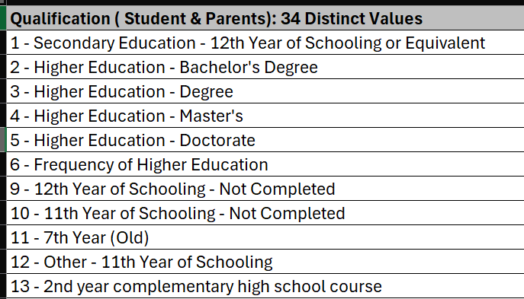
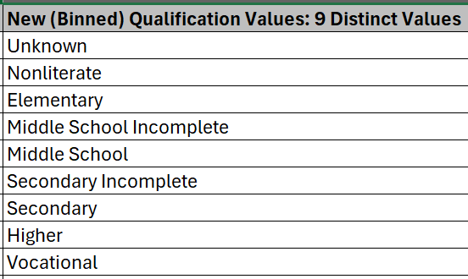
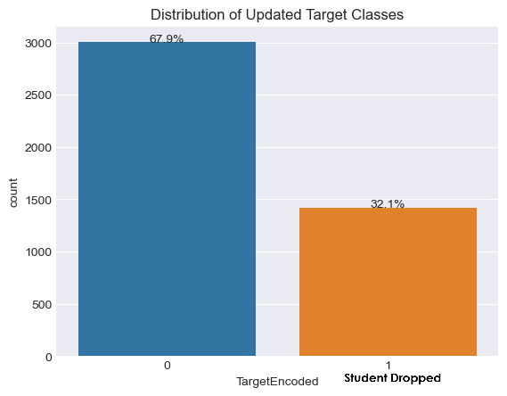
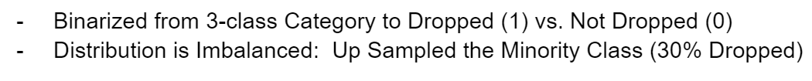
Data & Preprocessing
Collection of Student Enrollment 37 Features
Includes: - Academic path (curriculum credits, course, grade, schedule)
- Demographics (age, marital status, gender)
- Social-Economic Factors (parent info, financial)
Binning (Bucketing) of 8 High Cardinal Categorical Columns
Using: 1 – Domain Specific Knowledge:
ex. Educational Qualification
2 – Manual by Frequency
ex. Nationality is binarized: 1 out of 21 values is 97% (Portuguese - 1)
other 20 is put into Other – 0
Target
Notes:
A high-level overview of the dataset and preprocessing approach
The Data
A collection of student enrollment which includes:
- the student’s Academic path such as curriculum credits, GPA and schedule.
- demographic data such as age, marital status, gender.
- and social and economic factors such as parental and financial info.
It has 37 Features: 8-10 are nominal category columns with high cardinality ranging from 6 to 45 different categories.
Binning was done on these columns.
Used the strategy of domain-specific grouping such as Educational Qualification. I bucketed the 34 different levels of education to 9 general types ranging from Early Pimary to Higher education.
Another strategy used is by manually calculating the percentage of how frequent a category appears in the data. I bundled together all the categories that appear less than 1% in the data to Other.
The Target variable was binarized from 3 class: Dropped, Graduate or Enrolled. There is an imbalance here that skewed towards Not Dropped at 70% which I applied Sampling before any Modeling. I up sample the minority class which was the Dropped population at 30% initially.
Then after all this I applied One-Hot encoding dropping one of the categories from each feature.

Slide 5
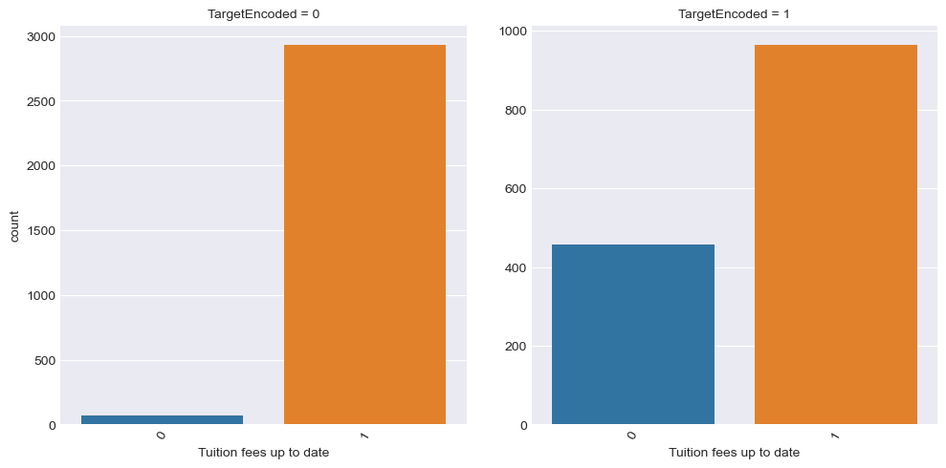
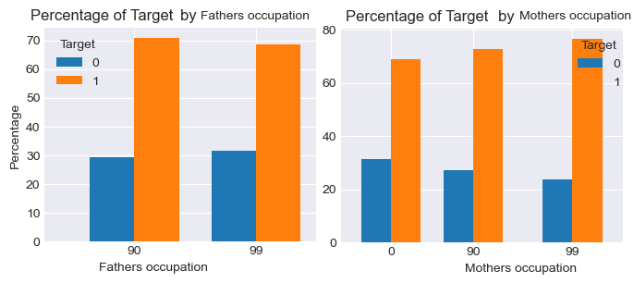
EDA Insights
Feature Correlation with Target
  Ex. Tuition Fees Up To Date – higher for Dropped.
Higher Dropped Percentage Rate for Certain Features Values
  Course, Marital Status, Age and Occupations
  Anomaly OR a very small population causes the high percentage.
  Ex. Parent Occupation: 90 - Other Situation
  99 - (blank)
  or Age of Enrollment tends to have higher drop rate with higher age.
Notes:
A key insight about your problem spaced uncovered through EDA or modelling
Graphing the Target column count for each value across the other features shows some evident patterns. In this example it’s shows that financially challenged students sees a higher count of them dropping.
I also calculated the percentage of the dropped vs not dropped for a certain value within a feature. I looked through each column and each value within that column and highlighted where the Dropped percentage is over 65% compared to the not dropped.
Some columns did pop up as over 65% dropped;
Such as:
- Marital Status: legally separated
- Course: Biofuel Production Technologies
- Age of Enrollment: most of high age
- Parent Occupation: Other or blank
These could just be an anomaly or the population for the particular value is very small that causes the percentage between the binary target to be high.

Slide 6
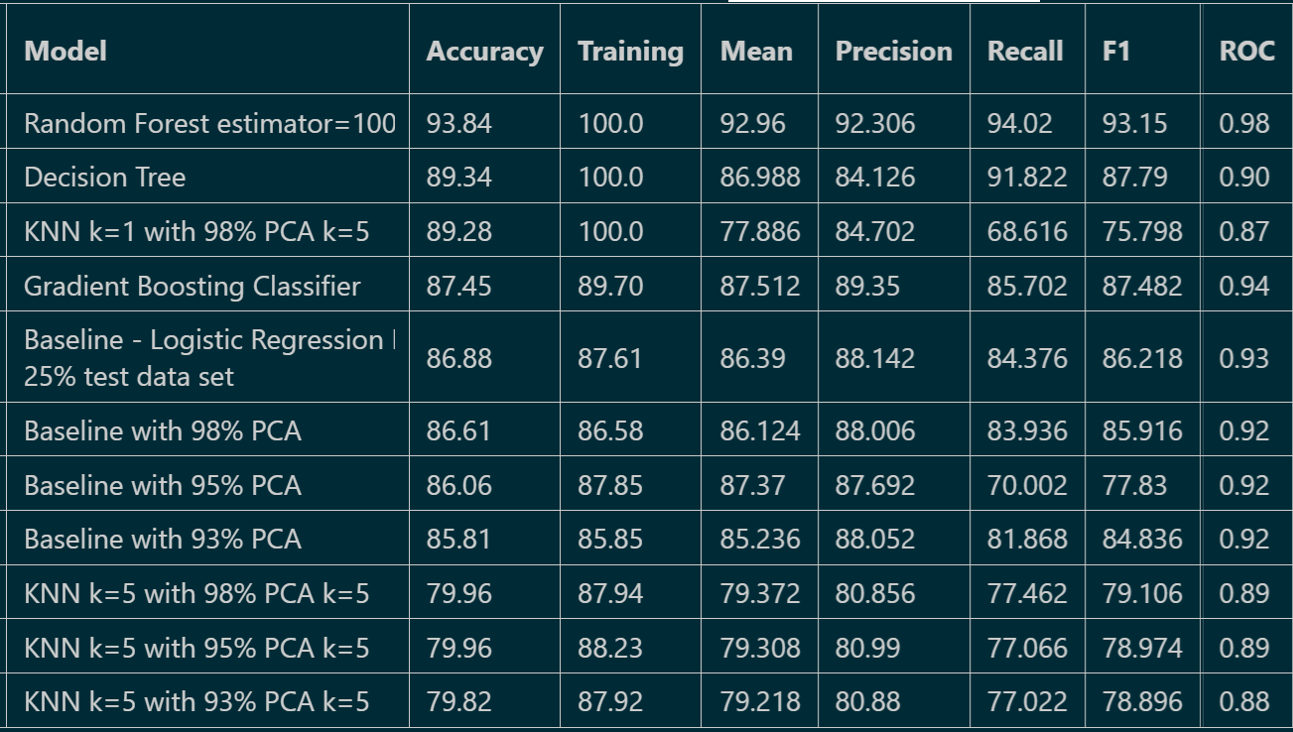
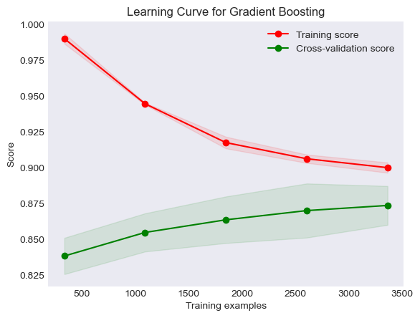
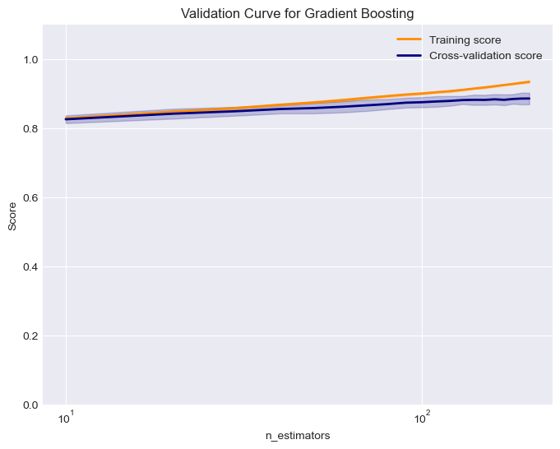



Modeling Comparison
Models used:
- Logistic Regression
- PCA Reduction
- KNN
- Random Forest
- Decision Tree
- Gradient Boosting Classifier
Evaluations Used:
- Accuracy Score
- Classification
- Cross-Validation
- ROC Curve
- Learning Curve
- Validation Curve
Notes:
Model comparison and interpretation (what did all your modeling work amount to?)
Once all the binning and sampling is done, I processed the data through a few machine learning models, evaluated them and compared it all together.
I use the following models:
As a base, the logistic regression
Added PCA
KNN with PCA
Random Forest
Decision Tree
And Gradient Boosting Classifier.
I scaled the data when using Logistic, PCA and KNN. I used Accuracy, Classification report, Cross-Validation, Confusion matrix and Receiver Operating Characteristic Curve. I also plotted the learning and validation curve the models.
For accuracy score, the range was from 79.9% up to 93.8% which is with Random Forest. It also scored on Cross Validation with Mean, Precision and Recall as well as the ROC curve with .98 area.
The learning curve for Random Forest shows a converging plot between learning and cross-validation which is ideal but the gap between them shows a potential for overfitting.
The validation curve was done on n_estimators and shows that both training and cross-validation scores are stable and very close across the range of estimator values, so no further turning is needed.

Slide 7
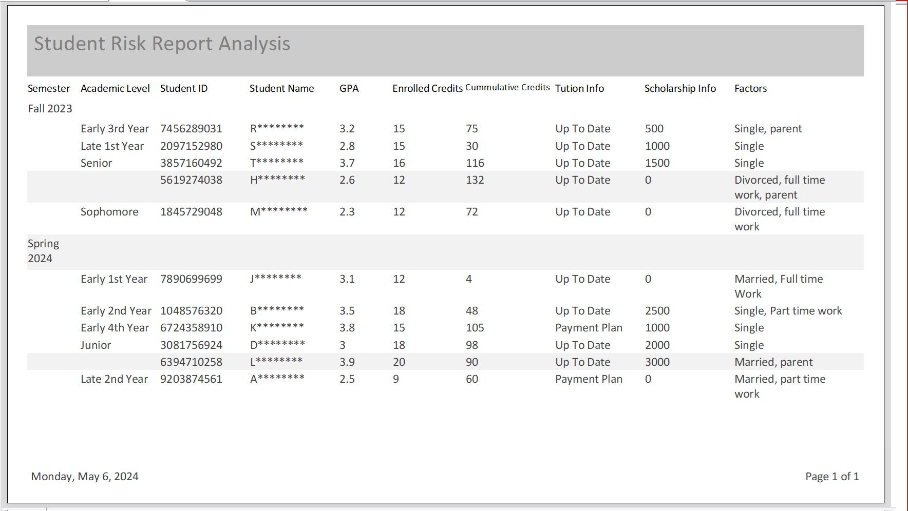
Potential Product
A Dashboard Report for Colleges
Notes:
A product demo (Dashboard, Web App) or designs for such a product
A potential product for this could be a dashboard report for Colleges that the Academic Advisement department may utilize. Given a dataset it will classify the potential for withdrawn target. The results will give a report of these students. It can be run per semester ideally at the beginning of the term so that strategies for help can be provided throughout the term.

Slide 8
Thank you
References:
Learnopoly College Dropout Rate Statistics
Educationdata.org College Dropout Rates
Data Source: Predict Students’ Dropout and Academic Success
Notes:
Thank you
References:
Learnopoly College Dropout Rate Statistics
Educationdata.org College Dropout Rates
Data Source: Predict Students’ Dropout and Academic Success

