Slide 1
Brainstation Capstone Sprint 2
At-Risk Students - Support for Success
Bobbie Razo 2024.03.12
Notes:
Good Evening class, Sriram, Elton and Catherine. My topic is about: Identifying At-Risk College Students with the hopes to Strengthen them for Success.

Slide 2
Contents
Overview: Business Problem & Solution
Data
EDA
Baseline Models
Next Steps
References

Slide 3
Escalating College Dropout Rates: A Growing Concern
With historical student data, can student withdrawal actions be predicted by identifying critical indicators?
We hope to use Data Science To Recognize Clues And Patterns That Precede College Student Dropouts.
Early Identification of At-Risk Students
Early Intervention
Implement Student Support Strategies
Student Succeeds
Increased Retention Rates
Notes:
If we can harness the power of data science and machine learning to predict at risk students using various factors we can collect about their environment (academically, socially, and financially) we can put in preventative strategies to support students in following through with finishing a degree.

Slide 4
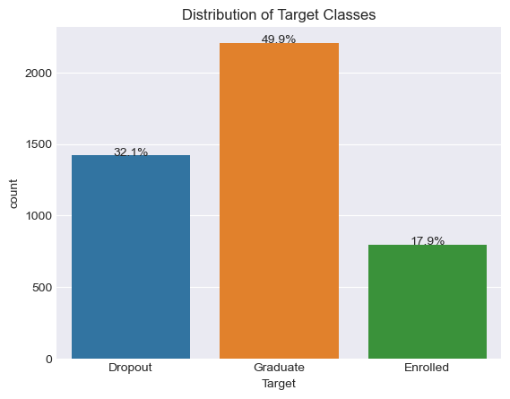
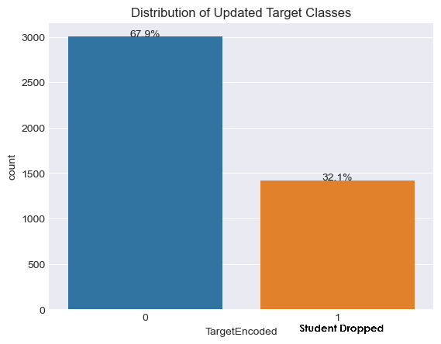
Data
Features: Age | Gender | Country GDP | Country Unemployment Rate | Country Inflation Rate | Day/Night Schedule | Course | Marital Status | Nationality | International Admission Grade | Qualifications (including Parents) | Parents Occupation | Scholarship Info | Tuition Info | Curricular Units | Target – Dropout / Not Dropout
Collection of student enrollment – academic path, demographics, and social-economic factors.
Binarize the Target Variable: Dropped or Not
Notes:
Some preprocessing involves binarizing the target variable. Convert the 3 class categorical text data to binary. Graduate and Enrolled can be merged into one and represent (0) those that did not drop out of college. Dropped population will remain on its own but be converted to 1 to represent those that had Dropped.

Slide 5
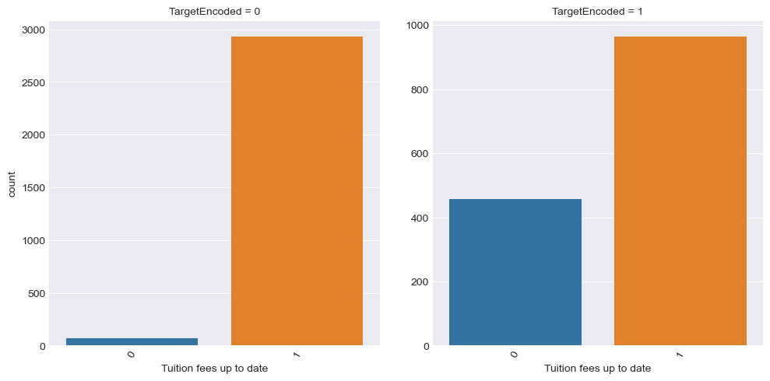
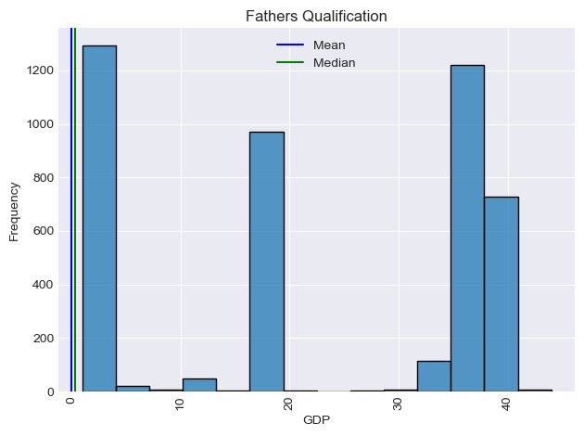
EDA
Numerous features with high cardinality
One-Hot Encoded
244 features for X data
Some features show a correlation with the Target: ex. Tuition fees up to date. This shows higher numbers of student struggling with tuition payments that result in dropping out.
Notes:
Initials observations
Mostly numeric columns. There were several already label encoded categorical columns that have high cardinality. This will make for a wide dataset adding many more columns that are dummy variables.
Graphing the Target column across the other features we can see some patterns. Ex. Financially challenged students sees a higher count of them dropping.

Slide 6
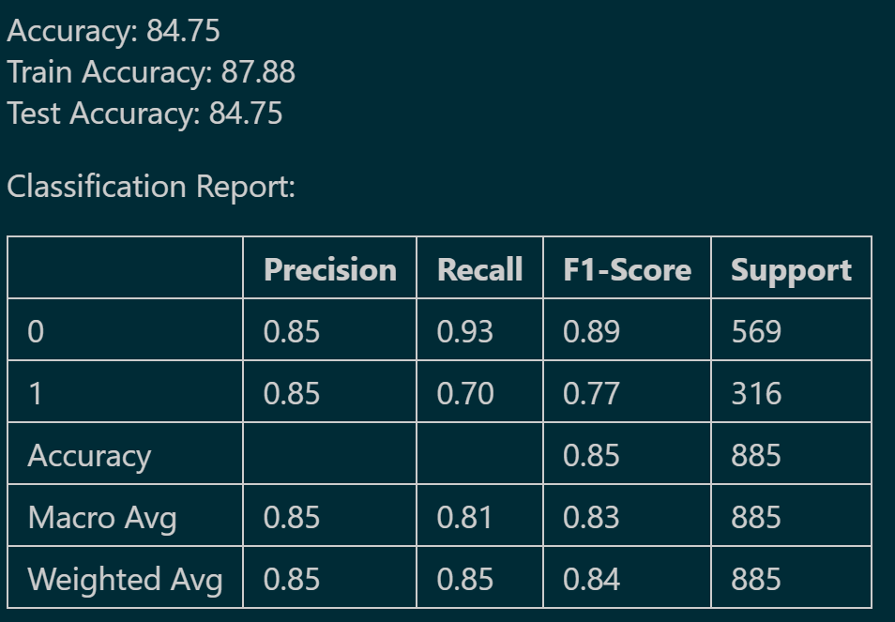
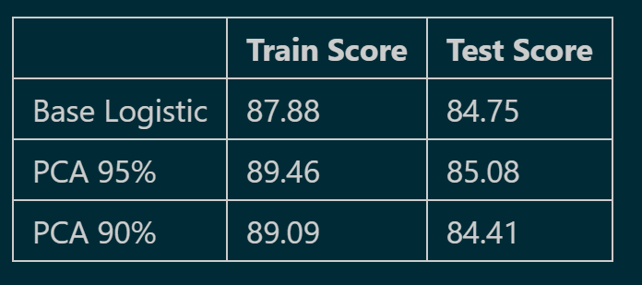
Basic Modeling
Initial modeling using Logistic Regression gives a somewhat good accuracy
PCA with .95 & .90 component
Notes:
Due to the wide data (244 X features) from the high cardinality categorical columns I used PCA to reduce the dimensions a bit. 95% and then 90% components were attempted. The ideal accuracy was 95%

Slide 7
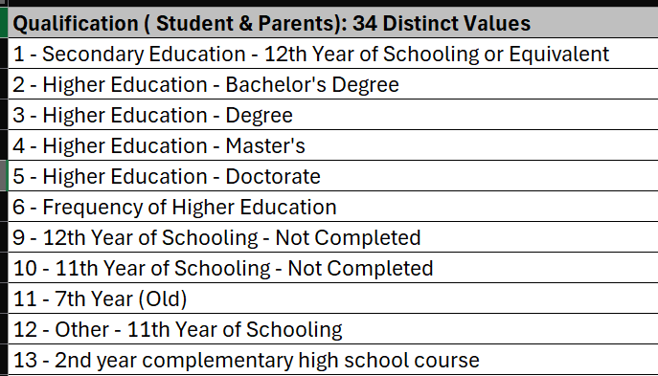
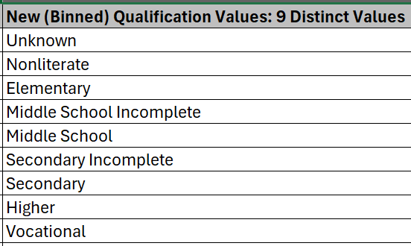
Next Steps
Further Feature Engineering:
- Binning of categorical features with high cardinality using domain knowledge and .map or .cut
Use of Up/Down Sampling for the unbalanced Features: Target variable
Assess using the SWOT Analysis (Strength, Weakness, Opportunities and Threats)
Strategize & Implement further Modeling: Decision Tree, SVM, Hyperparameters and Pipeline
Notes:
Next steps
- Binning of categorical features with high cardinality: this definitely calls for more Feature Engineering because I’d like to see how the modeling changes when I decrease the cardinality of the categorical columns before one-hot encoding them instead of using PCA.

Slide 8
Thank you
References:
Learnopoly College Dropout Rate Statistics
Educationdata.org College Dropout Rates
Data Source: Predict Students’ Dropout and Academic Success

