Slide 1
Acoustic Detection of Elephant Presence
Karthik Bobbili
Student ID#1508583
Capstone Mid TermPresentation

Slide 2
Preview
Elephants use Infrasonic sounds for Communication(Payne, Langbauer et al. 1986).
These Sounds have the ability to travel for a long distance(Langbauer, Payne et al. 1991).
The type and kind of Rumble can indicate various details about the project like Age(Angela S. Stoeger 2015),Sex(Stoeger and Baotic 2016),Group(Payne, Thompsen et al. 2003).
Human Elephant Encounter is a problem in tropical countries like India.(O'Connell-Rodwell, Rodwell et al. 2000).
The most common problem is in the case when there is a random encounter of a wild elephant in a commonly used landscape.
This problem can possibly be solved by designing a Elephant detection System(Stoeger† 2015).

Slide 3
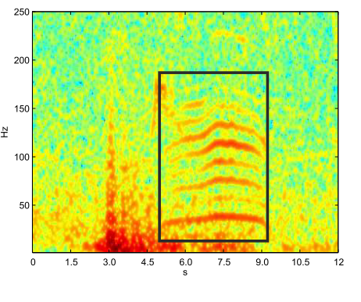
A typical Elephant Rumble

Slide 4
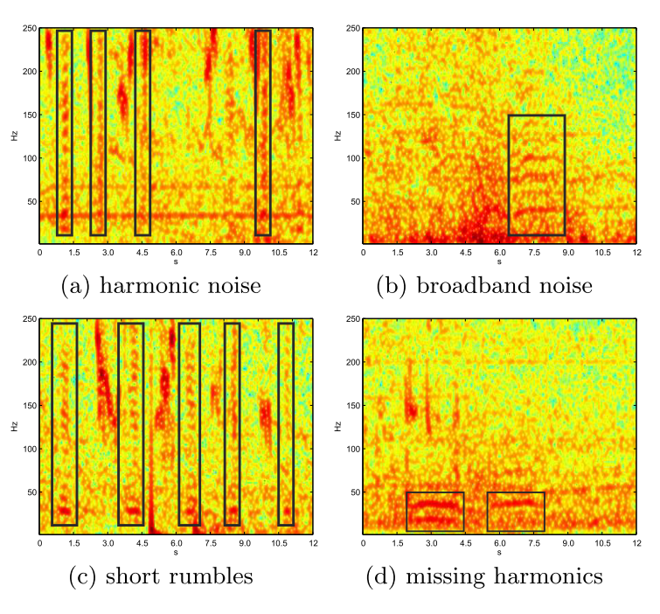
Noise and common Types

Slide 5
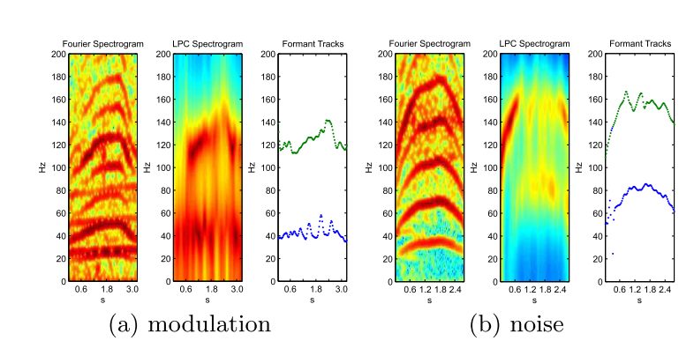
Formants

Slide 6
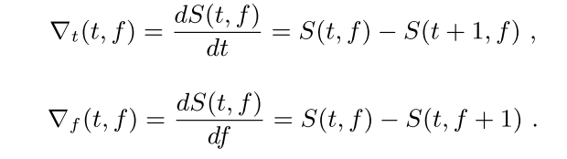
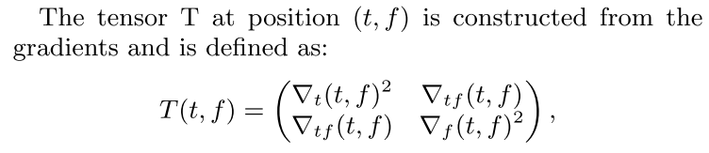
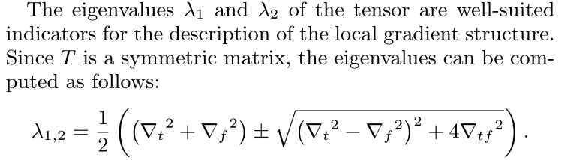
Noise Elimination

Slide 7
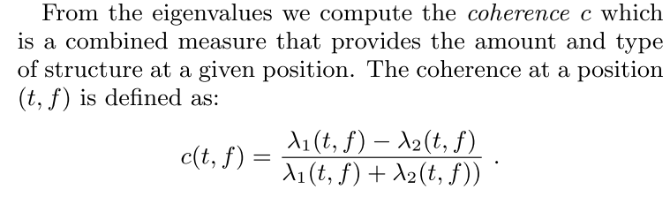

Noise Elimination

Slide 8
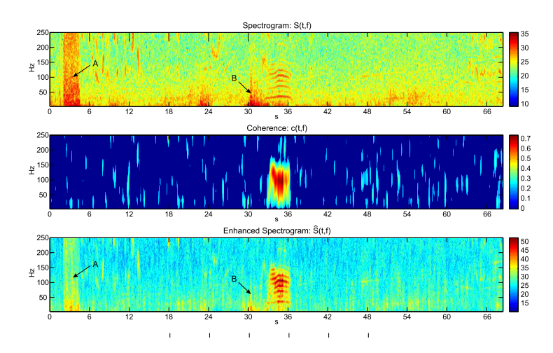
Noise Elimination

Slide 9
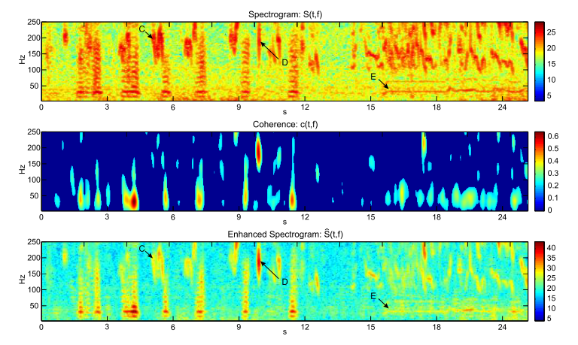
Noise Elimination

