Slide 1
Analysis of amazon review dataset using bigdata architecture
BOBBILI VAMSHI
2024000164

Slide 2
Objective
The main ideology behind this project is to analyze large-scale customer feedback from the Amazon Reviews (1996-2023) dataset using PySpark. The goal is to extract meaningful insights, understand customer sentiments, identify trends, and build data-driven models to support decision-making.
Not only the analysis of the dataset we also have data of 25 years of purchase history for famous e-commerce platform amazon so that we can know which products has been domination and mostly sold and also which products made more impact all over these year.

Slide 3
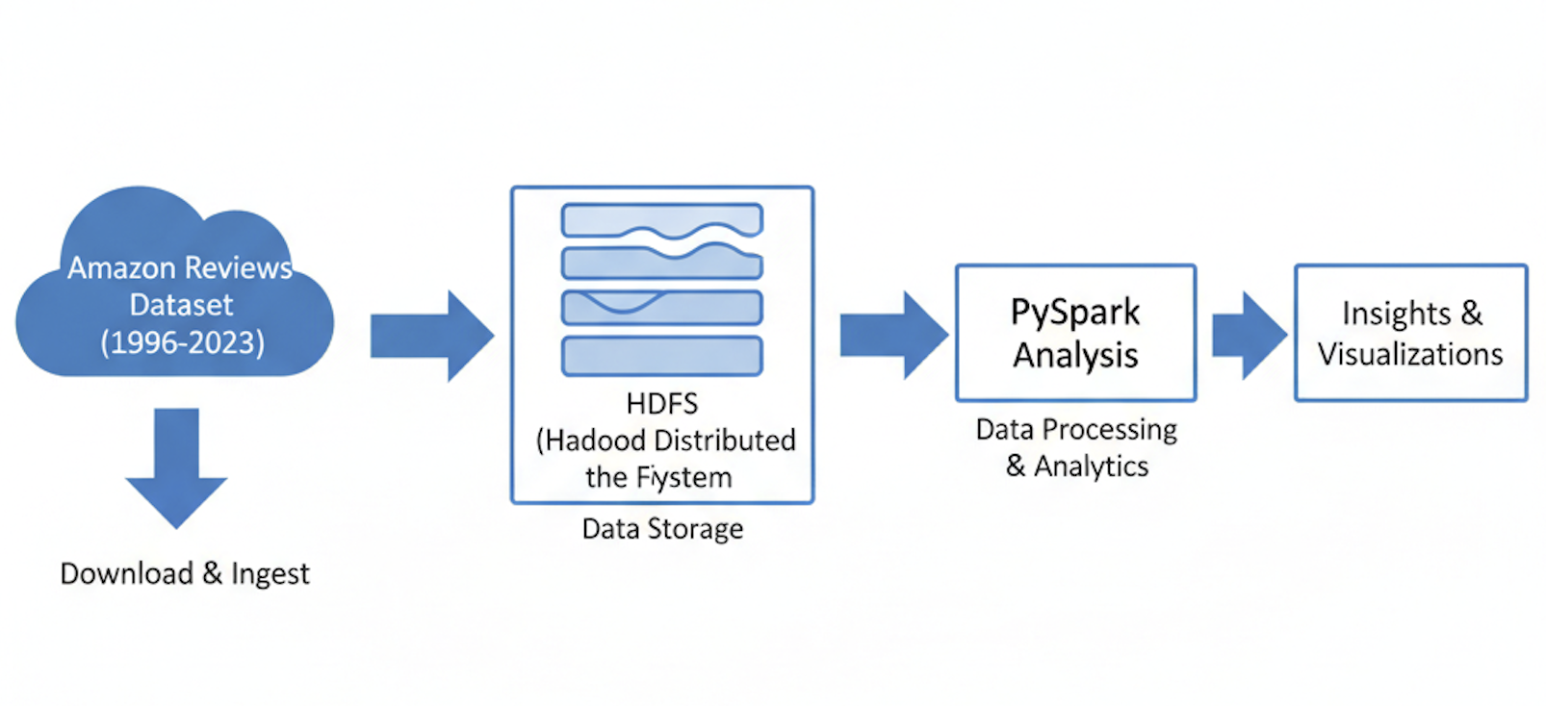
ARCHITECTURE FOLLOWED:

Slide 4
DATA SOURCE:
Primary Download Source
The dataset was obtained from the McAuley Lab website at the University of California, San Diego (UCSD), which hosts the publicly available Amazon review data for research purposes.
Official Website: http://jmcauley.ucsd.edu/data/amazon/
Original Compiler: The dataset was curated by Julian McAuley and colleagues.
Version Used: [ Amazon Reviews Data and meta data 2023]

Slide 5
Data Format:
The Amazon Review data was initially downloaded in JSON (JavaScript Object Notation) format.
JSON is hierarchical and unstructured/semi-structured, which is common for web data but not ideal for traditional tabular analysis
To prepare the data for efficient Exploratory Data Analysis (EDA) and machine learning model training, the raw JSON data was converted into a flat, tabular structure.

Slide 6
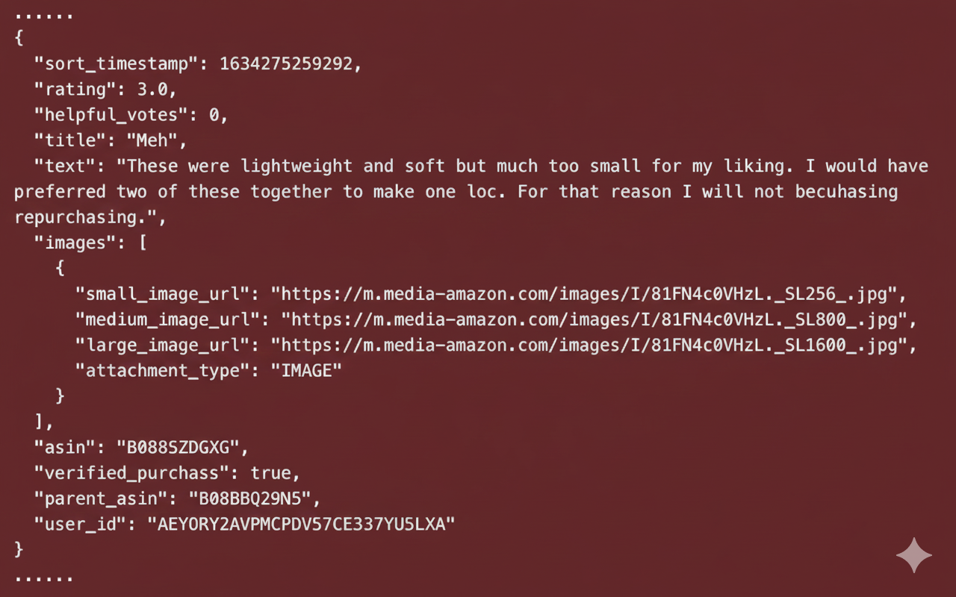

Slide 7
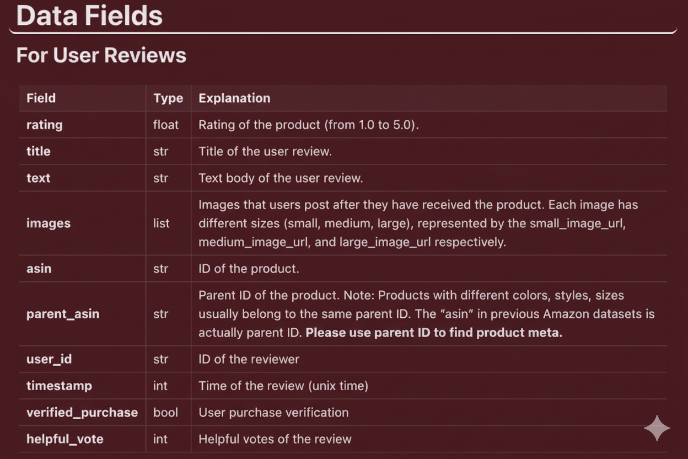

Slide 8
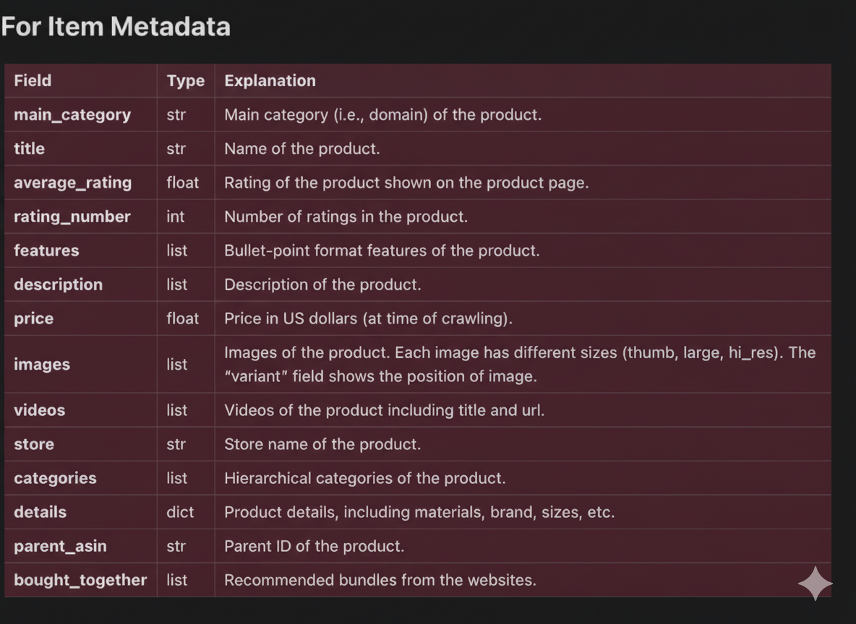

Slide 9
USINg HDFS FOR STORAGE:
HDFS (Hadoop Distributed File System) is the primary storage system used by Hadoop and is fundamental to large-scale data processing
Distributed Storage, Large File Optimization, Data Locality, Fault Tolerance and Reliability
cs-gss-21@csgss21-OptiPlex-Tower-Plus-7010:~$ sudo su – hadoop
hadoop@csgss21-OptiPlex-Tower-Plus-7010:~$ start-all.sh
$ sudo cp home/documents/amazon_reviews.json ./
$ hdfs dfs -mkdir -p /user/hadoop/raw_data/
$ hdfs dfs -put amazon_reviews.json /user/hadoop/raw_data/
(The file is broken down into blocks 128mb with replication factor of 3)
$hdfs dfs -D dfs.replication=1 -D dfs.block.size=1073741824 -put /home/hadoop_user/amazon_reviews.json /raw/amazon_data/

Slide 10
pyspark for Analysis:
PySpark is the Python API for Apache Spark, the industry-leading unified analytics engine for large-scale data processing.
Combines Python's ease of use (for data science/ML) with Spark's distributed computing power.
Speed (In-Memory Processing).
PySpark uses RDDS (Unstructured/Structured) , DataFrames (Structured Data).
This allows you to easily read your JSON data, apply a schema, and perform SQL-like operations (using Spark SQL) for cleaning and feature extraction.
Scalability and Fault Tolerance

Slide 11
LOading data into pyspark
Form pyspark.sql import SparkSession
Spark=SparkSession.builder.appName("my_session").getOrCreate()
Reviews_data_Frame=Spark.read.json('/Users/vamshibobbili/Desktop/bigdata/Clothing_Shoes_and_Jewelry.jsonl')
meta_data_frame=spark.read.json('/Users/vamshibobbili/Desktop/bigdata/meta_Clothing_Shoes_and_Jewelry.jsonl')

Slide 12
Cleaning the dataframe:
Checking the null values
Removing the unwanted datafields
Joining the tables both meta and review
Selecting the respective data Fields form the joined tables so that we can analyze the data

Slide 13
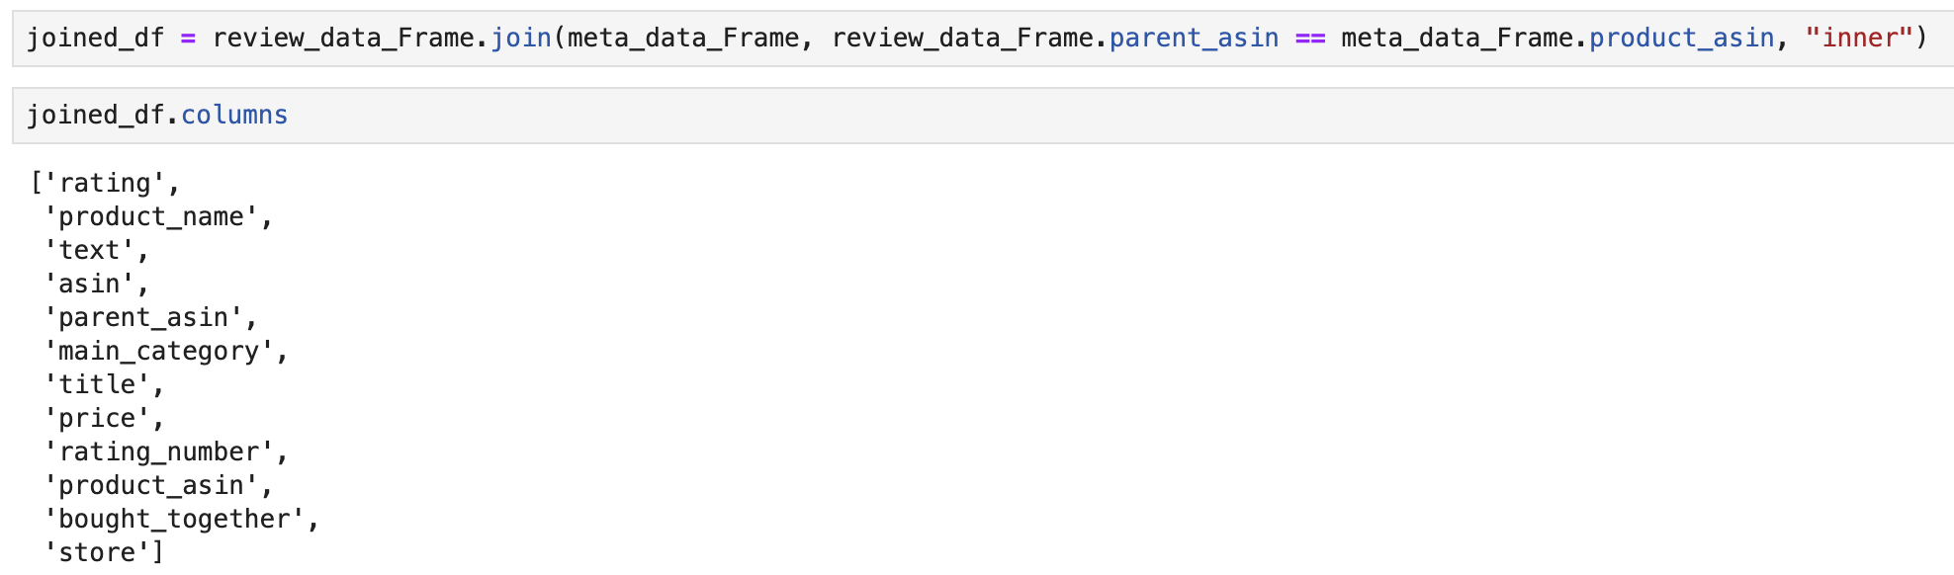
Joining the two tables:

Slide 14
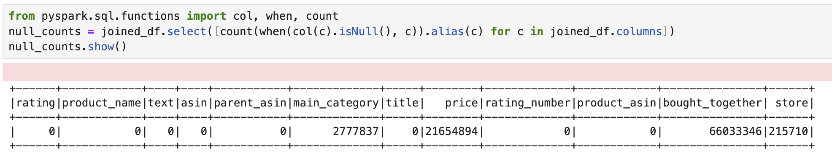
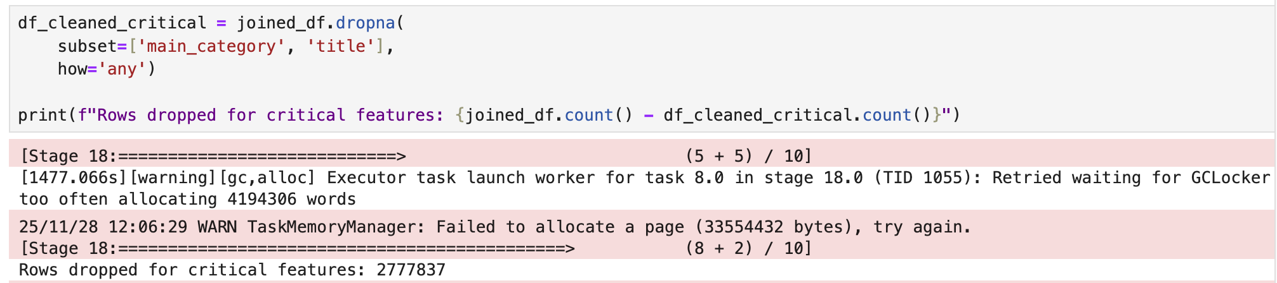
Checking for null Values and removing:
Null Values:
Removing Null Values:

Slide 15
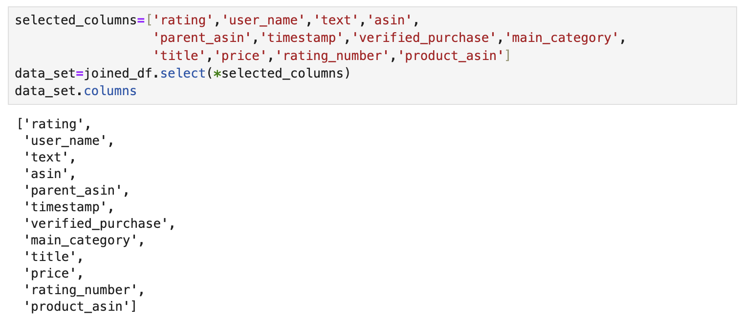
Selecting our required datafields:

Slide 16
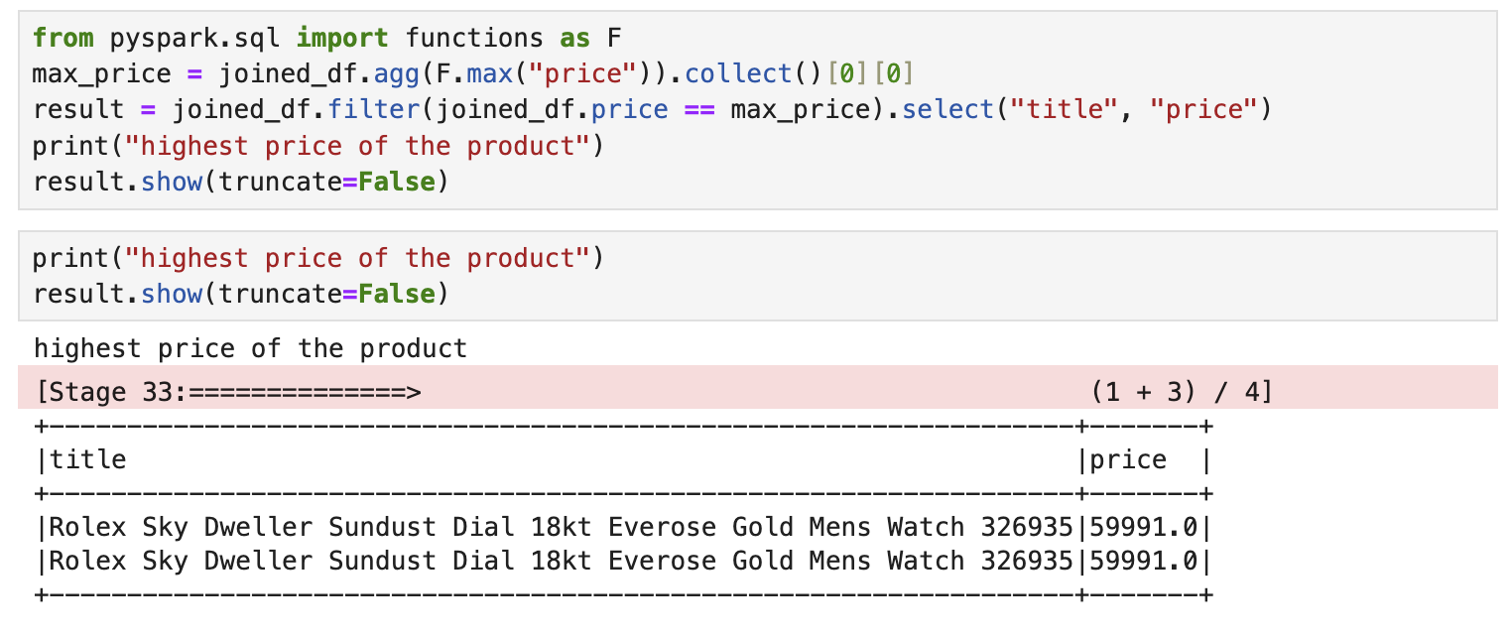
Query 1:
Highest priced product till 2023:

Slide 17
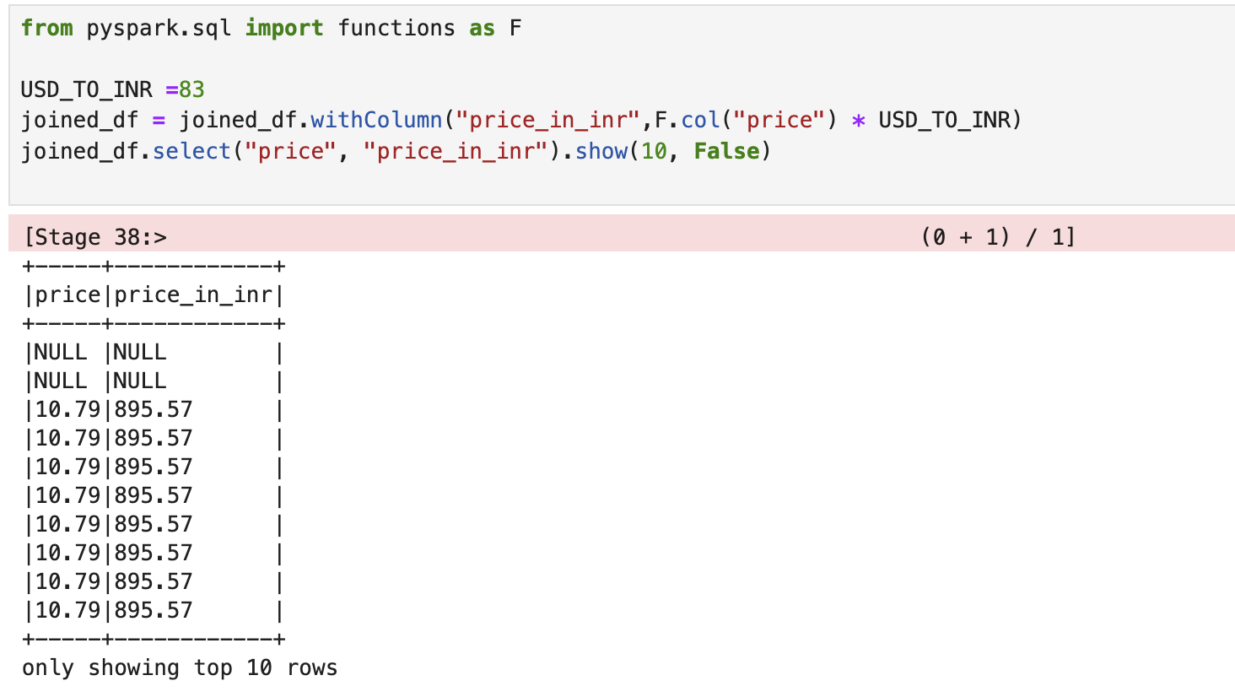
Query 2:
US Dollars to India rupees

Slide 18
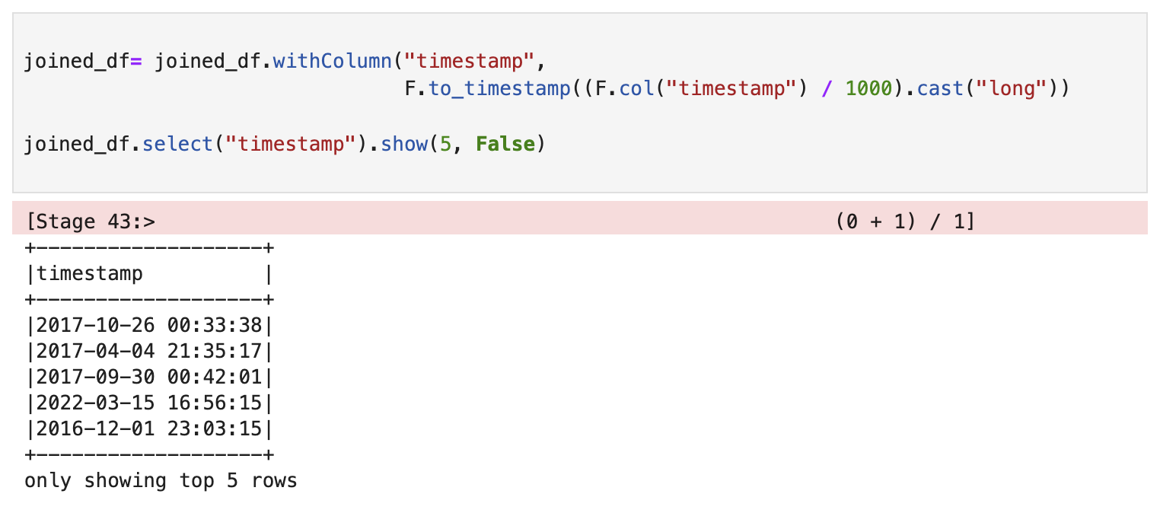
Query 3
Time conversion

Slide 19
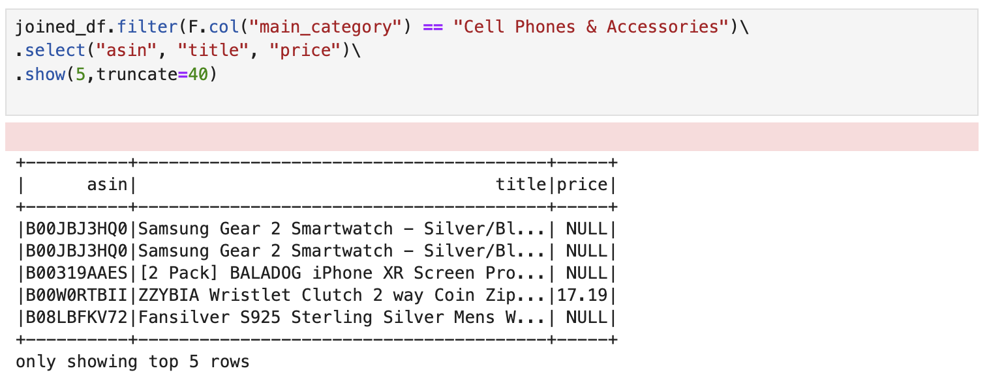
Query 4:
To get the products belonging to a certain category

Slide 20
Query 5:
Longest written review ever:
This review has nothing to do with any sellers. I like to come to amazon for reviews so I feel this is one of the best places to post my review of the Moto 360 and as of yet this listing seems to be the most prominent, so...<br /><br />I've been using a Pebble for about a year so I have a baseline to compare this verses what has been regarded as the best smartwatch to date.<br /><br />Purchase experience:<br />I ordered the moto 360 directly from Motorola just a few minutes after it started selling and received it on 9/15/14. I was tempted to pay a premium to get it a few days faster, but really a few extra days was no big deal and this watch is nice but it is not worth it to pay a premium.<br /><br />Initial impression:<br />I saw all the box opening videos, so I knew what to expect. What I didn't expect was that the watch is really big. I have quite a lot of watches of all types and even "dive" watches and this is as big as the biggest watches I have - which is big..............

