Slide 1
Data Science in Tax
Shan Sun
PyData London 2022

Slide 2

Tax Prequel
Fund public infrastructure and redistribute wealth
Broad types:
Direct tax
Indirect tax
International tax
Employment tax

Slide 3
Data Science in Tax
Clustering / NLP (e.g., keywords insights)
Binary classification (e.g. deductibility)
Multi-class classification (e.g. tax code assignment)
Computer vision (e.g. menu to tax code)
Inferential statistics (e.g. BEPS vs intangibles)

Slide 4
Challenges
Data sources
Data quality
Scalability

Slide 5
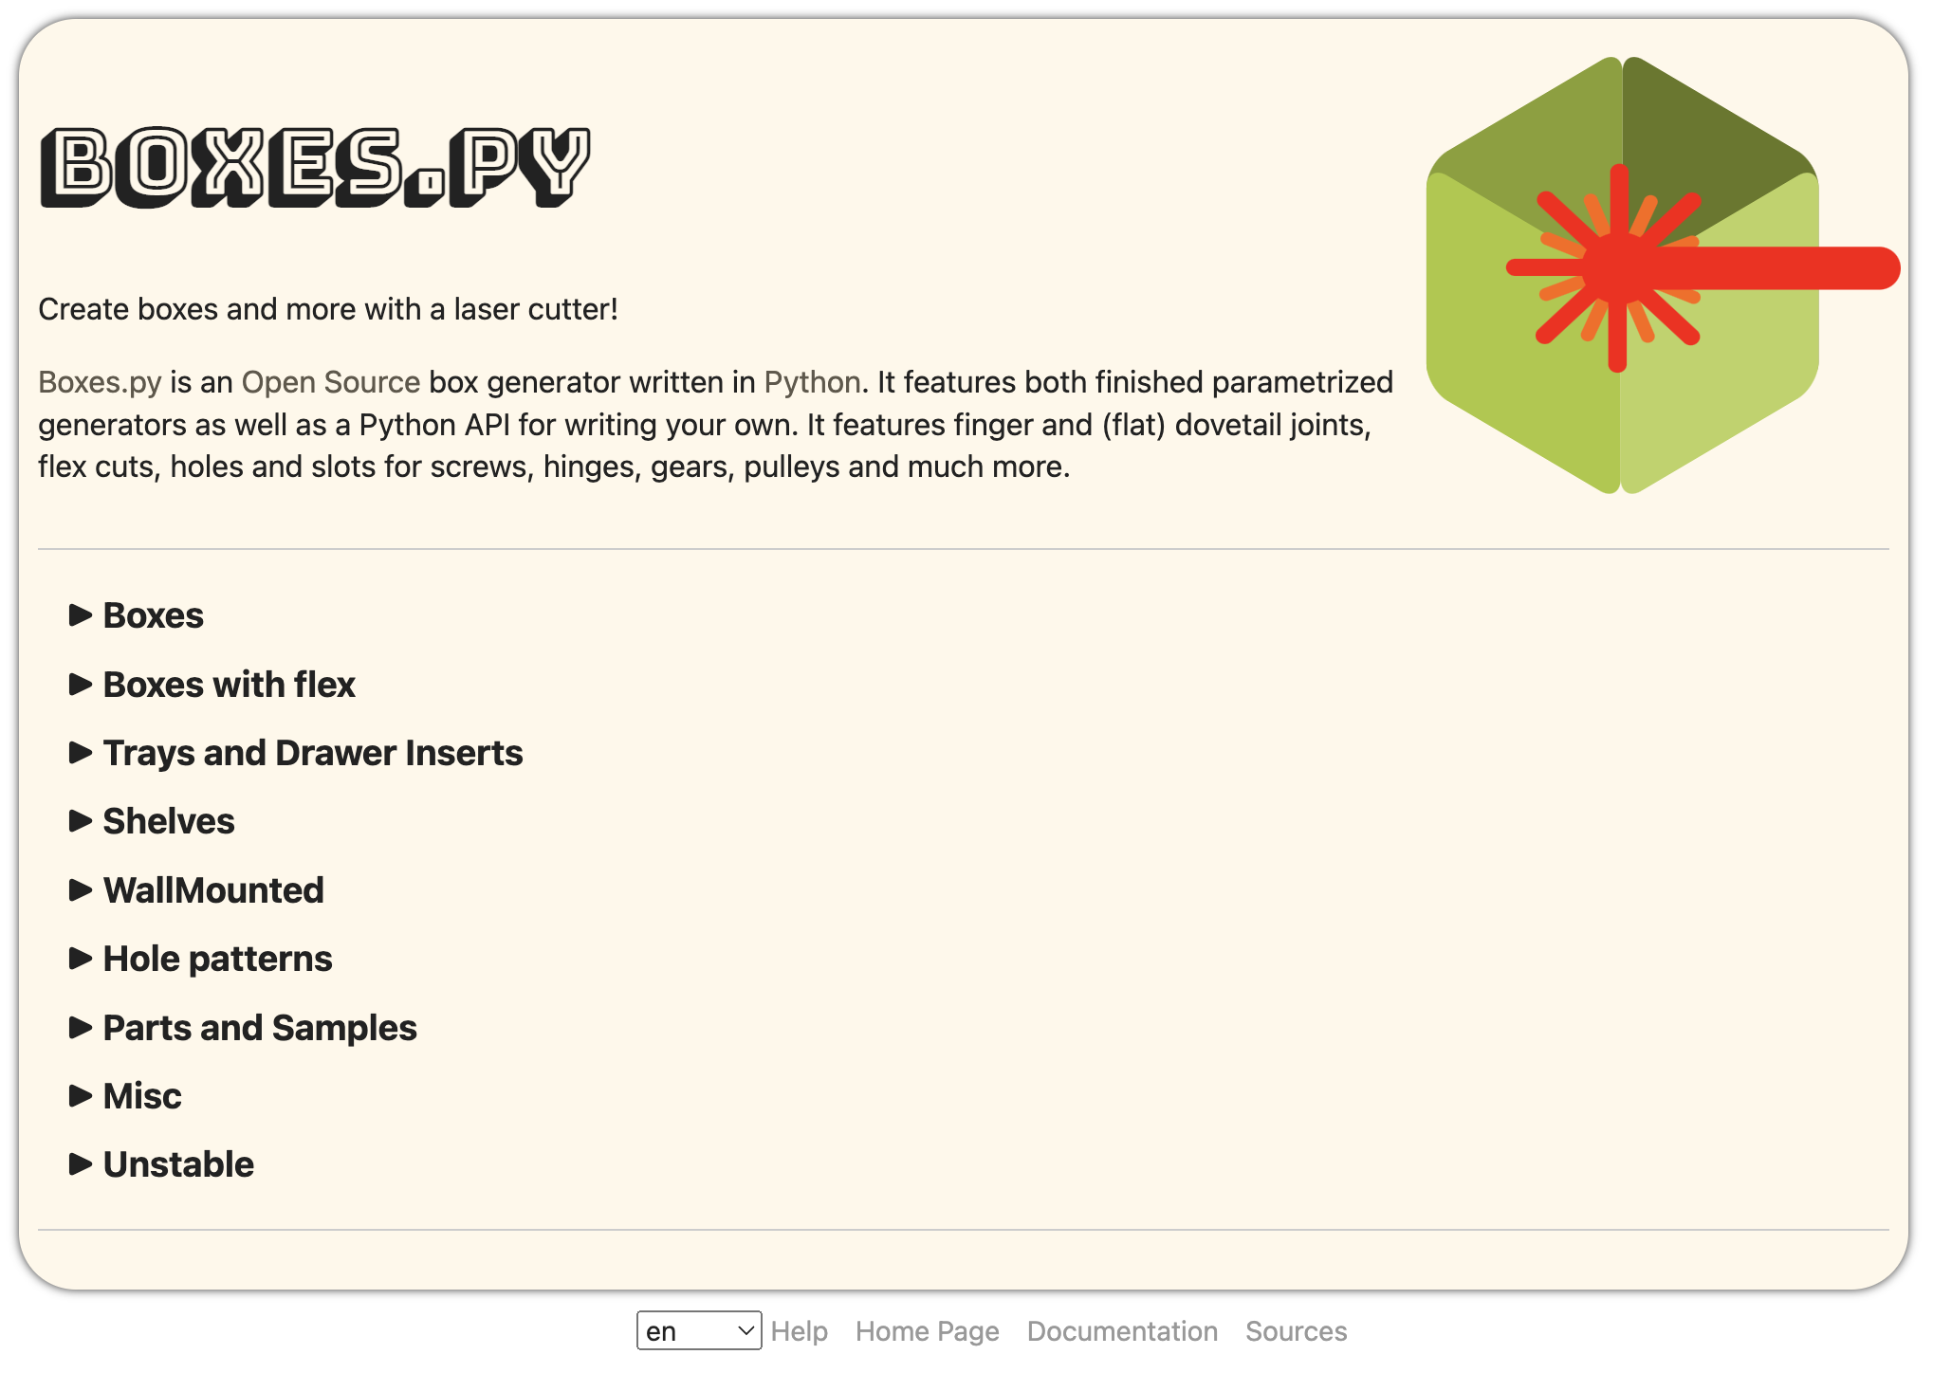
Fun time!
Boxes.py
Open source box generator in Python
Created by Florian Festi

Slide 6

THANK YOU
xiaoshan.sun

