Slide 1
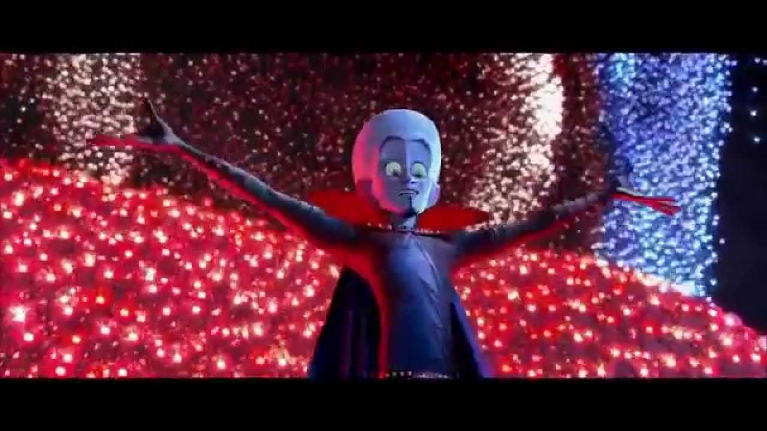
Kyles part of the presentation

Slide 2
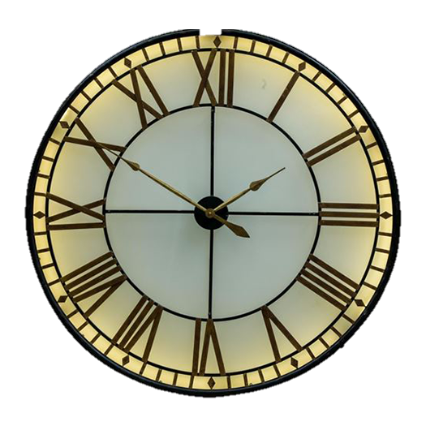
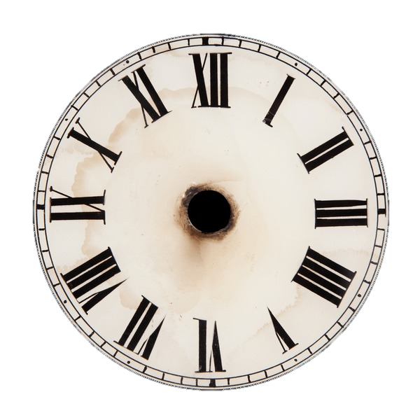
Timer class
This is a class I made and it count the time between two points in the program's execution.
It can then return the time that passed in full or it can return it in bits of 0.016 seconds until there are no more bits and this last part is useful for the physics stuff.
It can also return the time since the program or timers' creation.

Slide 3
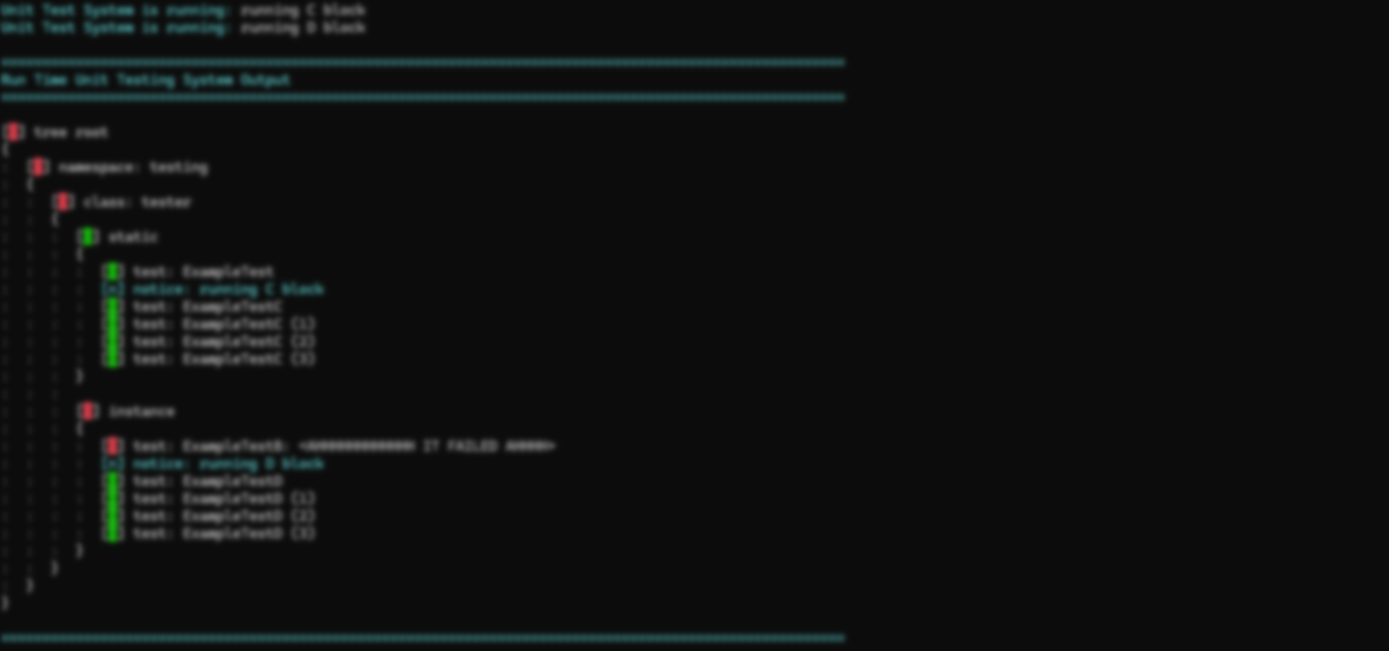

Run time unit testing system
The run time unit testing system is a unit testing library which contains two main classes which are RTUTSTreeConstructor, and RTUTSBindedListConstructor.
When a object of theses classes is created, function names can then be passed to it then those functions/test will be executed if they also return RTUTSUnitTestResults which is a object that can contain anything you wish to be returned from a test.
Once RunTests has been executed on the object the results can then be sent out to the console by sending the constructors data container to ConOutputTestResults.

Slide 4
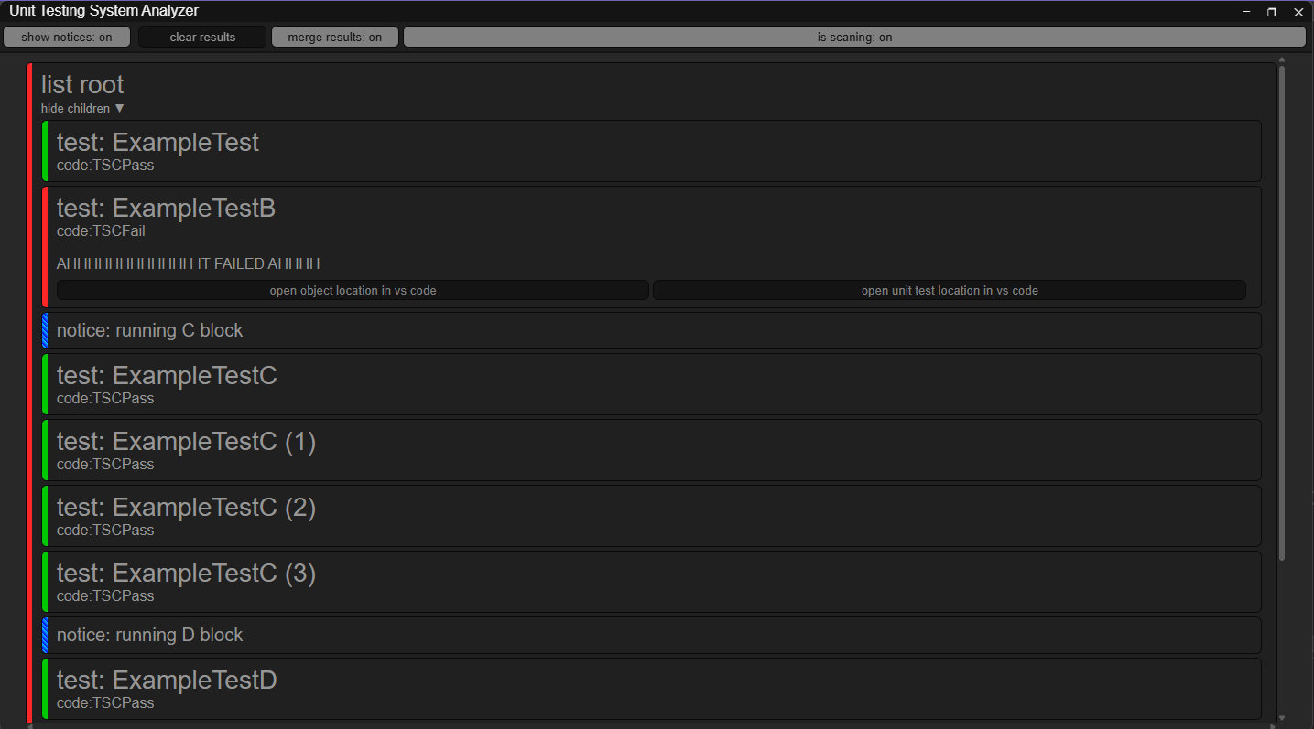
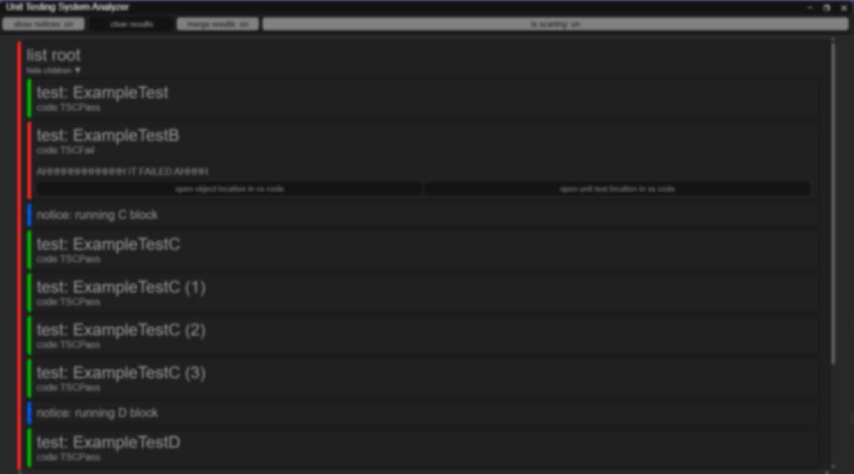
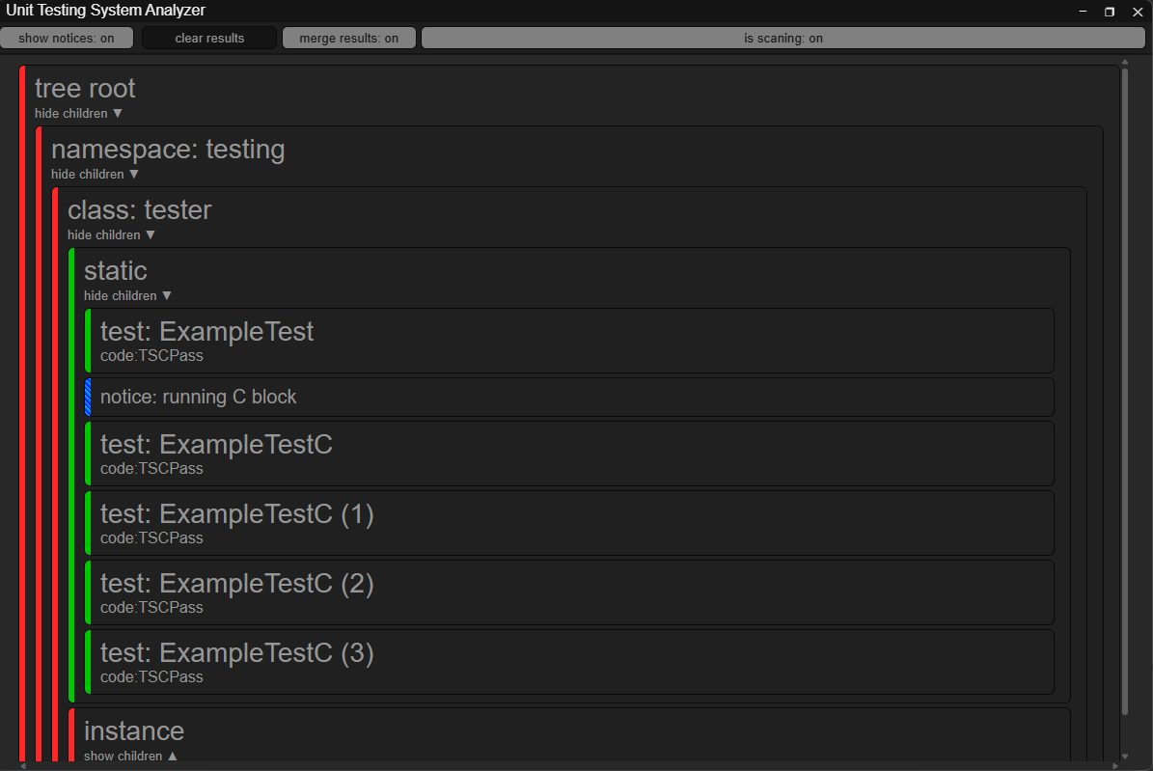
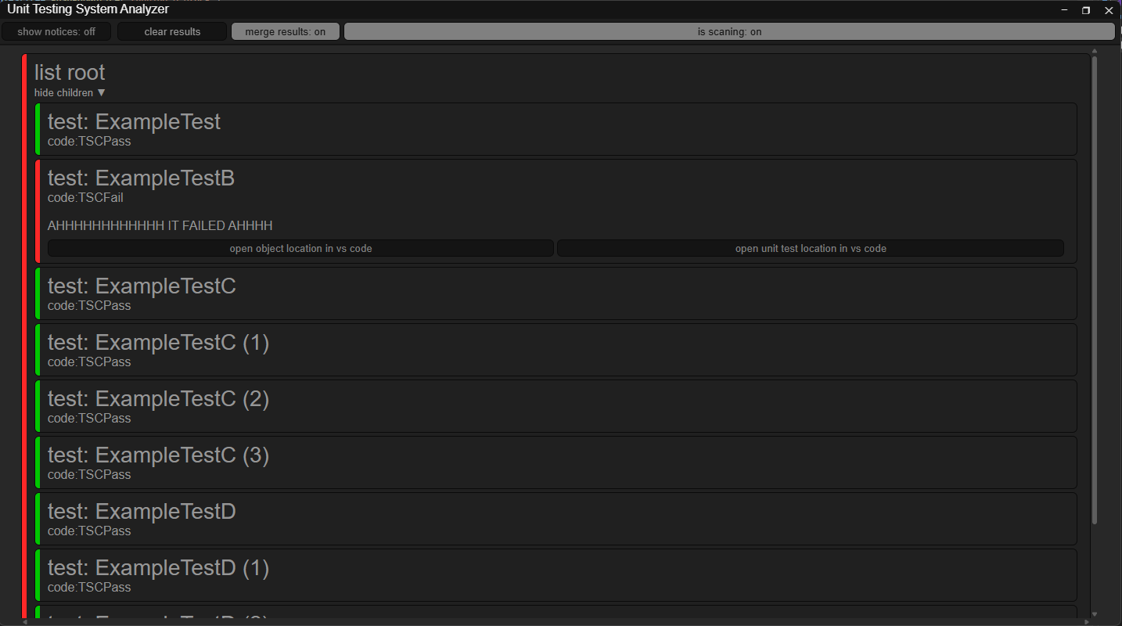
Run time unit testing system program
This is a program that I made, and I made as a means of handling data sent out by ExtOutputTestResults, particularly all the stuff that is unique to this unit testing system because the visual studios test view isn’t very good at handling unique data such as issue descriptions than can change base on test results and severity codes.
The program can consolidate all the results from different parts of the engine into one output and it can provide more help to track down issues than the normal console output.

Slide 5
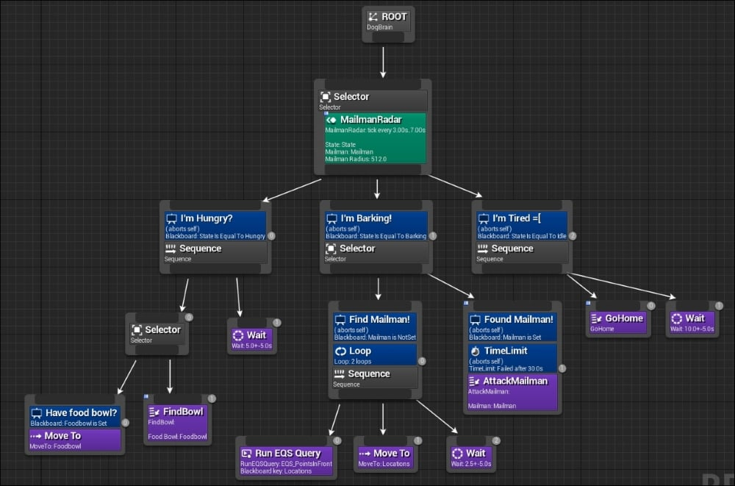
AI behaviour Trees
root
sequence
The behaviour trees can be process in two was forwards and backwards.
In forwards processing we go down as fast as we can and then when we can go down no more we go back to the root. And in backwards we do the same thing, but when we reach an end, we start going back up until we don’t need to anymore then we go back down.
root
sequence

Slide 6
AI MEB

Slide 7
AI navigation system

Slide 8
AI an ai

Slide 9
Models (It is not my place to fight this scourge but I did so and I did it valiantly FOR PLACEHALLA!!!)

Slide 10
textures (It is not my place to fight this scourge but I did so and I did it valiantly FOR PLACEHALLA!!!)

