Slide 1
Rob Young | Team Lead, Software Development, CANARIE
Testing and Containers @ CANARIE

Slide 2
Testing and Containers @ CANARIE
Overview of some of the CANARIE automated testing infrastructure
Provide an overview of interesting tricks and techniques picked up along the way
Work in progress!

Slide 3
Continuous Integration Cycle
Development
Source code commit
Build server
Automated tests run
Testing results

Slide 4
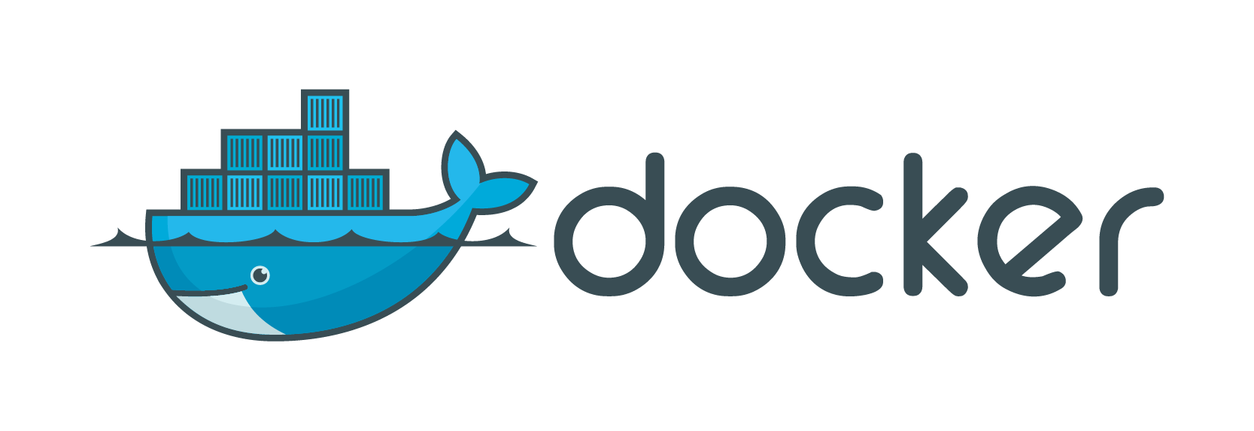

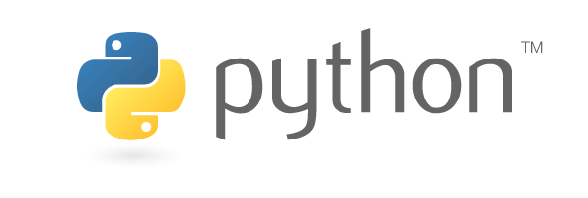
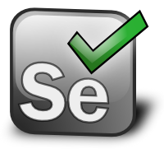

Definitions

Slide 5



Build Server VM: Version 1
Builder Virtual Machine
Windows Selenium Node
Jenkins CI process
Selenium node
Build Job
Build Job
Build Job
Build Job
Build Job
Browsers
Application server stack

Slide 6
Issues
Environment for jobs needs to be curated on the server before tests will run
Job artifacts hang around the server
Complicated environment management
Hard to share the build server between multiple projects
So we began looking for alternatives…
VM scripts?
Docker?

Slide 7
Enter Docker!
Containerizing jobs, environments to create a cleaner build environment
By containerizing test suites (unit and integration), we can encapsulate testing tooling and application servers
Ongoing development effort at CANARIE

Slide 8
What is Docker? Whirlwind Intro
https://www.docker.com/what-docker
Definitions
Image
Pre bundled application, containing code, data, etc. needed to run the application
Container
Running instance of a image, usually one or more live processes
Registry
Server used to store Docker images
Notes:
http://xebia.github.io/docker-introduction/slides/#/

Slide 9
Why Docker?
Beware, there is some hype
Pros
Smaller memory footprint than VMs
Less code to define a service
Faster to spin up containers than VMs
Excellent separation and packaging of code dependencies
Cons
Volume management
Disk space usage
Complexity, large number of related projects
Not a VM, container debugging can be more complicated if not planned for

Slide 10
Build Server V2, Step by Step

Slide 11
Step by Step Walkthrough
Walkthrough of how to set up a VM with:
Docker
Private Docker registry
Jenkins CI
Selenium Hub + nodes
Container-based testing
Full Vagrant-based demonstration VM available! https://github.com/canarie/research_software/tree/master/demo/ci_demo_vm
Notes:
Introduce vagrant first! ☺

Slide 12
Installed Docker, Now What?
Install guide: https://docs.docker.com/engine/installation/linux/centos/
Builder Virtual Machine
Docker Process

Slide 13
Install Jenkins CI
One-line install as container!
docker run -d -p 8080:8080 -p 50000:50000 --name jenkins --restart always -v /home/builder/jenkins:/var/jenkins_home jenkins

Slide 14
Jenkins CI Installed
Builder Virtual Machine
Docker-Managed Containers
Jenkins CI
Running Container

Slide 15
Install Docker Registry (Optional)
Provides a private repository for storing images locally
One-line install
docker run -d -p 5000:5000 --restart=always --name registry registry:2
Pushing images
docker push localhost:5000/containername
Notes:
Discuss purpose

Slide 16
Docker registry
Builder Virtual Machine
Docker-Managed Containers
Jenkins CI
Container-based installation
Easy to configure
Good alternative for container images you want to keep out of public repositories
Docker Registry
Running Container

Slide 17
Let’s create some basic test suites
Test Suite 1, Test Suite 2
Identical, except python version 2.7, 3.5
Demonstrates containerization of testing script environments

Slide 18
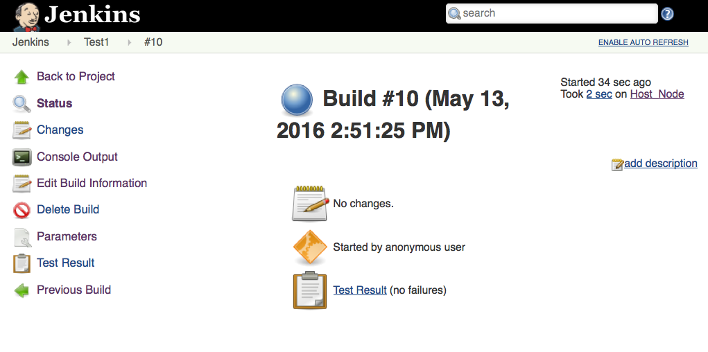
Test Suite Container Setup
Basic containerized integration test suite
Test output – standard Xunit file
Environment variables used to control the tests
All libraries (python, nosetests) needed to run the test suite are part of container

Slide 19
Test Container
Builder Virtual Machine
Docker-Managed Containers
Jenkins CI
Test Suite 1
Docker Registry
Test Suite 2
Running Container
Transient Containers

Slide 20
How do we run the test suite?
Run via Jenkins job
Create and run test container
But we’re running Jenkins in Docker, how do we get a handle on Docker?!
Option A
Running Docker within Docker …!
Option B
Jenkins slave node in the local native host OS
Option C
Passing Docker authorization info into the Jenkins CI container

Slide 21
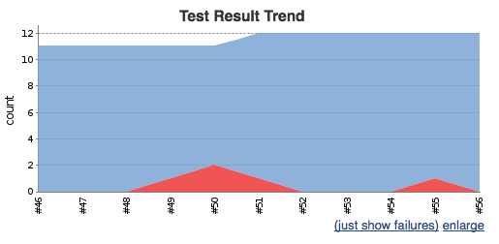
How do we run a test suite?
Builder Virtual Machine
Docker-Managed Containers
1. Dispatches job
Build Request
Jenkins CI
4. Ingests results
Jenkins slave node process
2. Creates and runs
test container
Test Suite 1
3. Executes tests
and publishes results
Running Container
VM Native Process

Slide 22
Why use a Jenkins slave?
Authorization issues already resolved (i.e. option C)
Don’t have to install any Docker client software on the Jenkins CI container, keeping the container clean
Clear separation of where job is being run
Slave nodes introduces option to run on a separate host
Relatively easy to mentally model, compared to option A

Slide 23
Running the Job…
docker pull localhost:5000/canarie/test1
docker run -v ${WORKSPACE}:/workspace -e BREAK_BUILD=${BREAK_BUILD} -t localhost:5000/canarie/test1
Need to link in workspace to get results.xml file (and any other files) out of the container
All files created inside the container are deleted at the end of execution!

Slide 24
What about Selenium?
Notes:
Now we have a test container for running tests, next step Selenium support so we can perform automated browser testing!

Slide 25
Selenium
What is Selenium?
Suite of tools for driving web browsers via code
Tests are run via distributed nodes (browsers) from a central hub – together form a Selenium Grid

Slide 26
Setting up a Selenium Grid
Thankfully there are containers set up for Selenium hub and nodes!
Create a Selenium hub
docker run -d -p 4444:4444 --name seleniumhub --restart always selenium/hub
Create a Firefox node
docker run -d -P --name firefox --link seleniumhub:hub --restart always selenium/node-firefox
Create a Chrome node
docker run -d --name chrome1 --link seleniumhub:hub --restart always selenium/node-chrome

Slide 27
Build VM: Version 2 Selenium Grid Architecture
Builder Virtual Machine
Docker-Managed Containers
Jenkins CI
Test Suite 1
Test Suite 2
Docker Registry
Jenkins slave node process
Selenium Chrome node
Selenium hub
Selenium Firefox node
Running Container
VM Native Process
Transient Containers

Slide 28
Next Step:
Adding a Selenium-Based Test Suite

Slide 29
Selenium Test Suite
New test suite that makes use of the hub
Include Selenium libraries in test suite container
Jenkins job to include Selenium hub
Create application server for test suite duration

Slide 30
Build VM: Version 2 - Selenium Test Suite
Builder Virtual Machine
Docker-Managed Containers
1. Dispatches job
Jenkins slave node process
Build Request
Jenkins CI
4. Ingests results
Selenium Firefox Node
2. Creates and runs
test, app serv container
3. Executes tests
and publishes results
Selenium Hub
Test 3
Selenium
App server
Running Container
VM Native Process

Slide 31
Selenium Test Suite Setup
Run app server container (httpd) as a daemon process
Run test instance, link to httpd and Selenium server containers
Get results and clean up Apache daemon
APACHE_ID=`docker run -d canarie/${APP_SERVER}`
TEST_STATUS=0
docker run --rm=true --link seleniumhub:seleniumhub --link ${APACHE_ID}:web -v ${WORKSPACE}:/workspace localhost:5000/canarie/test3selenium || TEST_STATUS=1
docker stop $APACHE_ID
docker rm $APACHE_ID
exit $TEST_STATUS

Slide 32
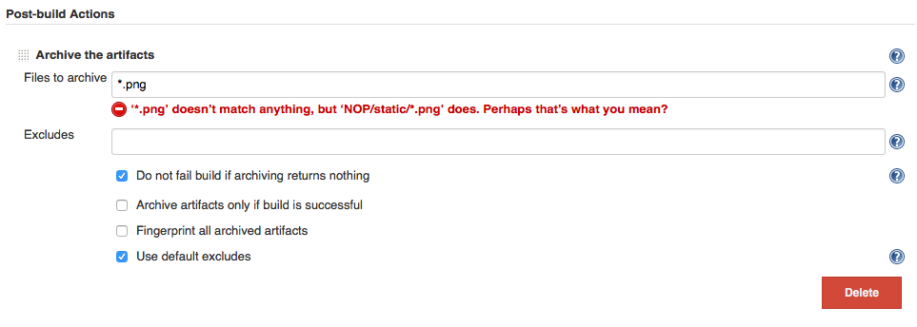
Getting Output from Jenkins
When the build fails…
Screen captures from the node when a test fails...but this information is lost if not archived!
Jenkins to the rescue!

Slide 33
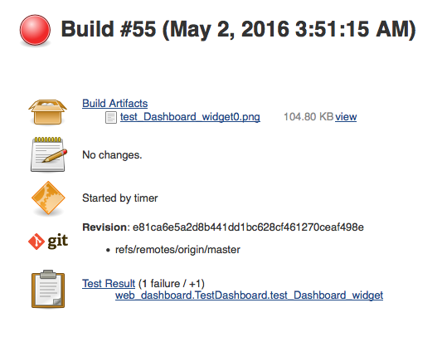
Getting Output from Jenkins

Slide 34
Build VM: Final Product
Builder Virtual Machine
Docker-Managed Containers
Jenkins CI
Test Suites
App server containers
Test Suites
App server containers
Test Suites
App server containers
Test Suites
App server containers
Test Suites
App server containers
Jenkins slave node process
Docker
Registry
Selenium Chrome node
Selenium hub
Selenium Firefox node
Always Running Container
VM Native Process
Transient Containers

Slide 35
Challenges
Working with containers
Transient files
Resources

Slide 36
Next Steps
Application server containerization
Increased Registry integration
Docker Swarm – clustered cloud

Slide 37
Questions?

