Slide 1
jBPM Kickstart
Bob Brady
ChemBio Informatics Platform

Slide 2
Agenda
Introduction
What is jBPM?
Workflows and Business Processes
Real-Life Workflow
Why should I care?
GoogleCode Project jbpmKickstart Demo
Hibernate/Spring/jBPM Eclipse project
Learn from Junit tests
Next Steps and Challenges
How to provide better integration w/J2EE stack

Slide 3
What is jBPM?
jBPM => Java Business Process Management
Persists process execution state
Triggers automatic actions: decision logic, task assignment, etc.
Stores contextual process instance information
Logs activity
RedHat application stack component
jBoss Hibernate (Object/Relational Mapping)
jBoss Seam (Web 2.0 framework)
jBoss Application Server
RedHat Enterprise Linux
Open Source
Available from sourceforge.net/project/jbpm
LGPL license

Slide 4
Workflows and Business Processes
Workflow <=> Business Process, synonyms
Workflow characteristics
- Natural representation by Graph or UML Activity Diagram
- Long running, asynchronous wait states request/response binding
Concurrent operations (forking)
Merging of activities (joining)
Notion of task assignment

Slide 5
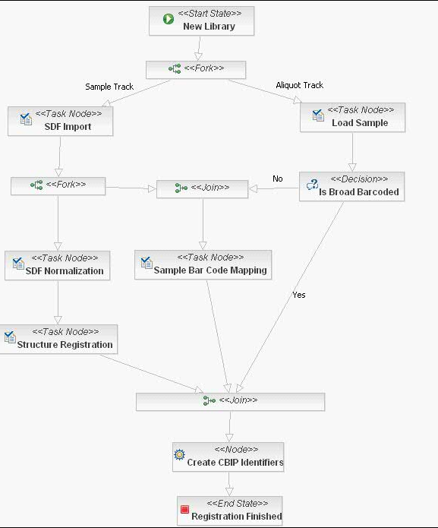
Real-Life Workflow: Structure Registration

Slide 6
Why Should I Care about jBPM?
Rapid Development
No need to start from scratch: jBPM provides a widely-used graphical oriented framework
Common workflow language
Lightweight footprint, database schema
Centralized Implementation
Business logic coded within process definition
UI page flow dispatched based upon process context/state
Integration with Commonly Used Webapp Stack
Hibernate+Spring

Slide 7
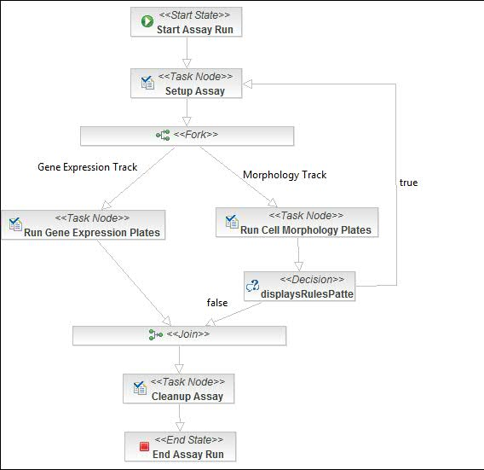

Workflow Common Language
Process
Scientist
Implementation
doStuf() {
signal node
if context has foo
then bar
else baz
}
Programmer
Server

Slide 8

Webapp Embedded jBPM
Tomcat
Integrates easily with Hibernate and Spring.
Lightweight: jar ~ 650 KB, schema ~ 30 tables.
Relatively simple deploy.
Highly extensible open source.
webapp.war
jBPM.jar
webappDB
jBPM Schema

Slide 9
Webapp Embedded BPM Alternative
Tomcat
webapp.war
BPM Engine
webappDB
bpmDB
Black Box Integration
Not easily extensible
Roundtrip overhead

Slide 10
Agenda
Introduction
What is jBPM?
Workflows and Business Processes
Real-Life Workflow
Why should I care?
GoogleCode Project jbpmKickstart Demo
Hibernate/Spring/jBPM Eclipse project
Learn from Junit tests
Next Steps and Challenges
How to provide better integration w/J2EE stack

Slide 11
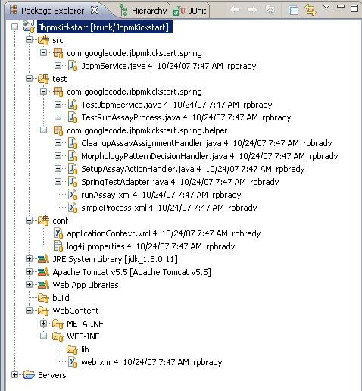
jbpmKickstart: GoogleCode Project
Project Home: http://code.google.com/p/jbpm-kickstart/
SVN Checkout
https://jbpm-kickstart.googlecode.com/svn/trunk/
Wiki, Downloads, Issues: Available, To-Be-Done

Slide 12
Agenda
Introduction
What is jBPM?
Workflows and Business Processes
Real-Life Workflow
Why should I care?
GoogleCode Project jbpmKickstart Demo
Hibernate/Spring/jBPM Eclipse project
Learn from Junit tests
Next Steps and Challenges
How to provide better integration w/J2EE stack

Slide 13
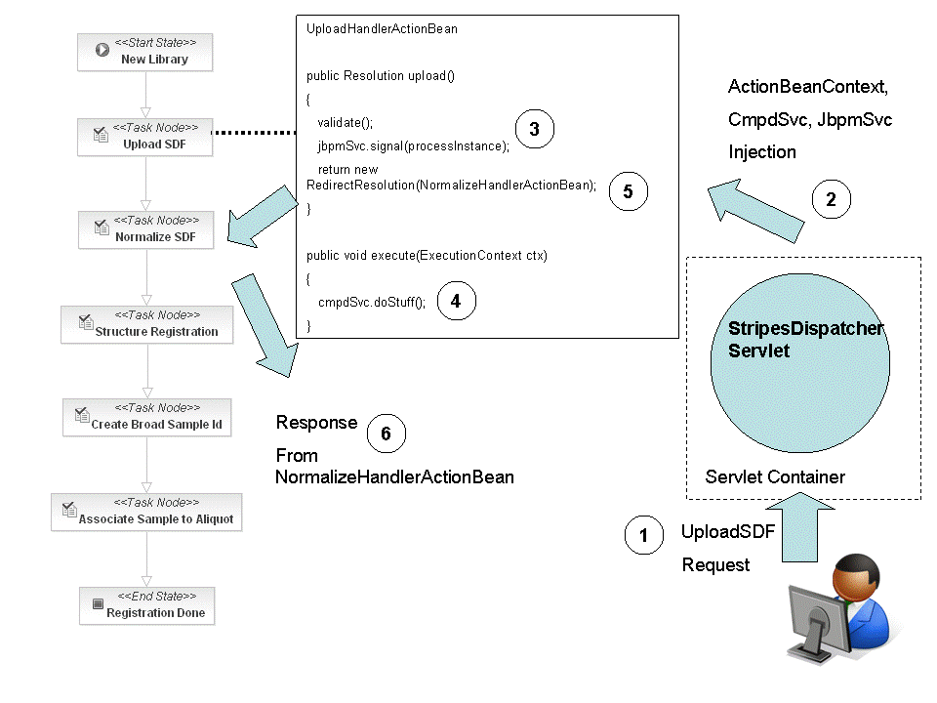
jBPM Integration: Nodes as MVC Controllers

Slide 14
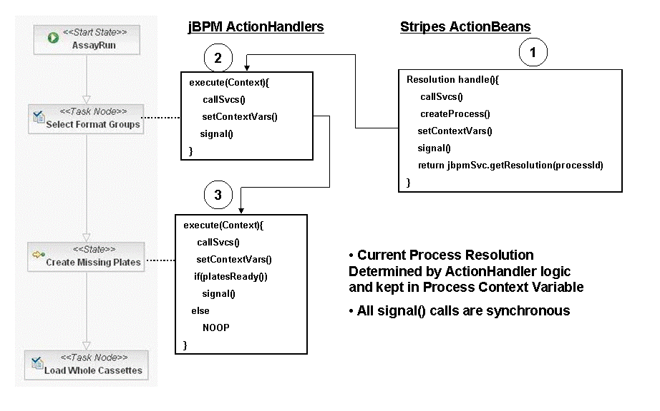
jBPM Integration: Nodes Encapsulate Service Calls

Slide 15
Questions

