Slide 1

Session 805
Developing Collaborative Tools With Equinox and ECF
Bob Brady
ALF, ECF Contributor

Slide 2
Agenda
Motivation & Use Case
Part I: OSGi Fundamentals
Part II: ECF Fundamentals
Part III: Server-Side Eclipse
Part IV: Putting It all Together
Questions & Resources

Slide 3

Motivation
Requirements
Design
Build
Test
Manage
Support
Application Lifecycle
Application Lifecycle Management
  Continuum of activities
  Intra-Team collaboration: practitioner x in USA, practitioner y in India
  Inter-group collaboration: practitioner, manager, executive
  Inter-tool collaboration: e.g., Build <-> QA Test
  “You Talkin’ to Me?” O(n²) point-to-point vs. O(n) collaborative integrations
What the Market Needs: Open Collaboration Tools for ALM
  Current cobbled solutions fall short: wiki + video conf + im
  Proprietary solutions not flexible, customizable
  Eclipse provides open frameworks for building collaborative tools: OSGi, ECF, Corona, ALF
This Talk: Stepping Stone to Advanced OSGi, ECF, Corona

Slide 4

Thematic Use Case: TPTP Test Collaboration
TPManager/TPBridge
Automaton Bundle
TPBuddy/TPBridge
“Tom Tester”
TPBuddy/TPBridge
“Polina PM”
Collaboration Server
Machine Under Test
Tom Tester requests JUnit test execution with TPBuddy™ GUI
Tom’s TPBuddy fires testexec event via TPBridge™ to TPManager™.
TPManager receives event, launches TPTP testsuite on MUT, fires testresult event to all TPBuddies.
TPBuddies’ GUIs updated in real-time.
Polina PM notices new results in TPBuddy GUI, chats with Tom.

Slide 5
Demo Infrastructure
The following software installed on a machine in a new workspace:
  Eclipse SDK 3.2 (http://www.eclipse.org)
  ECF latest release (http://www.eclipse.org/ecf)
  Equinox org.eclipse.equinox.event bundle (http://www.eclipse.org/equinox)
  TPTP (http://www.eclipse.org/tptp) via Eclipse Update
  See TPTeam home http://tpteam.sourceforge.net for more info.
  The demo projects from CVS:
    Server: tpteam.cvs.sourceforge.net
    Repository /cvsroot/tpteam
    User anonymous
    Password [NONE REQUIRED]
    Projects all projects under net.eclipseworld

Slide 6

Part I: Open Services Gateway Initiative Overview
OSGi Framework :
  Standardized (www.osgi.org) Java framework for delivery of networked managed services
  Manages bundle lifecycle: Install, start, and stop
  Eclipse equinox: OSGi implementation. Below Eclipse runtime in IDE stack.
Bundles :
  Basic framework element or component.
  Java code + resources + Manifest, typically as jar
  Bundles register and consume OSGi services
  Bundle Activator: called by framework to start, stop
  Collaborate through OSGi service objects, package sharing
Services :
  POJOs registered into the OSGi framework, inside a bundle, with a set of properties.
  Services registered by other bundles can be searched w/ LDAP-like queries

Slide 7
OSGi Collaborative Model
SOA: Find, bind, & execute
Event objects fired
  Bundle, Service, Framework, …
Equinox Services Commonly Used:
  Service Tracker
  Service Registration
  EventAdmin
  Log
  HTTP
How-To Consume a Service:
  Update Manifest: import service package
  Use ServiceTracker object to track ServiceEvents at bundle start
  Extend ServiceTracker for custom monitoring
How-To Provide a Service:
  Update Manifest: export service package
  Create service interface & implementation
  Register service, typically in bundle Activator
OSGi Framework
Bundle
Service
registry
Bundle
packages
packages
JAVA
Operating System
Hardware

Slide 8

Demo I: Round-Trip “Hello World!” w/EventAdmin
org.osgi.service.event.EventAdmin
“Hello World!”
HelloEventAdmin
EventAdmin
Bundle
Bundle
“Hello World!”
org.osgi.service.event.EventHandler

Slide 9
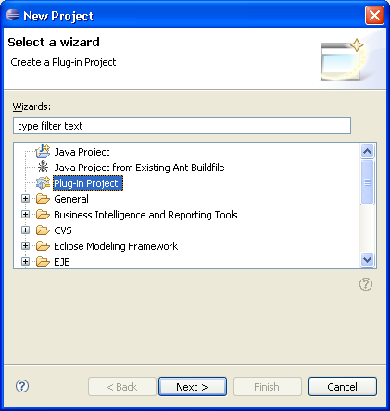
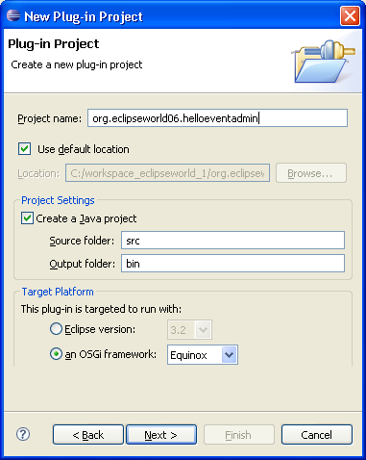
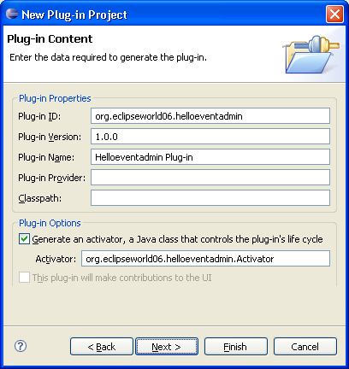
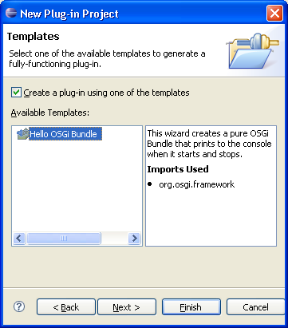
Demo I: Create the HelloEventAdmin bundle (1/4)
_{Step 1.}
_{Create new plug-in project}
_{Step 2}
_{Project name: helloeventadmin}
_{an OSGi framework: Equinox}
_{Step 3}
_{Generate an activator}
_{Step 4}
Use the Hello OSGi Bundle template

Slide 10
Demo I: Create the HelloEventAdmin bundle (2/4)
Activator.java
The bundle Activator implements the EventHandler interface
  Register the EventHandler service in the bundle start method
  Provide a concrete handleEvent method
Create of dictionary of event topics to be handled
  Use package-like descriptors
public class Activator implements BundleActivator, EventHandler {
private TimerEvent mTimerEvent;
Private Hashtable<String, String[]> mDictionary = new Hashtable<String, String[]>();
public void start(BundleContext context) throws Exception {
mDictionary.put(EventConstants.EVENT_TOPIC,
new String[] { "org/eclipseworld06/helloeventadmin/hello" });
context.registerService(EventHandler.class.getName(), this, mDictionary);
System.out.println("\nActivator: Registered EventHandler Service...\n");
mTimerEvent = new TimerEvent(context);
mTimerEvent.start();
}
…
public void handleEvent(Event event) {
System.out.println("Activator: Received Event: \""
+ ((String[])event.getProperty("MESSAGE_TEXT"))[0] + "\"\n");
}
…
}

Slide 11
Demo I: Create the HelloEventAdmin bundle (3/4)
Activator.java
The bundle Activator contains an inner Thread class
  Utilizes a ServiceTracker to handle EventAdmin service
  Fires off “Hello World!” event to EventAdmin every 5s, for a total of 10 times
Issues events with topic matching that of EventHandler
  Uses package-like descriptors
Don’t forget ServiceTracker.open() call!
  OSGi exemplary code left open() call out of docs
public class TimerEvent extends Thread {
private ServiceTracker mServiceTracker;
public TimerEvent(BundleContext context) {
mServiceTracker = new ServiceTracker(context, EventAdmin.class.getName(), null);
mServiceTracker.open();
mDictionary.clear();
}
public void run() {
for (int i = 0; i < 10; i++) {
try {
mDictionary.put("MESSAGE_TEXT",
new String[]{"Hello World from TimerEvent via EventAdmin!"});
EventAdmin eventAdmin = (EventAdmin) mServiceTracker.getService();
System.out.println("TimerEvent: Sent Event...");
eventAdmin.sendEvent(new Event("org/eclipseworld06/helloeventadmin/hello",mDictionary));
}
sleep(5000);
} catch (InterruptedException e) {}
}
System.out.println("TimerEvent: Done Sending Events!");
}}

Slide 12
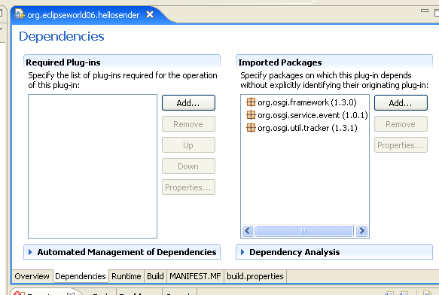
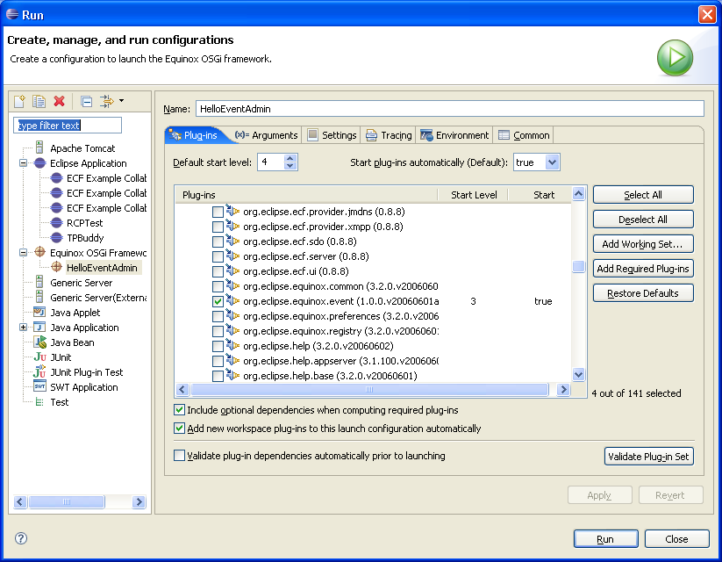
Demo I: Create the HelloEventAdmin bundle (4/4)
_{Step 5}
Add imported packages for EventAdmin, EventHandler, and ServiceTracker
_{Step 6}
Add plugins to launcher, set start levels for default, event, and services bundles

Slide 13
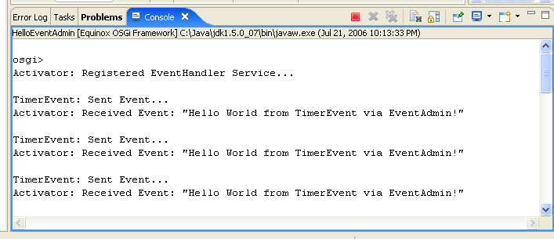
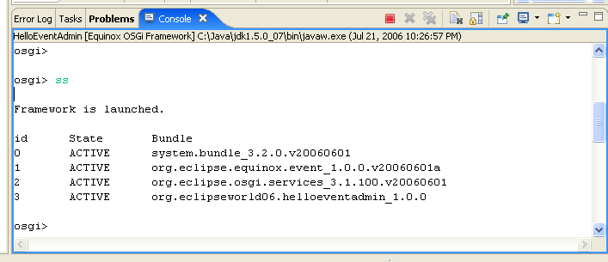
Demo I: Run HelloEventAdmin Bundle
The Framework now runs the helloeventadmin example
  See the printed text
It also runs a Framework console
  Equinox specific
Type “ss” (show status)
  Look at the active bundles
  Notice the number for the helloeventadmin bundle. This is the bundle id.
Type “stop <symbolic-name>”
  stop org.eclipseworld06.helloeventadmin
Type “start <symbolic-name>”
  start org.eclipseworld06.helloeventadmin
Experiment with the osgi console
  “osgi> help”

Slide 14
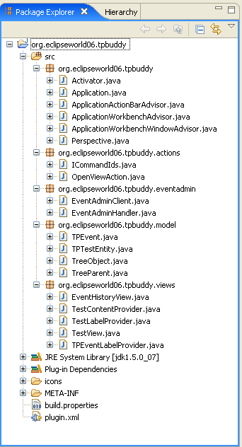
Demo 2: TPBuddy Test Exec Req w/EventAdmin & RCP (1/2)
org.osgi.service.event.EventAdmin
TPEvent: TestExecReq
TPBuddy
EventAdmin
Bundle
Bundle
TPEvent: TestExecReq
org.osgi.service.event.EventHandler

Slide 15
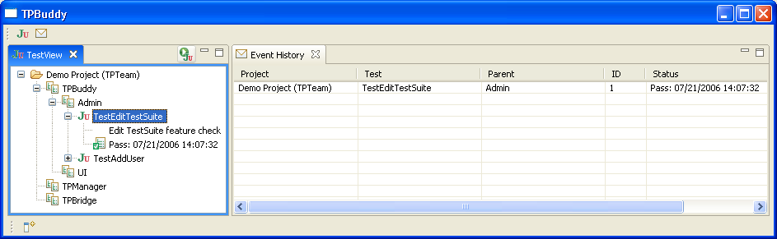
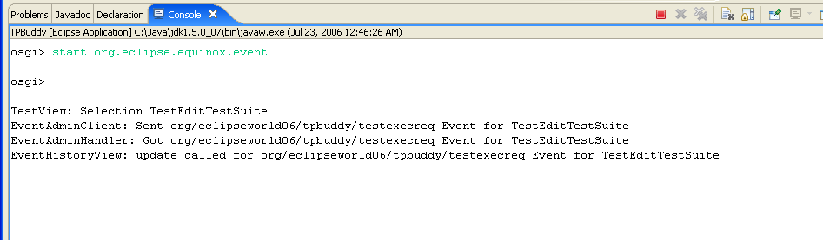
Demo 2: TPBuddy Test Exec Req w/EventAdmin & RCP (2/2)

Slide 16
Part 2: Eclipse Communications Framework (ECF)
ECF: common API for multiple communication protocols
  Min. Requirements: Eclipse runtime stack
  Protocols Supported: XMPP, JMS, JXTA, IRC, ECF, …
Core API: org.eclipse.ecf.core.IContainer
  Container: protocol specific communication context
  Can represent point-to-point or pub/sub. Async and/or sync.
  Write to one IContainer API, not many protocol impl APIs
IContainers utilize companion Objects for messaging
  ISharedObjectContainer => ISharedObject, message via Objects
  IChannelContainer => IChannel, message via bytes
  IPresenceContainer => IMessageSender, message via IM impl
ECF provides generic collaboration server
  Simple TCP/IP socket listener
  Allows newbies to focus on learning ECF API
  org.eclipse.ecf.serverfeature_x.x.x
ECF provides collaboration views, wizards, & dialogs for reuse
  ChatRoomView, RosterView, DiscoveryView
  JoinGroupWizard, ChatRoomSelectionDialog
  Some “teasing-out” required: intertwined w/examples

Slide 17
Serialized Object Messages w/ECF SharedObject
Example SharedObject Usage
All ECF Containers implement ISharedObjectContainer
ISharedObjects are created and added to ISharedObjectContainers
ISharedObjects send/receive events through container group
  Message events
  SharedObject lifecycle events
  Container lifecycle events
Event objects sent must implement Serializable
ISharedObject impl code handles events, directs to business logic
Event bookkeeping:
  OSGi Events
  ECF Events
  Your Events
  3rd Party Events
// A method in an ECFBridge bundle
public boolean sendECFTPMsg(String containerID, String sharedObjIDStr, Event event) {
try {
ISharedObjectContainer container = (ISharedObjectContainer) mIContainers
.get(containerID);
ID sharedObjectID = IDFactory.getDefault().createStringID(
sharedObjIDStr);
TPSharedObject tpSharedObject = (TPSharedObject) container
.getSharedObjectManager().getSharedObject(sharedObjectID;
TPEvent tpEvent = new TPEvent(event);
tpSharedObject.getContext().sendMessage(null, tpEvent);
} catch (Exception e) {
e.printStackTrace();
}
return true;
}
public class TPSharedObject extends Observable implements ISharedObject { …
// Customized SharedObject Event Handling
public void handleEvent(Event event) {
if (event instanceof ISharedObjectMessageEvent) {
ISharedObjectMessageEvent evt = (ISharedObjectMessageEvent) event;
setChanged();
notifyObservers((TPEvent)event.getData());
}
…}

Slide 18
ECF Client Lifecycle
Create IContainer
  OSGi Bundle: Populate ContainerFactory “manually”
  Eclipse Plug-in: Populate ContainerFactory via extension point
Retrieve/setup protocol adapter
Create target ID
Call IContainer.connect(targetID)
Send/receive messages (via adapter)
Disconnect
Dispose

Slide 19
ECF Client Lifecycle Example (OSGi Bundle, 1/2)
// Create IContainerInstantiator manually, since OSGi bundle, no Eclipse extension point available
IContainerInstantiator instantiator = new ContainerInstantiator();
// Create a container description with appropriate descriptive parameters
// These values from org.eclipse.ecf.example.collab plugin.xml <containerFactory> element
String[] argTypes = {"org.eclipse.ecf.core.identity.ID ","java.lang.Integer"};
String[] argDefaults = {"","30000"};
String[] argNames = {"id", "keepAlive"};
ContainerTypeDescription cd = new
ContainerTypeDescription("ecf.generic.client", instantiator,"ecf.generic.client", argTypes, argDefaults, argNames);
// Add this new description to ContainerFactory
IContainerFactory factory = ContainerFactory.getDefault();
factory.addDescription(cd);
// Create shared object container instance via ECF container factory
ISharedObjectContainer container = null;
container = SharedObjectContainerFactory.getDefault().createSharedObjectContainer(“ecf.generic.client”);
// Create ECF IDs from String IDs
ID targetID = IDFactory.getDefault().createStringID(targetIDStr);
ID sharedObjectID = IDFactory.getDefault().createStringID(sharedObjIDStr);

Slide 20
ECF Client Lifecycle Example (OSGi Bundle, 2/2)
// Create actual TPTeam shared object
TPSharedObject tpSharedObject = new TPSharedObject();
// Add shared object to container
container.getSharedObjectManager().addSharedObject(sharedObjectID, tpSharedObject, new HashMap());
// Join group identified by groupID
container.connect(targetID, null);
// Send message objects within & external to local JVM
tpSharedObject.getContext().sendMessage(null, tpEvent);
// Handle incoming messages with SharedObject subclass, e.g., withinTPSharedObject
public void handleEvent(Event event) {
if (event instanceof ISharedObjectMessageEvent) {
ISharedObjectMessageEvent evt = (ISharedObjectMessageEvent) event
If(evt.getData() instanceof TPEvent)
// Do stuff…
// Disconnect/Dispose
container.dispose(0);

Slide 21
ECF Client Tips for OSGi Bundles
Populate ContainerFactory “manually”
Import packages for simple SharedObject, no discovery:
  org.eclipse.ecf.core
  org.eclipse.ecf.core.events
  org.eclipse.ecf.core.identity
  org.eclipse.ecf.core.provider
  org.eclipse.ecf.core.util
  org.eclipse.ecf.provider.generic
Launcher plug-ins for simple SharedObject Client in demo:
  org.eclipse.ecf
  org.eclipse.ecf.provider
Start osgi event and ECF Bridge bundles before your app

Slide 22
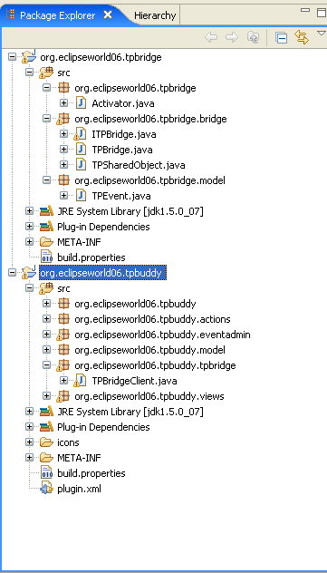
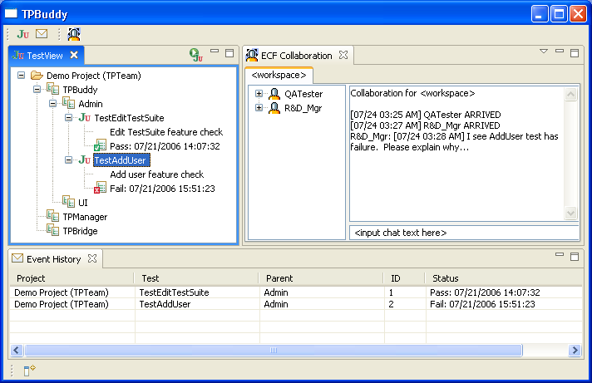
Demo 3: TPBuddy w/EventAdmin & ECF (1/2)

Slide 23
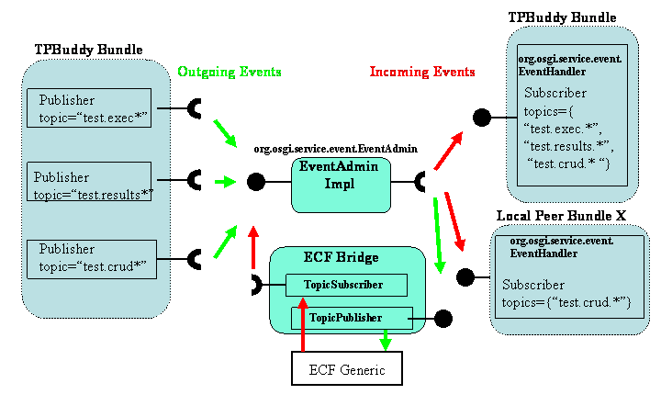
Demo 3: TPBuddy w/EventAdmin & ECF (2/2)
OSGI Runtime
Inter-JVM TPTeam

Slide 24
Part III: Collaboration w/Server-Side Eclipse
Why do this?
  Expose bundle to non-eclipse/Java clients
  Easy Reuse of components
  IT Shop already maintaining servlet-container
Servlet containter embedded OSGi: Equinox Provided
  “Server-Side” incubator project
  Starter OSGi runtime packed in bridge.war file
  BridgeServlet forwards requests to HttpService registered servlets
Bridge consumer responsibilities
  Register your servlets and resources as normal
  Add application bundles and dependencies
  Re-deploy during development

Slide 25


Equinox Bridge Architecture
Http
Servlet Container
OSGi Runtime
org.osgi.service.http.HttpService
Forward
BridgeServlet
Your Bundle
HttpService
Servlet
/myRoot/Servlet
/myRoot/*
Http
Context
OSGi Launcher
javax.Servlet
Servlet

Slide 26
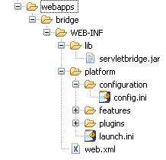
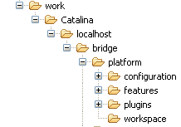
Embedded Equinox Directory Structure
WebApp
Work
bridge.war upacks here
BridgeServlet & OSGi Launcher
Re-deploy bundles here
Set Bundle Start Levels Here
Your bundle & dependencies
BridgeServlet Mapping & Init-Params

Slide 27
Server-Side Eclipse Code Examples
Bundle Activator & HttpServiceTracker Excerpts
Create a bundle ala Demo I
Create a ServiceTracker to handle HttpService
Add resources & servlets
Export your bundle
Add your bundle, dependencies to webapp & work dirs
Edit config.ini appropriately
Launcher is your friend
  Add required plug-ins
// Inside Bundle Activator
public void start(BundleContext context) throws Exception {
mHttpServiceTracker = new HttpServiceTracker(context);
mHttpServiceTracker.open();
}
// Inside HttpServiceTracker
public class HttpServiceTracker extends ServiceTracker {
public HttpServiceTracker(BundleContext context) {
super(context, HttpService.class.getName(), null);
}
public Object addingService(ServiceReference reference) {
HttpService httpService = (HttpService) context.getService(reference);
try {
httpService.registerResources("/tpteam/index.html", "/html/index.html", null);
httpService.registerServlet("/tpteam/processTestExec",
new ProcessTestExecServlet(), null, null);
} catch (Exception e) {
e.printStackTrace();}
return httpService;
}
public void removedService(ServiceReference reference, Object service) {
HttpService httpService = (HttpService) service;
httpService.unregister("tpteam/index.html");
httpService.unregister("tpteam/processTestExec");
super.removedService(reference, service);
}}

Slide 28
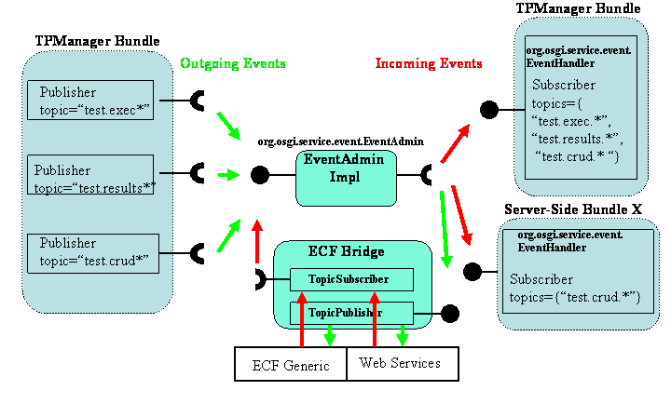
TPManager + TPBridge Bundles: Server-Side
Tomcat Web Container
OSGI Runtime
Inter-JVM TPTeam

Slide 29
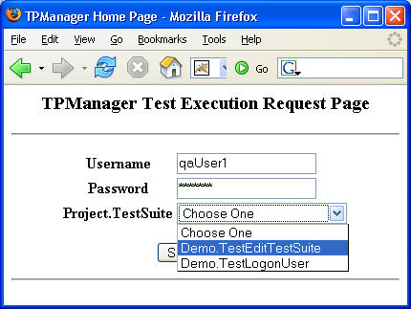
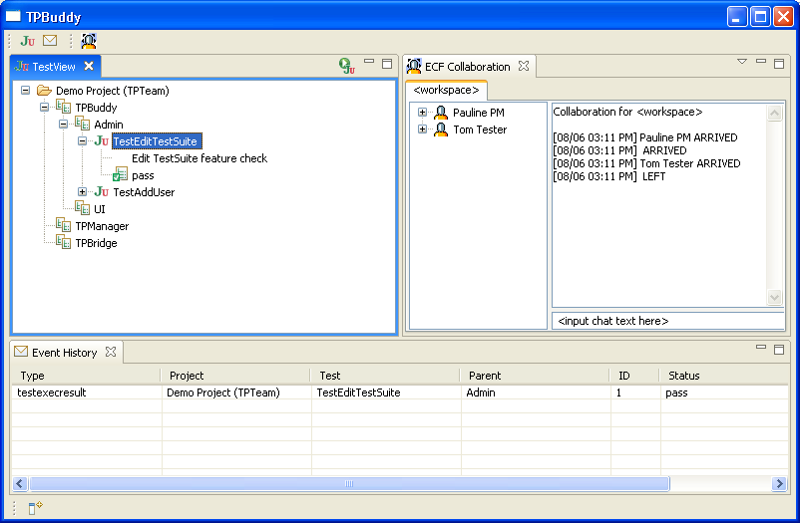
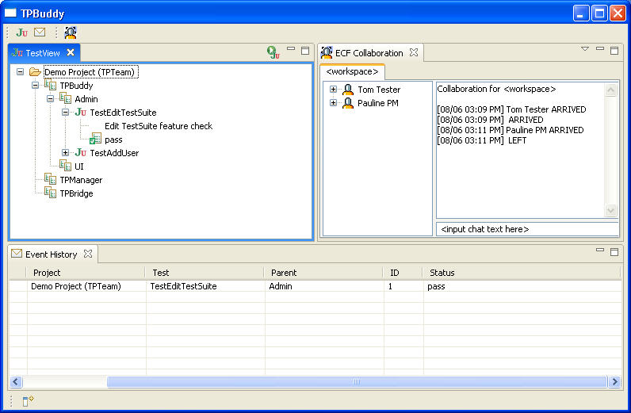
TPTeamTM Server-Side Bundle Demo
Web Browser
Tomcat Server-Side TPManager Bundle
Machine Under Test
1
2
4
HTTP
3
TPTP
4
4
ECF: TCP/IP
TPBuddy: Polina PM
TPBuddy: Tom Tester

Slide 30
Part IV: Putting It All Together
Use Case Solution
  Tom Tester requests JUnit test execution with TPBuddy GUI
  Tom’s TPBuddy fires testexec event to intra- & extra-JVM TPBuddies & bundles
  TPManager receives event, launches TPTP testsuite on MUT, receives & parses tests results, fires testresult event to all TPBuddies
  TPBuddies have test status GUIs updated with result event in real-time.
  Polina PM notices new results in TPBuddy GUI, chats with Tom about test status.
  Bonus: Suresh from Sales requests test execution from web, server-side TPManager receives event…TPBuddies updated.

Slide 31
Resources
Equinox: Jeff McAffer, Project Lead, jeff_nospam_mcaffer@ca.ibm.com
  www.eclipse.org/equinox
ECF: Scott Lewis, Project Lead, slewis@composent.com
  www.eclipse.org/ecf
Corona: Dennis O’Flynn, Project Lead, dennis.oflynn@compuware.com
  www.eclipse.org/corona
ALF: Ali Kheirolomoom, Project Lead, akheirolomoom@serena.com
  www.eclipse.org/alf
TPTP: Joe Toomey, jptoomey@us.ibm.com
  www.eclipse.org/tptp
“Dr. OSGi”, Didier Donsez, Professor, Joe Fourier University
  www-adele.imag.fr/users/Didier.Donsez/
TPTeam: Bob Brady, rpbrady@gmail.com
  http://tpteam.sourceforge.net

Slide 32

Questions

