Slide 1
Intro to saving data in the browser

Slide 2
Recap Questions
Where have we stored data thus far?

Slide 3
Recap Questions
Where have we stored data thus far?
Answer - in memory inside the browser!

Slide 4
Partners do:
Research ways to store data inside the browser
Data should be accessible when the page reloads
How do we store data?
How do we get data back out?
How do we clear data?

Slide 5
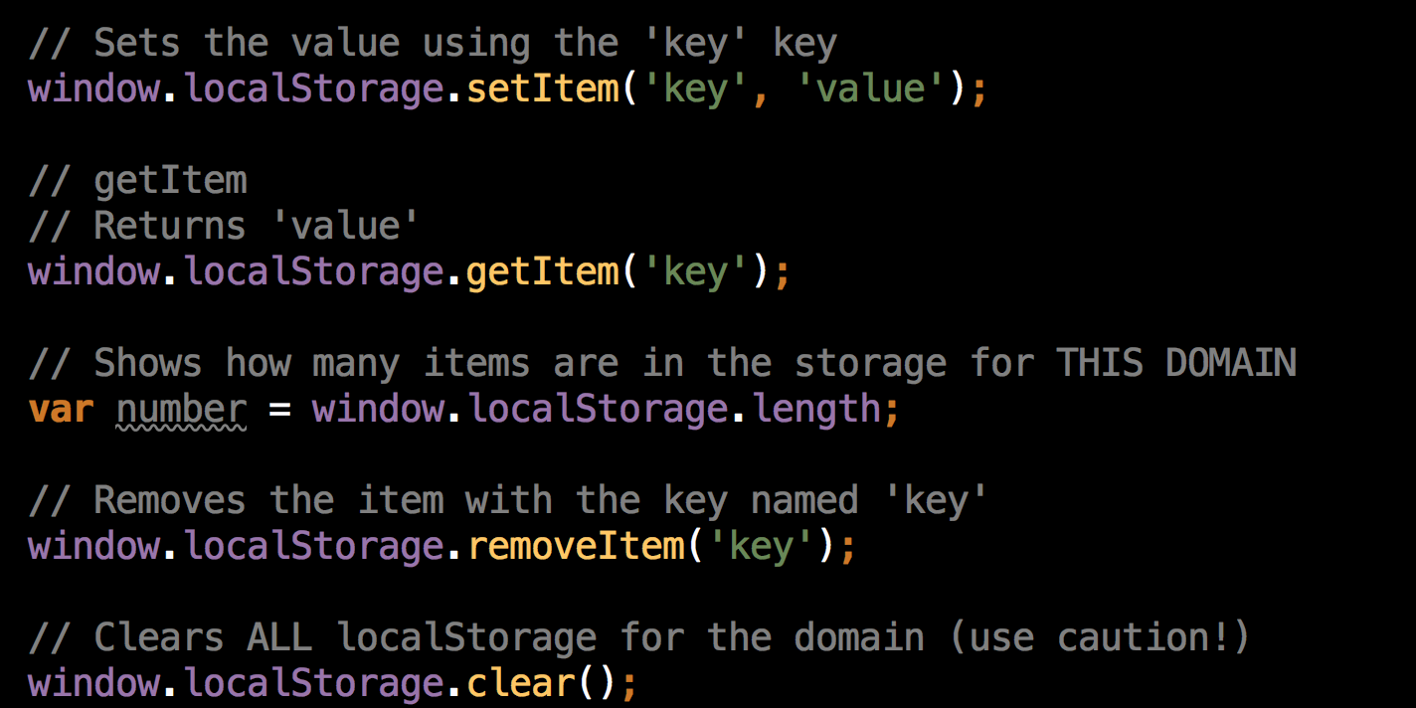
Introducing…
window.localStorage
wind

Slide 6
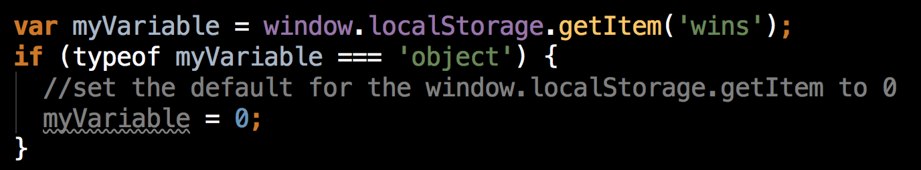
Dealing with defaults
If the item isn’t set, JavaScript returns a object. If it is set, it’ll be a string/integer/boolean

Slide 7
CoinFlip!
Work in pairs!
See the JavaScript file for TODOs

Slide 8
CoinFlip + Reset
Work in pairs!
See the JavaScript & HTML file for TODOs

Slide 9
Questions

