Slide 1
Team 3:
Some Title Here
Frank Masby
Anthony Saunders
Bobby Vandiver

Slide 2
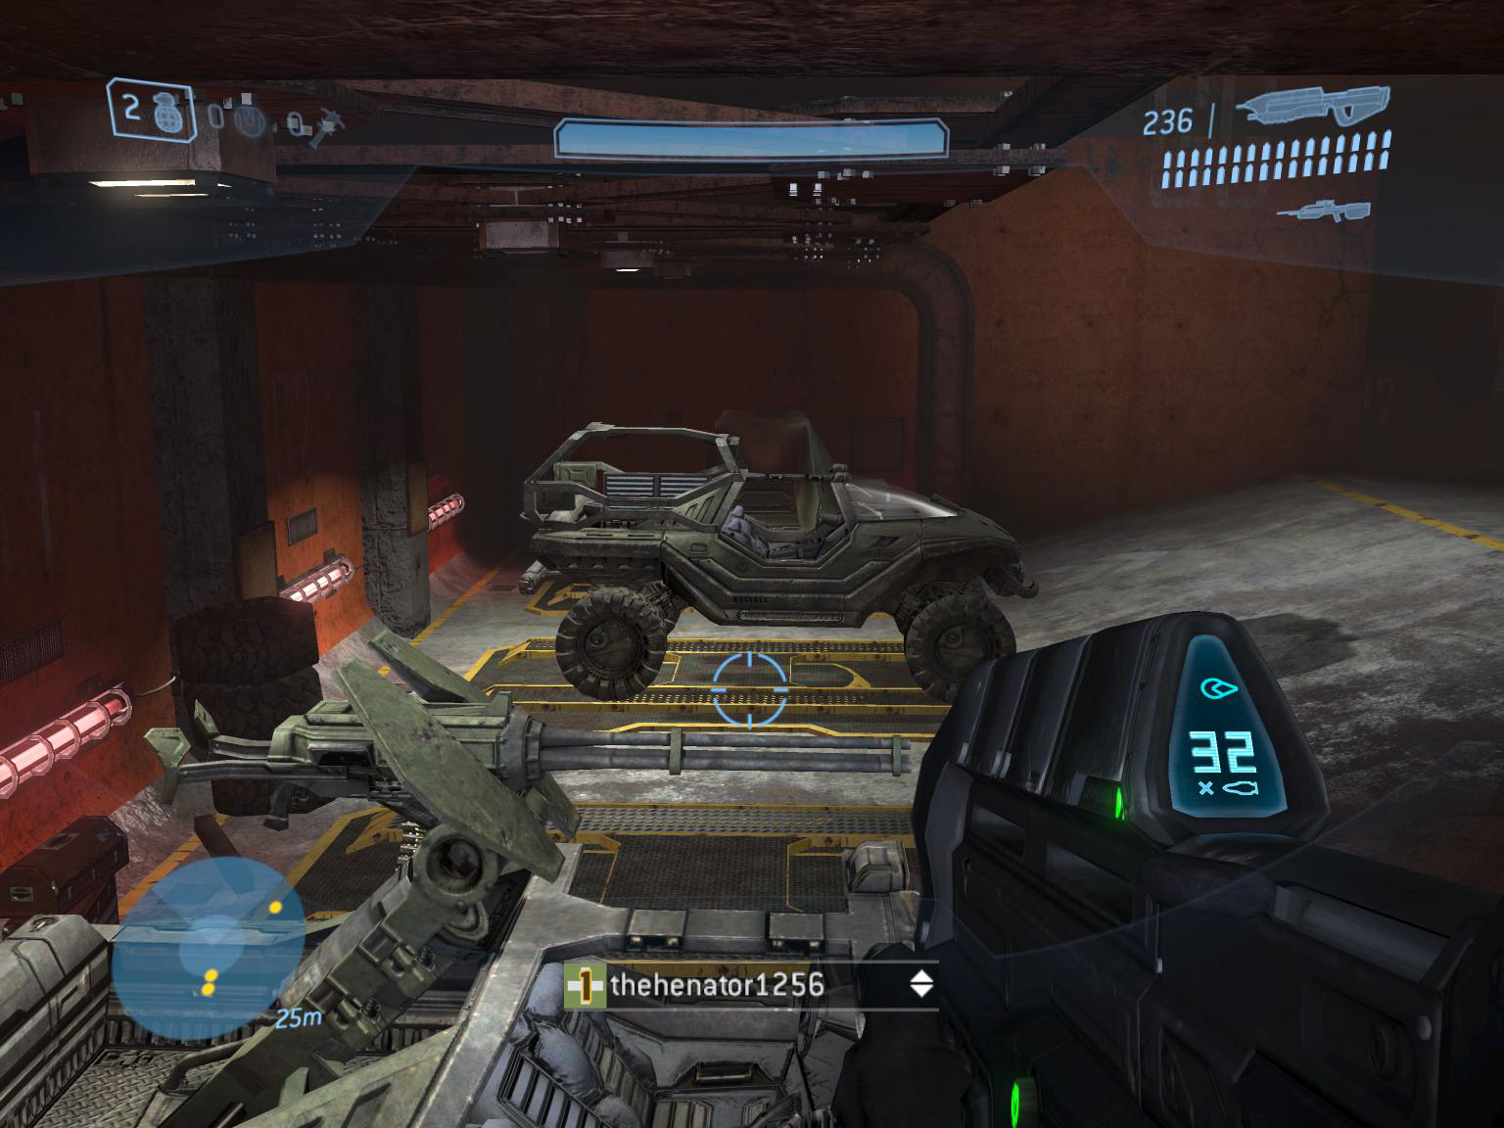
Similar Games in the Genre
Halo
Call of Duty
X-Box 360
Bargain Bin

Slide 3
Overview
You're just an average joe out cruising through space looking to get your kicks when you fly headlong into an asteroid field.

Slide 4
Overview
You're an inexperienced, cocky kind of guy with no hand-eye coordination to speak of.

Slide 5
Overview
You crash.

Slide 6
Overview
Of course.

Slide 7
Overview
And there are aliens.

Slide 8
Overview
Everywhere.

Slide 9
Feature Highlight
Asteroids in space level scatter into multiple smaller asteroids when destroyed.
The camera shakes when an asteroid hits the ground nearby.
The game architecture is flexible and supports new levels being "plugged-in".

Slide 10
Challenges
Alien model used has a single bone and couldn't be animated programmatically
    Simple pendulum movement (do the model waddle!)
Asteroid explosion and scattering
    Solution here
Falling asteroid placement and speed
    Scaling and trial and error to create a believable experience
Initial manual merge hell
    Subsequent merges were easier after drinking the Git Kool-aid

Slide 11
Contributions

Slide 12
Frank Masby
Asteroid bombardment
    Dynamic behavior
    Custom shaders
Camera shaking
HUD: Health bar and radar
Intro cut-scene video

Slide 13
Anthony Saunders
Space ship level
Space ship specific camera functionality
Asteroid explosion and scattering
Asteroid scaling with distance

Slide 14
Bobby Vandiver
General framework/infrastructure architecture
    Emphasis on OOP and enhancing flexibility
Planet Level
    Terrain generated from height map
    Gun mechanics and collision detection
    Alien logic

