Slide 1
NBA Draft Position
& Second Contract Salary
DSO 579 — Advanced Sports Performance Analytics
Spring 2026 · Xinyu Long, Yanbo Zhao
264 Players
2010–2021
r = −0.61
2.7×
Sample
Draft Years
Pearson Correlation
Top-5 vs Late-Round Pay

Slide 2
1
Introduction & Background
NBA first-round picks sign a 4-year rookie-scale contract (2 guaranteed + 2 team-option years) under the CBA
The second contract is the most consequential financial milestone of a player's career — front offices plan cap strategy around it
Does early draft position signal long-term financial value, or does on-court production override pedigree at negotiation time?
27% of first-round picks are never matched to a second contract — waived, went overseas, or did not survive the rookie period
Data: 264 matched first-round picks (2010–2021)

Slide 3
Research Questions & Hypotheses
Primary RQ
Does a player's overall draft pick number predict the size of their second NBA contract,
controlling for rookie-era performance?
H₁ (Alternative Hypothesis)
H₀ (Null Hypothesis)
Lower pick numbers are associated with higher second-contract salaries even after controlling for performance
Once on-court performance is controlled for, overall draft pick number has no meaningful additional effect on second-contract salary.
Sub-RQs:
SQ1: Position effect · SQ2: Performance moderation · SQ3: Draft-era comparison · SQ4: Player archetypes via clustering

Slide 4
Data & Methods
Data Sources
Analytical Methods (ISLR-aligned)
NBA Players Draft (1989–2021)
→ overall pick, draft year, career stats (PPG/RPG/APG/WS/BPM/VORP)
Multiple Linear Regression (OLS) — interpretable baseline with p-values
Ch. 3
Ch. 8
Decision Tree (max depth = 4) — captures non-linear thresholds
NBA Player Stats & Salaries (2010–2025)
→ annual salary, PTS/TRB/AST, Age, Position
Ch. 8
Random Forest (300 trees) — variance reduction via bagging
Variables
Ch. 5
5-Fold Cross Validation — honest model comparison
IV
overall_pick (1–30)
Ch. 12
K-Means Clustering (K = 4) — discover player archetypes
DV
2nd contract salary as % of league cap
Controls
PPG, RPG, APG, Win Shares, BPM, VORP, Age

Slide 5
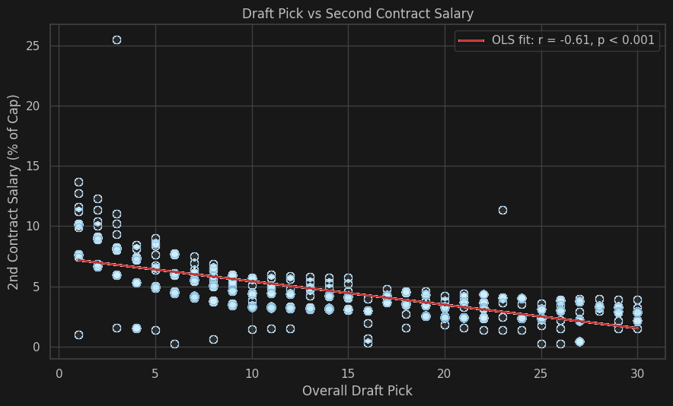
Descriptive Statistics
n = 264 players · draft years 2010–2021 · salary normalized to % of league cap
Mean Salary by Pick Tier
Pick Tier
Mean
Median
n
Top 5
8.05%
7.99%
51
6–10
4.86%
5.03%
52
11–15
4.15%
4.20%
46
16–20
3.23%
3.43%
38
21–30
2.94%
2.96%
77
Top-5 picks earn ~2.7× more than picks 21–30
(8.0% vs 2.9% of salary cap)

Slide 6
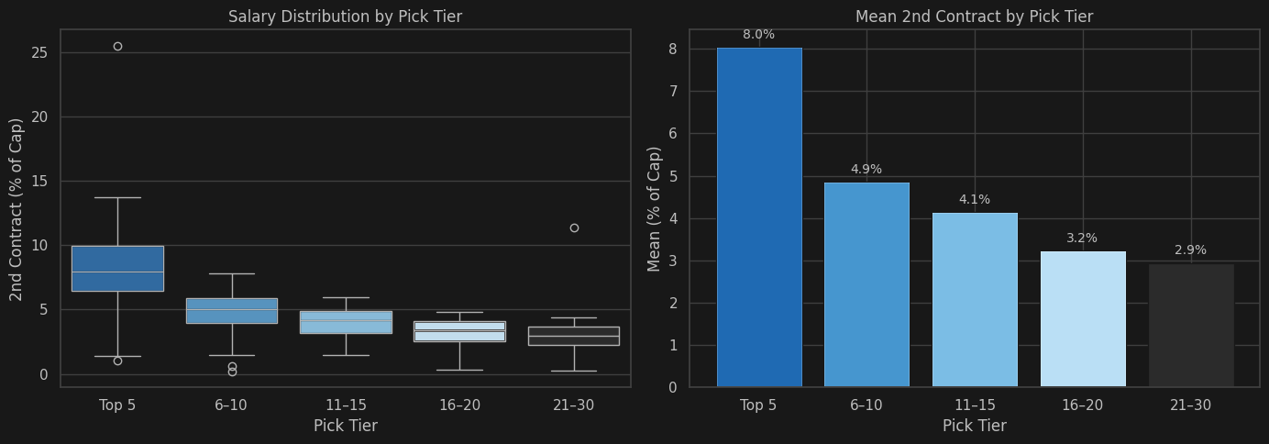
Salary Distribution by Pick Tier
Monotonic decrease: every tier earns less than the tier above. Top-5 median ≈ 8.0% cap vs. picks 21–30 median ≈ 3.0% cap.

Slide 7
Statistical Tests
Pearson Correlation
Strong negative linear relationship between draft pick and 2nd contract salary
r = −0.610, p < 0.001
Spearman Correlation
Rank-based test confirms result — robust to outliers and non-normality
ρ = −0.686, p < 0.001
One-Way ANOVA
Pick-tier group means differ far beyond sampling noise — groups are statistically distinct
F = 52.73, p < 0.001
→ All three tests reject H₀: draft pick is a strong, statistically significant predictor of second-contract salary

Slide 8
Multiple Linear Regression (OLS) · ISLR Ch. 3
0.490
0.474
30.60
2.38e-33
R²
Adj. R²
F-statistic
p-value
Key Coefficients
Variable
Coef
Std Err
p-value
Notes
overall_pick
−0.1479
0.017
< 0.001
★ Dominant predictor
career_ppg
+0.1371
0.042
0.001
Significant
career_rpg
+0.1683
0.080
0.037
Significant
career_bpm
+0.1573
0.071
0.029
Significant
career_apg
+0.1166
0.110
0.292
Not significant
career_vorp
−0.0256
0.047
0.588
Not significant

Slide 9
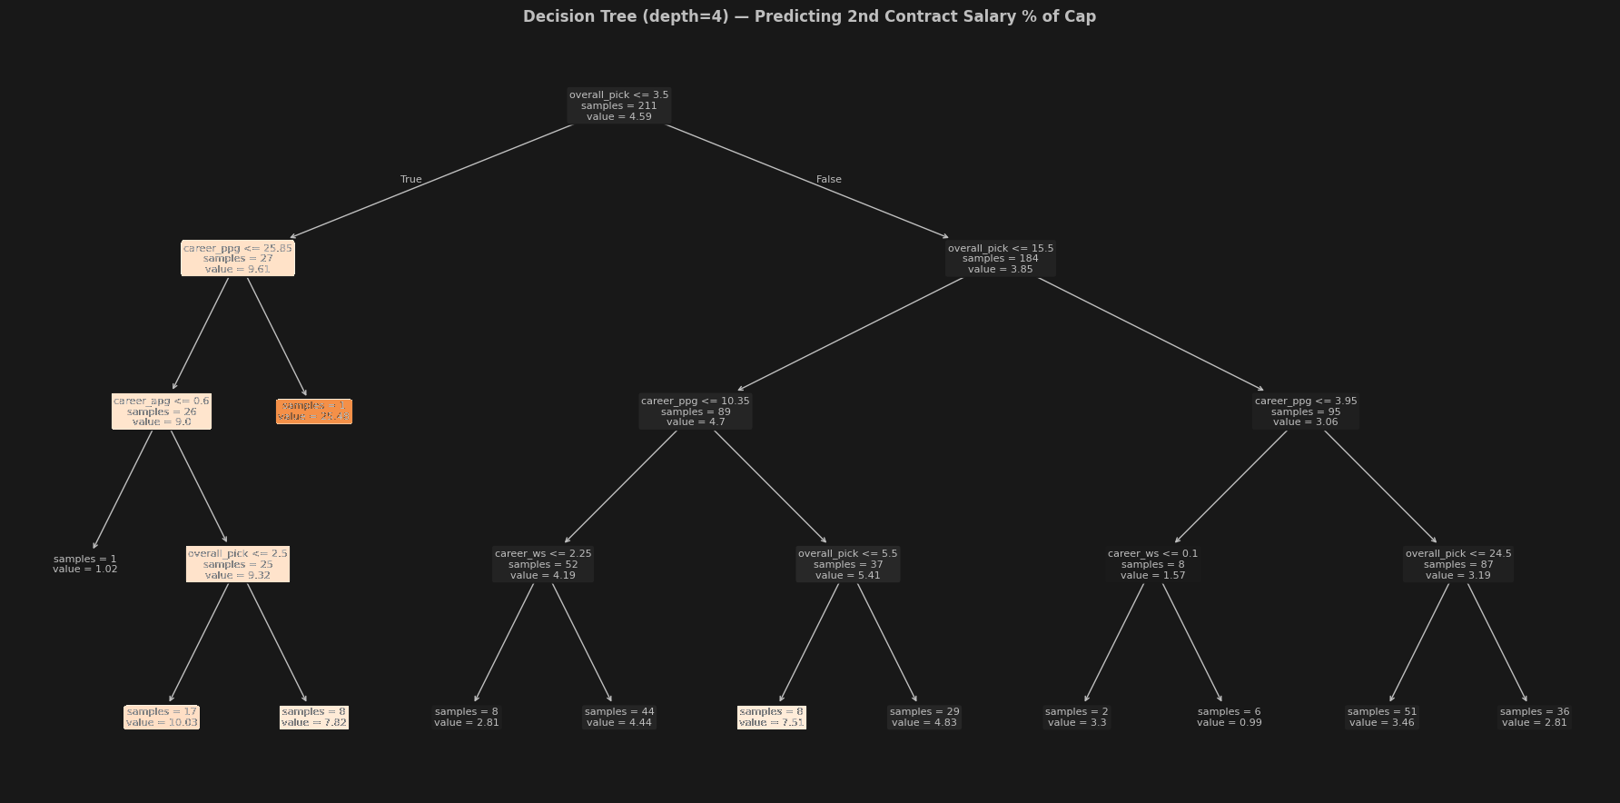
Decision Tree (Depth = 4) — Interpretable Structure
First split: overall_pick ≤ 9.5 separates star-track from role-player track. Deeper nodes use career_ws to refine salary predictions within each group.

Slide 10
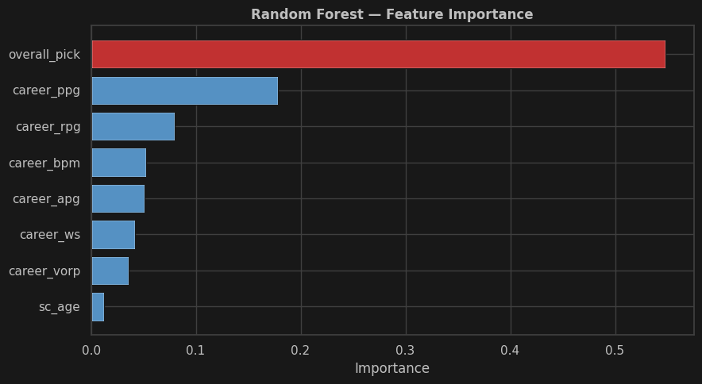
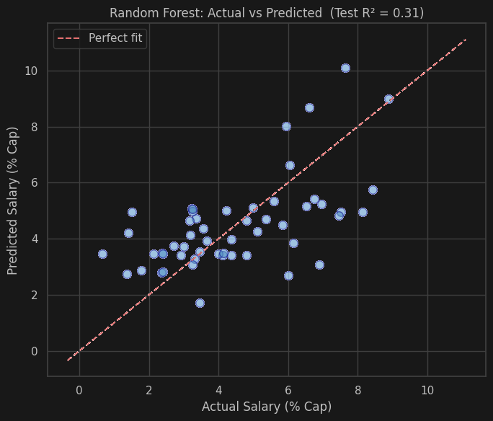
Random Forest — Feature Importance & Prediction Quality
Overall pick contributes 52% of total feature importance — more than 3× the next predictor.
Even controlling for all performance stats, draft pedigree dominates.

Slide 11
Machine Learning Model Comparison · 5-Fold Cross Validation
Model
CV R²
CV MAE
Test R²
Test MAE
Assessment
Linear Regression
0.375
1.38
0.332
1.32
Best interpretability
Decision Tree (depth=4)
−0.326
1.69
0.227
1.45
Overfits; use RF instead
Random Forest (300 trees)
0.341
1.37
0.313
1.35
Best generalization
Key Insight:
All three model families confirm the relationship is real and substantial. The modest gain from non-linear methods suggests the pick → salary relationship is approximately linear once salary is cap-normalized. Linear Regression is preferred for its interpretability.
CV R² (5-Fold)
Linear Reg
0.375
Random Forest
0.341
Decision Tree
-0.326

Slide 12
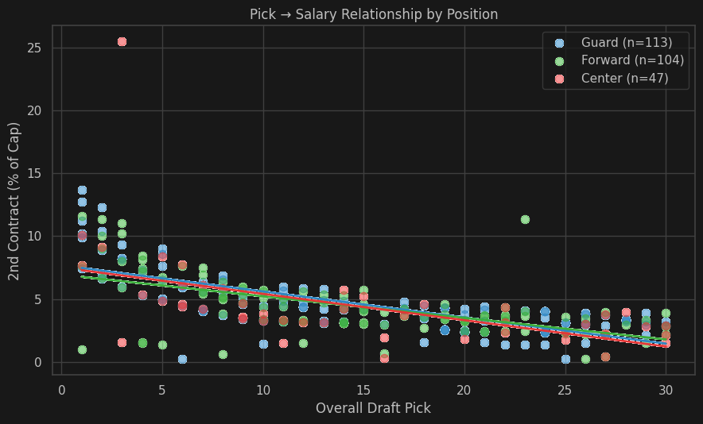
SQ1 — Position Analysis: Does the Pick Effect Hold Across Positions?
Pearson r by Position
Guard
−0.718
n = 113
Forward
−0.579
n = 104
Center
−0.512
n = 47
Finding: The negative pick→salary relationship holds across allpositions. Guards show the steepest slope — scarcity of true point
guards amplifies the pedigree premium.

Slide 13
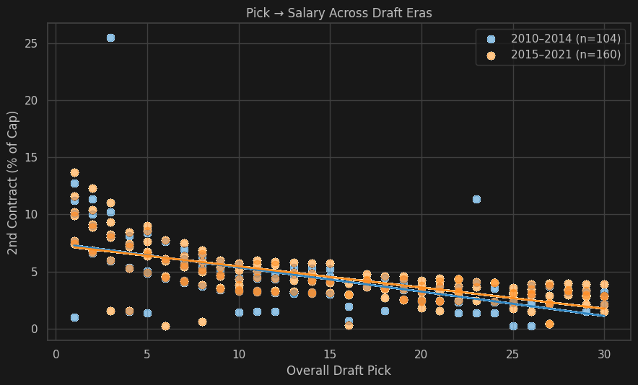
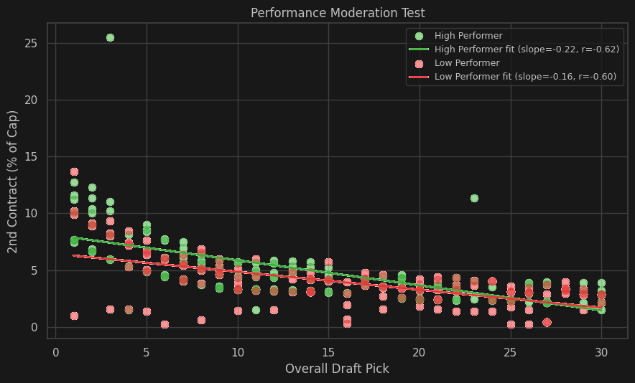
SQ2 — Performance Moderation: Does Production Override Pedigree?
Key Findings
Both High & Low Performers show a negative pick → salary slope
High performers earn more at every pick level (baseline shift)
Interaction term (pick × career ws) tests whether performance changes the strength of the pick effect
The pick premium is not eliminated by strong performance — pedigree retains independent market value

Slide 14
SQ3 — Era Analysis: Has the Pick Effect Changed Over Time?
Era Comparison
2010–2014
−0.545
n = 104
2015–2021
−0.688
n = 160
Finding: Negative correlation persists in both eras. Post-2015 shows a steeper slope — the 2017 cap spike disproportionately rewarded high
picks who reached free agency in the inflated cap window.

Slide 15
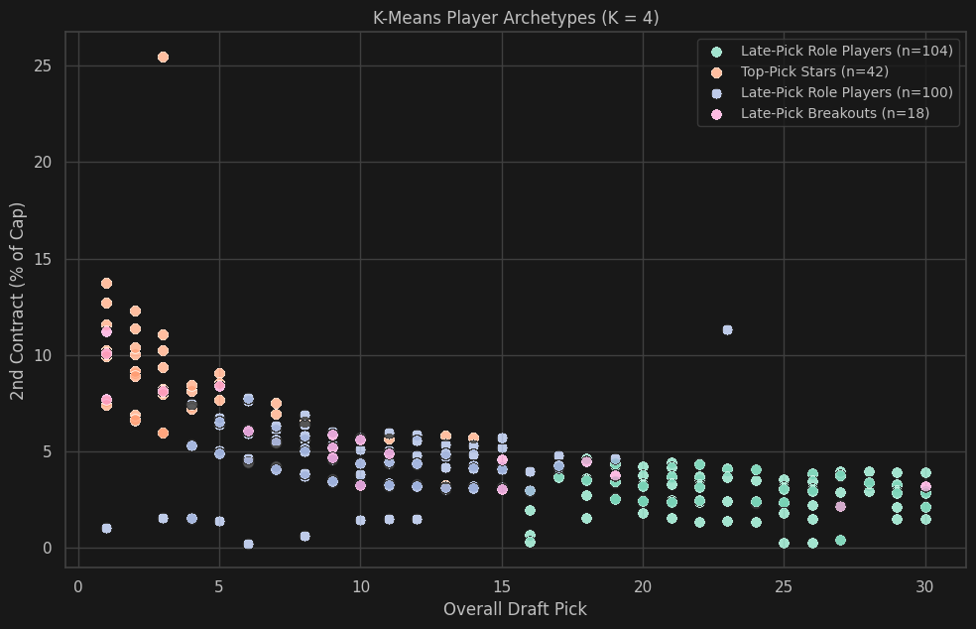
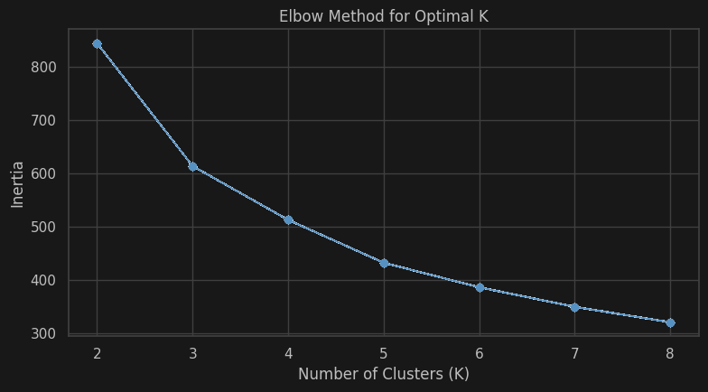
SQ4 — K-Means Clustering: Player Archetypes (K = 4)
Top-Pick Stars
n=42 · Pick≈4, Salary≈8.6%
Embiid,Lonzo Ball, Zion Williamson
Late Play Breakout
n=18 · Pick≈11, Salary≈5.7%
Damian Lillard
Top-Pick Disappointment
n=100 · Pick≈10, Salary≈4.4%
Mo Bamba, P. Williams
Late Play Role Players
n=104 · Pick≈23, Salary≈2.9%
K. Huerter, J. Allen

Slide 16
Key Findings
1
Strong Correlation
Pearson r = −0.61, Spearman ρ = −0.69 (p < 0.001) — earlier picks earn significantly more
2
Top-5 Premium
Top-5 picks earn 2.7× more than picks 21–30 on their second contract (8.0% vs 2.9% of cap)
3
Pedigree Effect
overall_pick remains significant (p < 0.001) even after controlling for 7 performance variables in OLS
4
Dominant RF Feature
Random Forest: overall_pick = ~52% of total feature importance — 3× greater than next predictor (PPG)
5
Universal Across Groups
Pick effect holds across all positions & both draft eras; stronger post-2015 cap spike
6
4 Player Archetypes
K-Means identifies Top-Pick Stars, Late-Pick Breakouts, and two tiers of Role Players

Slide 17
Implications & Recommendations
For General Managers
For Coaches
For Players & Agents
Budget top-5 picks as 12-year cap commitments, not just 4
Development minutes for late picks are high-ROI for cap value
Late picks: lead negotiations with BPM/VORP/on-off splits, not counting stats
Picks 16–30 offer the highest cap efficiency per $ invested
Audit rotation decisions against production, not draft slot
Top picks: pedigree pays even at moderate production levels
Build extensions that down-weight pedigree vs. on-court production
Year 3 is the inflection point — minutes shape extension leverage
27% of 1st-round peers never reach a 2nd deal — plan insurance early
Treat underperforming high picks as sell-high assets — market still pays pedigree
Limitations:
First-round picks only (n=264) · Rookie extensions vs. free-agent deals not separated · 27% attrition unmodeled (Heckman correction / survival analysis as future work)

Slide 18
Draft pick is more than a number.
It's a financial commitment that outlasts the rookie deal.
NBA Draft Position & Second Contract Salary
DSO 579 — Advanced Sports Performance Analytics · Spring 2026 · Xinyu Long, Yanbo Zhao
264
r = −0.61
R² = 0.49
52%
4
Players
Pearson r
OLS R²
Pick Importance (RF)
Archetypes

