Slide 1
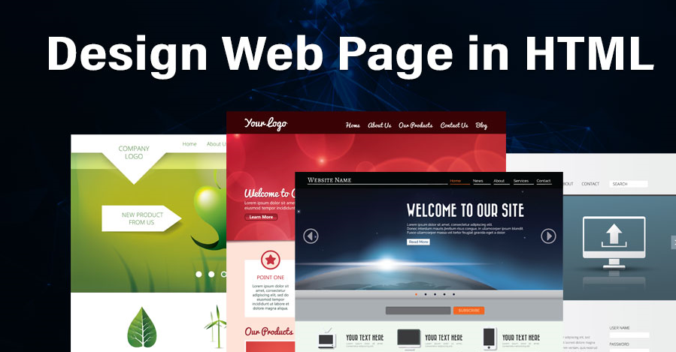
Web Application Development

Slide 2

What is a web page
A file containing
- Content design
- Format & layout design
- JavaScript controls
- Actual content
- Server-side code
- Java applets
- Tags that embed: sound, video, images

Slide 3
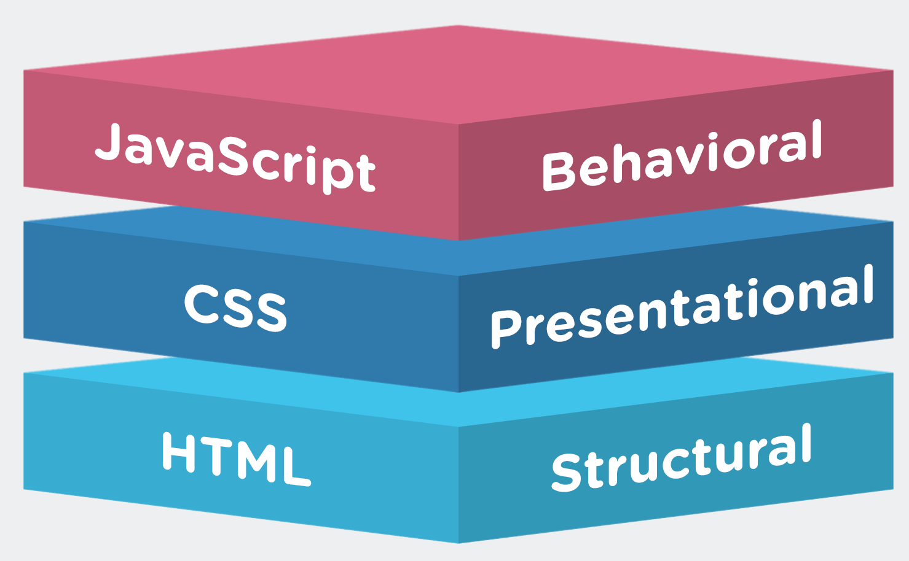
Components of a website
Hypertext Markup Language (HTML) files
- Document content specs
Cascading Style Sheets (CSS) (files & tag options)
- Document formatting
JavaScript
- Dynamically modifying content & styles
- Client-side programming
Server-side (CGI) programs
- PHP code
- ASP.Net/JSP.Net
- C/C++/Java

Slide 4
Basics
“Tag” based “Language”
- Describes the structure of a document
Cascading Style Sheets for formatting/styling
- style='font-style:italic; font-weight:bold; font-family:Arial’
- style='text-align:center’
JavaScript – programming inside a webpage file
- NOT Java
- Used to modify HTML and CSS
- Allows collection of user inputs
- Provides dynamic actions (behavior) on the page

Slide 5
What is HTML ?
A Markup Language for representing documents
• text (data)
• structure
• appearance
• functionality
• Designed for writing Web pages

Slide 6
Capabilities of HTML
Content presentation
• Structures, e.g., paragraphs, lists, tables, etc.
• Decorations, e.g., fonts, images, etc.
• Declaration of meta information
• e.g., the page title, language, etc.
• Linkage to other pages
• i.e., attaching links to components
• Management of user input
• e.g., searching, making reservations, ordering products
Directions for browsers
• e.g., refresh, redirect, caching control, etc.

Slide 7
Tags
Form of tags :
<tagname option=attribute pairs>
2 types
- Paired
<html> </html>
- Un-paired
<img … /> and <br />
Paired/Unpaired tags MUST have the "<" and ">“
Refer : https://www.w3schools.com/html/default.asp

Slide 8
Webpage Layout
Document type tag
<!DOCTYPE HTML>
HTML start tag
- Head start, elements, end
- Body start, elements, end
HTML end tag

Slide 9
Creating a web page
Created with a plain-text editor
- NOT Word or Wordpad!!!!
MUST be named "index.htm" or "index.html"

Slide 10
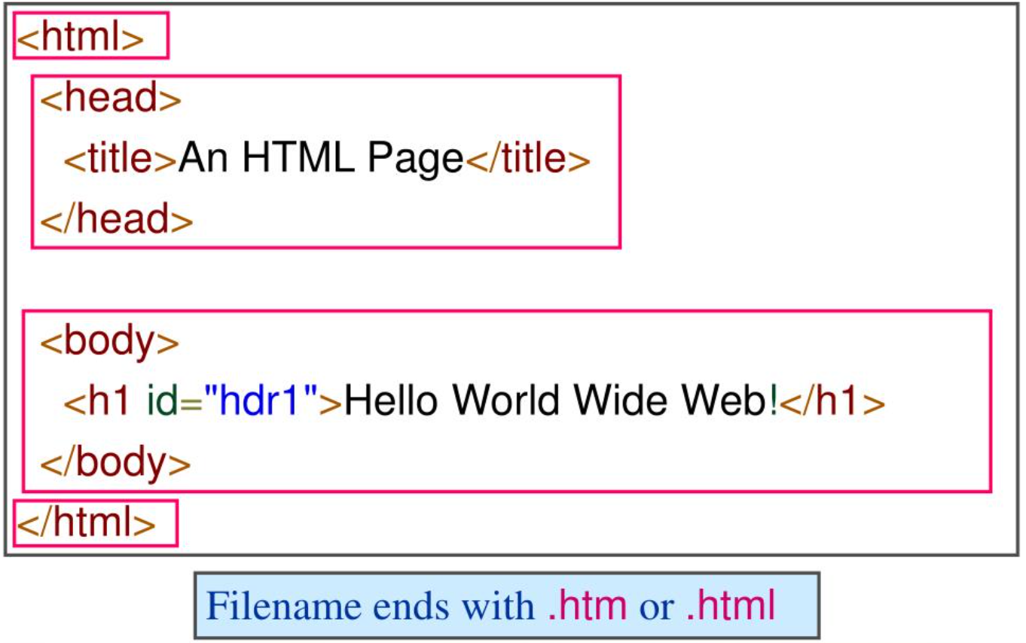
HTML Structure

Slide 11
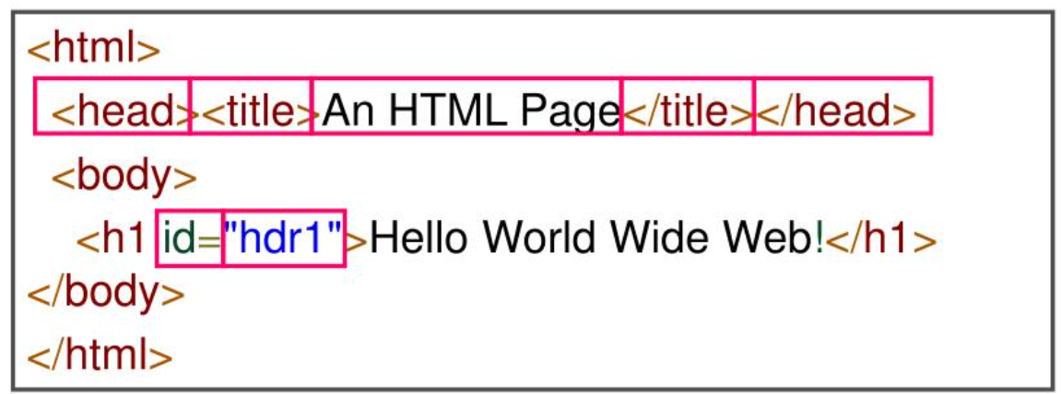
Basic HTML Syntax
HTML contains text, separated by tags
Tags come in pairs: opening and closing tag
Tags can have attributes, which have values <html>

Slide 12
Basic page tags, in order of placement
<!doctype html>
<html>
<head> <!-- following 5 may be in any order -->
<title> ….. </title>
<meta….. />
<link …... />
<script> … </script>
<style> … </style>
</head>
<body> ….. </body>
</html>

Slide 13
A simple webpage
<!doctype html>
<html>
<head>
<title>my page</title>
</head>
<body><p>This is my page content </p></body>
</html>

Slide 14
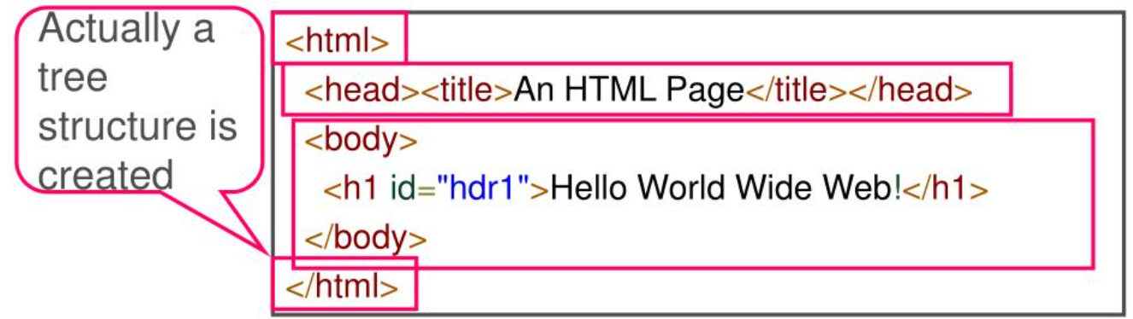
An HTML page is surrounded by the html tag
2 Basic parts:
• head: general information about the document
(e.g., title – shown on the browser bar)
• body: the content of the document

Slide 15
Element and attributes names must be in lower case
- HTML allows any case combination,
e.g., <Body> </BODY>, which conveniently helped distinguish tags from the body text
• All tags must have corresponding closing tags
- Use <br/> as a shorthand for <br></br>
• Elements should be properly nested
- e.g.,<b>hello <em>world</b></em>is illegal!
• Attribute values must be quoted
- e.g., <td rowspan="3"> and not <td rowspan=3>

Slide 16
Most prevalent server programs
Apache (open source) (Win & Linux)
Add-ons
- MySql – database
- PHP – scripting language
- PHPMyAdmin – managing a MySql DB

Slide 17
Formatting & Arrangement
Content (tables, lists, paragraphs) is done with HTML tags
ALL formatting in HTML 4 & 5 (font, color, alignment, size) is done via CSS
More arrangement possible with CSS "layers" & dynamic control with JavaScript
- Visibility
- Positioning on page (by pixel, inch, etc.)
- Multi-column pages.
Dynamic actions added with JavaScript

Slide 18
What are style sheets
A style sheet is a mechanism that allows to specify how HTML pages should look
The style is specified by style rules
The style rules appear either in the document or in external files, called style sheets
Usually, a file that ends with .css
A style sheet increases the separation between content and presentation

Slide 19
Cascading Style Sheet
3 types
Inline
Embedded – in the <head> section of a file
Linked – in separate files
Examples:
<p style="font-family:arial; font-weight:bold">
<style>p {font-weight:italic} </style>
<link href="some.url" type='text/css' rel='stylesheet' />

Slide 20
Java script
Creating a script
- Placed between <script> and </script>
- All nested inside <head> and </head>

Slide 21
Client Side Programming
Java Script is a scripting language for generating dynamic HTML pages in the browser
The script is written inside an HTML page and the browser runs the script and displays an ordinary HTML page
Java Script (not part of Java!) is an HTML-embedded scripting language for client-side programming
Certain parts of a Web application can be executed locally, in the client
For example, some validity checks can be applied to the user’s input locally
The user request is sent to the server only if the input is valid

Slide 22
Connection between JS and the system
Some pre-defined events:
- OnLoad / OnUnload
- OnClick / OnMouseOver
- OnFocus / OnBlur
- OnChange - lost focus and value changed
- OnSelect - text, textarea, password objects
- OnSubmit - with the form object

Slide 23
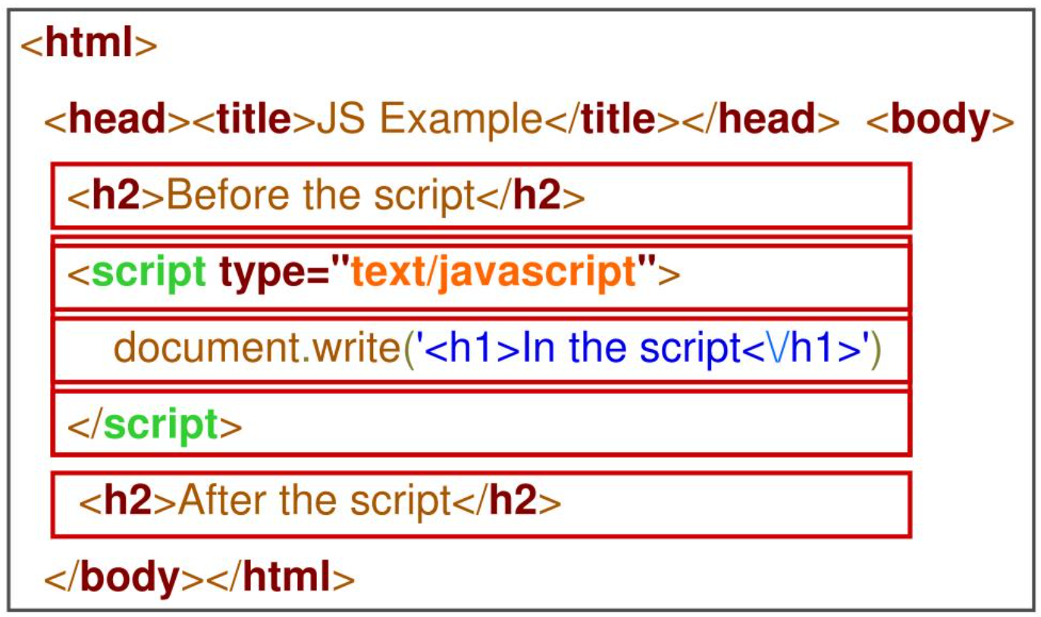
Javascript Example

Slide 24


