Slide 1
WELCOME

Slide 2



Accredited by NACC B++ & An ISO 9001:2015 certified Institute
SANT GAJANAN MAHARAJ COLLEGE OF ENGINEERING, MAHAGAON
Department of Computer Science & Engineering Academic Year 2020-21

Slide 3

Name of Project: CODEHUSTLE
Group Members:
Chilami Bobby Devappa
Kokare Janhavi Vivek
Rokade Jyoti Chandrakant
Patil Dhanshree Ajitkumar
Guide name:
Prof. C. H. Kamble

Slide 4
INDEX
Abstract
Introduction
Existing system
System Architecture
Users
Advantages
References

Slide 5
ABSTRACT
The aim of this project is to collect all the resources on a single platform, and make it available to everyone.
CodeHustle focuses on aptitude and technical rounds and how a student can crack them through pair programming.
This project includes a set of tools and some useful resources for learning and upskilling ones cognitive and coding abilities.

Slide 6
INTRODUCTION
Getting a job at a top MNC is dream of many students. Some students succeed whereas some get out at the first round itself.
This is due to lack of practice, lack of resources to practice and wrong method of learning.
The objective of the project is to build a web-based solution which will help programmers to learn, practice coding and interact with fellow programmers.
This platform provides some tools like quiz creating tool and discuss section.
We have introduced 400+ hand-picked coding questions for preparation of technical rounds.
The UI of quiz is built user-friendly and simple to use, with a vast range of options.

Slide 7
EXISTING SYSTEM
Existing System consists of only the theoretical resources which are not organized well & the students get confused over which platform is best for learning.
The proposed system will have the feature for clearing any doubts through discussion.
The major issue in today’s inability of coding among students is not enough practice of medium to hard level programming questions. But it can be solved in CodeHustle here there is large variety of programming questions, where the complexity is in ascending the students will be able to gradually grew up logical and algorithmic skills.
The second issue is aptitude preparation & the CodeHustle has a quiz section where the mentors can create aptitude tests & students can solve them .This feature will allow to monitor their results & the progression as well.

Slide 8
PROPOSED SYSTEM
The goal of this project is to create a web-based solution for students to learn and practice for the aptitude and technical rounds.
This will also help tutors to create simple tests which can help them evaluate students.
CodeHustle includes discuss section where anyone can ask their doubts, queries or they could collaborate, do pair programming.
CodeHustle includes discuss section where anyone can ask their doubts, queries or they could collaborate, do pair programming.

Slide 9
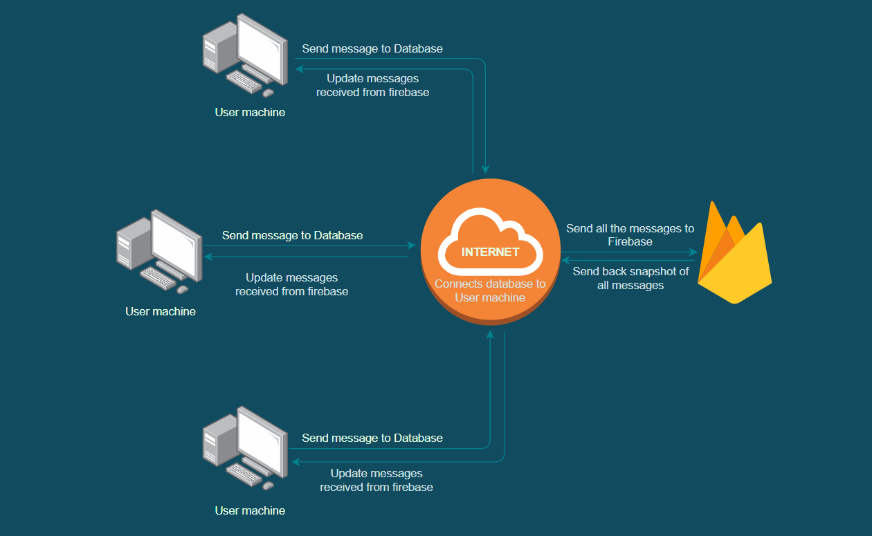
SYSTEM ARCHITECTURE
Discuss Section

Slide 10
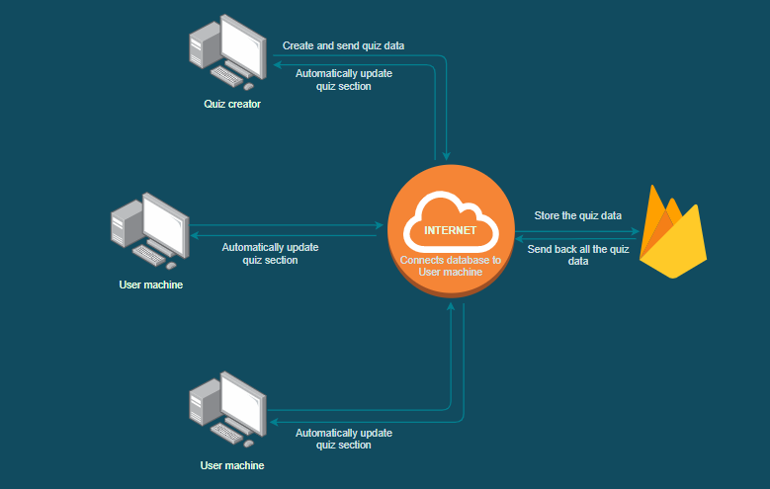
Quiz Section

Slide 11
USERS
Enthusiastic students who are willing to be prepared for technical interviews.
Students/any person who want to do peer-programming.
Lecturers who intend to create a simple quiz task for students swiftly.
Any person who wants to give aptitude test.

Slide 12
ADVANTAGES
1. Discussion section.
2. 400+ Handpicked Coding round questions for practice.
3. Platform for creating quiz/test easily with simple and interactive UI.
4. Platform to solve quizzes created by tutors or other users.

Slide 13
REFERENCES
Practical Remote Pair Programming by Adrian Bolboacǎ (Author)
https://firebase.google.com/docs/guides
3. https://www.freecodecamp.org/

Slide 14
THANK YOU

