Slide 1

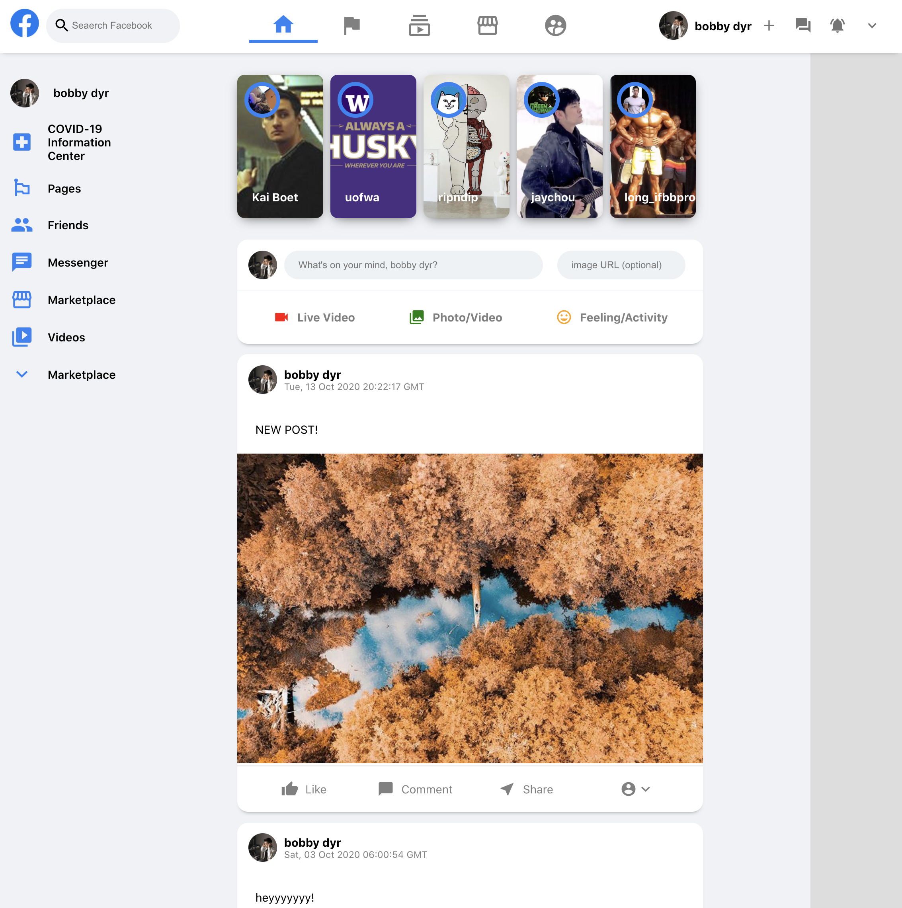
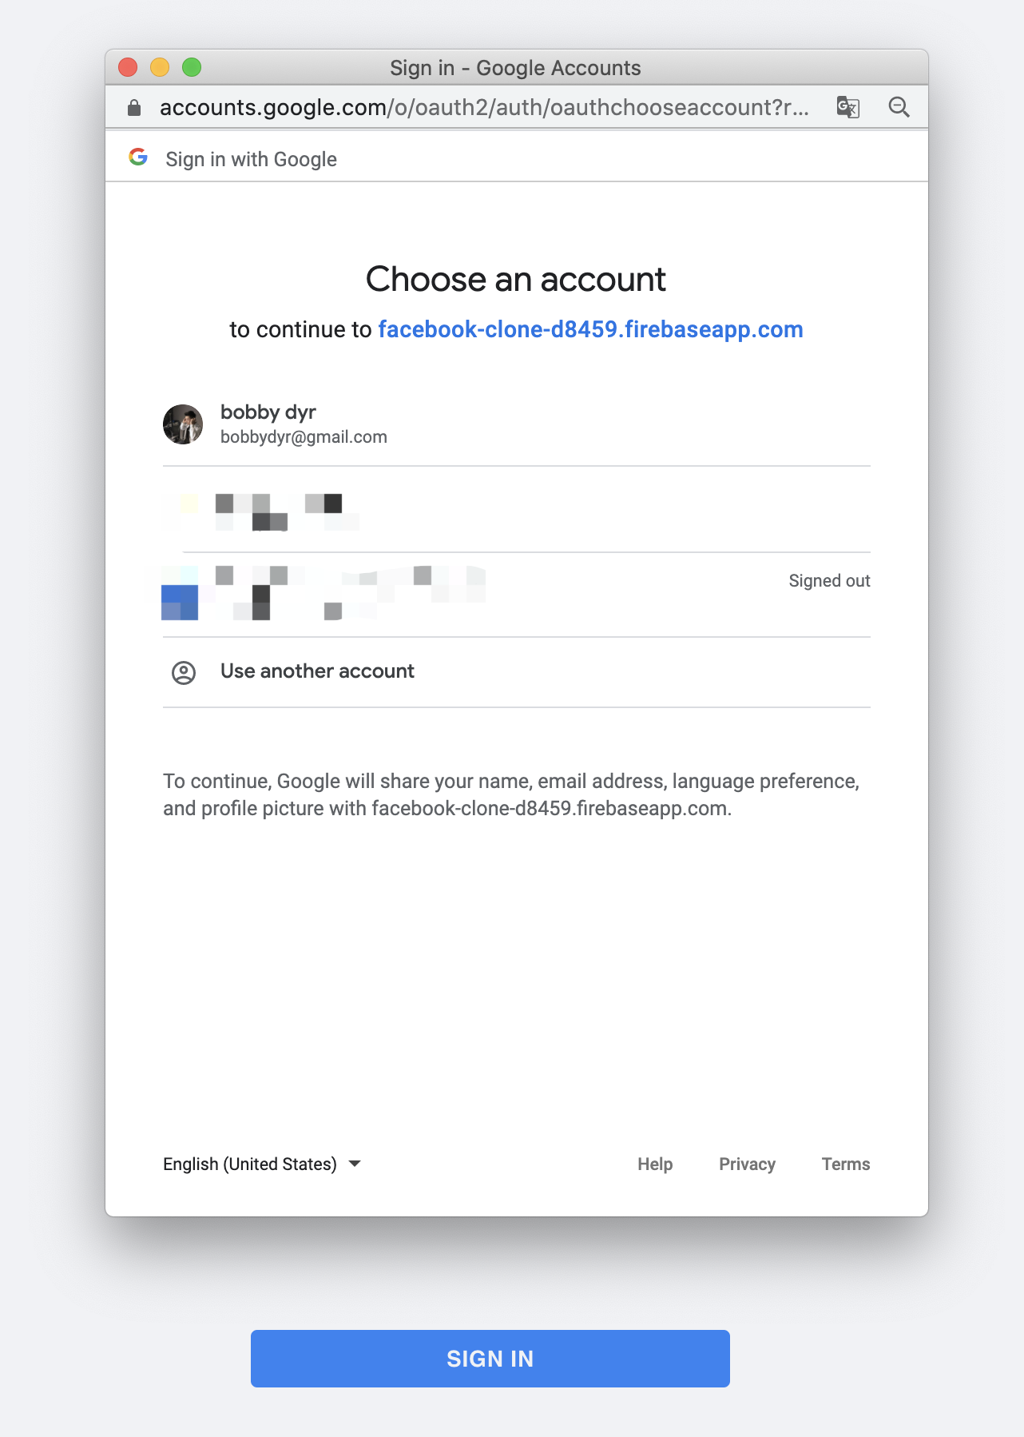
1. Use Google account to Login in.
2. Make a Post!!!

