Slide 1
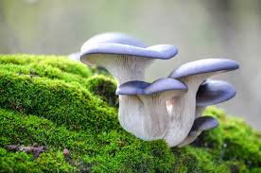
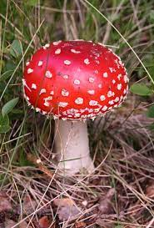
Mushroom classification
Bobby Gabriel

Slide 2
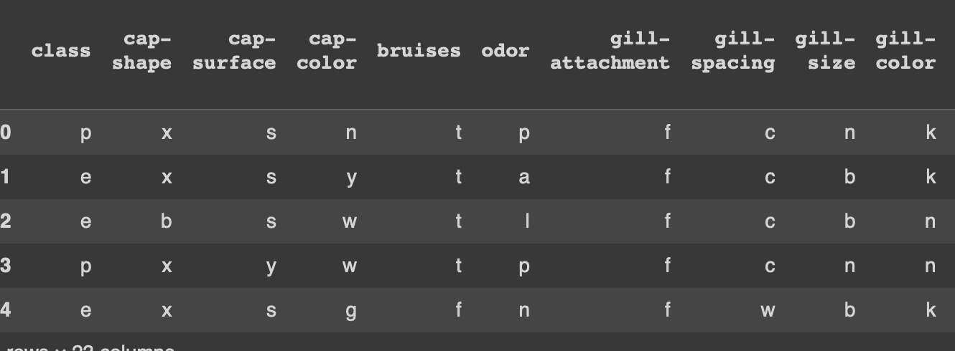
Dataset – Mushroom Classification
This dataset was obtained from Kaggle and it contains 23 columns with 8124 samples of all object data types
The data consists of various physical features spanning across 23 different species of mushrooms
The target of my model is the ‘class’ variable which indicates whether a mushroom is edible or poisonous.

Slide 3
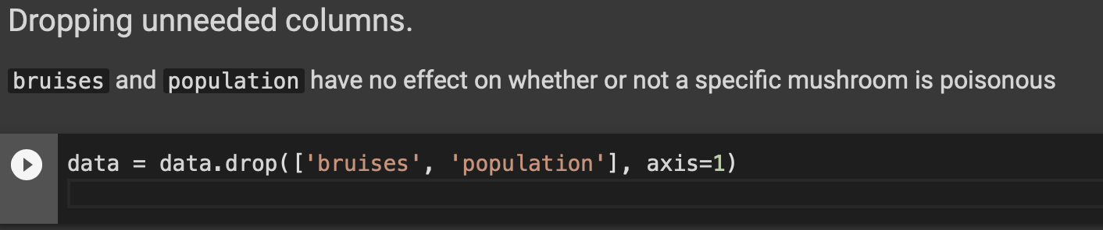
Data Preprocessing
The dataset contained no null values so there wasn’t a need to impute data using mean or median
I dropped 2 columns – ‘bruises’ and ‘population’ because these features are not relevant to the model when determining whether a mushroom is poisonous or edible.

Slide 4
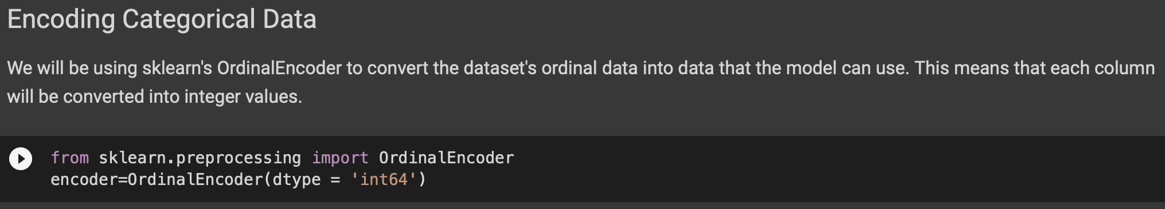
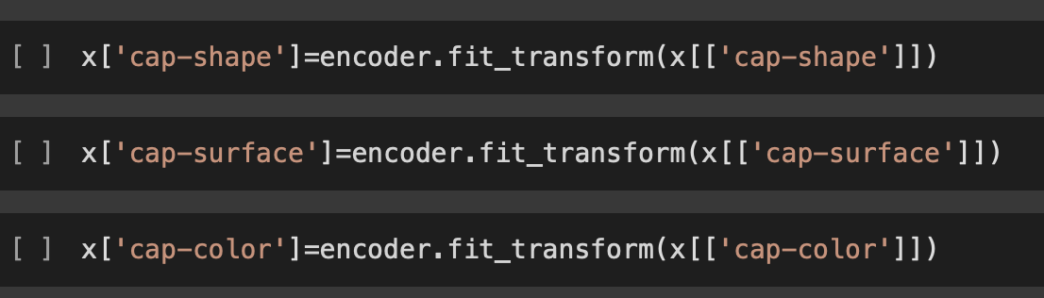
Data Preprocessing
The next preprocessing performed was Ordinal Encoding
Since every variable was an ‘object’ datatype I decided to use Sklearn’s Ordinal Encoder for all columns

Slide 5
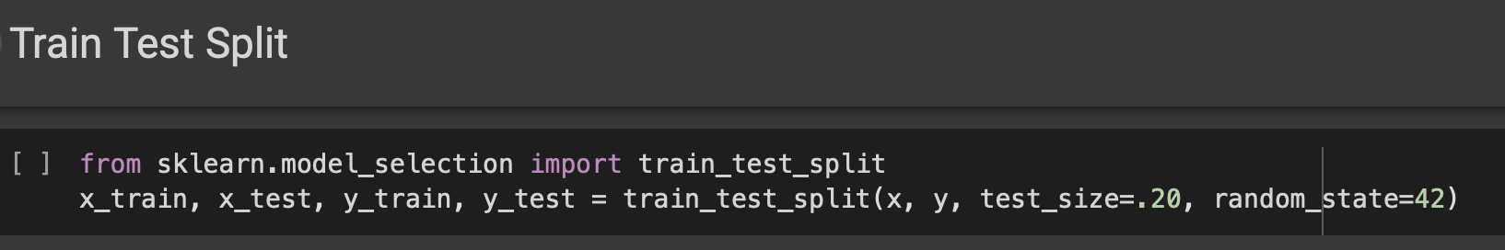
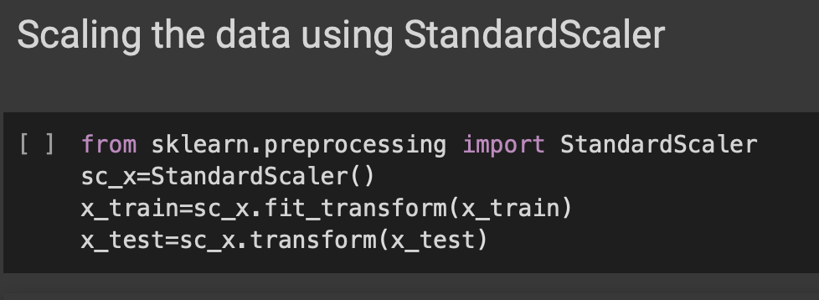
Data Preprocessing
The last preprocessing performed was applying a train/test/split of 80/20 and standardizing the data using sklearn’s Standard Scaler
Standard Scaler centers the values in each column around the mean with a unit standard deviation.

Slide 6
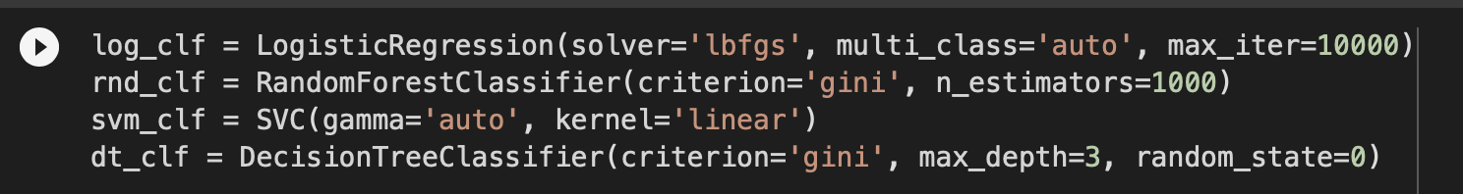
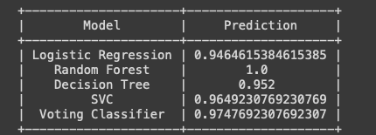
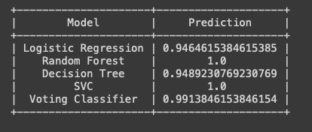
Running the models
4 different experiments were run with different parameters for SVC, RFC, DTC and LR
Every experiment was run with a train/test/split of 80/20
Experiments 1 and 2

Slide 7
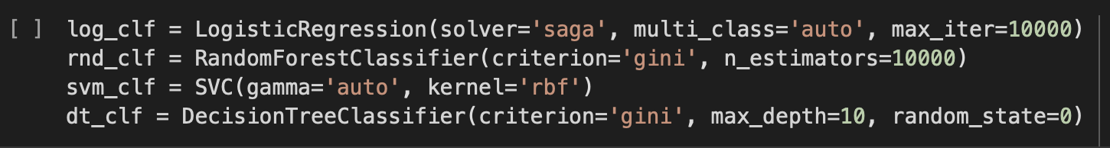
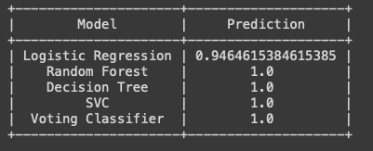
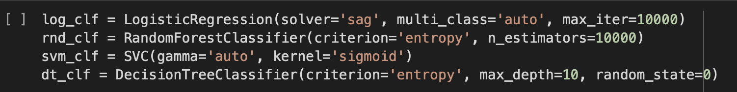
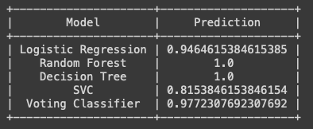
Experiments 3 and 4

Slide 8
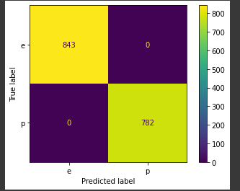
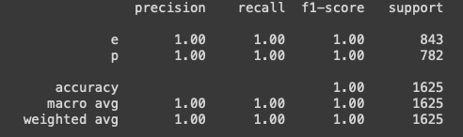
Results
Out of 4 experiments with different parameters tested for each classification model, Random Forest Classifier performed the best at 100% success each time
SVC, DT, and Voting Classifier all achieved 100% as well, but not as consistently as Random Forest
Random Forest Classifier Confusion matrix and Classification Report:

